Slide 1
First-Order Bayesian Networks
Section 2
Tutorial on Learning Bayesian Networks for Complex Relational Data

Slide 2
Bayesian Networks for i.i.d. data
Directed Acyclic Graph, where nodes = random variables
Parameters = probability of child node given parent nodes
Represents joint distribution of random variables
Supports probabilistic frequency queries, visualizes correlations

Slide 3
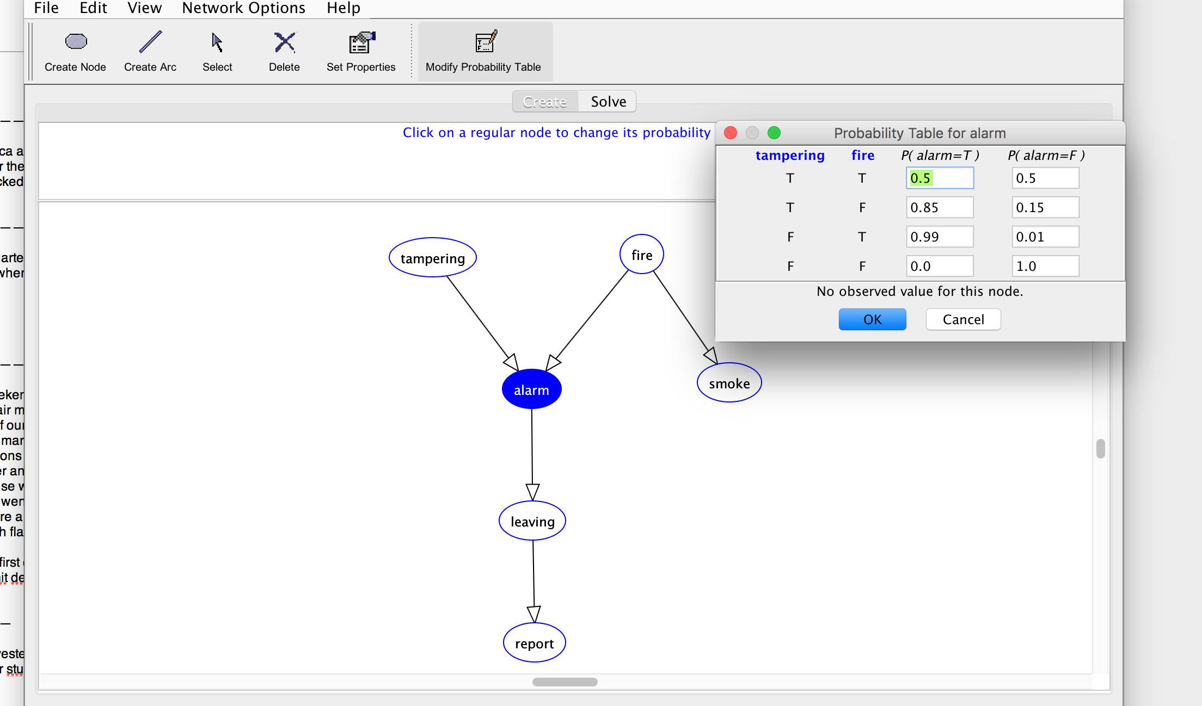
Bayesian Network Demo
Notes:
http://aispace.org/bayes

Slide 4
Extending Bayesian Network Models for Relational Data
Need to extend the following concepts:
relational random variable
joint distribution of relational random variables

Slide 5

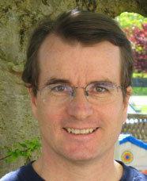

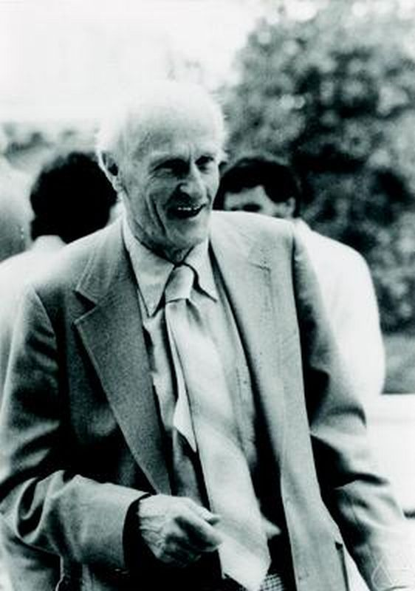
Relational Data and Logic
Lise Getoor
David Poole
Stuart Russsell
Stephen Kleene
Poole, D. (2003), First-order probabilistic inference, 'IJCAI’. Getoor, L. & Grant, J. (2006), 'PRL: A probabilistic relational language', Machine Learning 62(1-2), 7-31.
Russell, S. & Norvig, P. (2010), Artificial Intelligence: A Modern Approach, Prentice Hall.
Stephen Kleene, (1952). Introduction to Metamathematics.
Notes:
There are different formalisms for describing relational data and relational models. I follow the approach developed by Poole, Russell Getoor. The learning algorithms work for others as well. Basically, for any formalism based on first-order logic.

Slide 6
First-Order Logic
An expressive formalism for specifying relational conditions.
database theory
relational learning
First-Order Logic
Query language
Pattern Language
Notes:
Remind them that I use equational logic

Slide 7
First-Order Logic: Terms
A constant refers to an individual
“Fargo”
A first-order variable refers to a class of individuals
“Movie” refers to Movies
Terms
A constant or first-order variable is a term.
The result of applying a functor to a term is a term.
contains first-order variables?
first-order term e.g. salary(Actor, Movie)
ground term e.g. salary(UmaThurman, Fargo)
Notes:
could also build nested terms
values of ground terms are the smallest unit of information
fundamental split leads to two kinds of probabilities.
First-order probabilities are treated in this section
Instance/ground level probabilities are treated in section 5

Slide 8
Relational Random Variables
First-order random variable = First-order term + probabilistic semantics (Wang et al. 2008)
Ground random variable = ground term + probabilistic semantics (Kimmig et al. 2014)
Both complex terms and complex random variables are built by function application
Statistics | Logic
Apply function to random variable(s) ➔ new random variable | Apply function to term(s) ➔ new term
Notes:
One of Kleene’s motivations was to reflect mathematical practice

Slide 9
Formulas
A (conjunctive) formula is a joint assignment term₁ = value₁,...,term_{n}=value_{n}
e.g., ActsIn(Actor, Movie) = T, gender(Actor) = W
A ground formula contains only constants
e.g., ActsIn(UmaThurman, KillBill) = T, gender(UmaThurman) = W
Notes:
The value_i are constants.
Maybe say something about more complex formulas.

Slide 10

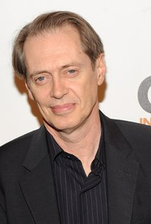

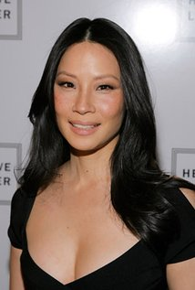


Network View: Formula = Template
A conjunctive formula can be viewed as specifying a type of subgraph in the Gaifman graph
e.g. the pattern ActsIn(Actor, Movie) = T, gender(Actor) = W occurs twice
gender = Man
country = U.S.
gender = Man
country = U.S.
gender = Woman
country = U.S.
gender =Woman
country = U.S.
✔
✔
$500,000
$5,000,000
$2,000,000
runtime = 98 min
country = U.S.
runtime = 111 min
country = U.S.

Slide 11
Notation
We use standard notation for relational random variables.
Concept | Notation
First-order random variable | X, X_{i}
Ground-random variable | X*
k-th value of random variable | x_{k}, x_{ik}
Parents of node i | Pa_{i}
j-th configuration of node i’s parents | pa_{ij}

Slide 12
Relational Frequencies
Probabilistic Semantics for First-Order Random Variables
Notes:
the basis of i.i.d. learning are frequencies observed in a sample
the basis of relational learning are frequencies observed in a database

Slide 13
Applications of Relational Frequency Modelling
Knowledge discovery/ rule learning “women users like movies with women actors”
Strategic Planning “increase SAT requirements to decrease student attrition”
Query Optimization (Getoor, Taskar, Koller 2001) Class-level queries support selectivity estimation ➔ optimal evaluation order for SQL query

Slide 14
Relational Frequencies
Database probability of a first-order formula = number of satisfying instantiations/ number of possible instantiations
Examples:
P_{D}(gender(Actor) = W) = 2/4
P_{D}(gender(Actor) = W, ActsIn(Actor,Movie) = T) = 2/8

Slide 15
The Grounding Table
P(gender(Actor) = W, ActsIn(Actor,Movie) = T) = 2/8
frequency = #of rows where the formula is true/# of all rows
FO Variable
Single data table that correctly represents relational joint frequencies Schulte (2011), Riedel, Yao, McCallum (2013)
Actor | Movie | gender(Actor) | ActsIn(Actor,Movie)
Brad_Pitt | Fargo | M | F
Brad_Pitt | Kill_Bill | M | F
Lucy_Liu | Fargo | W | F
Lucy_Liu | Kill_Bill | W | T
Steve_Buscemi | Fargo | M | T
Steve_Buscemi | Kill_Bill | M | F
Uma_Thurman | Fargo | W | F
Uma_Thurman | Kill_Bill | W | T
Notes:
FO = first-order
single data table that correctly represents relational frequencies
Riedel, S.; Yao, L.; McCallum, A. & Marlin, B. M. (2013), Relation Extraction with Matrix Factorization and Universal Schemas, in 'Human Language Technologies-NAACL', pp. 74--84.
Schulte, O. (2011), A tractable pseudo-likelihood function for Bayes Nets applied to relational data, in 'SIAM SDM', pp. 462-473.
Raedt, L. D. (1998), Attribute-Value Learning Versus Inductive Logic Programming: The Missing Links (Extended Abstract), in David Page, ed., 'ILP', Springer, , pp. 1-8
Compared to the single grounding table, the data representation with multiple tables is factorized. (Normalized in database terminology). The factored data representation reduces the overall dimensionality of the data representation compared to the single unnormalized table.

Slide 16

Random Selection Semantics
First-Order Variable ➔ Random Variable
Prob | Actor | Movie | gender(Actor) | ActsIn(Actor,Movie)
1/8 | Brad_Pitt | Fargo | M | F
1/8 | Brad_Pitt | Kill_Bill | M | F
1/8 | Lucy_Liu | Fargo | W | F
1/8 | Lucy_Liu | Kill_Bill | W | T
1/8 | Steve_Buscemi | Fargo | M | T
1/8 | Steve_Buscemi | Kill_Bill | M | F
1/8 | Uma_Thurman | Fargo | W | F
1/8 | Uma_Thurman | Kill_Bill | W | T
P(Movie = Fargo, Actor=Brad_Pitt) =1/2 x 1/4 = 1/8
Notes:
Population Variables are uniformly and independently distributed

Slide 17
Random Selection Semantics
Population Actors
Population variables
First-Order Random Variables
Actor Random Selection from Actors. P(Actor = brad_pitt) = 1/4
gender(Actor) Gender of selected actor. P(gender(Actor) = W) = 1/2
ActsIn(Actor,Movie) = T if selected actor appears in selected movie, F otherwise P(ActsIn(Actor,Movie) = T) = 3/8
Movies
Movie Random Selection from Movies. P(Movie = Fargo) = 1/2
Drama(Movie) Is the selected movie a drama? P(Drama(Movie)=T) = 1/2
Notes:
probabilities are examples

Slide 18
Bayesian Network Models for Relational Statistics
Statistical-Relational Models (SRMs) Random Selection Semantics for Bayesian Networks

Slide 19
Bayesian networks for relational data
A first-order Bayesian network is a Bayesian network whose nodes are first-order terms
(Wang et al. 2008)
AKA parametrized Bayesian network (Poole 2003, Kimmig et al. 2014)
gender(A)
Drama(M)
ActsIn(A,M)
Notes:
Bayesian networks are close to rules (Kersting and deRaedt)
parametrized BNs not a frequency model
Demo.
First-order Random variables = terms.

Slide 20
Random Selection Semantics for First-Order Bayesian Networks
P(gender(Actor) = W, ActsIn(Actor,Movie) = T, Drama(Movie) = F) = 2/8
“if we randomly select an actor and a movie, the probability is 2/8 that the actor appears in the movie, the actor is a woman, and the movie is a drama”
gender(A)
Drama(M)
ActsIn(A,M)
Notes:
Random or typical or normal individuals

Slide 21
Real-World Examples
To illustrate frequency semantics, learn and evaluate on the training set
ground truth about frequencies
We discuss generalization later

Slide 22
IMDb Data Format
data with two relationships
Notes:
todo: make EER diagram with 3 relationships

Slide 23
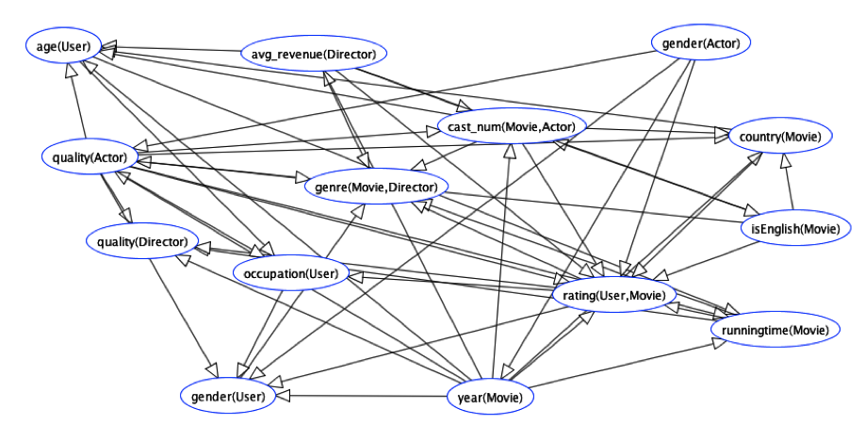
Learned Bayes Net for Full IMDB
Notes:
todo:
*rerun BayesBase with link analysis on
*rename columns to generate IMDB EER diagram with 3 relationships
*upload to Prague dataset

Slide 24
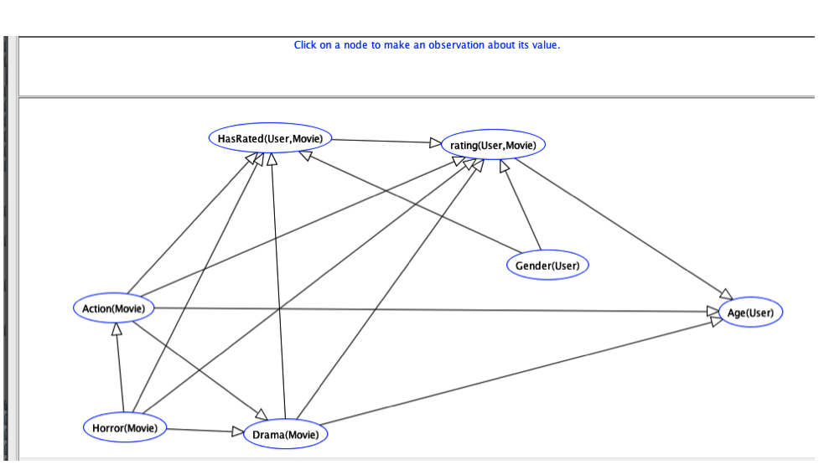
Learned Bayes Net for IMDb
With only 1 relationship HasRated(User,Movie).
Notes:
IMDb_1R.xml
for simplicity, our examples consider only one relationship. In principle, there is no limit to the number of relationships required.

Slide 25
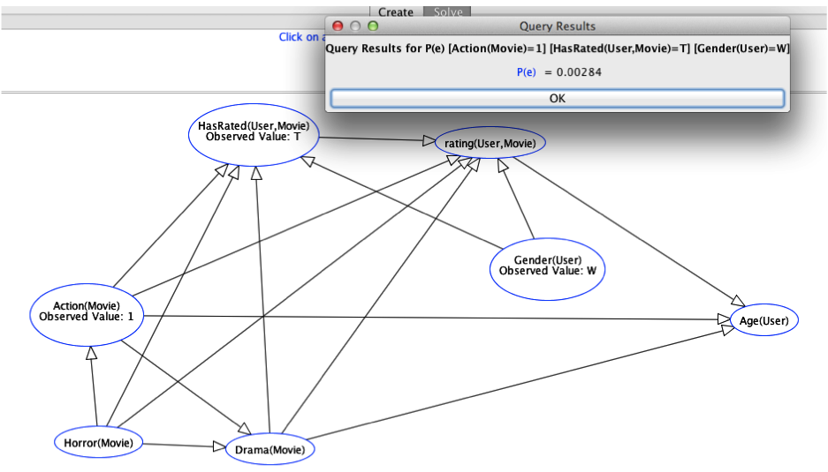
Bayes Net Query
Notes:
put pictures and xml files on-line

Slide 26
Data Query
Num Movies | 3883
Num Users | 6039
Num Movie-User Pairs | 3883 x 6039 = 23449437
movie-user pairs with action movie, woman user
Action(Movie) = T, HasRated(User,Movie) = T, gender(User) = W | 66642
Frequency | 66642/23449437= 0.0028
More Examples in spreadsheet on website
Notes:
run the actual queries

Slide 27
Mondial Data Format
Notes:
todo:
*simplify so it has only Country and Borders
* which database has that – Mondial Tutorial?
*make sure BayesBase runs correctly
*fix website too

Slide 28
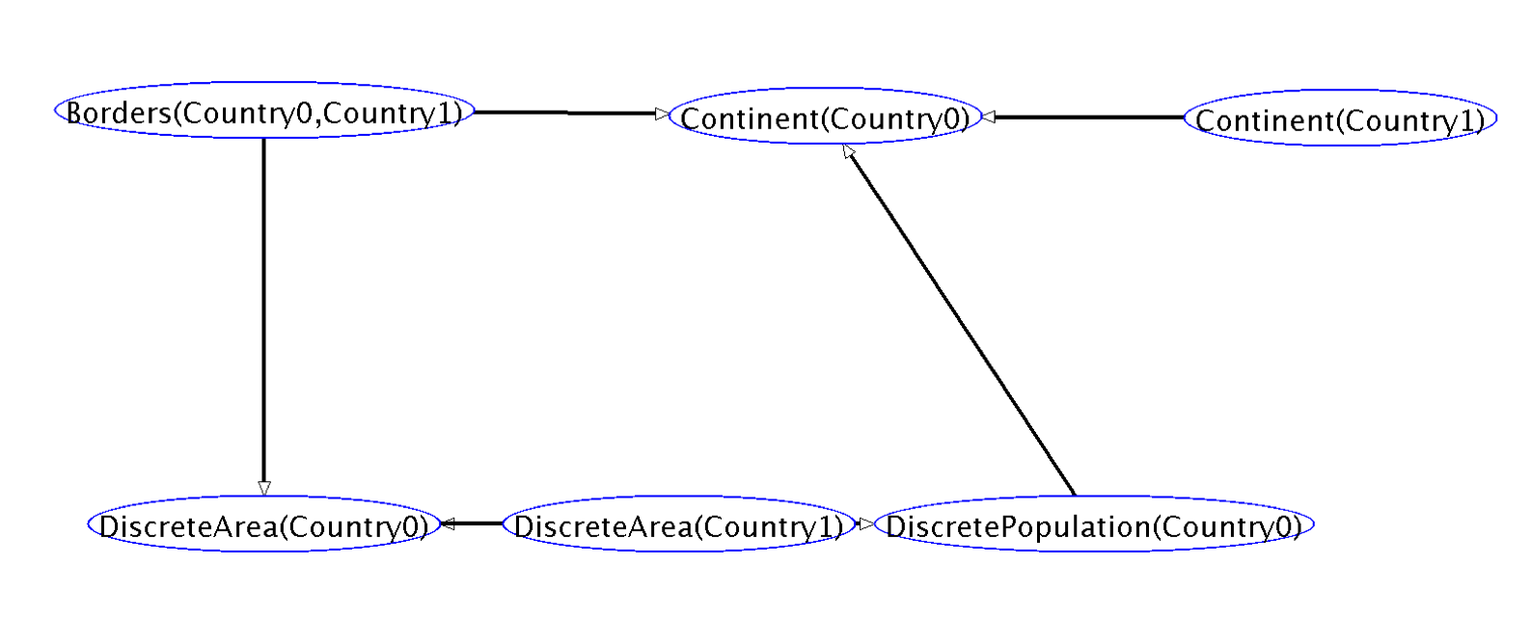
Learned Bayes Net for Mondial
Notes:
todo:
rerun Mondial with link analysis on
fix data format
Mondial.xml

Slide 29
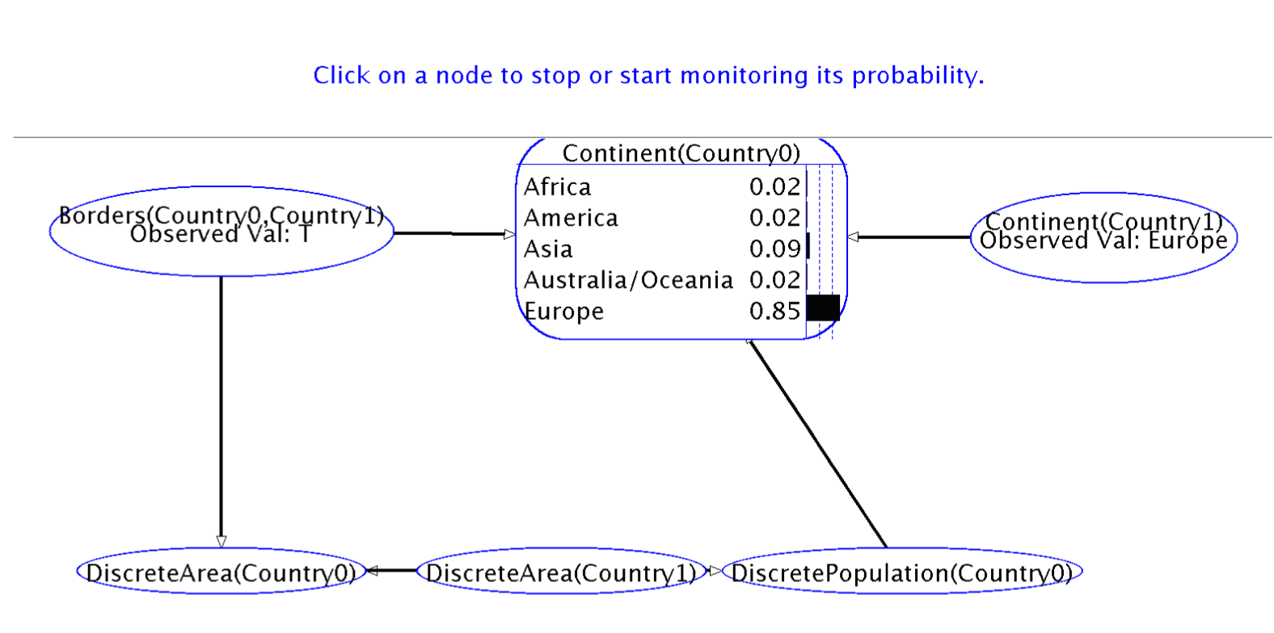
Bayes Net query
Notes:
Mondial.xml
todo: rerun to get rid of *

Slide 30
Data Query
Number of Europe-Europe Borders | 156
Number of *-Europe Borders | 166
P(continent(country1) = Europe|Borders(country1,country2) = T, continent(country2=Europe)) | 156/166= 93.98%
BN was learned with frequency smoothing (Laplace correction)
More Examples in spreadsheet on website
Notes:
exercise: query what the probability is of a country being in America given that it has a neighbour in America?
Europe has borders outside of itself: Turkey and Russia

Slide 31
Bayesian Networks are Excellent Estimators of Relational Frequencies
Queries Randomly Generated
Example: P(gender(A) = W|ActsIn(A,M) = true, Drama(M)=T)?
Learn Bayesian network and test on entire database as in Getoor et al. 2001

Slide 32
Summary: Relational Frequencies
The frequency of a conjunctive formula in a possible world = number of satisfying instantiations/ number of possible instantiations.
First-order Bayesian networks represent frequencies of conjunctive formulas very well.
visualize correlations
answer frequency queries using BN inference, not data access

