Slide 1
Relational Data Representations
Section 1
Tutorial on Learning Bayesian Networks for Complex Relational Data
Notes:
Section 0 and 1: 30 min

Slide 2
Overview
What are relational data?
Different notations/representations.
Logic
Tables
Graph
RDF (Resource Description Framework)
Matrix/Tensor
Common core: functions of multiple arguments.

Slide 3
The Prague Relational Learning Repository
Sample tutorial databases are available in the Repository
Can search for different dataset properties.
Write-up and connection details are available http://arxiv.org/abs/1511.03086
Host = relational.fit.cvut.cz
Username = guest
Password = relational
Port = 3306
Tutorial Databases are available under IMDB_1R, imdb_MovieLens, Mondial_Tutorial
Notes:
https://relational.fit.cvut.cz/
show actual log-in on mysql

Slide 4
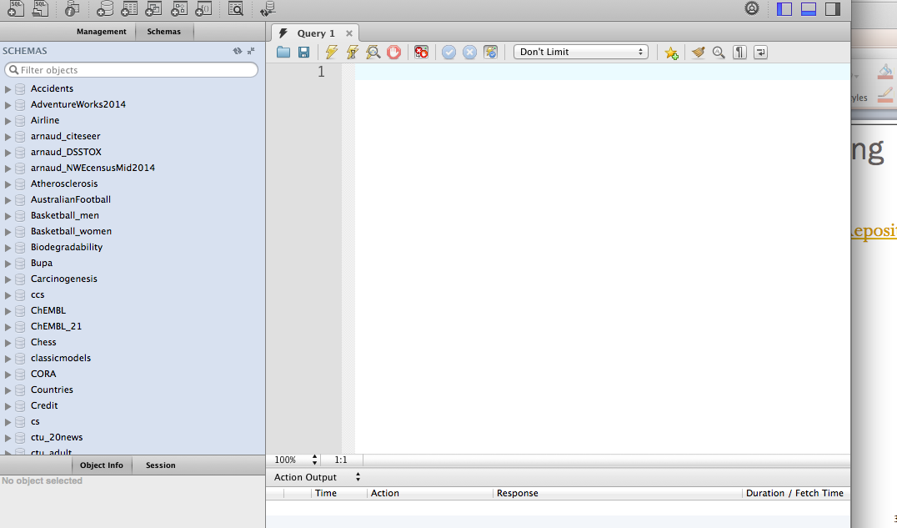
The Database Repository
Notes:
Screenshot After Connecting With MySQL Workbench

Slide 5



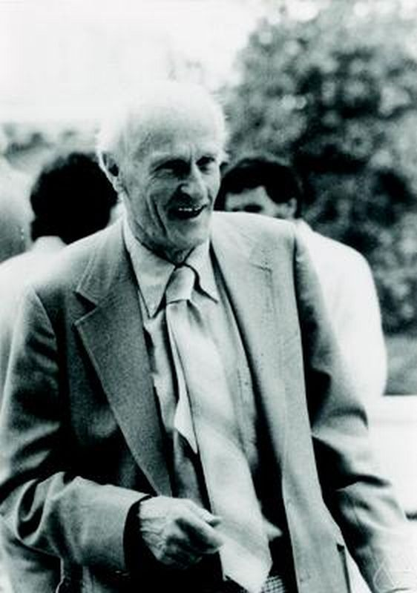
Definition of Relational Data
Lise Getoor
David Poole
Stuart Russell
Stephen Kleene
Notes:
classical logical formalism

Slide 6
What Are Relational Data?
Intuitively, represent
attributes of individuals
relationships among individuals
attributes of these relationships

Slide 7
Function-Based Notation
Mathematical formalism for describing relational data formats
Based on the familiar notion of a function
Shows what is common and what is different for different data models
Abstract, mathematical, not visual
Other representations for visualization, intuition, computation are shown in the supplementary material
Notes:
The supplement shows how to translate function-based representation into other representations, for visualization, intuition, computation

Slide 8
General Definition
Data model defined by three basic sets of objects.
Individuals
Values
Functors = Functions that map tuples of individuals to values

Slide 9




Individuals = Actors
Man
Woman
gender
Brad Pitt
Steve Buscemi
Uma Thurman
Lucy Liu
country
US
Notes:
functors: gender, genre, who acts in what.

Slide 10


Individuals = Movies
98 min
111 min
runtime
Fargo
Kill Bill
drama
True
False
Notes:
functors: gender, genre, who acts in what.

Slide 11
Actors + Movies
False
True
True
True
ActsIn
Notes:
functors: gender, genre, who acts in what.

Slide 12
IID Data vs. Structured Data
Traditional Data Matrix: every functor is unary: takes exactly one individual as argument (Nickel et al. 2016)
Structured Data: functors assign values to >1 individual
Relational Data: Structured Data with Boolean functors for classes and relationships
Structured Data
Relational Data
single-table data = unary functors
Notes:
IID data are a special case of relational data
IID data = relational data without relationships

Slide 13

The Generalization Principle
Relational algorithms should generalize unary functor (single-table) algorithms (van De Raedt 2008, Ch.6.1; Knobbe 2006)
Apply a relational algorithm in the special case where all functors are unary ➔same answer as traditional single-table algorithm.
In this tutorial we follow standard machine learning methods as closely as possible
Notes:
Advantages:
minimize the amount of new concepts
pinpoint the differences between learning for relational and for IID data

Slide 14
Individuals

Slide 15
Individuals
An individual is discrete and distinguishable from others
Unique constants assumption: Each individual has a unique Id
Logic | Statistics | Databases | Computer Science
Individual, Object | Unit | Entity | Instance (of Class)
Notes:
In open-world problems:
Some domains may include individuals without an ID (e.g. unrecognized objects in an image)
Some domain may include distinct IDs referring to the same individual (aliases)
See Stuart Russell reference

Slide 16
Collection of Individuals
The set of all individuals
Can be finite or infinite
Can consider subsets as well
Logic | Statistics | Databases | CS
Domain, Type, Sort | Population, Group | Entity Set | Class
Notes:
Subset of individuals = class

Slide 17




More Examples of Individuals
Users
user#1
user#2
user#3
user#4
Dates
Jan 1, 2014
Jan 1, 2015
Jan 1, 2016
Notes:
Individuals may or may not represent locations, i.e. points in a topological space (see stochastic processes).
STOP HERE

Slide 18
Values
In this tutorial, usually assume a finite set of values
Simplifying assumption: Values are disjoint from individuals
Special Values
T, F Boolean
n/a not applicable
Notes:
Simplifying assumption: Values are disjoint from individuals
more on disjointness from individuals below when we discuss many-one relationships

Slide 19
Functors

Slide 20
Functors
Let Pop denote the population and V the set of values
A functor of arity k is a map f: Pop^{k}➔V
A Boolean functor maps to T,F f: Pop^{k}➔{T,F}
Functor | Logic | Statistics
Boolean | Predicate | Indicator Variable

Slide 21
Examples
Functor Name | Arity
ActsIn | 2
salary | 2
running_Time | 1
country | 1
gender | 1
Notes:
A unary functor f: Pop➔V is a feature or attribute.

Slide 22
Relational Functors
Classes and Relationships

Slide 23
Class-Relationship Diagrams
AKA entity-relationship diagrams
A class-relationship diagram defines a set of functors
Notes:
Helps visualize the data format
Supported by many tools, e.g. MS Visio, yed

Slide 24
More Complex Example
Notes:
More realistic, still relatively small. From http://www.dbis.informatik.uni-goettingen.de/Mondial/
Used only once more in this tutorial

Slide 25
Classes and Their Attributes
A class is a unary Boolean functor
An attribute of class C is a functor f such that for all individuals a, if C(a) = F, then f(a) = n/a
Class | Attribute
Actor | gender
Movie | running_Time
Man
gender
n/a
Brad Pitt
Steve Buscemi
Fargo
Kill Bill
n/a
running_Time
98 min
111 min

Slide 26
Relationships
A relationship is a Boolean functor of arity > 1
An attribute of k-ary relationship R is a k-ary functor f such that for all k-tuples of individuals a, if R(a) = F, then f(a) = n/a
Relationship | Attribute
ActsIn | salary
False
True
ActsIn
n/a
$500,000
salary
Notes:
salary figures are made up

Slide 27
Decision Tree for Relational Functor Types
Arity
=1
>1
Values
Values
not Boolean
Boolean
not Boolean
Boolean
Class
Attribute
Relationship
Attribute

Slide 28
Possible Worlds and Samples

Slide 29
Possible Worlds
A possible world for a set of functors specifies
a population
the value of each functor for each argument
Logic | Databases | Statistics
relational structure interpretation | database instance | ?
Notes:
i.e for each functor of arity k, for each k-tuple of individuals, the possible world specifies the value of the functor

Slide 30
Possible World Toy Example
gender = Man
country = U.S.
gender = Man
country = U.S.
gender = Woman
country = U.S.
gender = Woman
country = U.S.
False
n/a
False
n/a
True
$500K
False
n/a
False
n/a
True
$5M
False
n/a
True
$2M
ActsIn
salary
runtime = 98 min
drama = true
runtime = 111 min
drama = false
Notes:
functors: gender, genre, who acts in what.

Slide 31
Learning From Relational Samples
A sample specifies
a set of observed individuals
For each tuple of observed individuals, the argument value for each functor
= possible world restricted to observed individuals
As with IID samples, we may have missing data = missing values for some arguments of a functor
Relational learning: given observed values of functions, extrapolate to unobserved values
Notes:
This view of relational learning immediately generalizes learning the standard view of learning from i.i.d. data
e.g. drawing balls from a urn containing a ball population

Slide 32
Example: Sample
gender = Man
country = U.S.
gender = Woman
country = U.S.
Observed individuals: Steve Buscemi and Uma Thurman
complete information for Uma Thurman and Steve Buscemi
have not observed Brad Pitt and Lucy Liu
True
$500K
False
n/a
False
n/a
True
$5M
ActsIn
salary
runtime = 98 min
drama = true
runtime = 111 min
drama = false
Notes:
functors: gender, genre, who acts in what.
subgraph sampling

Slide 33
Representations of Relational Data

Slide 34
Relational Data Formats
Data Format
graphical
logical
arrays
tabular
Nodes and edges in heterogenous network (Sun and Han 2012)
Logical Facts
Knowledge Graph/RDF Triples (Nickel et al. 2015)
Atoms/Literals
Matrices
Tensors
Database Tables
SQL
Notes:
this tutorial uses only the network and tabular representations
For graphical and tensor notation, the supplementary presentation has worked-out examples
Constraints on functor types can, and typically are, exploited in specific representations of relational data
For example, functional or many-one relationships, see supplementary presentation

Slide 35
Network View
A possible world is equivalent to a heterogeneous network where
the nodes are individuals
we have multiple types of nodes
nodes are labelled with the attributes of the individual
the links represent existing relationships (true functors)
we have multiple types of links
links are labelled with the attributes of the link
If some functors have arity > 2, need hyperedges
This is known as the Gaifman graph of a first-order relational structure

Slide 36
Network View: The Gaifman Graph
gender = Man
country = U.S.
gender = Man
country = U.S.
gender = Woman
country = U.S.
gender = Woman
country = U.S.
$500,000
$5,000,000
$2,000,000
runtime = 98 min
country = U.S.
runtime = 111 min
country = U.S.
Notes:
graphical representation for first-order structure

Slide 37
Tabular Representations
Most widely used in industry.
Database management systems: $15bn+ (Gardner).
Directly comparable to tabular representations of i.i.d. data.

Slide 38
Relational Data: Tabular Representation
Arity = 1
IID data

Slide 39
Table Representation for Unary Functors
Class ➔Table
Attribute ➔Column
Individuals ➔ Row
Each row is a datapoint = set of all attribute values for an individual from the class.
Actors | Functors/Attributes
individual | gender | country
Brad_Pitt | M | U.S.
Lucy_Liu | W | U.S.
Steve_Buscemi | M | U.S.
Uma_Thurman | W | U.S.

Slide 40
Data Tables for Relational Functors
Arity > 1

Slide 41
Table Representation for Relational Functors
Relationship ➔Table
Attribute ➔ Column
Tuples of Individuals ➔ Row
Closed-World convention: list only tuples for which the relationship is true (Russell and Norvig 2010)
ActsIn
Name | Title | salary (M$)
Lucy_Liu | Kill_Bill | 2
Steve_Buscemi | Fargo | 0.5
Uma_Thurman | Kill_Bill | 5
Brad Pitt | Kill_Bill | n/a
Notes:
ActsIn Table

Slide 42
Discussion: Relational Data Points
Unary and relational tables constructed in a similar way
But: big difference in dependencies
Unary table
Two data points represent complete information about distinct individuals
Can reasonably assume independence
Relational Table
A row does not contain all the information about the individuals involved
Different rows may refer to the same individual ➔ dependencies between rows

Slide 43
Example
Name | Title | Salary (M$)
Lucy_Liu | Kill_Bill | 2
Uma_Thurman | Kill_Bill | 5
Uma_Thurman | Be_Cool | 9
arity > 1
shared arguments
dependencies among functor values
Uma Thurman’s salary in Kill Bill carries information about her salary in Be Cool
Also carries information about Lucy Liu’s salary in Kill Bill
Notes:
First point: because the salary of an actor in one movie is correlated with her salary in the next
Second point: because the salary of an actor in a movie is correlated with the salary of actors in the same movie (e.g. low budget vs. high budget movie)

Slide 44
Summary: Data types
Functor: maps tuple of individuals to a value
IID data equivalent to unary functors with arity = 1
Arity > 1 ➔ structured data, not IID
Relational data: special type of structured data
Boolean classes + attributes
Boolean relationships + attributes
Unary functors, table representation:
One table per class
One row per individual
Datapoints = vector of functor values for individual
Relational functors, table representation:
one table per class and relationship

