Slide 1
General Graphical Model Learning Schema
After Kimmig et al. 2014.
Initialize graph G := empty.
While not converged do
Generate candidate graphs.
For each candidate graph C, learn parameters θ_{C} that maximize score(C, θ, dataset).
G := argmax_{C} score(C, θ_{C},dataset).
check convergence criterion.
lattice search

Slide 2
Structure Learning
Lattice Search

Slide 3
Upgrading IID Bayesian Network Learners
The Learn and Join Algorithm

Slide 4


Learning a Bayesian Multi-Net
Learn a Bayesian network for each relationship chain using a single-table Bayesian network learner
Nodes and edges are propagated from shorter chains to smaller chains
ActsIn(A,M), HasRated(U,M)
Lattice of Relationship
Chains
ActsIn(A,M)
HasRated(U,M)
Actors A
Movies M
🎥
Users U
Notes:
Theoretical result: Preserves model search complexity at each level.
A relationship chain with all true relationships is also known as a metapath Sun, Y. & Han, J. (2012), Mining Heterogeneous Information Networks: Principles and Methodologies, Vol. 3, Morgan & Claypool Publishers.

Slide 5
Network View: Single Template Nodes
Path length = 0
country, gender
country, runtime
occupation, gender
Actors A
Movies M
🎥
Users U
learn BN for attributes of random Actor
learn BN for attributes of random Movie
learn BN for attributes of random User

Slide 6
Network View: Single Links
Path length = 1
country, gender
country, runtime
country, runtime
occupation, gender
ActsIn(A,M)
HasRated(U,M)
Actors A
Movies M
Movies M
Users U
not ActsIn(A,M)
not ActsIn(A,M)
🎥
🎥
learn BN for attributes of random Actor, random Movie, existing link, absent link
learn BN for attributes of random User, random Movie, existing link, absent link

Slide 7
Network View: Two Links
Path length = 2
country, gender
country, runtime
occupation, gender
ActsIn(A,M)
HasRated(U,M)
Actors A
Movies M
Users U
not ActsIn(A,M)
🎥
not ActsIn(A,M)
learn BN for attributes of random Actor, random Movie, random User, 4 combinations of existing/absent links

Slide 8
Implementation of Lattice Search
Example
Notes:
show running code for BB jar

Slide 9
Contingency Table for Movies
🎥
count | Action | Drama | Horror
538 | 0 | 0 | 1
2504 | 0 | 1 | 0
845 | 1 | 0 | 0
Notes:
SELECT count(*) as count, Action, Drama, Horror FROM IMDB_1R.Movie group by Action, Drama, Horror;

Slide 10
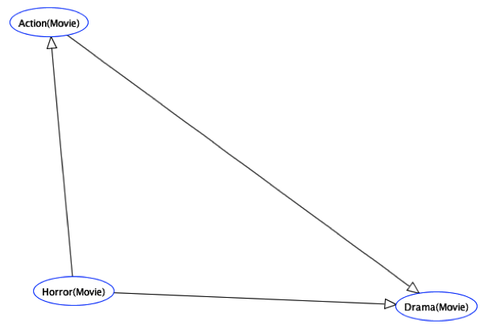
Learning a DAG for Movies
🎥
Apply existing Bayesian network learning for IID data to Movies contingency table

Slide 11
Contingency Table for Users
COUNT(*) | gender | age
78 | F | 1
298 | F | 18
557 | F | 25
338 | F | 35
189 | F | 45
146 | F | 50
144 | M | 1
805 | M | 18
1538 | M | 25
855 | M | 35
361 | M | 45
350 | M | 50

Slide 12
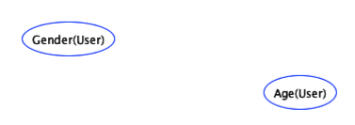
Learning a DAG for Users
Apply existing Bayesian network learning to Users table

Slide 13
Contingency Table for Users + Movies
🎥
🎥
count | Action | Drama | Horror | Age | Gender | HasRated
929 | 0 | 0 | 1 | 1 | F | T
2170 | 0 | 0 | 1 | 1 | M | T
4552 | 0 | 0 | 1 | 18 | F | T
14737 | 0 | 0 | 1 | 18 | M | T
8126 | 0 | 0 | 1 | 25 | F | T
32309 | 0 | 0 | 1 | 25 | M | T
4568 | 0 | 0 | 1 | 35 | F | T
16007 | 0 | 0 | 1 | 35 | M | T
2156 | 0 | 0 | 1 | 45 | F | T
6523 | 0 | 0 | 1 | 45 | M | T
40723 | 0 | 0 | 1 | 1 | F | F
74726 | 0 | 0 | 1 | 1 | M | F
154580 | 0 | 0 | 1 | 18 | F | F
415133 | 0 | 0 | 1 | 18 | M | F
289312 | 0 | 0 | 1 | 25 | F | F
788983 | 0 | 0 | 1 | 25 | M | F
175924 | 0 | 0 | 1 | 35 | F | F
440563 | 0 | 0 | 1 | 35 | M | F
98770 | 0 | 0 | 1 | 45 | F | F
186251 | 0 | 0 | 1 | 45 | M | F
.... | ....
the full CT table contains 42 rows
Notes:
note how we can get the false rows

Slide 14
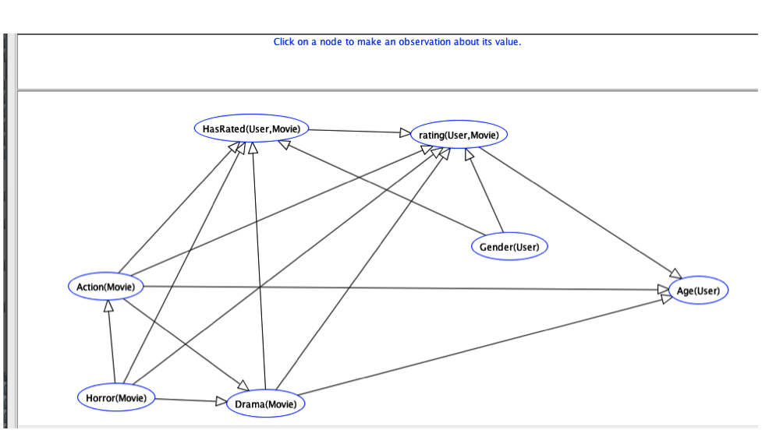
Learning a DAG for Users + Movies
🎥
🎥
Apply existing Bayesian network learning to join of Users, Movie, Ratings tables

Slide 15
Fast Structure Learning
Dataset | # Predicates | # tuples | RDN_Boost | MLN_Boost | Lattice
UW | 14 | 612 | 15±0.3 | 19±0.7 | 1±0.0
Mondial | 18 | 870 | 27±0.9 | 42±1.0 | 102±6.9
Hepatitis | 19 | 11,316 | 251±5.3 | 230±2.0 | 286±2.9
Mutagenesis | 11 | 24,326 | 118±6.3 | 49±1.3 | 1±0.0
MovieLens(0.1M) | 7 | 83,402 | 44±4.5 min | 31±1.87 min | 1±0.0
MovieLens(1M) | 7 | 1,010,051 | >24 hours | >24 hours | 10±0.1
Imdb(1.5M) | 17 | 1,538,400 | >24 hours | >24 hours | 549
Standard deviations are shown for cross-validation.
Units are seconds/predicate or function
Notes:
show system running
MovieLens 1M takes only 9 sec more because counting in RDBMS scales really well.
DNs are only learned for predicates for both MLN-Boost and RDN_Boost (two possible values only).
IMDB is evaluated only on unary predicates, for all methods. IMDB evaluated only on one fold.
We report the average per node.
good at finding long relationship chains.
Hepatitis has a complex schema: longer to learn single model than learn independently.
--------------------
IMDB = 540 x 17 = 2.5 hrs.

Slide 16
Learned Structure Example IMDB_3R
UserID | Occupation | Age | gender
UserID | MovieID | Rating
RDN-Boost
MovieID | Time
🎥
Model | Target | Markov Blanket
RDN-Boost | gender(U) | Occupation(U), Age(U)
Learn-and-Join | gender(U) | Occupation(U), Age(U), Rating(U,M), RunningTime(M), CastMember(M,X), AGender(X)
ActorID | MovieID
ActorID | AGender
Notes:
RDN-Boost stays within the original target table. LAJ finds predictive features that are 2 links away.

Slide 17
Consistency Preservation
Statistical Consistency: As the amount of available data increases, the graphical model learner converges to a graphical structure that is correct for the data generating mechanism.
Theorem If a Bayesian network structure learner is consistent for IID data, then upgrading the learner with the learn-and-join algorithm is consistent for relational data.
Notes:
ugrading objective function is discussed in starai paper

Slide 18
Conclusion
Structure Learning: Structure search using the lattice of relationship chains
Apply iid Bayes net learner to each point in the lattice
Propagate correlations from lower levels to higher levels, dynamic programming style
fast structure learning
complex correlations along long relationship chains

