Slide 1
Parts Tech AI
Gerardo Alcocer Mathilde Vankelegom Oscar Chavez

Slide 2
Objectives
Facilitate the look up of automotive parts.
Create a natural interaction, such as a conversational experience.
Avoid entry barriers like downloading an app.

Slide 3
Goals
Integrate the PartsTech API
Create a chatbot on top of the API.
Use NLP to differentiate entities
Create a smart chatbot.
Allow clients to find or quote automotive parts
Track new and potential clients.

Slide 4
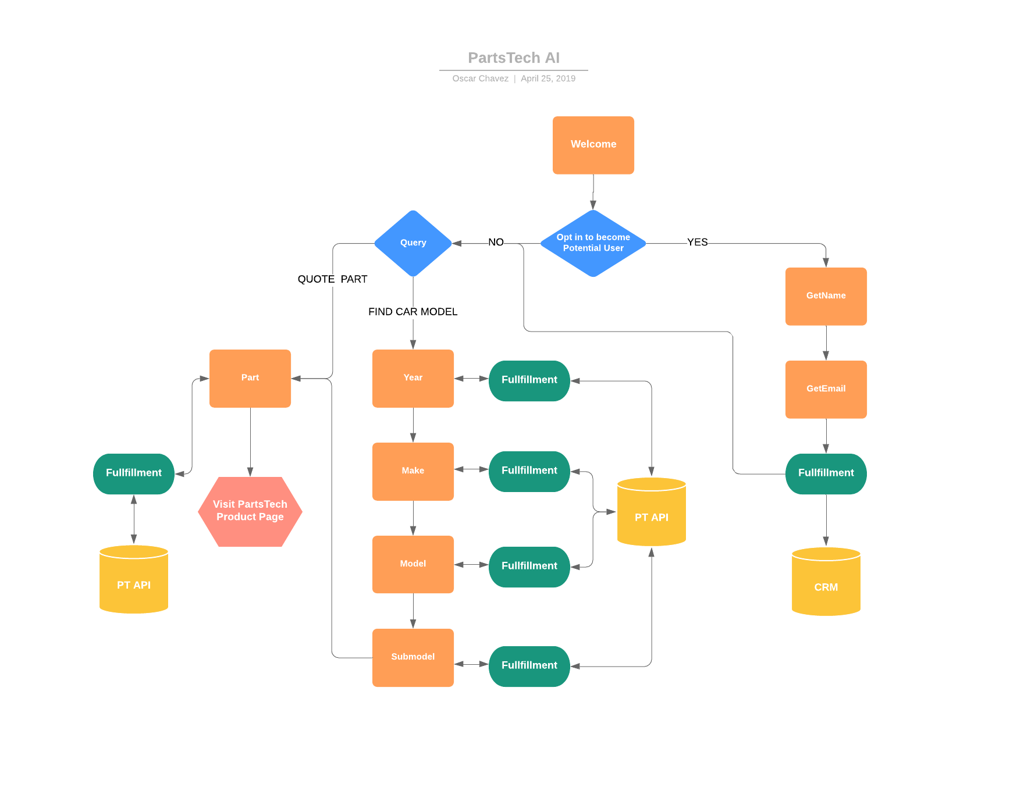
Flow

Slide 5
Arquitectura

Slide 6
Demo

