Slide 1



Slide 2
Agentic case: Extracting and querying product information from PDF catalogs.
Hydroscand_Hoses

Slide 3
Background
Problem:
In aircraft design (like at Saab), every fastener, rivet, or bolt used in a 3D CAD model must comply with strict regulatory and design standards (RDS = Regulatory Design Standards) — things like tightening torque, hole tolerances, and installation notes.
Today, engineers often look these up manually in series of PDF documentation or manuals, which is time-consuming and error-prone.
What if an engineer could, by right-clicking a part (say, a bolt) in the 3D CAD viewer, instantly find the correct installation instructions or parameters, automatically derived from the appropriate standards, all via a context menu?

Slide 4
Example workflow
An engineer highlights a bolt in the 3D viewer (e.g., Catia Composer).
They right-click and choose a category such as “Installation”.
The AI agent analyzes the part’s metadata, e.g. STD4305-05007.
STD4305 → the standard/specification defining the bolt type.
05007 → dimensions (5 mm diameter, 7 mm clamp length).
The agent looks up relevant standard documents (STD codes) that specify torque, washers, etc.
It returns a concise card showing:
Torque range (e.g. 3.4–4.8 Nm)
Required washers, sealing compound, inspection method
Links to the exact regulatory tables used.
Result: the system effectively generates the RDS section automatically, saving manual lookup time.

Slide 5
Core capabilities required
CAD-to-Standard Mapping Interpret part codes, parse attributes (e.g., size, standard, clamp length), and find matching entries in the regulation database.
On-the-Fly RDS Generation Combine all relevant parameters (torque, tooling, cleaning, sealing, etc.) into a compact, human-readable instruction sheet, essentially an automated “mini-RDS” document.
Explainability Every returned value must cite the source STD document and table, so the engineer can trace how the AI found it.
Fallback Logic If a perfect match isn’t found, the AI suggests the closest valid alternative and shows its confidence score.

Slide 6
Challenge areas
Challenge | Description
Cross-referencing standards | Some standards reference others (e.g. STD4314 → STD4323 → torque table). The AI must chain these correctly.
Parsing CAD metadata | Must accurately interpret codes like STD4305-05007 to identify standard and dimensions.
Regulation ingestion | Standards are often in PDF, Excel, or scanned form — need OCR, structure extraction, and indexing.
Dead-ends and ranking | When multiple standards overlap, the AI must rank results by relevance.
User experience | The engineer must stay in control — quick answers, minimal clicks, clear provenance.

Slide 7
In essence:
The Saab RDS AI Agent is:
A context-aware assistant that automatically retrieves and explains regulatory assembly data for fasteners directly inside the CAD environment, turning static documentation into real-time, explainable knowledge.

Slide 9
Find out about the LiU graphic profile on Liunet
liuonline.sharepoint.com

Slide 10
Development

Slide 11
High-level flow:
Ingest → Normalize → Knowledge → Serve
Raw data extraction (harvested.db)
Structured representation (structured.db)
Intelligent reasoning (knowledge capture layer)
User interaction (interface)

Slide 12
Layer 1: Harvested Database (Raw Extraction)
Purpose
Store unprocessed, source-faithful data exactly as extracted from CAD files and PDF documents.

Slide 13
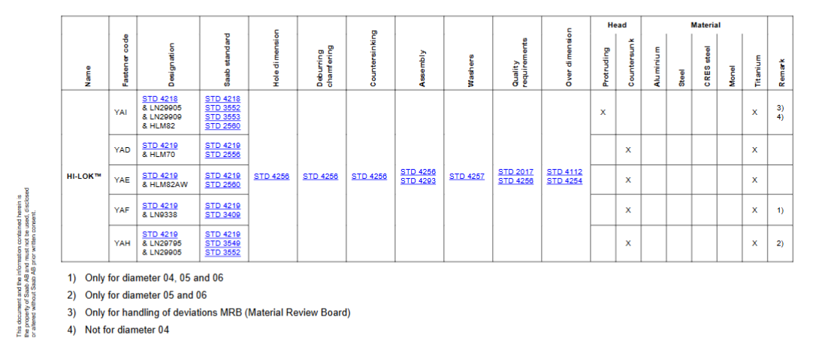
Layer 1: Harvested Database (Raw Extraction)
Stage 3: Table Extraction Strategy

Slide 14
Layer 1: Harvested Database (Raw Extraction)
Stage 3: Table Extraction Strategy

Slide 15
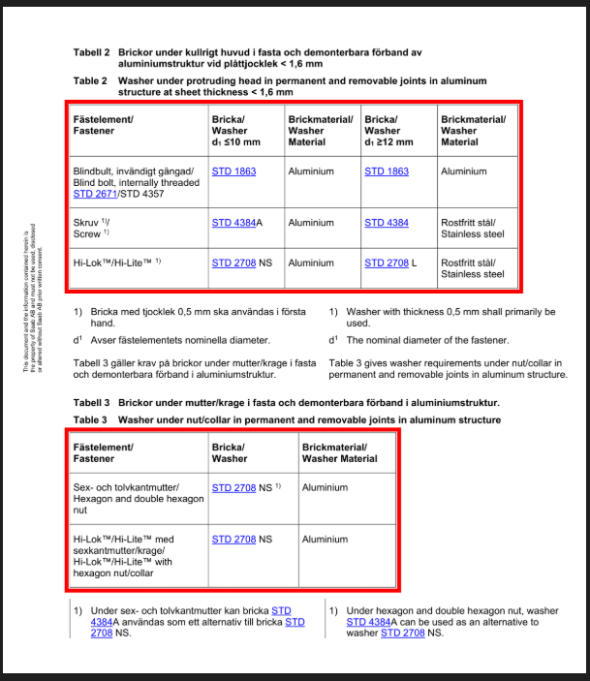
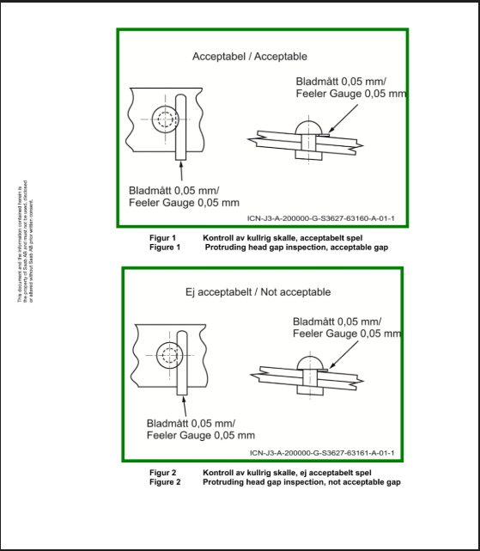
Layer 1: Harvested Database (Raw Extraction)
Stage 3: Table Extraction Strategy

Slide 16
Layer 1: Harvested Database (Raw Extraction)
Stage 3: Table Extraction Strategy

Slide 17
L2
Layer 2: Structured Database (Canonical Representation)
Purpose
Transform raw harvested data into a normalized, canonical form optimized for reasoning and queries.

Slide 18
L3
Declarative Knowledge (Facts)What it stores: "STD4305-05007 is an M5 fastener with 7mm clamp length"
declarative_knowledge.db (Option A: Dedicated DB)
Alternative: Semantic Triple Store (RDF)
SQL Pros: Familiar, integrates with existing stack, good for structured queries
RDF Pros: Native semantic relationships, SPARQL queries, ontology reasoning
Recommendation: Start with SQL, migrate to RDF if semantic reasoning becomes critical

Slide 19
L3
Conditional Knowledge (Rules & Logic)
What it stores: "IF fastener is M5 AND material is Steel THEN torque = 3.4-4.8 Nm"
conditional_knowledge.db (Option A: Rule Engine)
Alternative: Knowledge Graph (Neo4j)
Rule Engine Pros: Explicit logic, easier debugging, conflict resolution
Graph Pros: Visual reasoning paths, complex relationship queries, pattern matching
Recommendation: Knowledge graph (Neo4j) for conditional knowledge — natural fit for "IF component has properties X, Y THEN apply requirement Z"

Slide 20
L3
Procedural Knowledge (Workflows & Processes)
What it stores: "To install fastener: 1) Clean hole, 2) Apply sealant, 3) Insert fastener, 4) Torque to spec"
procedural_knowledge.db
Alternative: BPMN/Workflow Engine Integration
Database-driven vs. Workflow engine?
Database Pros: Simple, integrates with SQL stack, easy queries
Workflow Engine Pros: Advanced orchestration, parallel execution, real-time monitoring
Recommendation: Start with database for simplicity, migrate to workflow engine if real-time execution tracking is needed

