Slide 1
G12: KErNEL BUG
计52 2015011258 沈俊贤
计52 2015011264 刘攀

Slide 2
原理介绍
框架：Dr.checker
https://github.com/ucsb-seclab/dr_checker

Slide 3
Dr.checker的优点
当前的很多静态代码文件是post-completion方式的，而post-completion的结束点不同，导致在进行多种analyse的时候，因为analyse的不同而导致对结束点的要求不同，从而无法同时进行多种analyse。而Dr.Checker采用flow-sensitive和context-sensitive的方式

Slide 4
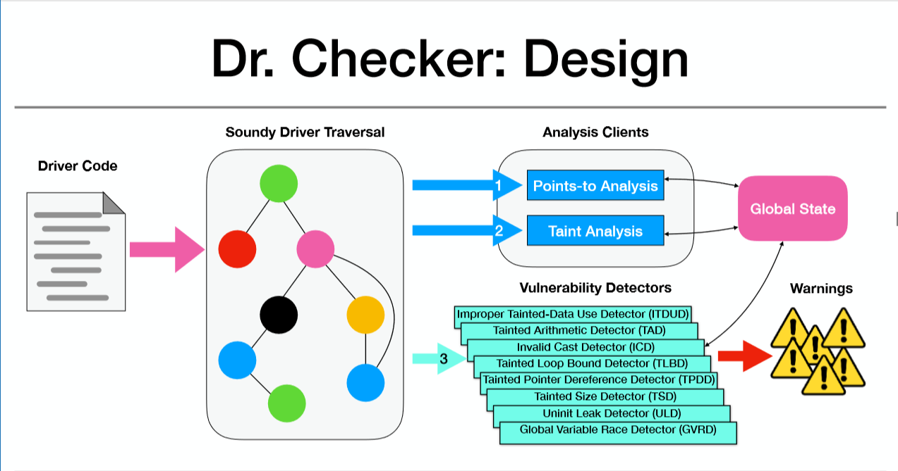

Slide 5
五大部分
1. build llvm
2. Driver link
3. Parse Headers
4.EntryPointIdentifier
5.SoundyAnalysisRunner

Slide 6
Assumptions contribute to soundyness
Assumption 1. We assume that all of the code in the mainline Linux core is implemented perfectly, and we do not perform any inter-procedural analysis on any kernel application program interface (API) calls.
Assumption 2. We only perform the number of traversals required for a reach-def analysis in loops, which could result in our points-to analysis being unsound.
Assumption 3. Each call instruction will be traversed only once, even in the case of loops. This is to avoid creating additional contexts and limit false positives, which may result in our analysis being unsound.

Slide 7
LLVM五种基本操作
1. Alloca (v = alloca typename) allocates a stack variable with the size of the type typename and as- signs the location to v (e.g., %1 = alloca i32).
2. BinOp ( v = op op1, op2) applies op to op1 and op2 and assigns the result to v (e.g., %1 = add val, 4).
3. Load (v = load typename op) is the standard load instruction(e.g.,%tmp1 = load i32* %tmp).
4. Store (store typename v, op) is the standard store instruction(e.g., store i8 %frombool1, %y.addr).
5. GetElementPtr (GEP) is the instruction used by the IR to represent structure and array-based accesses and has fairly complex semantics (e.g., %val = getelementptr %struct.point %my point, 0).

Slide 8
框架trace的变量范围
1. Function local variables (or stack locations): We maintain an alias object for each local variable.
2. Dynamically allocated variables (or heap loca- tions): These are the locations that are dynamically allocated on the program heap (e.g., as retrieved by malloc or get page). We similarly create one alias object for each allocation site.
3. Global variables: Each global variable is assigned a unique alias object.

Slide 9
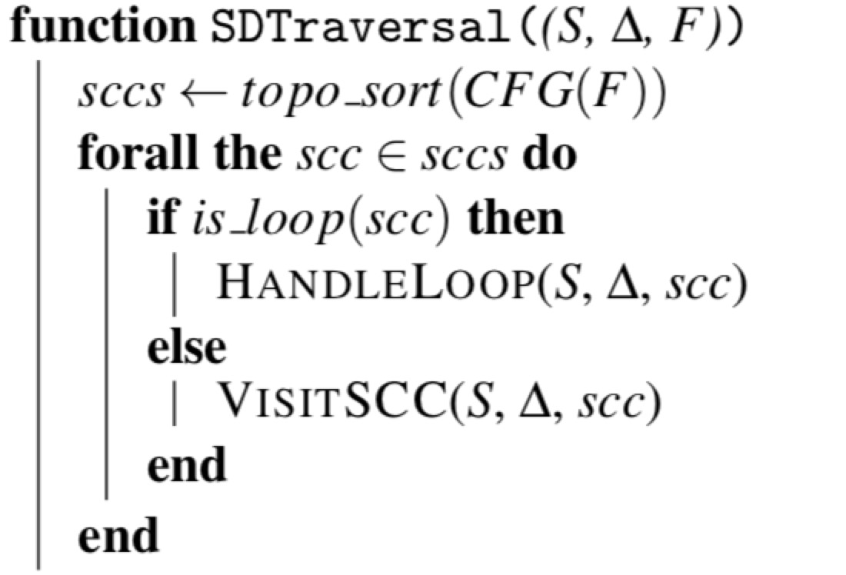
核心遍历算法SDTravesal
为了得到有序的SCC

Slide 10
我们使用的detector
Tainted Loop Bound Detector (TLBD)
Global Variable Race Detector (GVRD)
Tainted Pointer Dereference Detector (TPDD)
Tainted Loop Bound Detector (TLBD)
Integer Overflow Detector(IOD)

Slide 11
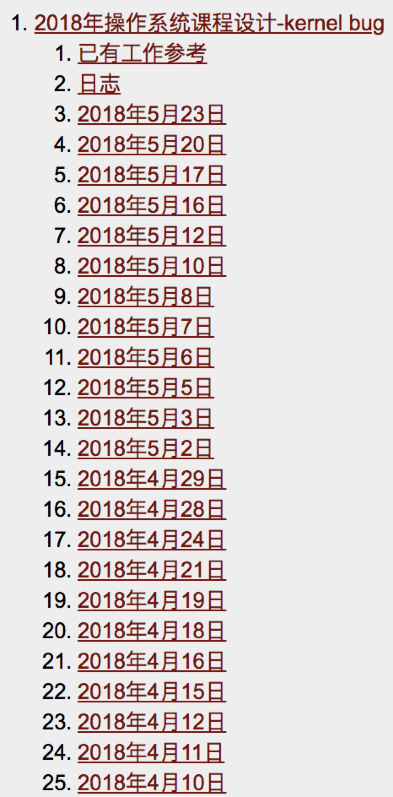
我们的工作
Wiki上比较详细地记录了工作情况

Slide 12
进一步改进
一、建立模块化
二、降低pointer的误报率
三、增加detector

Slide 13
成果展示

Slide 14
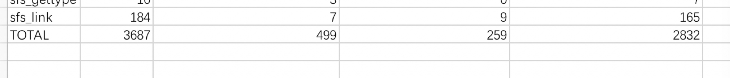

Slide 15
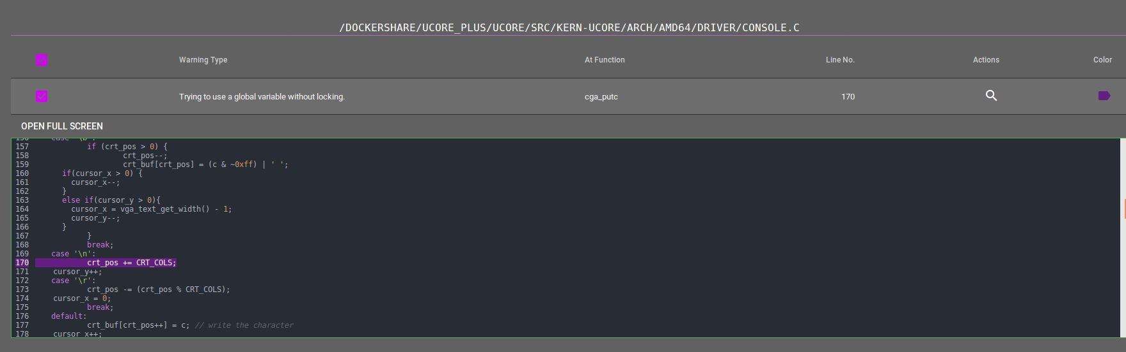

Slide 16
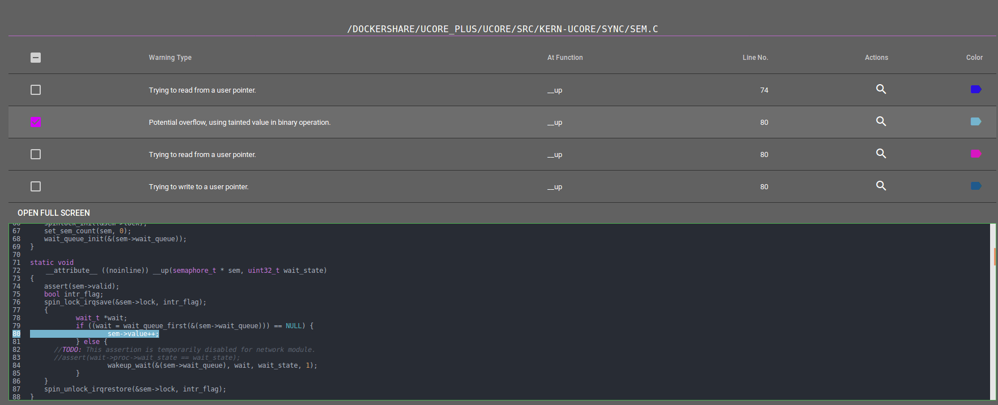

Slide 17
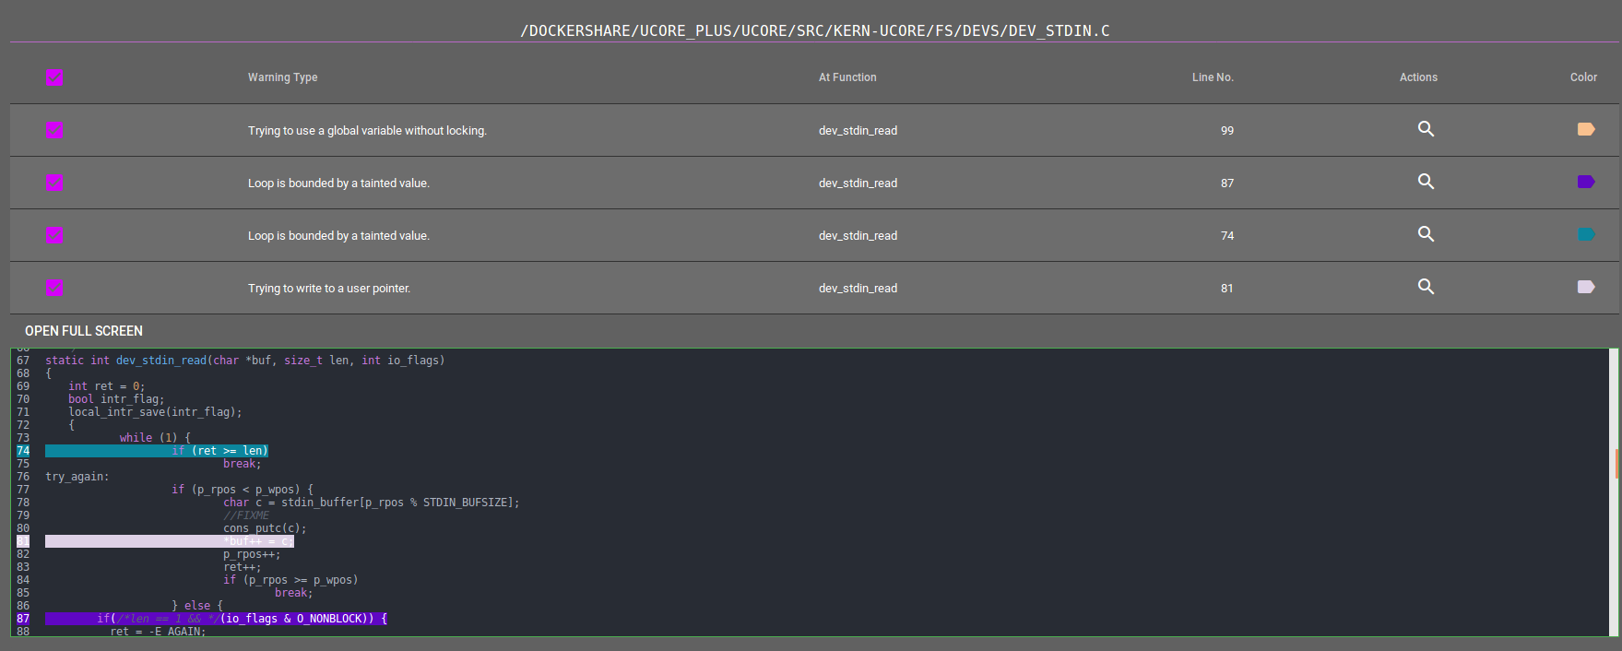

Slide 18
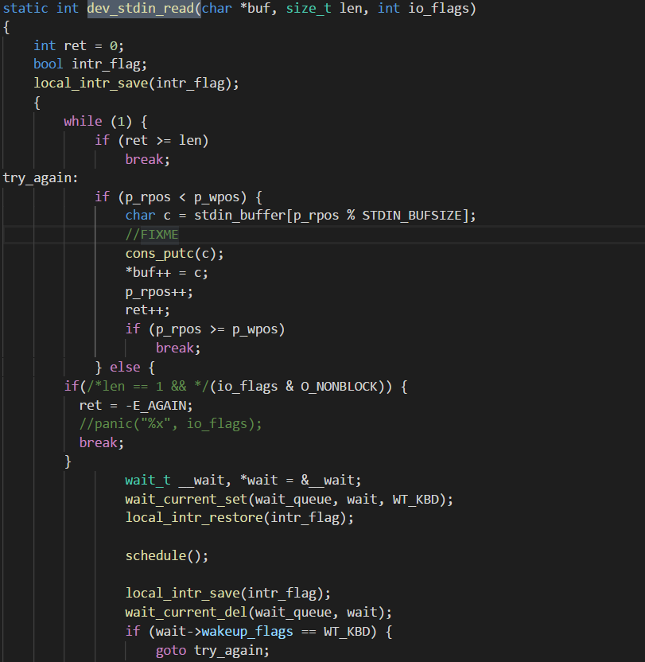

Slide 19
沈俊贤：论文阅读以及代码分析;llvm的学习;完成llvm的build;完成driver_linker的修改;完成ParseHeaders的修改;完成EntryPointIdentifier的修改;核对验证找出来的warnings
刘攀：论文阅读以及代码分析;llvm的学习;ucore_plus的分析，修改部分makefile;完成llvm的build;完成SoundyAnalysisRunner的修改;完成可视化工作;核对验证找出来的warnings

Slide 20
THANKS

