Slide 1
CGP2004M – Graphics & Games Programming
Introducing XNA

Slide 2

About ...
Olivier Szymanezyk
B.Sc. Games Computing
M.Sc. Advanced Games Computing
Ph.D. Computing
Email: oszymanezyk@lincoln.ac.uk
Blog: http://games.lincoln.ac.uk
Will introduce XNA for the first weeks. Dr. John Murray will take over unit upon his return.

Slide 3
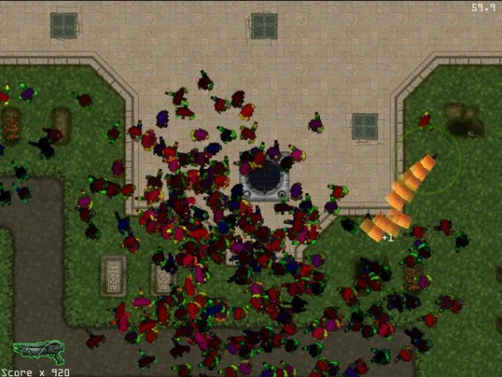
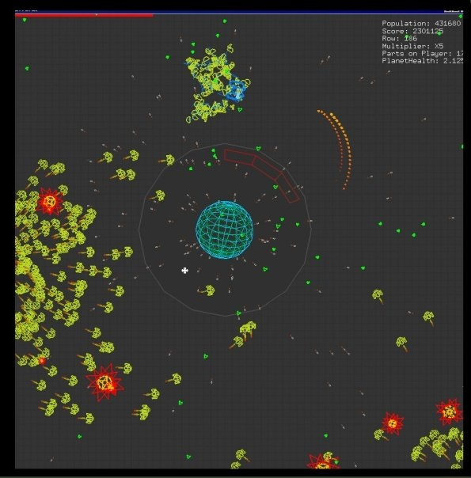
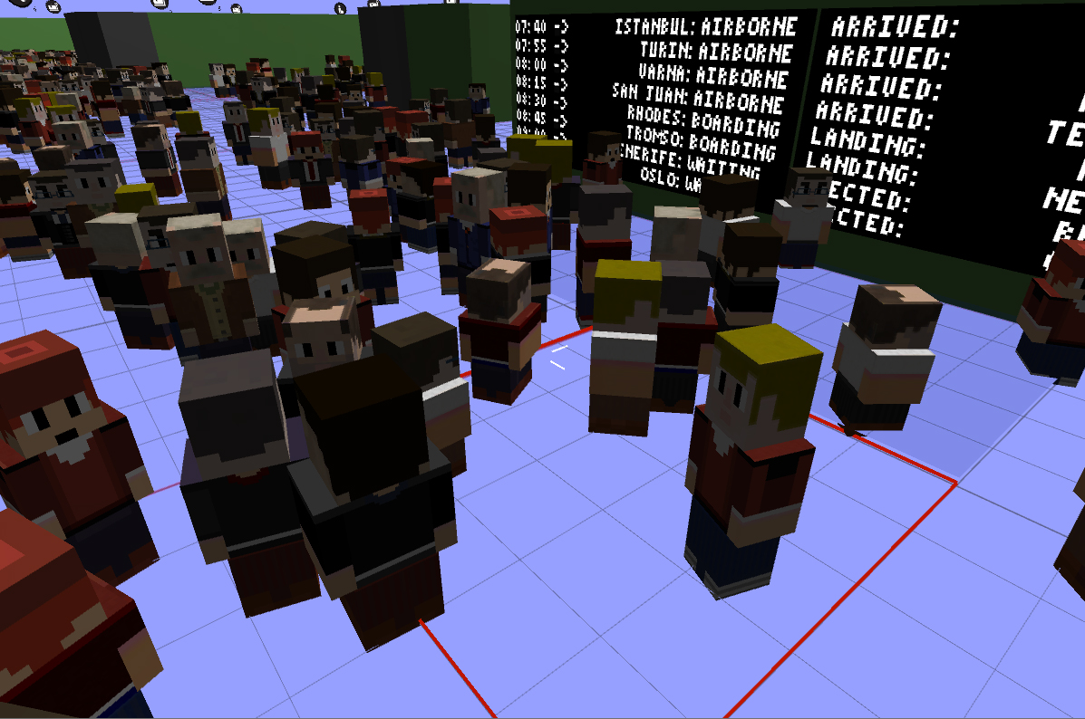

Slide 4
Outline
What we are going to achieve:
Next three weeks looking at XNA
Overview of XNA as a development framework
A look at the foundation of XNA
MS Game Studio
Programming
Differences between PC development and Console Development
Controller input
Creating basic elements, 2D and 3D
Game properties – Collision detection, movement
Audio for games

Slide 5

Set of tools to facilitate video game development
The XNA Framework is based on the .NET Framework 2.0:
It contains an extensive set of class libraries
Specific to Windows environments
It tries to promote code reuse across target platforms
It also includes a version of the Common Language Runtime
optimized for gaming use on Windows/Xbox 360.
XNA games are written for this runtime
XNA games will run on any platform supporting the XNA framework
with minimal or no modification.
Class libraries specific to game development
Written using C#
Notes:
What is the .NET FrameWork
The .NET Framework (pronounced dot net) is a software framework developed by Microsoft that runs primarily on Microsoft Windows. It includes a large library and provides language interoperability (each language can use code written in other languages) across several programming languages. Programs written for the .NET Framework execute in a software environment (as contrasted to hardware environment), known as theCommon Language Runtime (CLR), an application virtual machine that provides services such as security, memory management, and exception handling. The class library and the CLR together constitute the .NET Framework.
What is the CLR
The Common Language Runtime (CLR) is an Execution Environment . It works as a layer between Operating Systems and the applications written in .Net languages that conforms to the Common Language Specification (CLS). The main function of Common Language Runtime (CLR) is to convert the Managed Code into native code and then execute the Program. The Managed Code compiled only when it needed, that is it converts the appropriate instructions when each function is called . The Common Language Runtime (CLR) 's Just In Time (JIT) compilation converts Intermediate Language (MSIL) to native code on demand at application run time.
During the execution of the program ,the Common Language Runtime (CLR) manages memory, Thread execution, Garbage Collection (GC) , Exception Handling, Common Type System (CTS), code safety verifications, and other system services. The CLR ( Common Language Runtime ) defines the Common Type System (CTS), which is a standard type system used by all .Net languages . That means all .NET programming languages uses the same representation for common Data Types , so Common Language Runtime (CLR) is a language-independent runtime environment . The Common Language Runtime (CLR) environment is also referred to as a managed environment, because during the execution of a program it also controls the interaction with the Operating System. In the coming section you can see what are the main functions of Common Language Runtime (CLR).

Slide 6
The Framework
It encapsulates low-level technological details involved in coding a game
Makes sure the framework itself handles differences between platforms
Thereby allowing game developers to focus more on the content and gaming experience.
The XNA framework can integrate with tools to aid in content creation.

Slide 7
XNA Game Studio Express
Game Studio is an IDE just like VS
However, it contains a series of libraries
These are for creating 2D and 3D computer games
Uses C# as the primary programming language
Integrated with Visual Studio C# Express
Games can run under Windows or on Xbox 360
It is possible to create professional games using this toolkit
Game examples: http://catalog.xna.com/en-US/gamescatalog.aspx

Slide 8


Slide 9
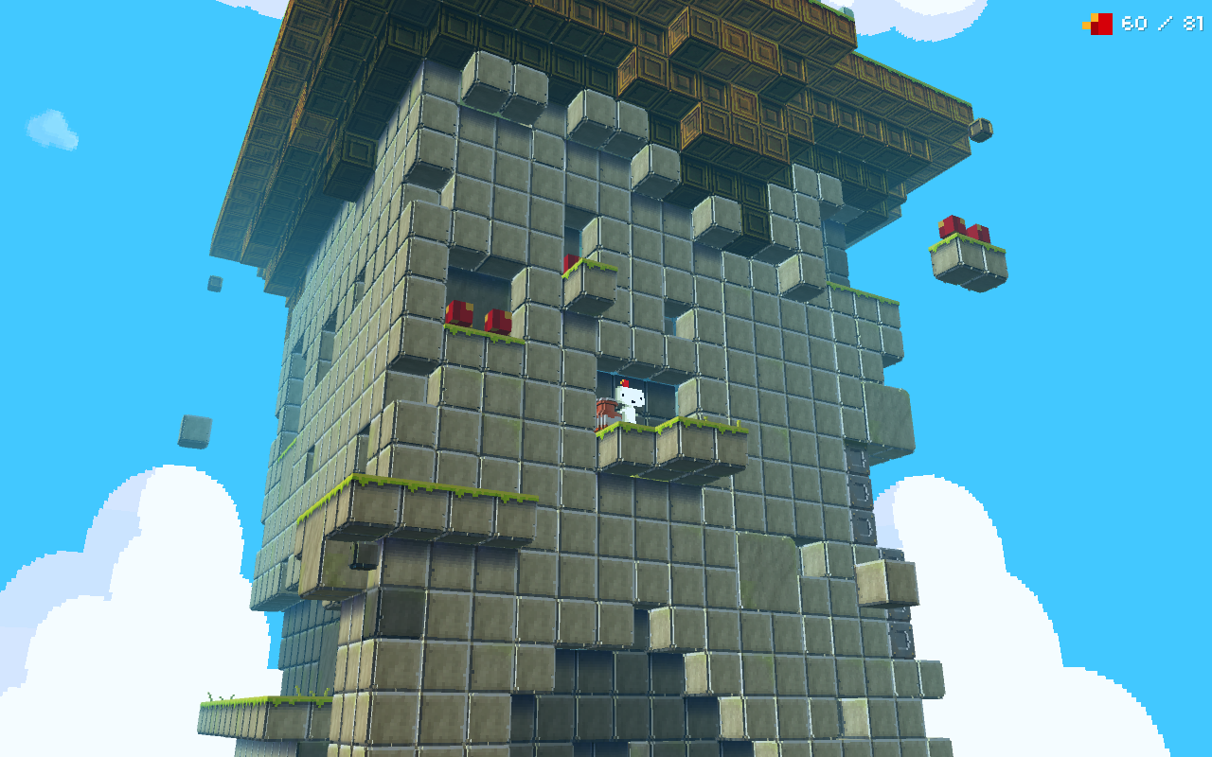

Slide 10

XNA Features
XNA features:
2D & 3D graphics support
Access to a High level shading language
Pixel and vertex shading
Audio support
XACT cross-platform audio tool
Controller and keyboard input
Xbox 360 controller / Kinekt
Game save storage
Networking
Packing and Distribution Tools

Slide 11
Using C#
Games developed for XNA use C#
Anyone know the history?
Language features
Unified object system
Everything type is an object (This includes primitives (e.g. int, double) inherit from a single root object type )
Single inheritance
Just like java, but unlike ...
C++
Interfaces
Specify methods & interfaces, but no implementation
Structs
Like Abstract Data Type (ADT) in Java
Garbage collection
Notes:
Difference between Struct and Class:
http://msdn.microsoft.com/en-us/library/aa664471(v=vs.71).aspx
Structs differ from classes in several important ways:
Structs are value types (Section 11.3.1).
All struct types implicitly inherit from the class System.ValueType (Section 11.3.2).
Assignment to a variable of a struct type creates a copy of the value being assigned (Section 11.3.3).
The default value of a struct is the value produced by setting all value type fields to their default value and all reference type fields to null (Section 11.3.4).
Boxing and unboxing operations are used to convert between a struct type and object (Section 11.3.5).
The meaning of this is different for structs (Section 11.3.6).
Instance field declarations for a struct are not permitted to include variable initializers (Section 11.3.7).
A struct is not permitted to declare a parameterless instance constructor (Section 11.3.8).
A struct is not permitted to declare a destructor (Section 11.3.9).

Slide 12
XNA GSE Architecture
You write your game in C#
Using features in XNA Framework
Runs on top of common language runtime
Game Code (C#) and Content
You provide
Provided for you
XNA Framework
Common Language Runtime (CLR)
Windows API’s DirectX
Notes:
GSE (Game Studio Express)

Slide 13
Using C#
Creating a simple program – Hello World!
class Hello
{
static void Main()
{
System.Console.WriteLine(“Hello, World!”);
}
}
Create a new object type (class) called Hello.
It contains a single method - Main.
Main contains one line, which writes “Hello, World!” on the display.
The method that performs this action is called WriteLine.
The WriteLine method belongs to the System.Console object.
The keyword static makes the Main a class method, as opposed to an instance method.
.NET Framework Class Library
http://msdn.microsoft.com/en-us/library/gg145045.aspx

Slide 14
Using C#
Reading Input from the user
public class ConsoleInput
{
static void Main( String[] args)
{
string user_input;
System.Console.WriteLine(“What is your name? ”);
user_input = System.Console.ReadLine();
}
}
There are three possible ways to read input from the console in C#
ReadLine
Read a line of input into a string
ReadKey
Read the next key pressed into ConsoleKeyInfo instance
Provides access to whether ctrl, alt, shift were pressed
Read
Read a line of input, giving successive characters each time you call Read

Slide 15
XNA Game Studio Template
When you create an XNA GSE game project in Visual C# Express
You are given a framework template
Can fill-in this template to create your own game
Creates a class (Game1) that includes
Constructor
Initialization
Initialize(), LoadContent()
Update
Update game state every clock tick
Draw
Create display every clock tick
MSDN XNA Game Studio 4.0 Environment Documentation Available at :
http://msdn.microsoft.com/en-us/library/bb200104.aspx
Unofficial XNA Wiki: http://www.xnawiki.com/

Slide 16
XNA Game Initialisation
Create new Game1
Call to constructor, Game1()
Game1.run()
Initializes game, then,
Runs the main game loop & processes events
Initialization phase of run(),
The following methods are called on Game1
Initialize()
call Initialize() on parent class
Initialize your game state
Create player object, create enemy objects, create object to hold main game state, etc.
LoadContent()
Method used to load textures, create SpriteBatches

Slide 17
XNA Main Game Loop
Time elapsed between each clock tick:
If we set it as fixed:
1/60th of a second (16.6667 milliseconds per tick)
myGame.IsFixedTimeStep = true
The default value
If we set it up as Variable:
Adjusts based on the time required to perform previous tick
myGame.IsFixedTimeStep = false
Each clock tick
Run() calls Tick()
Tick() calls Update() then Draw()
You supply Update() and Draw()

Slide 18
XNA Tick Loop
Update()
Update the state of all objects
Receive input, move player around
Compute opponent AI, move opponent objects
Collision detection & consequences
Detect end-of-game or end-of-level condition
Basically ANYTHING to do with the game model
Draw()
Re-create the on-screen scene using the up-to-date positions of objects
Advice
Avoid stuffing your entire game into the definition of these two methods
Methods become too big!
Have these methods call out to your player object, opponent objects, game objects etc.

Slide 19

Let’s do something…
So, we have our game application framework
But it doesn’t actually do anything at the minute
So, what about drawing an object or a sprite to the screen…
We do with the creation of SpriteBatches…

Slide 20
Getting a 2D image on the screen
LoadContent()
Create a Texture
A bitmap image. Load it into the Content (Right click -> add)
Create a SpriteBatch
Collects all textures being drawn to screen
Draw()
Begin the SpriteBatch
Draw texture
Draw() is defined on a SpriteBatch
Adds texture to the SpriteBatch
End the SpriteBatch
Causes textures in SpriteBatch to be drawn to screen

Slide 21
XNA Code
First we define some variables:
// Our own variables
Texture2D myImage;
Vector2 position;
myImage is the Texture container for the image
position is a 2D vector holding the x,y co-ordinate of the image

Slide 22
XNA Code
We now need to load our image
and place it inside our ‘myImage’ variable
myImage = Content.Load<Texture2D>(“smileFace");
position = new Vector2(100, 100);
Content.Load tells the program that we want to load some content
and that the content we wish to load is a 2D texture
position we set to some x,y pixel position

Slide 23
XNA Code
In the Draw() method, every time this method is called something will be draw on the screen.
spriteBatch.Begin();
spriteBatch.Draw(myImage, position, Color.White);
spriteBatch.End();

Slide 24
Questions?

