Slide 1
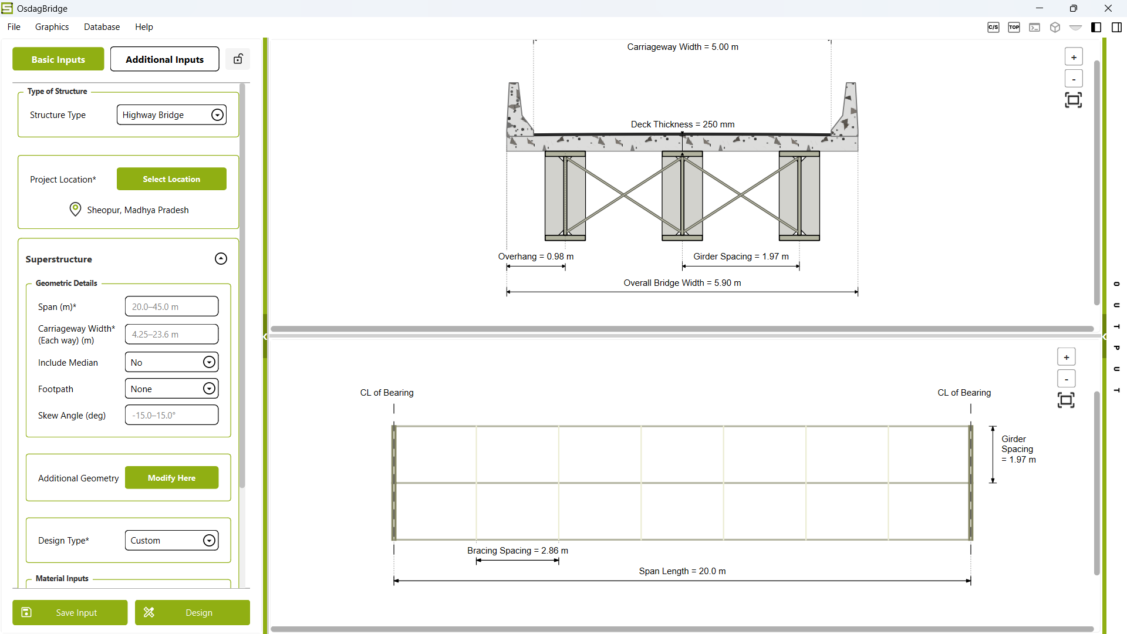
Zoom In
Zoom Out
Fit/Reset View

