Slide 1
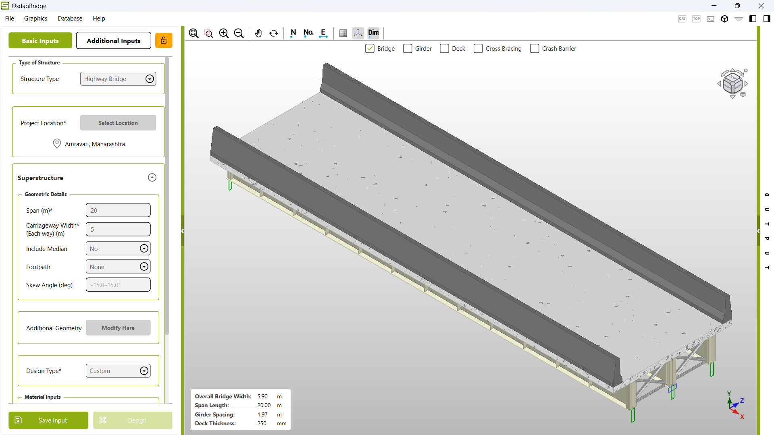
Use the lock icon to lock or unlock the input fields for editing

