Slide 1
An Introduction to Rust
Lorenzo Tucci and Michał Osadnik

Slide 2
Fast but hard
Slow but easy
Memory is allocated/deallocated manually
Variable types are statically assigned
A lot of (critical) memory and concurrency bugs can arise, undefined behaviors
Not many abstractions, dense syntax
Extremely fast
Low memory footprint
Memory is automatically managed
Types may be dynamically assigned
Memory safe
A lot of convenient abstractions and simple syntax
Generally order of magnitudes slower
High memory overhead
Examples: C++, C
Examples: Python, JavaScript, Ruby, etc.

Slide 3
Why Rust?
It's a perfect fit to write cryptographic implementations.
Extremely fast, but safe
Memory safety is enforced by the compiler, no undefined behaviors
Makes it easy to do parallel computation
Good developer ecosystem
Package manager is pleasant to use
Libraries and documentations are rich
Compiler tells how us to fix things
High-level language features
Code can be written elegantly using functional-style features
Notes:
Good to remember
Don’t paste text direct from other documents onto the PowerPoint template, as this will render incorrect formatting. Before pasting any text onto this template, use for example Notepad for removing the source text formatting.
To configure the display language:
Within any Office application, select File > Options > Language.
Under Office display Language, make sure the display language you want Office to use is listed.
Select the language you want, and then select Set as Preferred.
How to insert header & footer
1. Choose "Insert / Header & Footer" to change footer text.
2. In the panel you can change the footer, page number and date options.
How to add images
Click icon to add image. Or, you can choose one related to your content from a selection of photos available in Material Bank.
https://materialbank.aalto.fi/l/w2wWj_hmTJGx
***
Hyvä muistaa
Älä kopioi tekstiä suoraan muista sovelluksista tai dokumenteista, etteivät pohjan valmiit muotoiluasetukset muuttuisi. Käytä esimerkiksi Notepadia poistaaksesi tekstistä valmiit muotoiluasetukset.
Näyttökielen määrittäminen:
Valitse missä tahansa Office-sovelluksessa Tiedosto > Asetukset > Kieli.
Varmista Office-näytön kieli -kohdassa, että näyttökieli, jota haluat Officen käyttävän, on lueteltu.
Valitse haluamasi kieli ja valitse sitten Aseta ensisijaiseksi.
Näin lisäät ylä- tai alatunnisteet
1. Valitse “Lisää / Ylä- ja alatunniste”
2. Valintaikkunassa voit muuttaa ylä- ja alatunnisteiden, sivunumeroinnin ja päivämäärän asetuksia.
Uuden sivun luominen
Valitse valikosta ”Aloitus / Uusi dia” jolloin saat näkyviin listan valmiiksi määritellyistä mallipohjista.
Voit myös muuttaa olemassa olevan sivun ilmettä valikosta ”Aloitus / Asettelu”, jolloin saat näkyviin listan mallipohjan sivuista.
Kuvien lisääminen
Lisää kuva klikkaamalla ikonia. Vaihtoehtoisesti voit valita aiheeseen sopivan kuvan Materiaalipankissa olevista ehdotuksista.
https://materialbank.aalto.fi/l/w2wWj_hmTJGx

Slide 4
Struct and methods
Struct: a way to package together values into a single object
struct Zq {
value: u64,
modulus: u64
}

Slide 5
Struct and methods
Struct: a way to package together values into a single object
struct Zq {
value: u64,
modulus: u64
}
Method: a function associated with some type (can be Struct, Enum, Trait, etc.)
impl Zq {
fn add(&self, other: Zq) -> Zq {
(self.value + other.value) % self.modulus
}
}

Slide 6
Generic Data Types
Define generic parameters can be defined in structs and functions
struct Zq<T, const M> {
value: T,
}

Slide 7
Generic Data Types
Define generic parameters can be defined in structs and functions
struct Zq<T, const M> {
value: T,
}
When implementing for a generic struct or function, you can use a specific type or a generic
impl Zq<T, const M> {
fn add<T, M>(&self, other: Zq<T, M>) -> Zq<T, M> {
(self.value + other.value) % self.modulus
}
}

Slide 8
Traits: shared behavior
Traits can define shared behavior that may be implemented by different types.
This is the std::ops::Add trait:
pub trait Add {
fn add(self, rhs: Self) -> Self;
}

Slide 9
Traits: shared behavior
Traits can define shared behavior that may be implemented by different types.
This is the std::ops::Add trait:
pub trait Add {
fn add(self, rhs: Self) -> Self;
}
We can implement it for our types, enabling us to do use the + operator.
impl<T, M> Add for Zq<T, M> {
fn add(self, other: Zq<T, M>) -> Zq<T, M> {
Zq<T, M> {
value: (self.value + other.value) % M,
}
}
}

Slide 10
Trait bounds
Traits can be passed as a bound on generic type.
For example, we can require a generic type that implements addition and modulo (remainder).
fn add<O: Add + Rem>(self, other: O) -> Zq<T, M> {
Zq<T, M> {
value: (self.value + other) % M,
}
}

Slide 11
Trait bounds
Traits can be passed as a bound on generic type.
For example, we can require a generic type that implements addition and modulo (remainder).
fn add<O: Add + Rem>(self, other: O) -> Zq<T, M> {
Zq<T, M> {
value: (self.value + other) % M,
}
}
Or we might return a type implementing some trait.
fn do_stuff(self, other: O) -> impl Add + Red {
// do stuff
}

Slide 12
Why should we care?
Our code can become much more succint, pleasant to use and more correct.
let z: u64 = (a * b) % Q) + c % Q); // ops on primitive types
let z: Zq<u64> = c.add(b.mul(a)); // no traits and generics
let z = a * b + c; // final version

Slide 13
Why should we care?
Our code can become much more succint, pleasant to use and more correct.
let z: u64 = (a * b) % Q) + c % Q); // ops on primitive types
let z: Zq<u64> = c.add(b.mul(a)); // no traits and generics
let z = a * b + c; // final version
trait Encrypt<P, C, ...> {
fn encrypt(P) -> C;
fn decrypt(C) -> P;
fn keygen(...) -> ...
}
Even more importantly, we can write modular code that can be easily reused and exposed.
Cryptographic protocols often requires generic schemes that we can define (or implement).

Slide 14
Why should we care?
Our code can become much more succint, pleasant to use and more correct.
let z: u64 = (a * b) % Q) + c % Q); // ops on primitive types
let z: Zq<u64> = c.add(b.mul(a)); // no traits and generics
let z = a * b + c; // final version
trait Encrypt<P, C, ...> {
fn encrypt(P) -> C;
fn decrypt(C) -> P;
fn keygen(...) -> ...
}
Even more importantly, we can write modular code that can be easily reused and exposed.
Cryptographic protocols often requires generic schemes that we can define (or implement).
struct Protocol<E: Encrypt, ...> {
enc: E,
cmt: C
}
impl Protocol<E: Encrypt> {
fn encrypt_and_commit(msg) -> {
let ctx = enc.encrypt(msg);
...
}
}

Slide 15
Stack vs heap
Stack: fast but small, fixed size (~2-8 Mb)
Data is pushed/popped on the stack with function calls
All data must have know fixed size
Heap: on-demand allocation of dynamic memory
Data is indexed by a pointer
Slower to allocate and access
Infamous memory bugs can happen here (deallocating memory in use, multiple threads using same memory, deallocating twice, etc.)

Slide 16
Vec<U> vs Array vs Slice
Array: fixed length, used for small number of primitive types
let mut a: u6[Zq; N]; // allocate Zq elements on the stack
Vec: dynamic length, allocated on the heap. Can be expanded
let mut a: Vec<Zq>::new(); // initialise Vec on the heap, can be grown or shrank
Slice: a reference to a sequence of elements of an array or collection.
let slice = &a[0...N/2]; // this is just a reference to a Vec, Array or similar

Slide 17
Ownership: the rules
Each value in Rust has an owner.
There can only be one owner at a time.
When the owner goes out of scope, the value will be dropped.

Slide 18
Ownership: the rules
Each value in Rust has an owner.
There can only be one owner at a time.
When the owner goes out of scope, the value will be dropped.
Example:
{ // v1 is not valid before this block
let v1: Vec<Zq> = sample_uniform_vec(8); // v1 is now in scope
let v2 = v1;
let v3 = eltwise_mod_q(v1, v2);
} // v2 is now out of scope, can't be used

Slide 19
Ownership: the rules
Each value in Rust has an owner.
There can only be one owner at a time.
When the owner goes out of scope, the value will be dropped.
Example:
{ // v1 is not valid before this block
let v1: Vec<Zq> = sample_uniform_vec(8); // v1 is now in scope
let v2 = v1; // ownership is "moved" to s2
let v3 = eltwise_mod_q(v1, v2); // This fails!
} // v2 is now out of scope, can't be used

Slide 20
Ownership: move vs copy
Stack-only data is always copied
All primitive fixed size types like integers, floats, bools and their combination
let y = 5;
let x = y; // x copies the value of y, not a reference
println!("{x}, {y}");

Slide 21
Ownership: move vs copy
Stack-only data is always copied*
All primitive fixed size types like integers, floats, bools and their combination
let y = 5;
let x = y; // x copies the value of y, not a reference
println!("{x}, {y}");
Heap data can be cloned
let v1: Vec<Zq> = sample_uniform_vec(8);​
let v2 = v1.clone(); // s2 "clones" the current value of s1, no ownership changes ​
let veltwise_mod_q(v1, v2);

Slide 22
Ownership and functions
Passing variable to a function will move or copy, just as an assignment does.
You can transfer the ownership by returning the value.
fn eltwise_mod_q(z1: Vec<Zq>, z2: Vec<Zq>) -> Vec<Zq> { // z1, z2 go in scope
// do element wise mod q
z3
} // z1, z2 go out of scope and memory is freed

Slide 23
Ownership and functions
Passing variable to a function will move or copy, just as an assignment does.
You can transfer the ownership by returning the value.
fn eltwise_mod_q(z1: Vec<Zq>, z2: Vec<Zq>) -> Vec<Zq> { // z1, z2 go in scope
// do element wise mod q
z3
} // z1, z2 go out of scope and memory is freed
fn eltwise_mod_q(z1: Vec<Zq>, z2: Vec<Zq>) -> Vec<Zq> {
// do element wise mod q
z1
} // z1 is returned, ownership is moved to the caller

Slide 24
References and borrowing
At any point of time, you can either have one mutable reference or any number of immutable references.
References are always valid (they are "borrowing" from owners, enforced by compiler).
fn eltwise_mod_q(z1: &Vec<Zq>, z2: &Vec<Zq>) -> Vec<Zq> {
// do dot mod q
z3
} // z1, z2 go out of the scope. Memory is not freed, the borrow ends
fn eltwise_mod_q(&mut z1: Vec<Zq>, &z2: Vec<Zq>) {
// do dot mod q
} // z1 is modifed, and the borrow ends.

Slide 25
Lifetimes
In order to check validity of the references, the compiler needs to "think" in terms of lifetimes.
fn main () {
let r;
{
let x = 5;
r = &x;
}
println!("r: {r}");
}
'b
'a

Slide 26
Lifetimes
In order to check validity of the references, the compiler needs to "think" in terms of lifetimes.
fn main () {
let r;
{
let x = 5;
r = &x;
}
println!("r: {r}");
}
fn main () {
let r;
let x = 5;
let r = &x;
println!("r: {r}");
}
'b
'b
'a
'a
A reference is only valid if it lives as long as the data being referenced.
But sometimes, the compiler needs more information to check that all references are valid...

Slide 27
Lifetimes
Rust cannot determine whether the return type was borrowed from 'x' or 'y'.
fn longest(x: &Vec<Zq>, y: &Vec<Zq>) -> &Vec<Zq> {
if x.len() > y.len() { x } else { y }
}

Slide 28
Lifetimes
Rust cannot determine whether the return type was borrowed from 'x' or 'y'.
fn longest(x: &Vec<Zq>, y: &Vec<Zq>) -> &Vec<Zq> {
if x.len() > y.len() { x } else { y }
}
This annotation tells the compiler that the two parameters "live" for some lifetime 'a, which is at least as long as the lifetime of the reference returned.
fn longest<'a>(x: &'a Vec<Zq>, y: &'a Vec<Zq>) -> &'a Vec<Zq>{
if x.len() > y.len() { x } else { y }
}
Lifetimes annotations connect lifetimes parameters with the lifetimes of return values.

Slide 29
Cargo: Rust's package manager
Projects are created with cargo new, run with cargo run.
$ tree . .
├── Cargo.toml
├── README.md
├── benches/
└── bench.rs
└── src/
└── main.rs
└── lib.rs
└── mod1.rs
└── mod2.rs
Cargo.toml defines the dependencies of your project.
You can easily add "crates" (Rust libraries) with cargo add crate_name
Functionality is usually split in "modules" that you can import using
use mod_name::item_name. Equivalent for externally defined crates.
You can also write tests or benchmarks and run cargo test or cargo bench

Slide 30
General programming tips
Search a lot
For Rust, rust.lang.org/book is a good reference
Documentation for crates and standard library
Avoid repetition
Your code gets easier to modify and expand
Pattern matching (matching some case) is useful

Slide 31
General programming tips
Search a lot
For Rust, rust.lang.org/book is a good reference
Documentation for crates and standard library
Avoid repetition
Your code gets easier to modify and expand
Pattern matching (matching some case) is useful
Don't be afraid to prototype
focus on functionality first
refactoring can always come later
Abstract with interfaces and modularize
Should the data be bundled in a struct?
Can I write or use some traits?
Separate interface from implementation

Slide 32
General programming tips
Search a lot
For Rust, rust.lang.org/book is a good reference
Documentation for crates and standard library
Avoid repetition
Your code gets easier to modify and expand
Pattern matching (matching some case) is useful
Don't be afraid to prototype
focus on functionality first
refactoring can always come later
Abstract with interfaces and modularize
Should the data be bundled in a struct?
Can I write or use some traits?
Separate interface from implementation
Clear names and documentation
Good names alone get you far
Look up how to write documentation with cargo doc
Handle errors with Result and Option
Sometimes, things can "fail" or not be found
You can look it up in the Rust book or std docs.

Slide 33
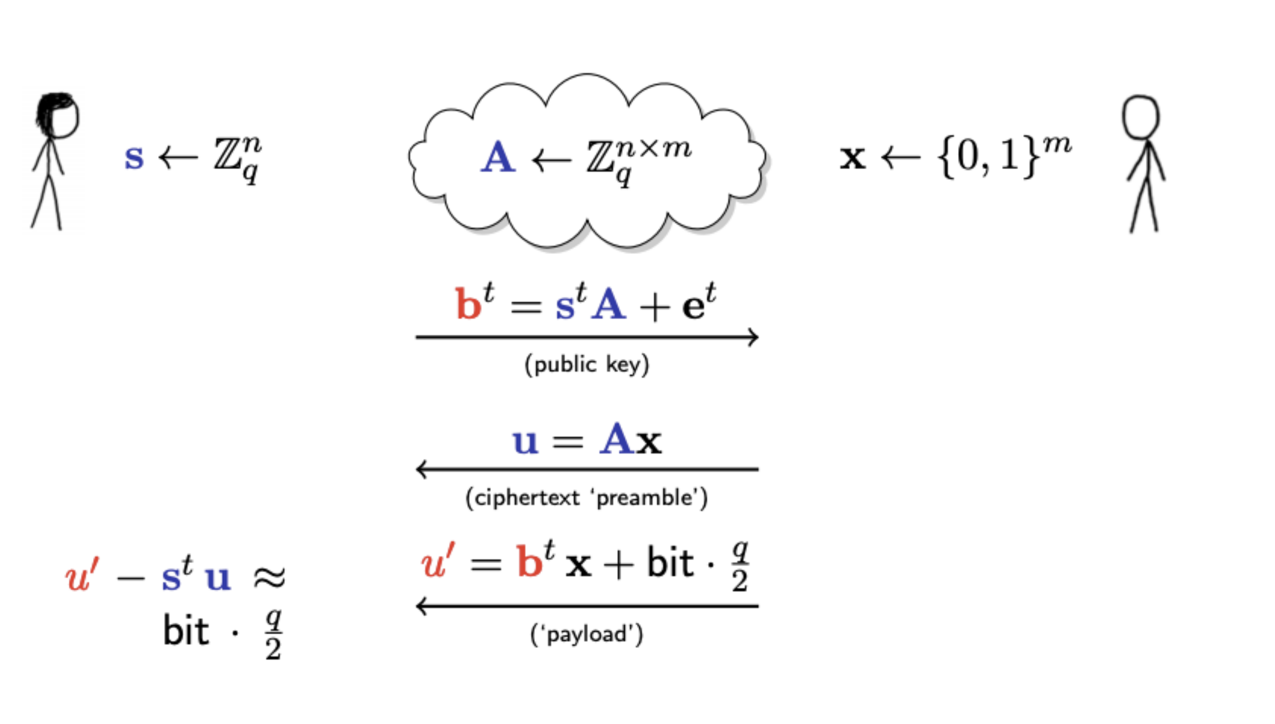
First workshop task: Regev scheme

Slide 34
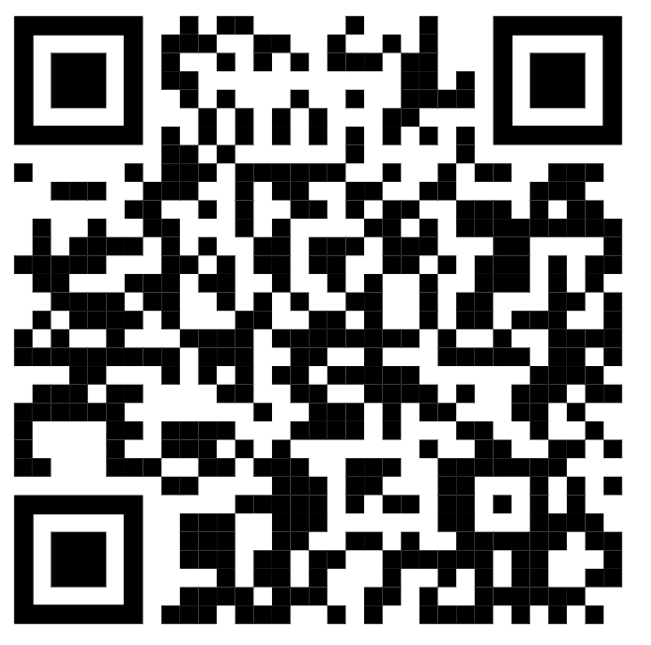
First workshop task: Regev scheme
We prepared an example implementation...
https://github.com/osdnk/crypto-workshop-day-1

Slide 35
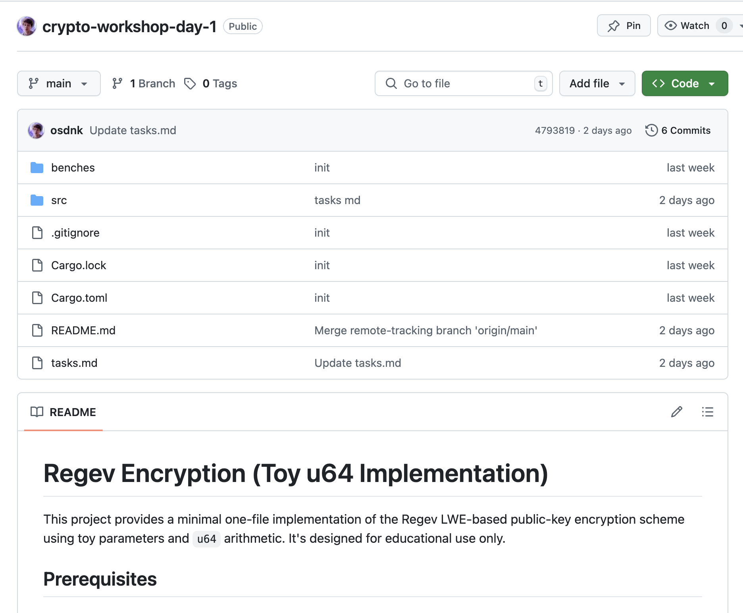
First workshop task: Regev scheme

Slide 36
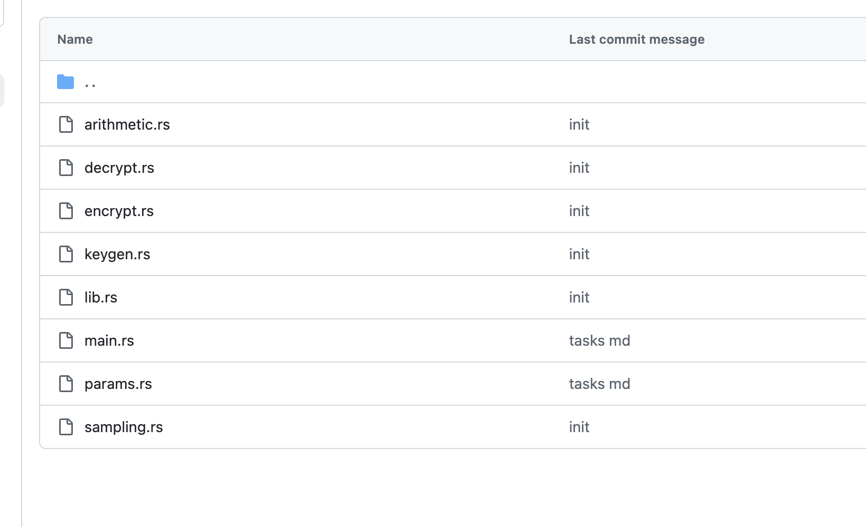
First workshop task: Regev scheme
The implementation is relatively simple, yet following good programming practices.
We have many files (abstraction):

Slide 37
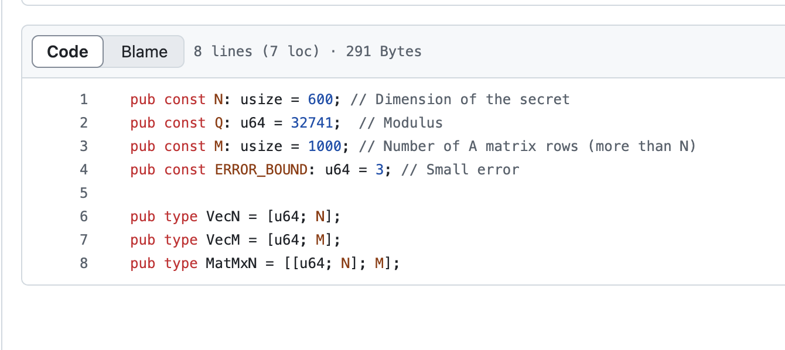
First workshop task: Regev scheme
The implementation is relatively simple, yet following good programming practices.
We have flexible parameters:

Slide 38
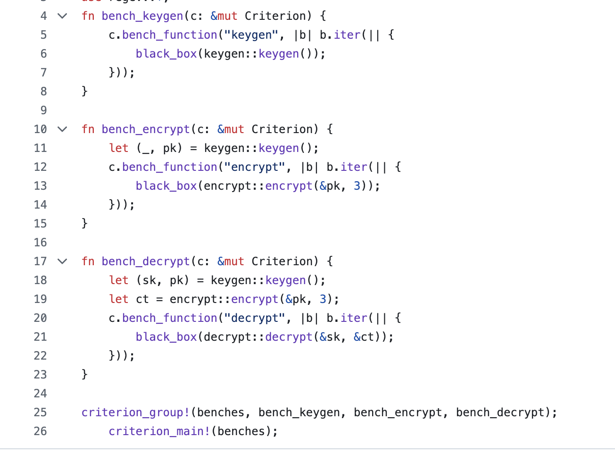
First workshop task: Regev scheme
The implementation is relatively simple, yet following good programming practices.
We have benchmarks:

Slide 39
First workshop task: Regev scheme
The implementation is relatively simple, yet following good programming practices.
We have tests:

Slide 40
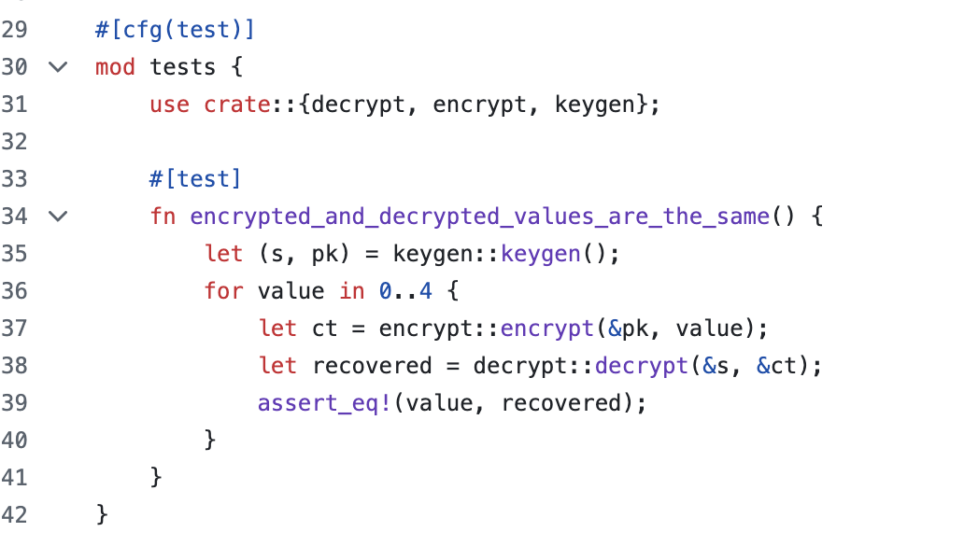
First workshop task: Regev scheme
The implementation is relatively simple, yet following good programming practices.
We have tests a singular test:

Slide 41
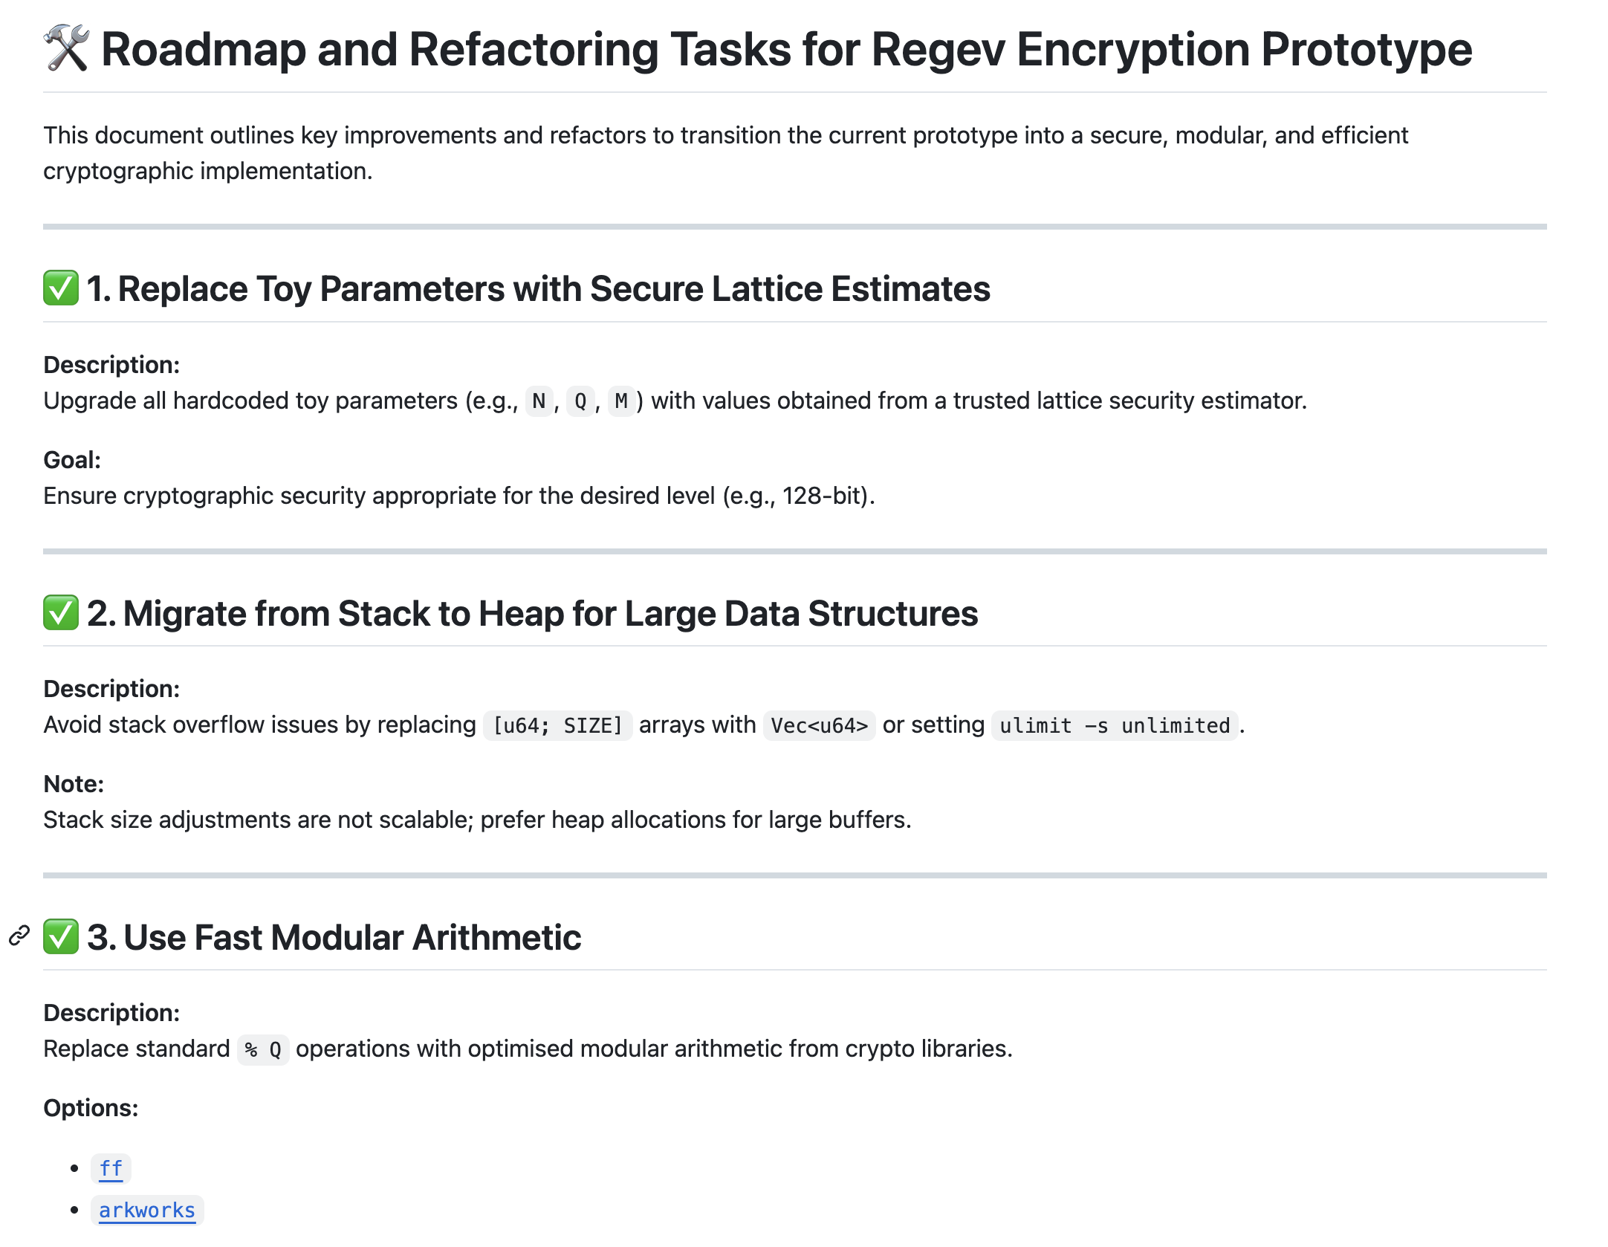
First workshop task: Regev scheme
The implementation is relatively simple, yet following good programming practices
We have many areas to improve!

Slide 42
First workshop task: Regev scheme
Happy coding!
https://github.com/osdnk/crypto-workshop-day-1

