Slide 1
Intel HE Acceleration Library
basic usage and integration with Rust

Slide 2



As we already know…
Lattice-based crypto is cool
Often, many important (and time-sensitive) operations can be re-phrased in the terms of linear algebra, i.e. matrix-vector multiplications over “relatively large” dimensions
For example, yesterday we focused on Regev PKE:
in “standard” lattice-based cryptography, those are operations over $ℤ_{q}$
Another example includes Ajtai commitment:
Notes:
Good to remember
Don’t paste text direct from other documents onto the PowerPoint template, as this will render incorrect formatting. Before pasting any text onto this template, use for example Notepad for removing the source text formatting.
To configure the display language:
Within any Office application, select File > Options > Language.
Under Office display Language, make sure the display language you want Office to use is listed.
Select the language you want, and then select Set as Preferred.
How to insert header & footer
1. Choose "Insert / Header & Footer" to change footer text.
2. In the panel you can change the footer, page number and date options.
How to add images
Click icon to add image. Or, you can choose one related to your content from a selection of photos available in Material Bank.
https://materialbank.aalto.fi/l/w2wWj_hmTJGx
***
Hyvä muistaa
Älä kopioi tekstiä suoraan muista sovelluksista tai dokumenteista, etteivät pohjan valmiit muotoiluasetukset muuttuisi. Käytä esimerkiksi Notepadia poistaaksesi tekstistä valmiit muotoiluasetukset.
Näyttökielen määrittäminen:
Valitse missä tahansa Office-sovelluksessa Tiedosto > Asetukset > Kieli.
Varmista Office-näytön kieli -kohdassa, että näyttökieli, jota haluat Officen käyttävän, on lueteltu.
Valitse haluamasi kieli ja valitse sitten Aseta ensisijaiseksi.
Näin lisäät ylä- tai alatunnisteet
1. Valitse “Lisää / Ylä- ja alatunniste”
2. Valintaikkunassa voit muuttaa ylä- ja alatunnisteiden, sivunumeroinnin ja päivämäärän asetuksia.
Uuden sivun luominen
Valitse valikosta ”Aloitus / Uusi dia” jolloin saat näkyviin listan valmiiksi määritellyistä mallipohjista.
Voit myös muuttaa olemassa olevan sivun ilmettä valikosta ”Aloitus / Asettelu”, jolloin saat näkyviin listan mallipohjan sivuista.
Kuvien lisääminen
Lisää kuva klikkaamalla ikonia. Vaihtoehtoisesti voit valita aiheeseen sopivan kuvan Materiaalipankissa olevista ehdotuksista.
https://materialbank.aalto.fi/l/w2wWj_hmTJGx

Slide 3
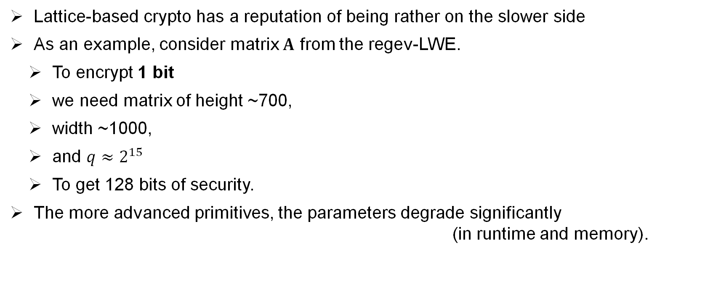
… which has certain practical implications
Lattice-based crypto has a reputation of being rather on the slower side
As an example, consider matrix $A$ from the regev-LWE.
To encrypt 1 bit
we need matrix of height ~700,
width ~1000,
and $q≈2^{15}$
To get 128 bits of security.
The more advanced primitives, the parameters degrade significantly (in runtime and memory).
Reasonable implementation executes in 0.5ms,
which is slower than e.g. RSA for significanly smaller message space.
Notes:
Esityksen saavutettavuus
Powerpoint-pohjan ulkoasussa on pyritty huomioimaan saavutettavuusvaatimukset, mutta jos jaat PowerPoint-esityksesi verkossa, on syytä tarkistaa seuraavat asiat
Nimeä tiedosto selkeästi; tiedostonimi kertoo ytimekkäästi, mistä esityksessä on kysymys, lisäksi otsikoi esitys
Lisää kuviin vaihtoehtoinen teksti (alt-teksti)
Anna linkeille kuvaava, näkyvä teksti
Tarkista lukemisjärjestys
Tarkista helppokäyttöisyys (saavutettavuus)
Käytännön ohjeita toteutukseen löydät osoitteesta https://www.saavutettavasti.fi/saavutettavat-asiakirjat/powerpoint/
ja (eri ohjelmaversioille ja käyttöjärjestelmille) https://support.microsoft.com/fi-fi/office/tee-powerpoint-esityksist%C3%A4-helppok%C3%A4ytt%C3%B6isi%C3%A4-toimintarajoitteisille-k%C3%A4ytt%C3%A4jille-6f7772b2-2f33-4bd2-8ca7-dae3b2b3ef25

Slide 4
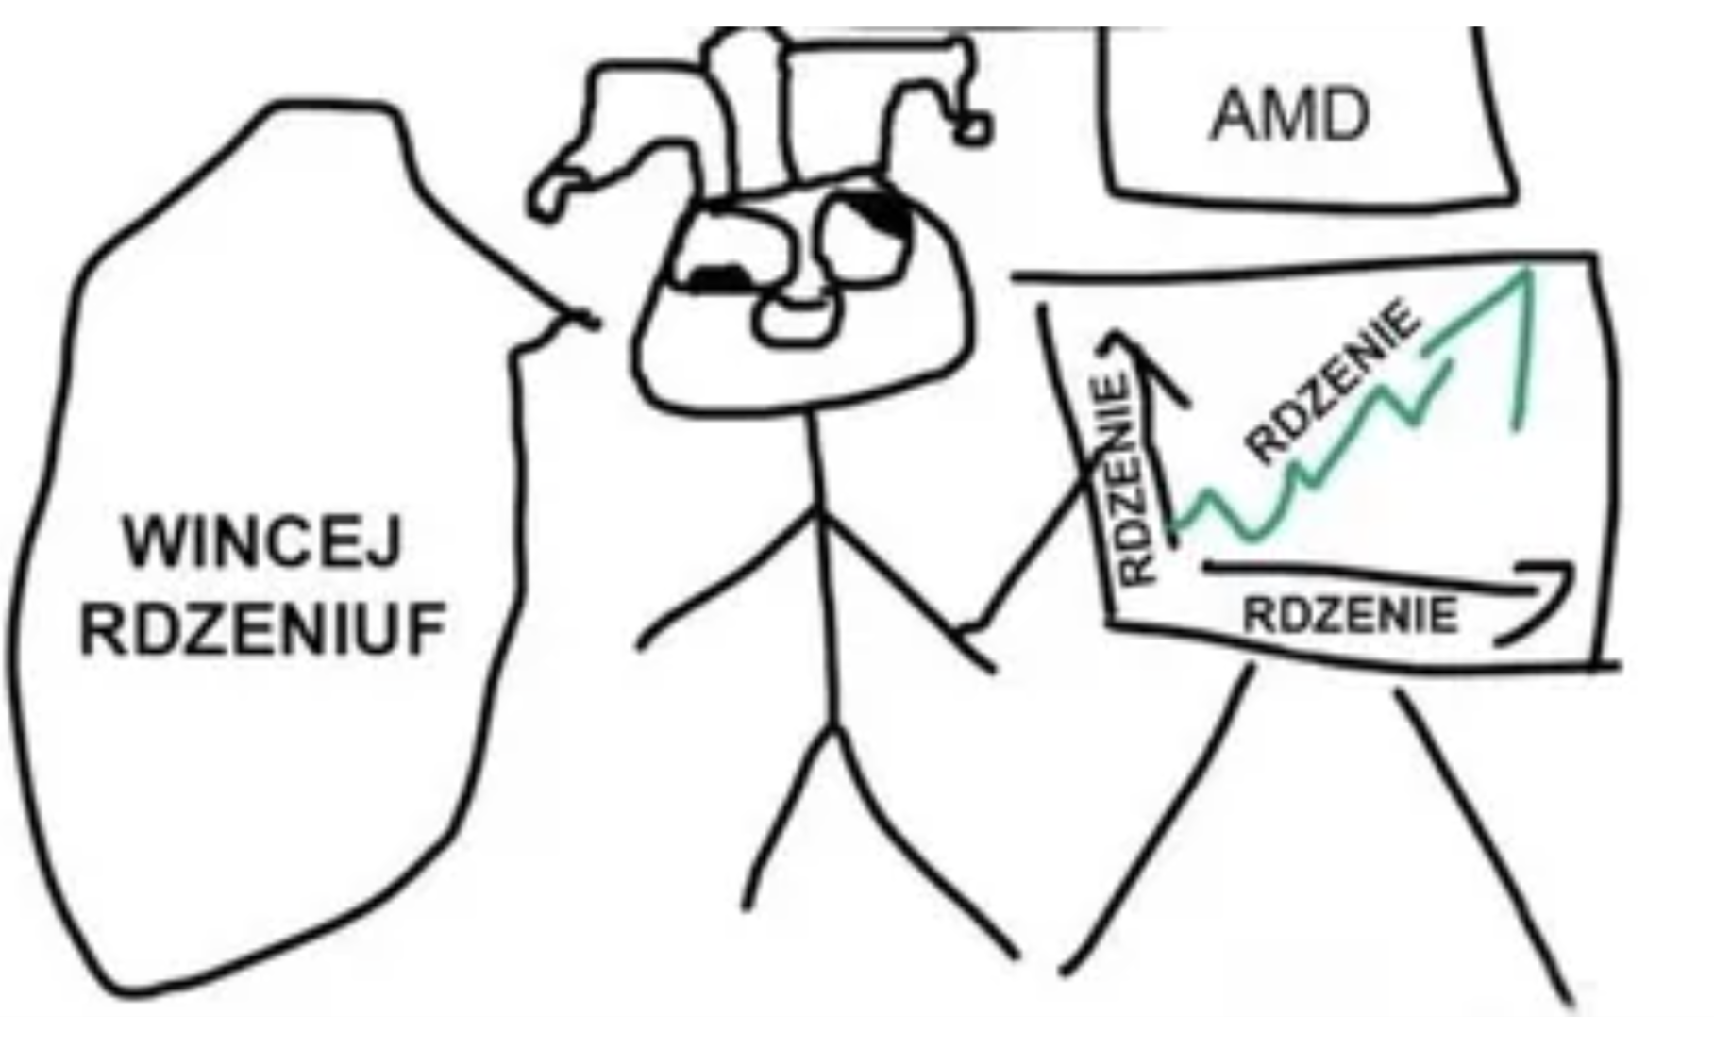
… so we need to speed-up our algorithms
Of course, we may use more CPU cores
triton
CPU CORES
MORE CPU CORES
CPU CORES
CPU CORES

Slide 5
… so we need to speed-up our algorithms
Yet, it makes the research not very sustainable, i.e.
it does not scale and
the comparisons are unfair.
We need to be a bit smarter: many research directions explore making the matrices more structures:
=

Slide 6
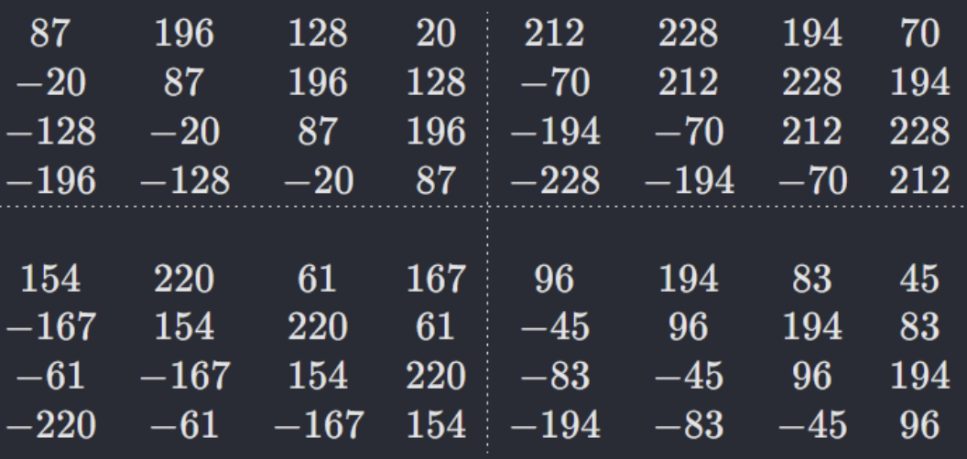
… so we need to speed-up our algorithms
The common approach is to consider “partially circulant” matrices
…and then, the arithmetic can be rephrased as arithmetic over quotient polynomial rings.

Slide 7
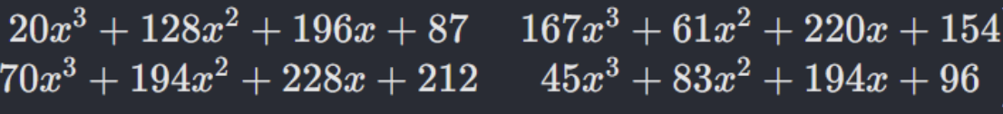
… so we need to speed-up our algorithms
The common approach is to consider “partially circulant” matrices
…and then, the arithmetic can be rephrased as arithmetic over quotient polynomial rings.

Slide 8
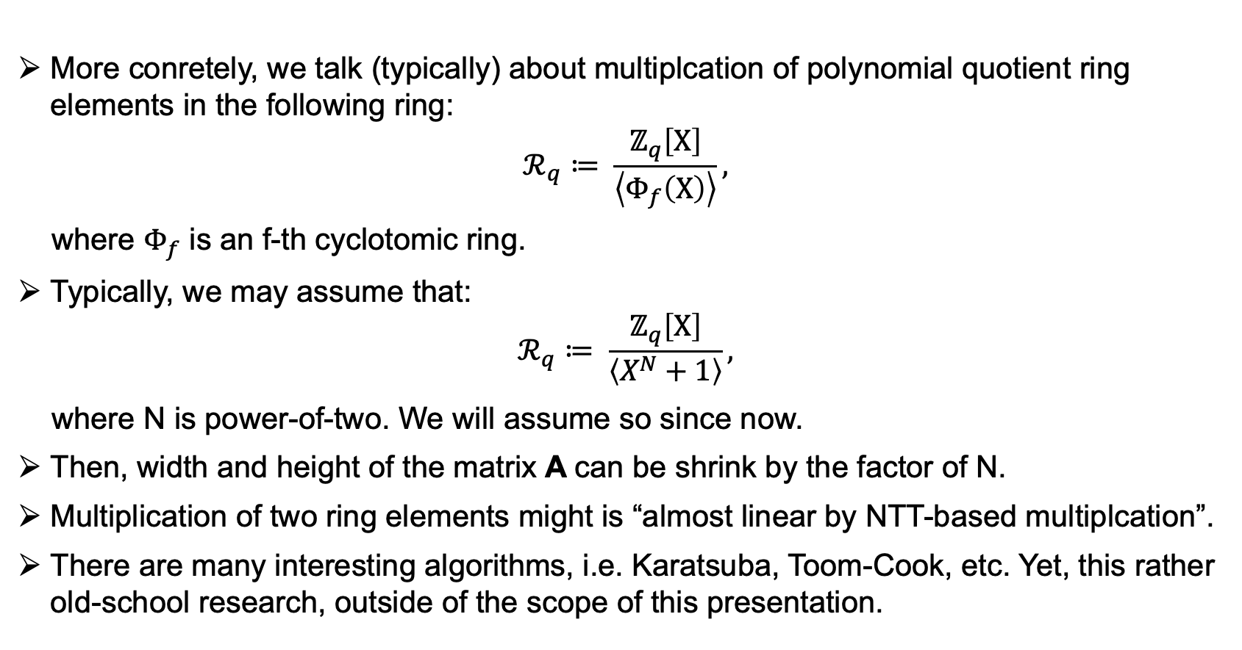
… so we talk about polynomial multiplications
More conretely, we talk (typically) about multiplcation of polynomial quotient ring elements in the following ring:
$$ℛ_{q}≔ \frac{ℤ_{q}\left[X\right]}{\left\langle Φ_{f}\left(X\right)\right\rangle },$$
where $Φ_{f}$ is an f-th cyclotomic ring.
Typically, we may assume that:
$$ℛ_{q}≔ \frac{ℤ_{q}\left[X\right]}{\left\langle X^{N}+1\right\rangle },$$
where N is power-of-two. We will assume so since now.
Then, width and height of the matrix A can be shrink by the factor of N.
Multiplication of two ring elements might is “almost linear by NTT-based multiplcation”.
There are many interesting algorithms, i.e. Karatsuba, Toom-Cook, etc. Yet, this rather old-school research, outside of the scope of this presentation.

Slide 9
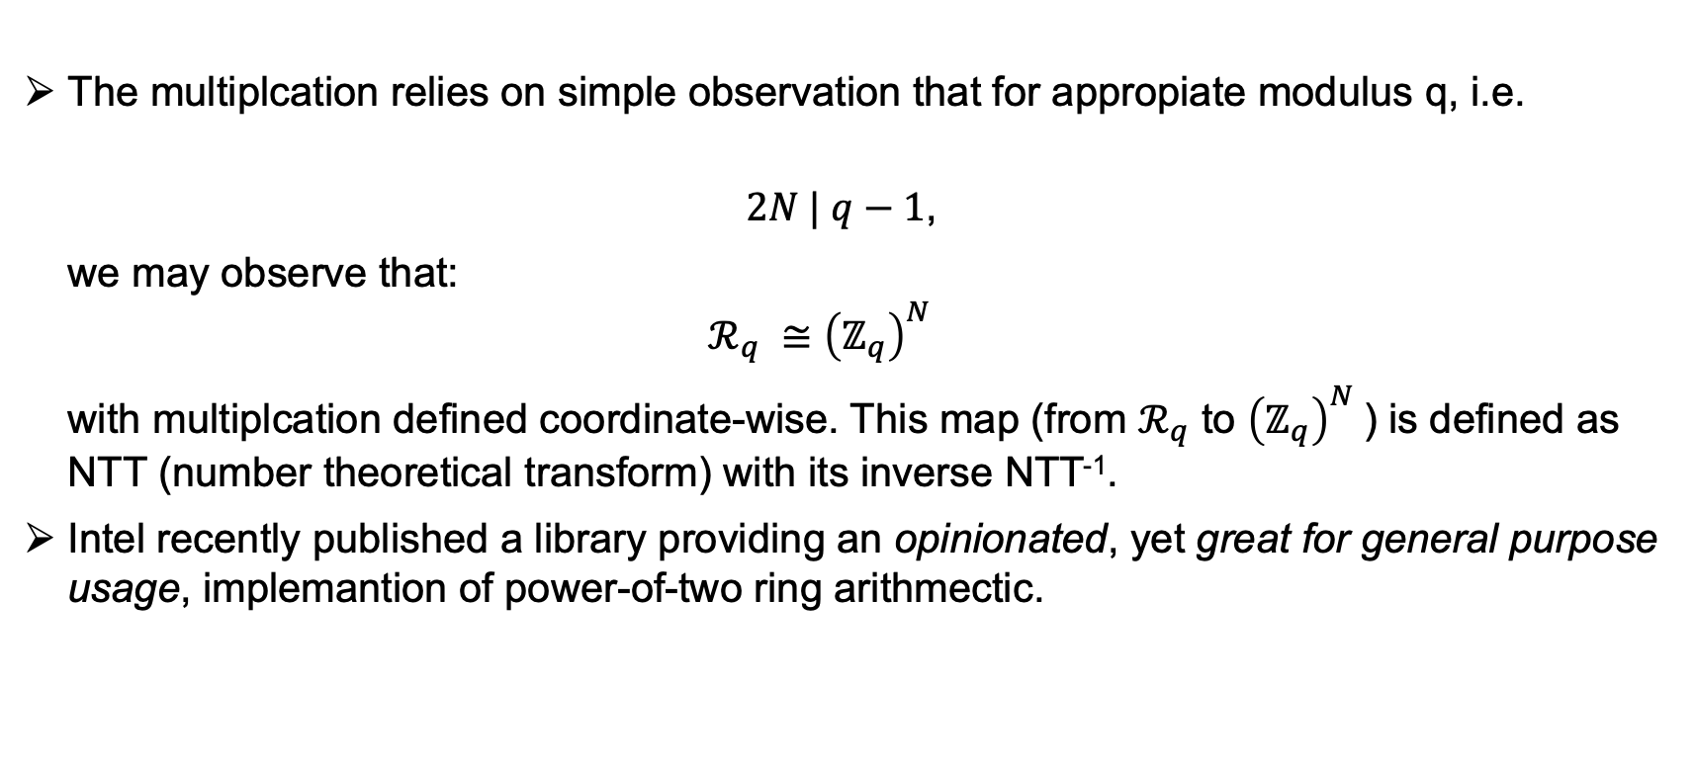
NTT multiplication
The multiplcation relies on simple observation that for appropiate modulus q, i.e.
$2N | q−1$,
we may observe that:
$$ℛ_{q} ≅{\left(ℤ_{q}\right)}^{N}$$
with multiplcation defined coordinate-wise. This map (from $ℛ_{q}$ to ${\left(ℤ_{q}\right)}^{N}$) is defined as NTT (number theoretical transform) with its inverse NTT⁻¹.
Intel recently published a library providing an opinionated, yet great for general purpose usage, implemantion of power-of-two ring arithmectic.

Slide 10
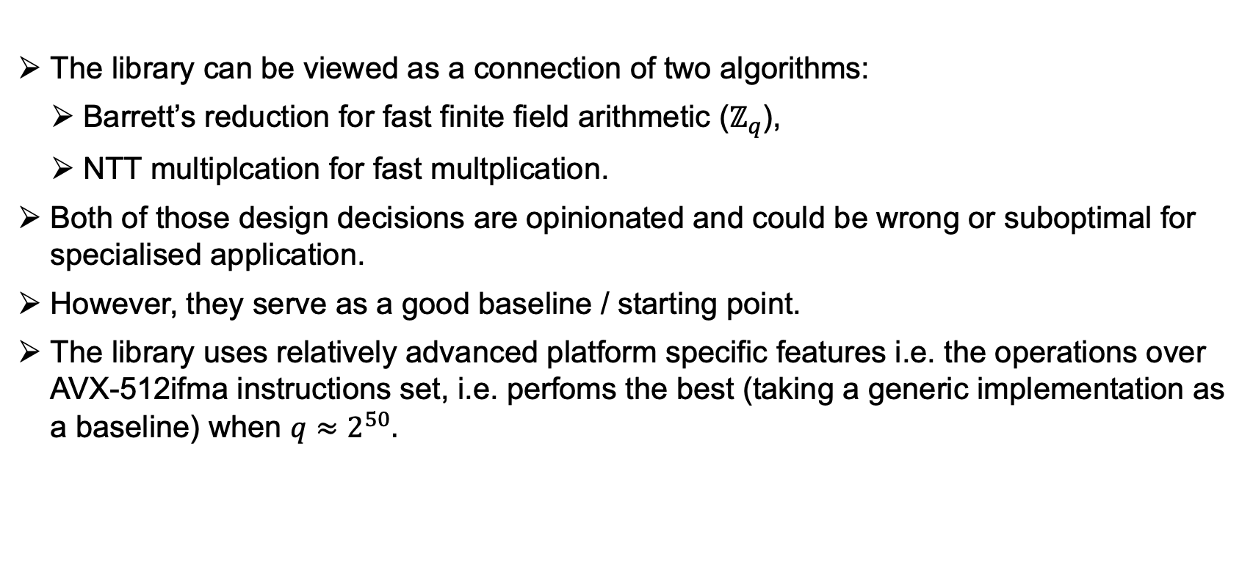
HEXL – Homomorphic Encryption Acceleration Library
The library can be viewed as a connection of two algorithms:
Barrett’s reduction for fast finite field arithmetic ($ℤ_{q}$),
NTT multiplcation for fast multplication.
Both of those design decisions are opinionated and could be wrong or suboptimal for specialised application.
However, they serve as a good baseline / starting point.
The library uses relatively advanced platform specific features i.e. the operations over AVX-512ifma instructions set, i.e. perfoms the best (taking a generic implementation as a baseline) when $q≈2^{50}.$

Slide 11
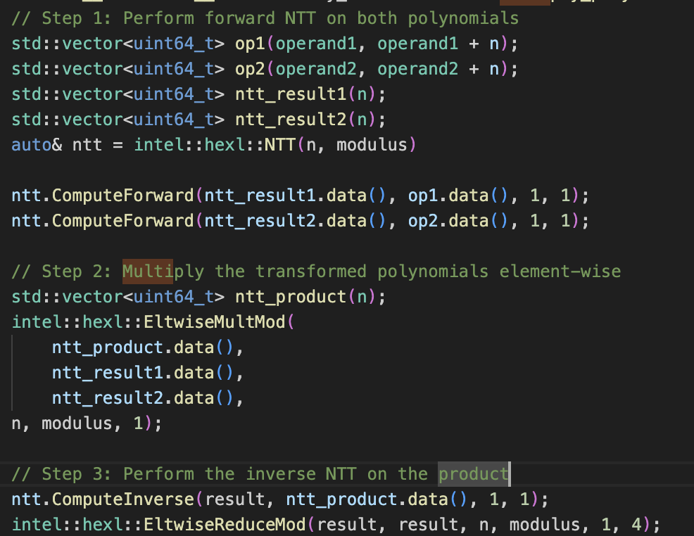
Example of usage
The multiplcation of a and b contains 3 steps:
Computation of NTT for a and b
Coordinate-wise multiplcation in the NTT domain
Computation of invNTT for the output
Notes:
Sometimes, for further speed-up the cyclotomic ring element can stay in NTT domain for many multiplications / additions.
Some parts of the computation could (and should) be cached.

Slide 12
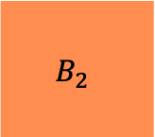
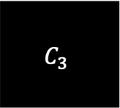

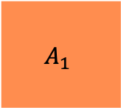

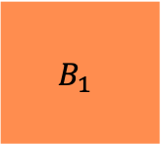
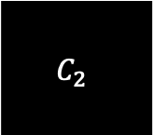

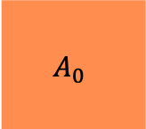


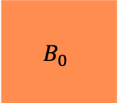
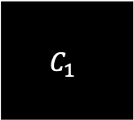
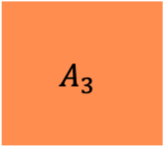

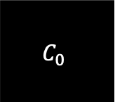

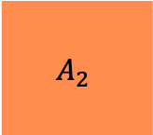
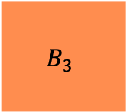

HEXL as an SIMD library
HEXL uses SIMD (Single Instruction, Multiple Data) instructions to perform parallel (yet single thread) operations on data blocks.
HEXL provides vectorised support for:
Addition, subtraction, multiplication, fused multiply-add (FMA), modular reductions.
In more detail, HEXL “packs” 8-16 operations into one (512-bits) instructions.
The single SIMD operation is slightly more expensive than a “regular” one.
$$A_{0}$$
$$B_{0}$$
$$C_{0}$$
$$+$$
$$=$$
$$A_{1}$$
$$B_{1}$$
$$C_{1}$$
$$+$$
$$=$$
$$A_{2}$$
$$B_{2}$$
$$C_{2}$$
$$+$$
$$=$$
$$A_{3}$$
$$B_{3}$$
$$C_{3}$$
$$+$$
$$=$$

Slide 13
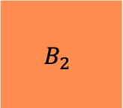
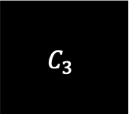


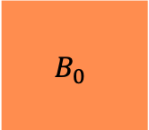
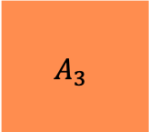

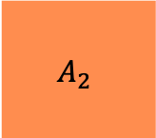
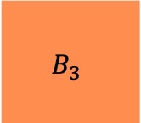

HEXL as an SIMD library
HEXL uses SIMD (Single Instruction, Multiple Data) instructions to perform parallel (yet single thread) operations on data blocks.
HEXL provides vectorised support for:
Addition, subtraction, multiplication, fused multiply-add (FMA), modular reductions.
In more detail, HEXL “packs” 8-16 operations into one (512-bits) instructions.
The single SIMD operation is slightly more expensive than a “regular” one.
$$A_{0}$$
$$B_{0}$$
$$C_{0}$$
$$A_{1}$$
$$B_{1}$$
$$C_{1}$$
$$⨁$$
$$=$$
$$A_{2}$$
$$B_{2}$$
$$C_{2}$$
$$A_{3}$$
$$B_{3}$$
$$C_{3}$$

Slide 14
What else HEXL can do?
What HEXL doesn’t do?
Support for vectorised arithmetic
Addition
Subtraction
Multiplication
Muiltiplication-and-addition (as a single operation; FMA)
Modular Reductions
Berret
Montgomery
NTT and FFT (experimental) helpers
Primitive roots computation/check,
FHE-style operations:
KeySwitching
No complete protocols (e.g. FHE)
No error samplings (gaussians)
No trapdoors
No optimisations apart AVX-512dq and AVX-512ifma
No multithreading
No GPU acceleration
No “native” support for other languages than C++
Use OpenFHE
(with HEXL as a “backend”)
How to use HEXL with e.g. Rust?

Slide 15
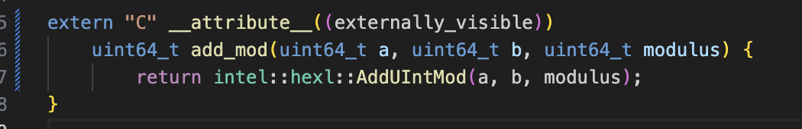
Cross-language usage
HEXL library exposes a C++ API
To employ HEXL in the family of system programming languages (Rust, but also Pascal, C, ADA, Forth, Fortran), we need to build a (static or dynamic) library mapping C++ API for lower level (C-style) types.
As an example, we consider a simple fuction additing two number (mod q)
Typically, this pattern is called Foreign Function Interface, or FFI in short.
Those binding are built into a system library (e.g., .so)

Slide 16
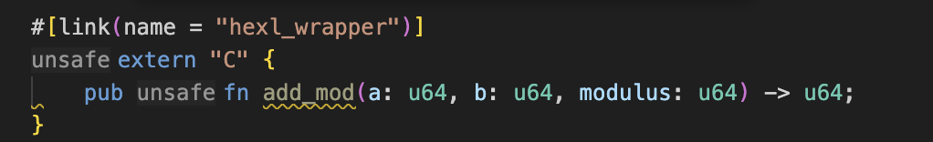

Cross-language usage
HEXL library exposes a C++ API
Rust can “understand” this newly-compiled library
So the function, upon declaration, can be used almost as a “regular” Rust function

Slide 17

More guidance
HEXL is not “dummy-proof”, i.e. it
does not check or print if your prime does not fulfil conditions, but simply fails,
will not warn if AVX-512-ifma instructions’ set is not available, but fallback to less optimal,
checks the architecture during compilation => compile on the same CPU you execute,
is single-thread.
For smooth start, I made a simple project in our workshop repository. Project already includes:
installation instructions,
example of usage and benchmarks.
https://github.com/osdnk/crypto-workshop-day-2

