Slide 1
Introduction to Lab #3: Lab_CubeStats_New
José Nelson Amaral
CMPUT 229
University of Alberta

Slide 2
Requirements
Follow all subroutine calling conventions
Must use $fp to access anything that is stored in the stack
Only can use $sp in this assignment to change the size of the stack.

Slide 3
CubeStats
Receives the following parameters:
corner: the address of the first element of a cube in an n-dimensional array.
edge: the size of the edge of the cube.
dimensions: the number of dimensions of the cube (and base array).
size: the size of the base array
Assume that the size of the base array is the same in all dimensions, i.e. the base array is itself a cube

Slide 4
A two-dimensional example
corner
0
1
2
3
4
5
6
7
8
9
0
1
2
edge
3
4
5
6
7
dimension = 2
8
9
size

Slide 5
CubeStats Return Values
$v0: a signed integer representing the floor of the average of all negative elements in the specified cube.
$v1: a signed integer representing the floor of the average of all positive elements in the specified cube.

Slide 6
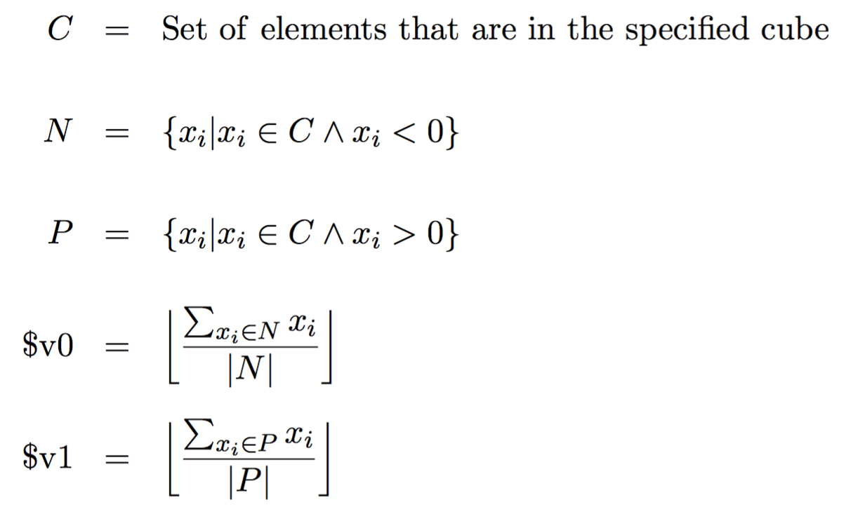
CubeStats Return Values --- more formally

Slide 7
CubeStats Return Values --- more formally

Slide 8
CubeStats (cont.)
Assume that the parameters are correct:
Parameters are positive
The Cube is contained within the base array

Slide 9
1-d Array Storage
What is the address of element -1 (i=2) ?
Address
Value
0x10001024
0x10001020
0x1000101C
⋅⋅⋅
0x10001018
15
0x10001014
-5
…
7
3
-1
1
4
-5
15
…
0x10001010
4
0x1000100C
1
↑
0x10001008
-1
A
0x10001004
3
0x10001000
7
A[i]
0x10000FFC
⋅⋅⋅
One-dimensional matrix A.
Organization of B in memory
in row-major style.

Slide 10
2-d Array Storage
What is the address of element w (i=1, j =2) ?
Address
Value
j
0x10001024
0x10001020
z
r
s
t
0x1000101C
y
0x10001018
x
u
v
w
0x10001014
w
i
0x10001010
v
x
y
z
0x1000100C
u
0x10001008
t
0x10001004
s
0x10001000
r
B[i][j]
0x10000FFC
Organization of B in memory
in row-major style.
Two-dimensional 3×3 matrix B.

Slide 11
2-d Array Storage
Which elements belong to a Cube at position (1,1) with
an edge = 2?
Address
Value
j
0x10001024
0x10001020
z
r
s
t
0x1000101C
y
0x10001018
x
u
v
w
0x10001014
w
i
0x10001010
v
x
y
z
0x1000100C
u
0x10001008
t
0x10001004
s
0x10001000
r
B[i][j]
0x10000FFC
Organization of B in memory
in row-major style.
Two-dimensional 3×3 matrix B.

Slide 12
2-d Array Storage
Which elements belong to a Cube at position (1,1) with
an edge = 2?
Address
Value
j
0x10001024
0x10001020
z
r
s
t
0x1000101C
y
0x10001018
x
u
v
w
0x10001014
w
i
0x10001010
v
x
y
z
0x1000100C
u
0x10001008
t
0x10001004
s
0x10001000
r
B[i][j]
0x10000FFC
Organization of B in memory
in row-major style.
Two-dimensional 3×3 matrix B.

Slide 13
3-d Array Storage
What is the address of element h (i=1, j =1, k=1) ?
Address
Value
e
f
0x10001024
0x10001020
i
0x1000101C
h
g
h
0x10001018
g
a
b
0x10001014
f
0x10001010
e
c
d
a
b
0x1000100C
d
j
0x10001008
c
0x10001004
b
c
d
0x10001000
a
k
0x10000FFC
C[i][j][k]
Organization of C in memory
in row-major style.
Three-dimensional 2×2×2 matrix C.

Slide 14
3-d Array Storage
What is the address of element h (i=1, j =1, k=1) ?
Address
Value
e
f
0x10001024
0x10001020
i
0x1000101C
h
g
h
0x10001018
g
a
b
0x10001014
f
0x10001010
e
c
d
a
b
0x1000100C
d
j
0x10001008
c
0x10001004
b
c
d
0x10001000
a
k
0x10000FFC
C[i][j][k]
Organization of C in memory
in row-major style.
Three-dimensional 2×2×2 matrix C.

Slide 15
main program
reads a k-dimensional Cube from a file
places the values in the memory in row-major format
for each specification of a cube in the file:
initializes four global variables to zero:
totalNeg, totalPos, countNeg and countPos
calls your CubeStats subroutine
prints the value returned by CubeStats

Slide 16
File format
size of array
dimension of array
C[1][0][1]
C[1][0][1]
C[1][0][1]
C[1][0][1]
↔ f
3 2
a b
c d
e f
g h
1 0 1 1
0 0 0 2
-1
e
e
f
e
f
f
f
i
g
g
h
h
a
b
j
c
d
a
b
c
d
k
Cube a position (0,0,0)
with edge 2
C[i][j][k]
Cube at position (1,0,1) with edge 1

Slide 17
main
Reading and understanding the main routine is part of the assignment.

Slide 18
Test Generator
A test generator, written in Python, is provided to you as a convenience.
Have fun modifying/playing with it.
Caution:
Large test cases overflow the arena provided
Increasing the arena is ok but will eventually run into the static space limit of SPIM.

Slide 19
What to hand in
A single file named CubeStats.s containing your subroutine CubeStats written in MIPS assembly.
Your subroutine must return to the caller using the instruction:
jr $ra
Your file must not contain a main function.

