Slide 1

MapReduce
How to painlessly process
terabytes of data

Slide 2
MapReduce Presentation Outline
What is MapReduce?
Example computing environment
How it works
Fault Tolerance
Debugging
Performance

Slide 3
What is MapReduce?
Restricted parallel programming model meant for large clusters
  User implements Map() and Reduce()‏
Parallel computing framework
  Libraries take care of EVERYTHING else
    Parallelization
    Fault Tolerance
    Data Distribution
    Load Balancing
Useful model for many practical tasks

Slide 4
Map and Reduce
Functions borrowed from functional programming languages (eg. Lisp)‏
Map()‏
  Process a key/value pair to generate intermediate key/value pairs
Reduce()‏
  Merge all intermediate values associated with the same key

Slide 5
Example: Counting Words
Map()‏
  Input <filename, file text>
  Parses file and emits <word, count> pairs
    eg. <”hello”, 1>
Reduce()‏
  Sums all values for the same key and emits <word, TotalCount>
    eg. <”hello”, (3 5 2 7)> => <”hello”, 17>

Slide 6
Example Use of MapReduce
Counting words in a large set of documents
map(string key, string value)‏
  //key: document name
  //value: document contents
  for each word w in value
    EmitIntermediate(w, “1”);
reduce(string key, iterator values)‏
  //key: word
  //values: list of counts
  int results = 0;
  for each v in values
    result += ParseInt(v);
  Emit(AsString(result));

Slide 7
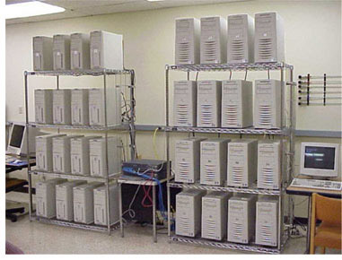
Google Computing Environment
Typical Clusters contain 1000's of machines
Dual-processor x86's running Linux with 2-4GB memory
Commodity networking
  Typically 100 Mbs or 1 Gbs
IDE drives connected to individual machines
  Distributed file system

Slide 8

How MapReduce Works
User to do list:
  indicate:
    Input/output files
    M: number of map tasks
    R: number of reduce tasks
    W: number of machines
  Write map and reduce functions
  Submit the job
This requires no knowledge of parallel/distributed systems!!!
What about everything else?

Slide 9
Data Distribution
Input files are split into M pieces on distributed file system
  Typically ~ 64 MB blocks
Intermediate files created from map tasks are written to local disk
Output files are written to distributed file system

Slide 10
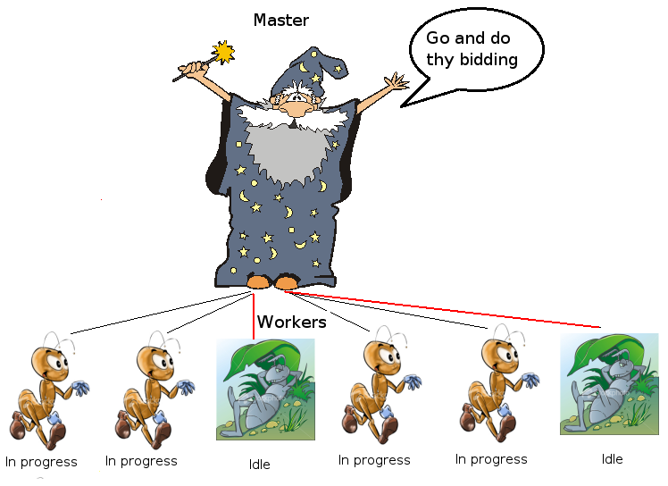
Assigning Tasks
Many copies of user program are started
Tries to utilize data localization by running map tasks on machines with data
One instance becomes the Master
Master finds idle machines and assigns them tasks

Slide 11
Execution (map)‏
Map workers read in contents of corresponding input partition
Perform user-defined map computation to create intermediate <key,value> pairs
Periodically buffered output pairs written to local disk
  Partitioned into R regions by a partitioning function

Slide 12
Partition Function
Example partition function: hash(key) mod R
Why do we need this?
Example Scenario:
  Want to do word counting on 10 documents
  5 map tasks, 2 reduce tasks

Slide 13
Execution (reduce)‏
Reduce workers iterate over ordered intermediate data
  Each unique key encountered – values are passed to user's reduce function
  eg. <key, [value1, value2,..., valueN]>
Output of user's reduce function is written to output file on global file system
When all tasks have completed, master wakes up user program

Slide 14
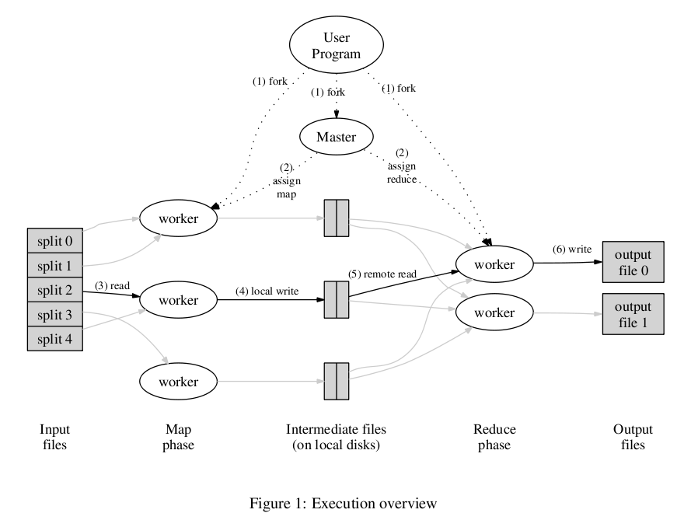

Slide 15
Observations
No reduce can begin until map is complete
Tasks scheduled based on location of data
If map worker fails any time before reduce finishes, task must be completely rerun
Master must communicate locations of intermediate files
MapReduce library does most of the hard work for us!

Slide 16
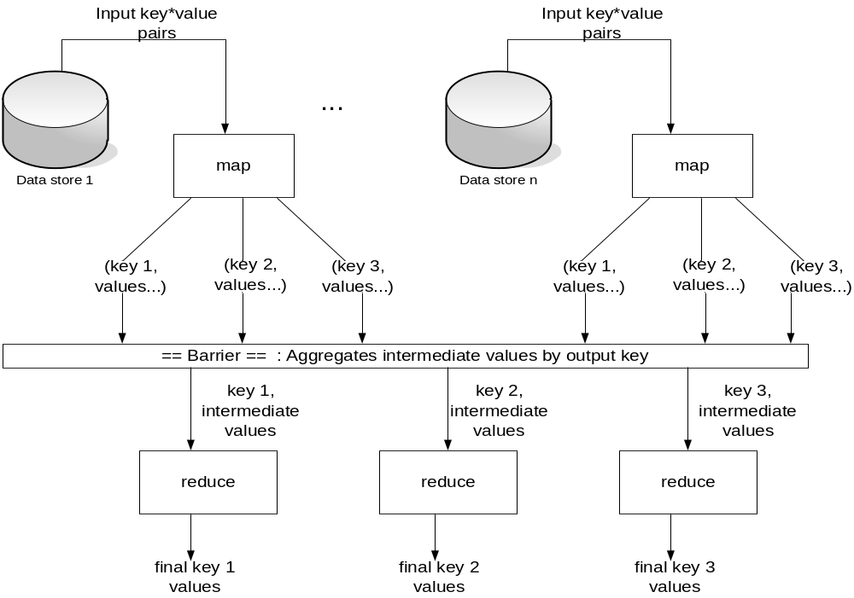

Slide 17
Fault Tolerance
Workers are periodically pinged by master
  No response = failed worker
Master writes periodic checkpoints
On errors, workers send “last gasp” UDP packet to master
  Detect records that cause deterministic crashes and skips them

Slide 18
Fault Tolerance
Input file blocks stored on multiple machines
When computation almost done, reschedule in-progress tasks
  Avoids “stragglers”

Slide 19
Debugging
Offers human readable status info on http server
  Users can see jobs completed, in-progress, processing rates, etc.
Sequential implementation
  Executed sequentially on a single machine
  Allows use of gdb and other debugging tools

Slide 20
Performance
Tests run on 1800 machines
  4GB memory
  Dual-processor # 2 GHz Xeons with Hyperthreading
  Dual 160 GB IDE disks
  Gigabit Ethernet per machine
Run over weekend – when machines were mostly idle
Benchmark: Sort
  Sort 10^10 100-byte records

Slide 21
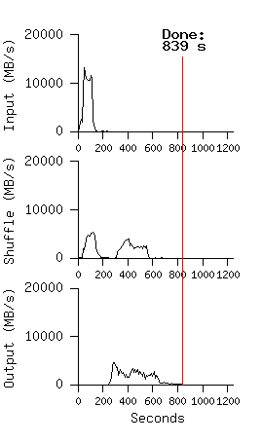
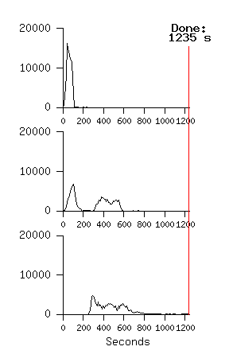
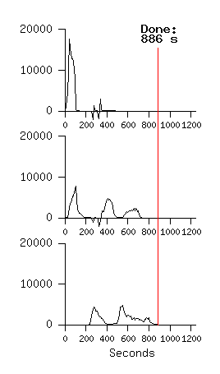
Performance
Normal
No Backup Tasks
200 Processes Killed

Slide 22
Conclusions
Simplifies large-scale computations that fit this model
Allows user to focus on the problem without worrying about details
Computer architecture not very important
  Portable model

Slide 23
References
Jeffery Dean and Sanjay Ghemawat, MapReduce: Simplified Data Processing on Large Clusters
Josh Carter, http://multipart-mixed.com/software/mapreduce_presentation.pdf
Ralf Lammel, Google's MapReduce Programming Model – Revisited
http://code.google.com/edu/parallel/mapreduce-tutorial.html

