Slide 1
Another billion
WEB TECHNOLOGIES FOR NEXT GENERATION OF CONNECTED DEVICES
12/09/2015
STATE OF THE BROWSER 5 MARTIN JAKL @JAKLMARTIN

Slide 2
Overview
We have a new generation of low power low performance connected devices.
It is called Internet of Things
12/09/2015
STATE OF THE BROWSER 5 MARTIN JAKL @JAKLMARTIN

Slide 3
Can we learn from mobiles?
How can we develop apps for them?
Can we reuse knowledge and tools?
Can we learn anything from mobile industry?
12/09/2015
STATE OF THE BROWSER 5 MARTIN JAKL @JAKLMARTIN

Slide 4
Background
C++ developer, embedded systems and mobile OS development
12/09/2015
STATE OF THE BROWSER 5 MARTIN JAKL @JAKLMARTIN

Slide 5
Web – Mobiles – Next Gen
We have made a long journey with mobile internet and web.
It took many steps to get where we are today – working mobile web
12/09/2015
STATE OF THE BROWSER 5 MARTIN JAKL @JAKLMARTIN

Slide 6
Smartphones
Smartphones are running version of desktop browsers.
Will we repeat the same mistakes with next generation devices?
12/09/2015
STATE OF THE BROWSER 5 MARTIN JAKL @JAKLMARTIN

Slide 7
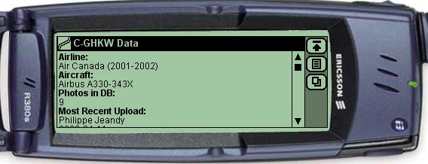
This was going to be future of mobile web
12/09/2015
STATE OF THE BROWSER 5 MARTIN JAKL @JAKLMARTIN

Slide 8
History – Wireless Application Protocol
Driven by mobile operators driven
Mobile equivalent of HTML + HTTP
Huge investment by entire industry for technology nobody really used
12/09/2015
STATE OF THE BROWSER 5 MARTIN JAKL @JAKLMARTIN

Slide 9
History – WAC 2.0
  Wholesale Applications Community – platform for mobile software developers
12/09/2015
STATE OF THE BROWSER 5 MARTIN JAKL @JAKLMARTIN

Slide 10
History – WAC 2.0
  Driven by mobile operators
  Based on HTML, JavaScript, and CSS
  Almost like HTML5, but not quite. By the time it was ready, HTML5 was picking up.
12/09/2015
STATE OF THE BROWSER 5 MARTIN JAKL @JAKLMARTIN

Slide 11
Mobile Browsers
Initially driven (and limited) by hardware and software (mobile phones).
This usually caused more issues than in solved.
Versions of desktop browsers are available on mobiles now.
12/09/2015
STATE OF THE BROWSER 5 MARTIN JAKL @JAKLMARTIN

Slide 12
Next Gen - IoT
Internet of Things is emerging technology – smart sensors, wearable tech, connected house, connected car... You name it
Reasonably established in some categories like wearable tech and smart watches.
12/09/2015
STATE OF THE BROWSER 5 MARTIN JAKL @JAKLMARTIN

Slide 13
Internet of things by numbers
Range of connected devices and already counting in billions
  Many trivial devices – smart sensors
  More complex devices with dedicated OS – Google Project Brillo
  Devices supporting web technologies – perhaps smallest group of IoT devices, but given the scope of market still significant
12/09/2015
STATE OF THE BROWSER 5 MARTIN JAKL @JAKLMARTIN

Slide 14
Next Gen - IoT
Why web technologies ?
Existing dev tools and existing developers
12/09/2015
STATE OF THE BROWSER 5 MARTIN JAKL @JAKLMARTIN

Slide 15
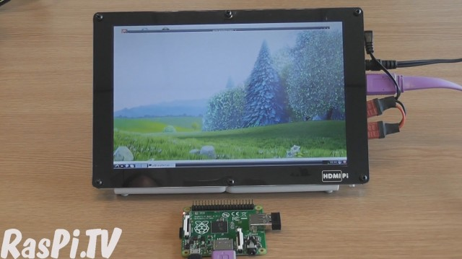
Raspberry Pi
12/09/2015
STATE OF THE BROWSER 5 MARTIN JAKL @JAKLMARTIN

Slide 16
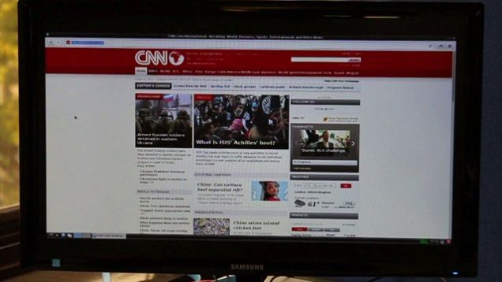
Epiphany -Fast, Modern Browser for the Raspberry Pi
Much-improved HTML5
JavaScript JIT
Hardware-accelerated video decoding
12/09/2015
STATE OF THE BROWSER 5 MARTIN JAKL @JAKLMARTIN

Slide 17
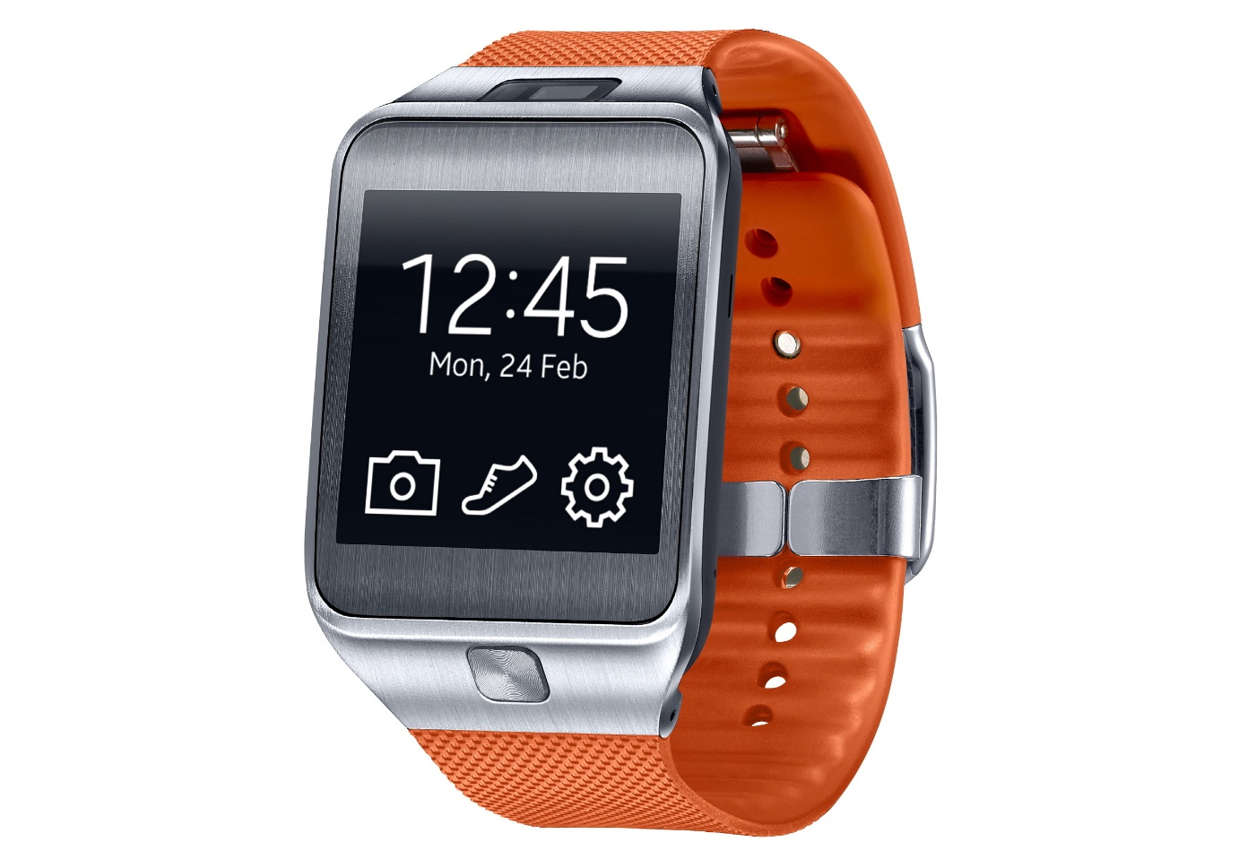
Samsung Gear 2
Runs WebKit
12/09/2015
STATE OF THE BROWSER 5 MARTIN JAKL @JAKLMARTIN

Slide 18
IoT issues
As with any emerging technology, there are issues to be sorted out
Ease of development
Security
Privacy
Less powerful hardware
12/09/2015
STATE OF THE BROWSER 5 MARTIN JAKL @JAKLMARTIN

Slide 19
Lets use WebKit
Using WebKit as development environment for IoT has many advantages
  Existing development tools
  Developers
  Well understood Security implementation
12/09/2015
STATE OF THE BROWSER 5 MARTIN JAKL @JAKLMARTIN

Slide 20
Security
We get a lot from WebKit technologies by default
https:// - based on TLS and SSL using OpenSSL libraries
12/09/2015
STATE OF THE BROWSER 5 MARTIN JAKL @JAKLMARTIN

Slide 21
Privacy
Privacy in WebKit – for embedded devices, we can disable or configure some features
  Cookies
  web storage
  CORS
12/09/2015
STATE OF THE BROWSER 5 MARTIN JAKL @JAKLMARTIN
Notes:
Privacy issue in general
Even more so in devices with cameras, mics, sensors
Dumb-down the device make it more secure and private

Slide 22
Running Out Of Memory
If you run with memory budget of 200MB you are likely to hit OOM
  The Web App really needs that much memory – not much to do apart from redesigning
12/09/2015
STATE OF THE BROWSER 5 MARTIN JAKL @JAKLMARTIN

Slide 23
Running Out Of Memory
Web App is not optimised
  Optimise the App itself and improve WebKit OOM handling and Garbage Collection algorithm.
12/09/2015
STATE OF THE BROWSER 5 MARTIN JAKL @JAKLMARTIN

Slide 24
Generic optimisation
for(var i=0; i<10; i++){
var obj = {key:'val'};
console.log(obj);
}
12/09/2015
STATE OF THE BROWSER 5 MARTIN JAKL @JAKLMARTIN

Slide 25
OOM stress test
Initialise variables
var numberOfImages = 0;
var memoryDiv = document.getElementById('memory');
//get references to the 6 static DOM elements up front.
var imageDivs = [];
for (var i = 0; i < 6; i++) {
imageDivs.push(document.getElementById('image' + i));
}
12/09/2015
STATE OF THE BROWSER 5 MARTIN JAKL @JAKLMARTIN

Slide 26
WebKit OOM & GC
function interval() {
var currentImageDiv = imageDivs[numberOfImages % 6];
currentImageDiv.innerHTML =
'<img src="testimage.png?cachebuster=' + numberOfImages + '" />';
numberOfImages++;
}
12/09/2015
STATE OF THE BROWSER 5 MARTIN JAKL @JAKLMARTIN

Slide 27
Existing GC issue in WebKit
In certain situations clearing the WebKit's MemoryCache doesn't releases all CachedResource to system.
https://bugs.webkit.org/show_bug.cgi?id=111094
Garbage Collect to release the references of CachedResource
12/09/2015
STATE OF THE BROWSER 5 MARTIN JAKL @JAKLMARTIN

Slide 28
Out Of Memory in WebKit
Existing functionality in WebKit is proven for desktop.
Managing memory budget involves cache, font storage, Garbage Collection
Full Memory Pressure Handler is needed in WebKit.
12/09/2015
STATE OF THE BROWSER 5 MARTIN JAKL @JAKLMARTIN

Slide 29
Going forward
Web developers and designers should consider memory optimisation on Next Gen devices.
Better memory management in WebKit is needed.
Specific embedded WebKit port for IoT devices is needed.
12/09/2015
STATE OF THE BROWSER 5 MARTIN JAKL @JAKLMARTIN

Slide 30
Conclusion
Performance as such is not generally an issue
Hardware acceleration is not an issue
Memory usage is the issue
12/09/2015
STATE OF THE BROWSER 5 MARTIN JAKL @JAKLMARTIN

