Slide 1

Game Engine Programming
GUI

Slide 2
Benefits
Games a little bit awkward without them!

Slide 3
A few different types
Retained
Immediate Mode
3D

Slide 4
Retained
Add components in a hierarchy
Use layout managers
Add callbacks
//Lay out the buttons from left to right. JPanel buttonPane = new JPanel(); buttonPane.setLayout(new BoxLayout(buttonPane, BoxLayout.LINE_AXIS)); buttonPane.setBorder(BorderFactory.createEmptyBorder(0, 10, 10, 10)); buttonPane.add(Box.createHorizontalGlue()); buttonPane.add(cancelButton); buttonPane.add(Box.createRigidArea(new Dimension(10, 0))); buttonPane.add(setButton);
Becomes quite a lot of code to add layouts you need

Slide 5

Immediate Mode
The logic closely integrated with the layout
The controller and view tightly integrated
Easy to add, great for tools
void OnGUI() { if (GUI.Button(new Rect(0, 0, 75, 25), "Press Me")) { Debug.Log("Hello!"); } }
Some performance issues – draw calls cannot be cached without a lot of work.

Slide 6
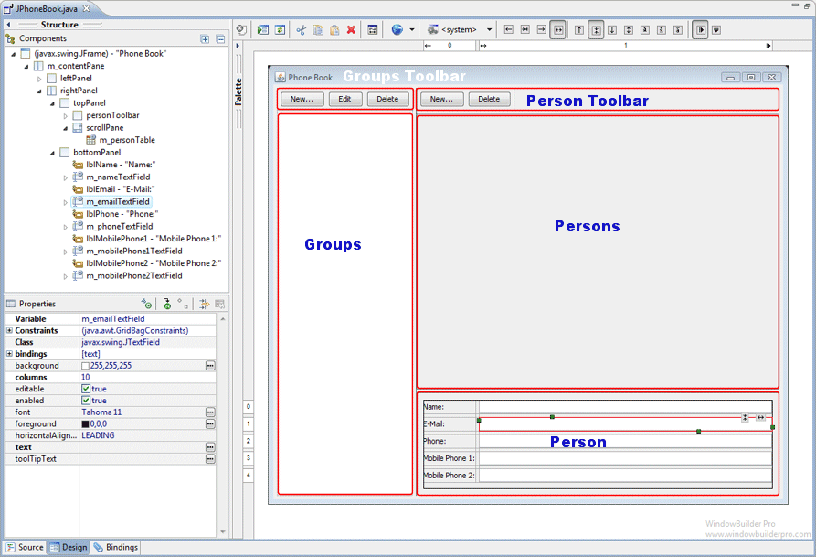
Where to use
Immediate Mode if you need something done quickly
Retained if you need consistent sizing and can spend time doing so
Retained if you have a GUI editor

Slide 7
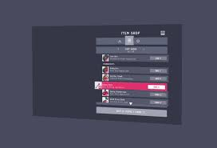
3D
Can be retained or immediate
GUI components “in the game world”
Cannot use mouse x, y to click
Must create a ray from x, y, projection, view matrix and ray triangle intersect

Slide 8
Lets have a look at some UML

Slide 9
Model Loading
A model is just a series of points
We need to parse it
Store those points in vertex buffers
Done

Slide 10
The complex part
Some models are binary, some are plain text
Binary files can integrate with C / C++ directly
Plain text is safer
Plain text needs to be parsed

Slide 11
The format of obj files
V – specifies a vertex position
Vt – specifies a vertex tex coord
Vn – specifies a vertex normal
F – specifies a face
  Made up of the previous points
  Specified by index (starting at 1)

Slide 12
Where is this done?
You have a VertexBuffer class
You have a constructor that takes nothing?
Lets have a constructor that takes a std::string
Then we can call
va = std::make_shared<VertexBuffer>(“models/myawesomecatmodel.obj”);

Slide 13
Lets have a look at some UML

Slide 14
Next steps
CES – complete
Transform – complete
MeshRenderer – complete
  Gets in_Model from transform – complete
  Gets in_Perspective from Screen – complete
  Gets in_View from Camera’s transform (inversed) - complete
  Takes a model - complete
  Takes a texture - complete
We are pretty much done with OpenGL in our engine!

Slide 15
Any Questions?

