Slide 1

3D Game Programming
Lighting

Slide 2
The lighting equation
Common approximation is:
  Total illumination = emissive + ambient + diffuse + specular

Slide 3
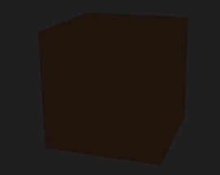
Emissive and Ambient
Emissive is the light the surface provides
  Usually 0
  Glowing slime
Ambient is the scene’s light
  Rarely 0
  Even a night sky provides some light
Total = {0,0,0} + {0.2,0.1,0.1}

Slide 4

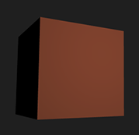
Diffuse
Equation
K_{d} is the surface diffuse colour
N is surface normal
L is direction from surface to the light

Slide 5
Dot product
The product of the Euclidean magnitudes of the two vectors and the cosine of the angle between them
“How smack bang into the other it is”
Parallel lines would yield 0
Lines at right angle to each other would yield 1
Line at right angle from behind the triangle would yield -1

Slide 6
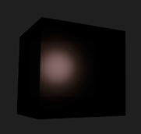
Specular
Equation
K_{s} is the surface specular colour
facing is a function that is 1 if N . L > 0 and 0 otherwise to stop specular lighting on surfaces that face away from the light
N is the surface normal
H is the half-vector, half way between light direction and eye direction.

Slide 7
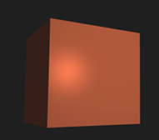
The we simply combine them all
illumination = emissive + ambient + diffuse + specular

Slide 8
That was the maths bit
Now we need to transfer this stuff into shaders

Slide 9
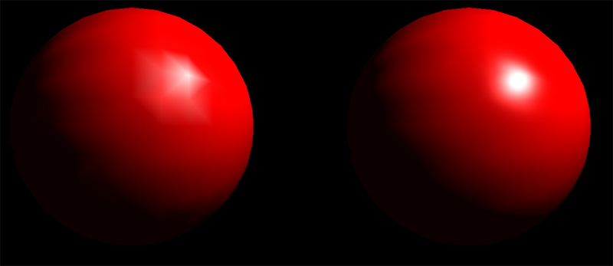
Which shader to use?
Vertex operates per point
Fragment operates per pixel
You can use either
Vertex shader is computationally cheaper
Fragment shader gives smoother output

Slide 10
The data we use in the shaders
We have normals
We have the matrices
We need in_Emissive
We need in_Ambient
We need in_LightPos
  shader->setUniform("in_LightPos", glm::vec3(50, 10, 10));

Slide 11
We start in the Vertex Shader
Since we are going to do the lighting in the Fragment shader (looks better), we need to pass through some things:
  Normals
    So we know the direction of the face fragment
  Fragment position (gl_Position)
    Se we know the position of the face fragment
We need to transform both into world space (where I do the calculations). Some people use eye space instead so would need to be transformed by view too.
Normals are a direction so we do not care about position. Use a mat3 rather than w = 0 for performance.

Slide 12
In the fragment shader
First we normalize the normals.
  Vertex → Fragment interpolation could cause changes
We then obtain the light direction
  Simply minus fragment position from light position
We find the dot product between the normal and light direction (“how smack bang”).
  This tells us how much it is facing the light
We then max(result, 0)
  We don’t want less than 0 (if the light is coming from the back)
  Negative light is awkward to deal with (and incorrect)
Multiply your diffuse color by this result

Slide 13
We are done
Just multiply your output fragment (probably just pixel from texture) by:
  Emissive + ambient + diffuse
  0.0, 0.0, 0.0 + 0.1, 0.1, 0.2 + 0.63, 0.63, 0.63

Slide 14
Next steps
Create a separate lighting shader
  basic
  light
Add emissive, ambient and diffuse lighting
Specular next
Emissive is lame. We should actually make it glow (post processing)

Slide 15
Any Questions?

