Slide 1

3D Graphics Programming
Specular Lighting
& Render Textures

Slide 2

Specular
Equation
K_{s} is the surface specular colour
facing is a function that is 1 if N . L > 0 and 0 otherwise to stop specular lighting on surfaces that face away from the light
N is the surface normal
H is the half-vector, half way between light direction and eye direction.

Slide 3
Currently we have 1 camera
Needed by:
  Mesh Renderer
  Sprite Renderer

Slide 4
How we obtain the camera
When we require a View and Projection matrix
std::shared_ptr<Entity> ce = getWorld()->getEntity<Camera>(); shader->setModel(getTransform()->getModelMatrix()); shader->setView(glm::inverse(ce->getTransform()->getModelMatrix()); shader->setProjection(ce->getComponent<Camera>()->getProjection());

Slide 5
We want multiple cameras
while(running) { while (SDL_PollEvent(&event)) { if(event.type == SDL_QUIT) { running = false; } } getWorld()->tick(); getWorld()->display(); }
Becomes...

Slide 6
We want multiple cameras
while(running) { while (SDL_PollEvent(&event)) { if(event.type == SDL_QUIT) { running = false; } } getWorld()->tick(); std::vector<std::shared_ptr<Entity> > ces; getWorld->getEntities<Camera>(ces); for(size_t i = 0; i < cameras.size(); i++) { getWorld()->setActiveCamera(cameras.at(i)->getComponent<Camera>()); getWorld()->display(); }

Slide 7
Now when we render
shader->setView(glm::inverse(getWorld()->getCurrentCamera()->getTransform()->getModel())); shader->setProjection(getWorld()->getCurrentCamera()->getProjectionMatrix());

Slide 8
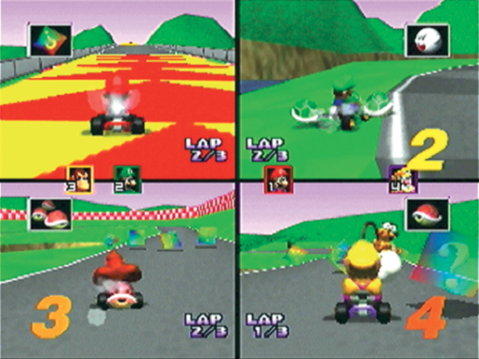
Why do we want multiple cameras?
Split screen
Use a different glViewport for each camera

Slide 9
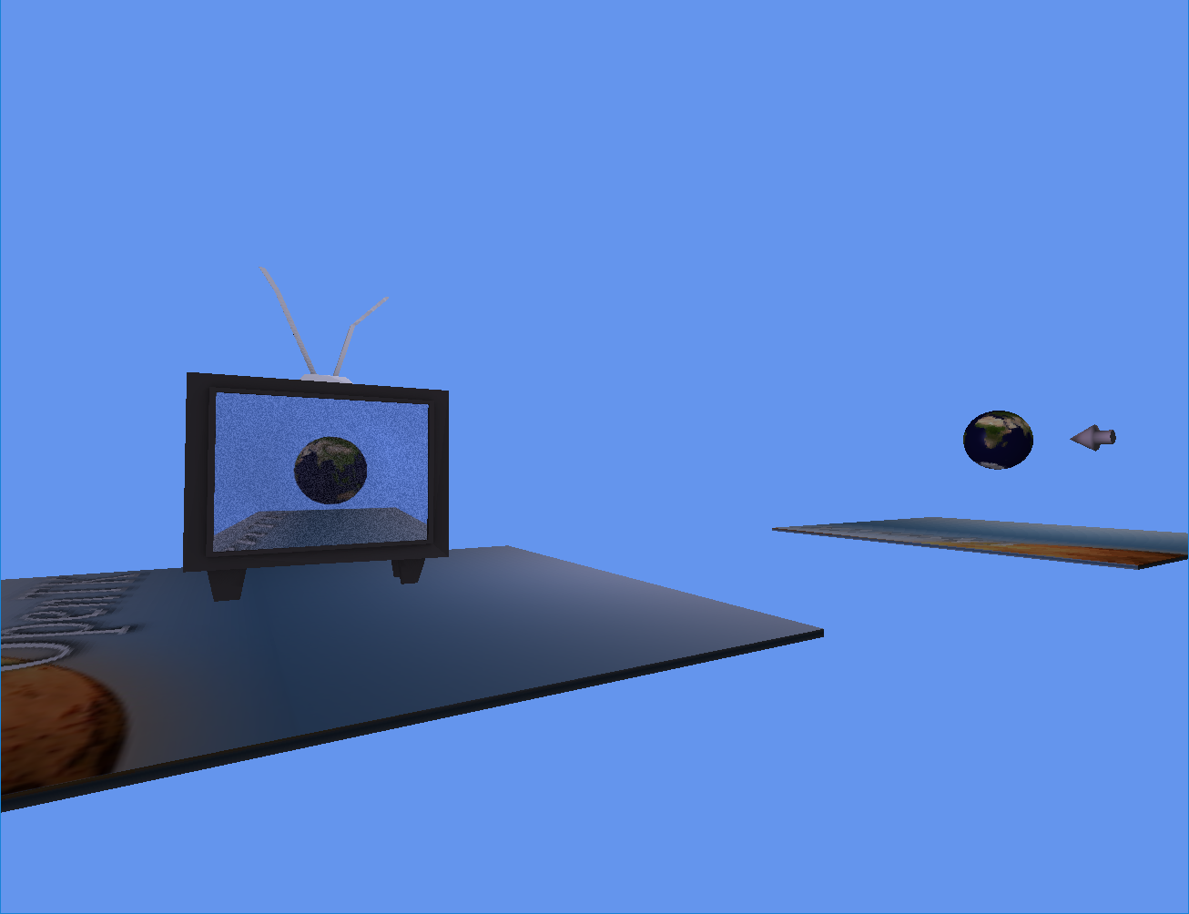
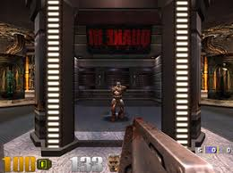
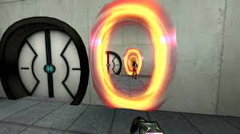
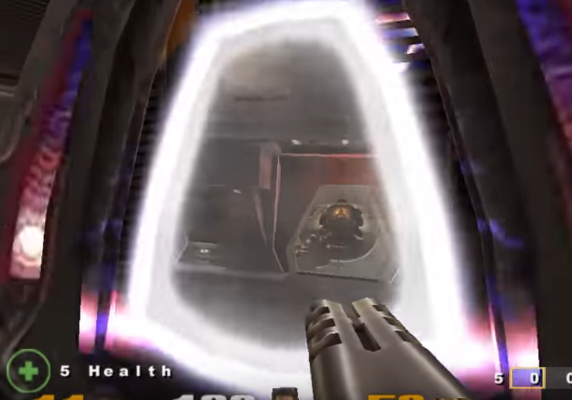
Why do we want multiple cameras
Render textures

Slide 10
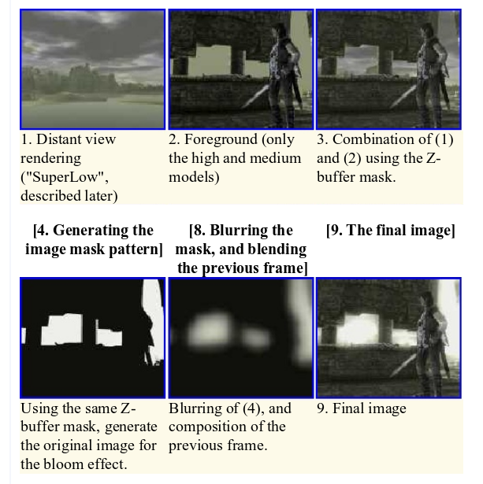
Render textures can do more!
Non-photorealistic rendering

Slide 11
The general steps
Create and bind frame buffer
Create a texture to hold the color data
Attach texture to frame buffer color
Create a render buffer (or texture) to hold the depth data
Bind render buffer to frame buffer depth
Bind and unbind frame buffer as you want to draw to frame buffer or screen respectively
You can use the texture so long as frame buffer is not bound

Slide 12
The implementation
GLuint fbo = 0; glGenFramebuffers(1, &fbo); if(!fbo) throw std::exception(); glBindFramebuffer(GL_FRAMEBUFFER, fbo); GLuint fbt = 0; glGenTextures(1, &fbt); glBindTexture(GL_TEXTURE_2D, fbt); glTexImage2D(GL_TEXTURE_2D, 0, GL_RGB, RENDER_TEXTURE_SIZE, RENDER_TEXTURE_SIZE, 0, GL_RGB, GL_UNSIGNED_BYTE, NULL); glTexParameteri(GL_TEXTURE_2D, GL_TEXTURE_MIN_FILTER, GL_LINEAR); glTexParameteri(GL_TEXTURE_2D, GL_TEXTURE_MAG_FILTER, GL_LINEAR); glBindTexture(GL_TEXTURE_2D, 0); glFramebufferTexture2D(GL_FRAMEBUFFER, GL_COLOR_ATTACHMENT0, GL_TEXTURE_2D, fbt, 0); GLuint rbo = 0; glGenRenderbuffers(1, &rbo); glBindRenderbuffer(GL_RENDERBUFFER, rbo); glRenderbufferStorage(GL_RENDERBUFFER, GL_DEPTH24_STENCIL8, RENDER_TEXTURE_SIZE, RENDER_TEXTURE_SIZE); glBindRenderbuffer(GL_RENDERBUFFER, 0); glFramebufferRenderbuffer(GL_FRAMEBUFFER, GL_DEPTH_STENCIL_ATTACHMENT, GL_RENDERBUFFER, rbo);

Slide 13
Next steps
Work on your games
Implement multiple cameras
Play with render texture / viewports
We will try to implement simple bloom

Slide 14
Any Questions?

