Slide 1

3D Graphics Programming
Matrix

Slide 2
Remember matrices?
Useful for a number of tasks
Can hold an arbitrary transformation
  Translation (position)
  Rotation
  Scale

Slide 3
How can they be used?
Create a translation matrix (0, 0, 10)
Create a Vector3 (1, 1, 1)
Pass the Vector3 through the matrix (multiply)
Output?

Slide 4
Answer
1, 1, 11

Slide 5
How do rotations work
In the same way
Rotate by 90
Translate by 0, 0, 10
Pass vector3 (0, 0, 0) into it
Result?
10, 0, 0

Slide 6
Order matters
Rotate 90 degrees and walk forward 2 meters
Vs
Walk forward 2 meters and then rotate 90 degrees
(Note: do this in your own time)

Slide 7
Our data is on the GPU
We could replace the data with transformed values
3 points in a triangle = 3x3 = 9 floats
Model might have many more than 1 triangle
Expensive
Pass a matrix in as a uniform
  Just like you did with color

Slide 8
Vertex Shader
uniform mat4 in_Model; attribute vec3 in_Position; attribute vec4 in_Color; varying vec4 ex_Color; void main() { gl_Position = in_Model * vec4(in_Position, 1.0); ex_Color = in_Color; }

Slide 9
Normalized coordinates
Notice points on triangle go between
  -1.0 and 1.0
  X, Y, Z
We cannot really do much with this
We want to simulate depth

Slide 10
Projection Matrix
Perspective
  Appear smaller as they get further away
  Viewing frustrum
  Great for 3D
Orthographic
  Same size regardless of depth
  Absolute pixel position on screen
  Great for GUI (And CAD)
  Not the same as normalized device coords!

Slide 11
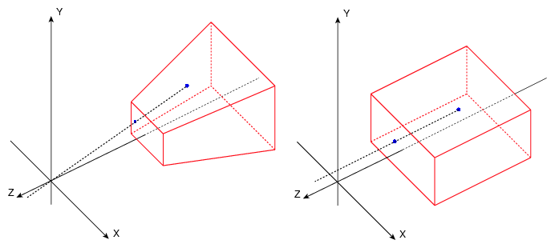
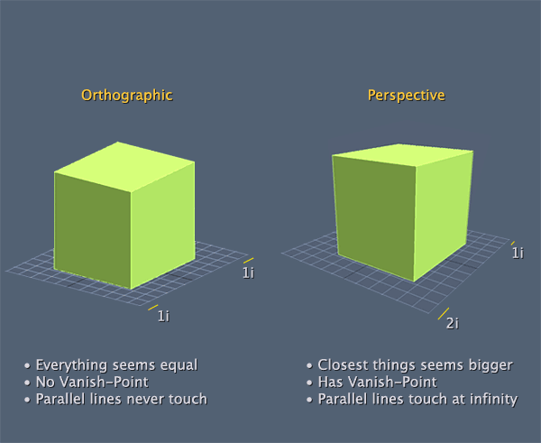
Examples

Slide 12
What this looks like in code?
projection = glm::perspective(glm::radians(45.0f), (float)WINDOW_WIDTH / (float)WINDOW_HEIGHT, 0.1f, 100.f)
projection = glm::ortho(0.0f, (float)WINDOW_WIDTH, 0.0f, (float)WINDOW_HEIGHT, 0.0f, 1.0f)

Slide 13
Our new shader
uniform mat4 in_Projection; uniform mat4 in_Model; attribute vec3 in_Position; attribute vec4 in_Color; varying vec4 ex_Color; void main() { gl_Position = in_Projection * in_Model * vec4(in_Position, 1.0); ex_Color = in_Color; }

Slide 14
Again order matters
Squash yourself into a projection matrix and then walk forward 2 meters
Vs
Walk forward 2 meters and then squash yourself into a projection matrix
Note: Do this in your own time

Slide 15
Next Steps
Wrap OpenGL
  Without this, life will be hard!
Make triangle spin

Slide 16
Any Questions?

