Slide 1

3D Graphics Programming
Introduction
Karsten Pedersen

Slide 2

3D Graphics Programming
Introduction
Karsten Pedersen

Slide 3
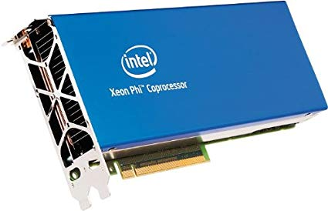
Why do we use a GPU?
Performance
GPUs are not “more powerful”
Parallelism
Micro threads
Certain tasks are faster if the work can be divided

Slide 4
How can work be divided?
Think back to your ray tracer
Each ray handled by one GPU process
  Workload partitioning more common (over utilization)
Rasterisation, each triangle can be done in parallel

Slide 5
The rest is still just maths
Ray tracing
  Project out a ray from each pixel on screen
  See what it collides with
  Project out more rays from that point
  Most of you did this for your assignment
Rasterisation
  Projecting point from 3D space onto 2D screen
  Bresenham's line algorithm
  Interpolation of points
  Some of you did this for your assignment

Slide 6
GPUs currently favour rasterisation
Faster process (on current hardware)
Less accurate
A lot needs to be faked
NVIDIA RTX is first consumer hardware looking at ray tracing
I predict in 20 years, we will just use the CPU (they will have so many cores by that point)

Slide 7






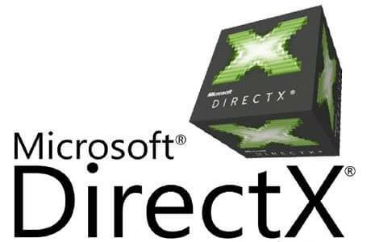

Graphics API’s
3Dfx Glide
OpenGL
Direct X
AMD Mantle
Metal
Vulkan

Slide 8
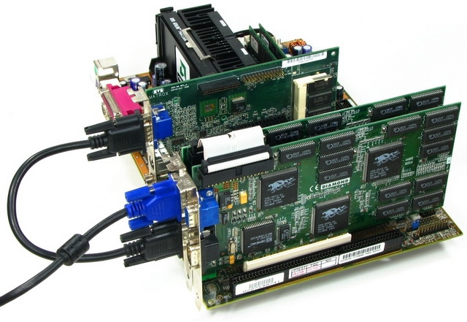
The Voodoo 2

Slide 9
OpenGL (and Vulkan) not libraries
They are specifications
Thus the “open” in the name
Implemented by your GPU manufacturer
Open and closed source implementations
Mesa (On Linux) is open-source
Because of this, can never really “die”

Slide 10

Vulkan will keep everything going
DXVK
Molten VK
GLO
GLide (kept glide alive. I.e Carmageddon 2)
ANGLE (OpenGL|ES → DirectX)
DirectX 10 maps to OpenGL 4.x

Slide 11

SDL 2
Mostly just opens up a window
  libX11
  WinAPI
  Carbon / Cocoa
A small wrapper around (SDL_Renderer)
  OpenGL
  Direct X on Windows
  OpenGL / Metal on macOS
  GCM on PS4

Slide 12
OpenGL
Versions
  1.2 (oldschool)
  2.1 (most compatible for now)
  3.0 (disappointing because old crap remained)
  4.6 (the very latest that no-one can run ;)
This is important for:
  Indies
  Casual
  Edutainment
  Advergaming
  Portfolio

Slide 13
How versions are handled on Windows
Windows provides version 1.2
We point the missing functionality towards the driver manufacturers implementation
Some manufacturers provide extensions that are not in the standard. Usually ending with EXT. They sometimes make it into the standard a few years later.
  glGenBuffersEXT

Slide 14

Enter, glew
GL Extension Wrangler
We use this to manage the extensions manually.
Basically makes the Windows implementation of OpenGL look as modern as it can
#include <GL/glew.h> instead of <GL/gl.h> and call glewInit(). Done

Slide 15
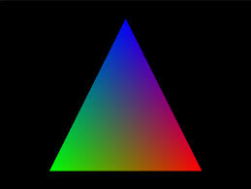
Drawing a triangle
Quite involved
Do it once and you can reuse code
Almost build up a little “mini-engine”

Slide 16
The steps...
Upload positions of triangle to GPU (VBO)
Organise that data on the GPU (VAO)
Compile vertex shader
Compile fragment shader
Link vertex and fragment shader
Draw

Slide 17
Shaders
Vertex Shader
  Deals with the points (vertices) of the shape
  Position
  Vertex Colors
  Vertex lighting

Slide 18
Shaders
Fragment Shader
  Deals with the pixels (fragments) of the shape
  Color
  Texture mapping
  Per-pixel lighting

Slide 19
GLSL
GL Shader Language
  NVIDIA Cg is deprecated but still a popular alternative (Unity uses it)
Very C-like with a few C++ elements.
Inbuilt mathematics features such as vec3, mat4, etc.
Some of it may look familiar because glm’s naming was based upon it.

Slide 20
In the labs
We will get you set up with OpenGL
We will draw a triangle
1-2 sessions
  Upload points
  Upload shaders
  Instruct to render
Code is reusable
  This will make up the core of your assignment

Slide 21
For your CV
(as a developer)
OpenGL will look so much better than more Unity games (you already have some right?).
You want to show off your C++ skills
  This is the industry preferred language (since the late 80s and probably until the known universe implodes)
You want to show off a more technical project

Slide 22
Important Dates
2nd March 2020 - Inclass Test
18th May 2020 - CW

Slide 23
Next Steps
Building vertex buffer objects
  Define the points of shapes
Looking at shaders
  How they interact with the data

Slide 24
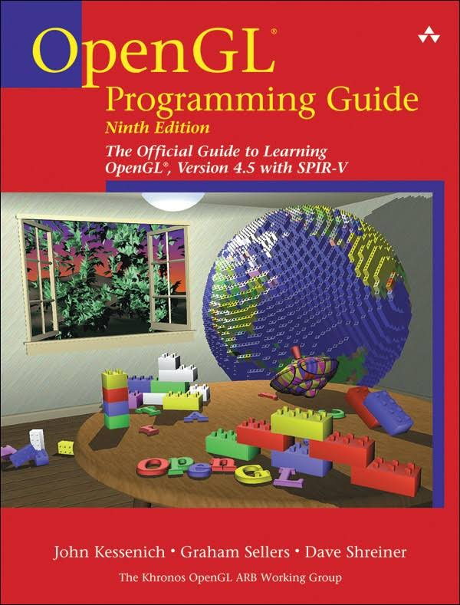
Reading Material
OpenGL Red Book
  Get the newest you can
  4.5 currently
https://learnopengl.com/
  Good content
  Following it will make it hard to make a game
  Use as reference only

Slide 25
Any Questions?

