Slide 1

3D Graphics Programming
Multi-texturing

Slide 2
What is multi-texturing?
Using more than 1 uniform sampler in the shader
uniform sampler2D in_Texture;
uniform sampler2D in_Lightmap;
void main()
{
...
}

Slide 3
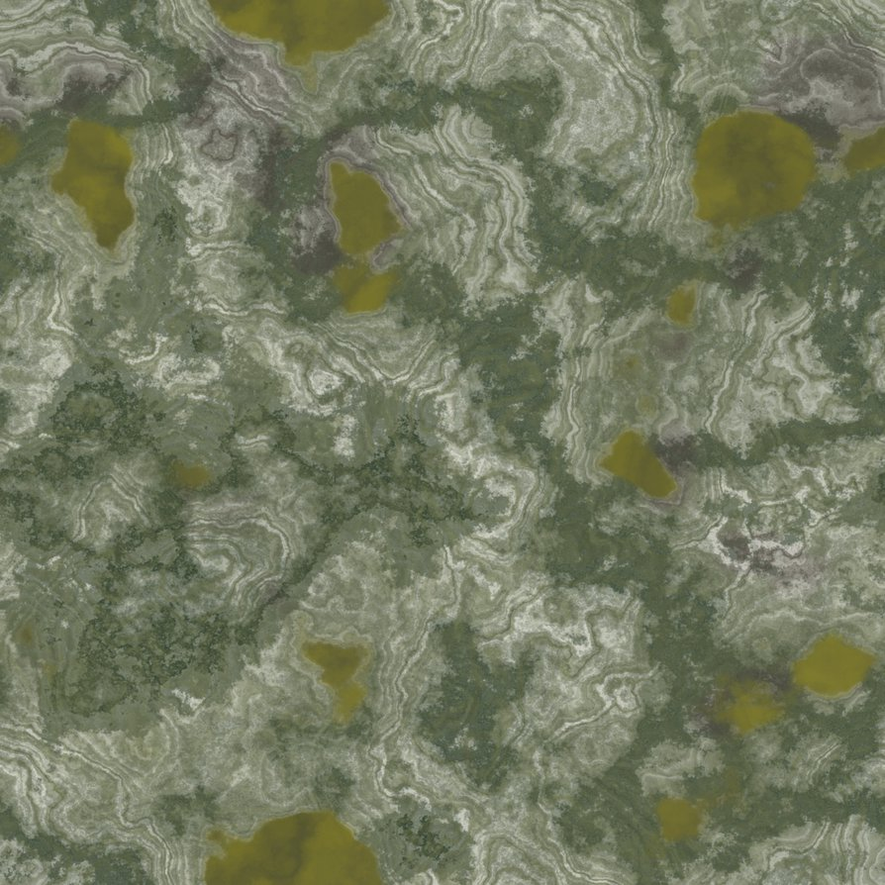
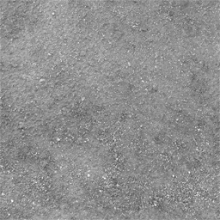
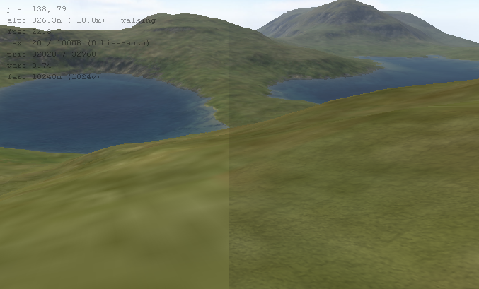
Why do we do this?
Detail map
  One stretched
  The other tiled

Slide 4
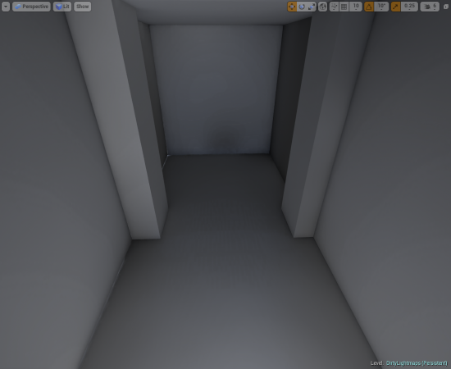
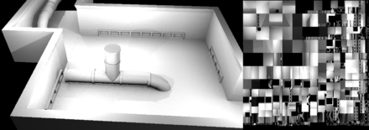
Why? (continued)
Light map
  Bake lighting into texture
  Texture like normal
  Overlay the “lighting layer”
  Instant shadows
  No dynamic lighting
  Good performance
  Baker
    Blender
    GtkRadiant
  Superior Ray traced lighting

Slide 5
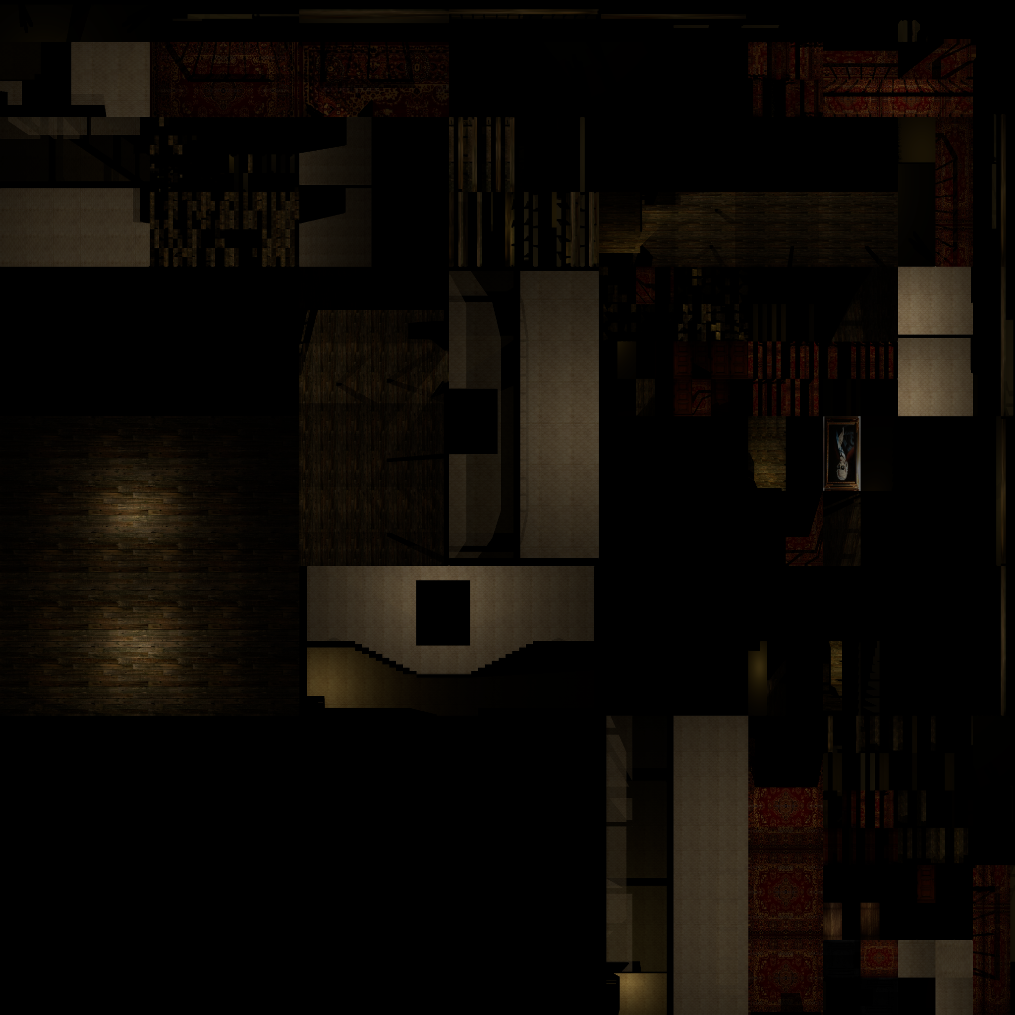
Why not just bake the entire texture?

Slide 6
Baking diffuse map
Wasteful
Need massive texture or blurry I.e wallpaper
Blurry shadows however don’t look bad

Slide 7
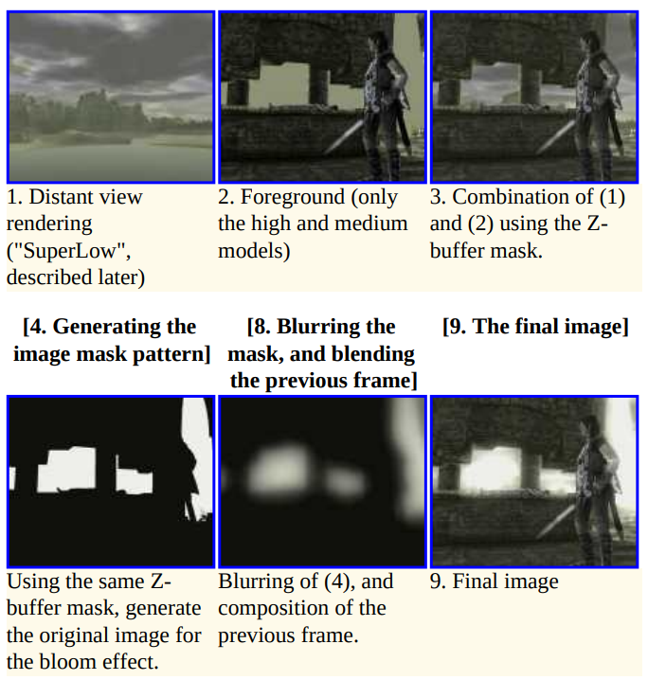
Involving complex pipelines
Very useful for post processing effects like bloom!

Slide 8
Simple merge two textures
Lightmap pixel will be between 0 and 1
vec4 tex = texture2D(in_Texture, ex_TexCoord); vec4 lm = texture2D(in_Lightmap, ex_LmCoord); gl_FragColor = tex * lm;

Slide 9
Any Questions?

