Slide 1

Game Engine Programming
Renderer

Slide 2
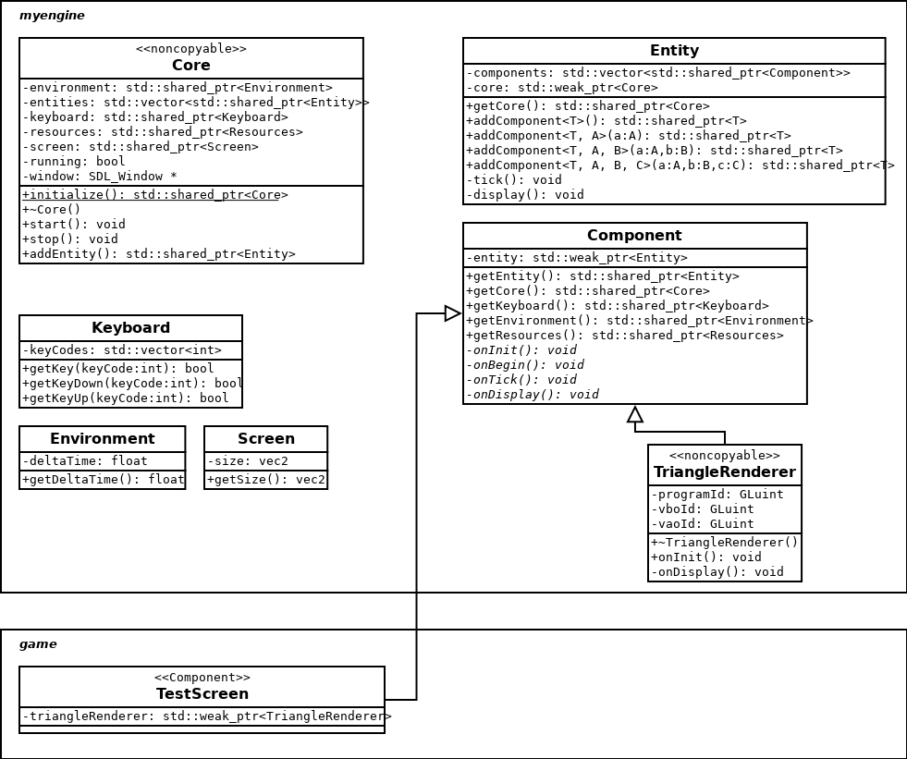
The CES

Slide 3
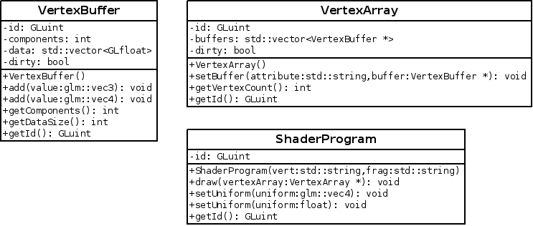
Rather than raw OpenGL

Slide 4
SDL_Window *
Too complex to wrap into a smart pointer.
  You do not necessarily control its memory
  SDL_Quit for example will take it out
  Double free when smart pointer goes out of scope
  You must make sure the containing class cannot be copied

Slide 5
Preventing a class being copied
class NonCopyable { protected: NonCopyable() {} ~NonCopyable() {} private: NonCopyable(const NonCopyable &); NonCopyable& operator=(const NonCopyable &); };
class Core : private NonCopyable { ... };

Slide 6
Tasks remaining
Renderer will need to take
  Model matrix (entity position)
  View matrix (camera position)
  Projection matrix
  Vertex Array (Mesh)
  Shader (Material)

Slide 7
Where do these positions come from?
Transform component
  glm::vec3 position
  glm::vec3 rotation
  glm::vec3 scale
glm::quat if you are looking at flight sims
  Gimbal lock

Slide 8
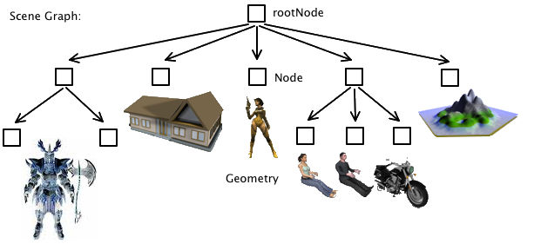
Scene Graph

Slide 9
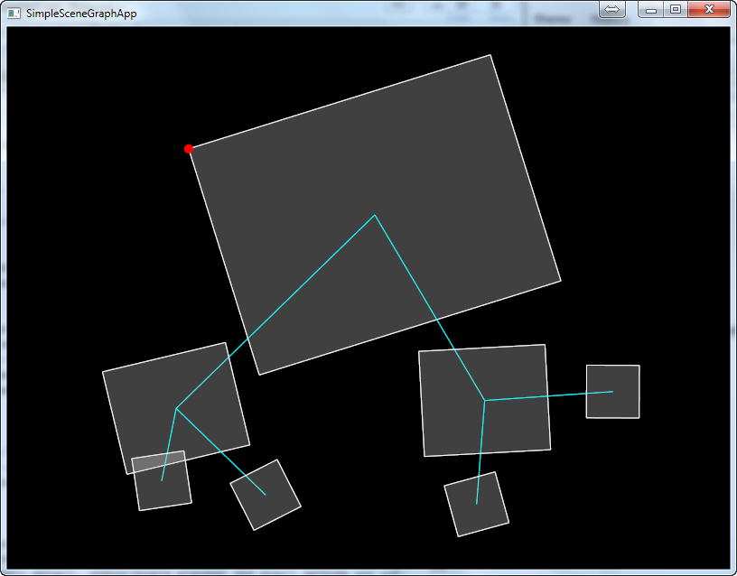
Scene graph (contin)

Slide 10
Scene Graph (contin)
Essentially another logical hierarchy
Each transform has a parent and potentially children
If the parent moves, rotates or scales, so does its children
Rather than returning the “localPosition”
  Go up the tree transforming your model matrix by all of the parents

Slide 11
Pseudo code
Function GetPosition Mat4 model Traverse up each parent model = model * transform(parent’s position, rotation, scale) Return model * localPosition EndFunc

Slide 12
We know how to add a component
Entity::addComponent<T>(...)

Slide 13
We need to recover a component
std::shared_ptr<T> Entity::getComponent<T>();
Use of std::dynamic_pointer_cast<T>(t)
  dynamic_cast but for smart pointers
  static_cast not appropriate

Slide 14
Next Steps
Expand Renderer
  Projection matrix from Screen
  View matrix from current camera’s transform
  Provide a Mesh rather than hardcoded triangle
Resource loader
  Model loader
    Will be provided or
    Dust off your own from PGG!

Slide 15
Any Questions?

