Slide 1

Game Engine Programming
Introduction

Slide 2
What is a game engine?
Called a framework in other software professions
A bunch of useful / reusable code
Collection of libraries
Workflow / tooling

Slide 3
Why do developers use a game engine?
Reduce development time / costs
Increase scalability of project
Consistent API for additional components
Code reuse
3rd Party support
Generic (Workforce knowledge)
Tools, test suite, build system
Prosumers
  Well marketed
  Naive

Slide 4
Disadvantages of a Game Engine
Sometimes generic (some parts unused)
Overkill (For 2D, do you really need one?)
Complex to learn
Hard to port to upcoming platforms (I.e Tizen, WebAssembly)
Hard to backport to older or lighter platforms (QNX, RTEMs, INTEGRITY, Plan 9)
A cancerous sprawling mess
  “Lets put that cat hammer into the engine so we can use it for another game... maybe in the future”

Slide 5
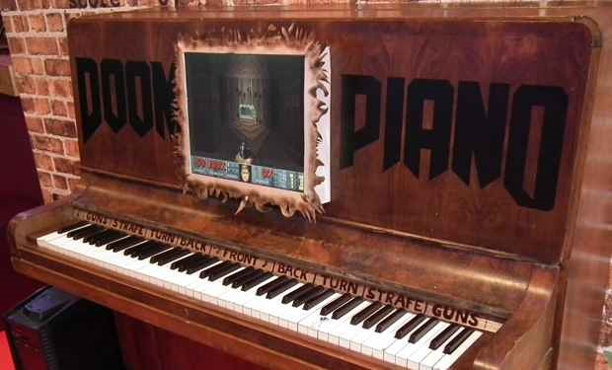
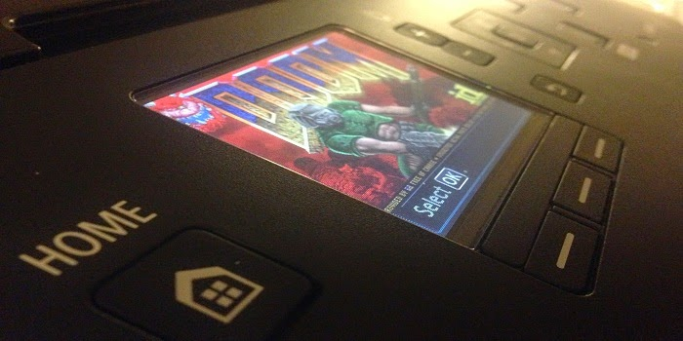
The Dawn of Game Engines
John Carmack
Doom
IdTech 1
Modify “wad” files
Modding
Total Conversions

Slide 6
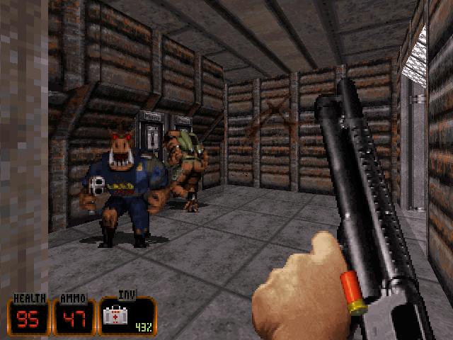
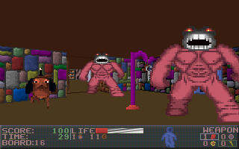
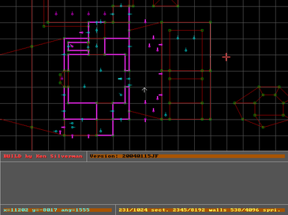


Early “AAA” Game Engine
Ken Silverman (when he was 17)
Build Engine
Ken's Labyrinth
Duke Nukem 3D
Blood
Shadow Warrior

Slide 7
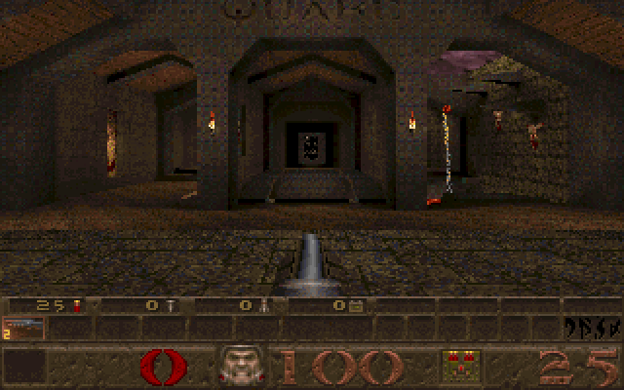
Early Game Engines
Quake
IdTech 2
Modify “pak” files (just .zip)
Quake C

Slide 8
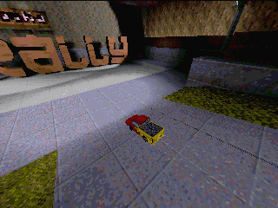
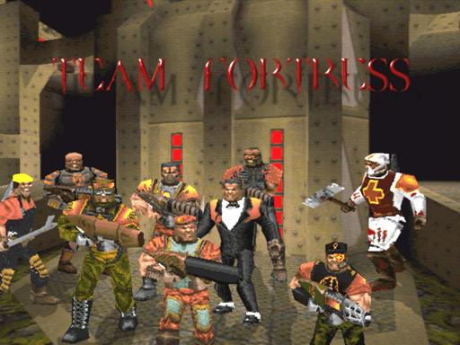
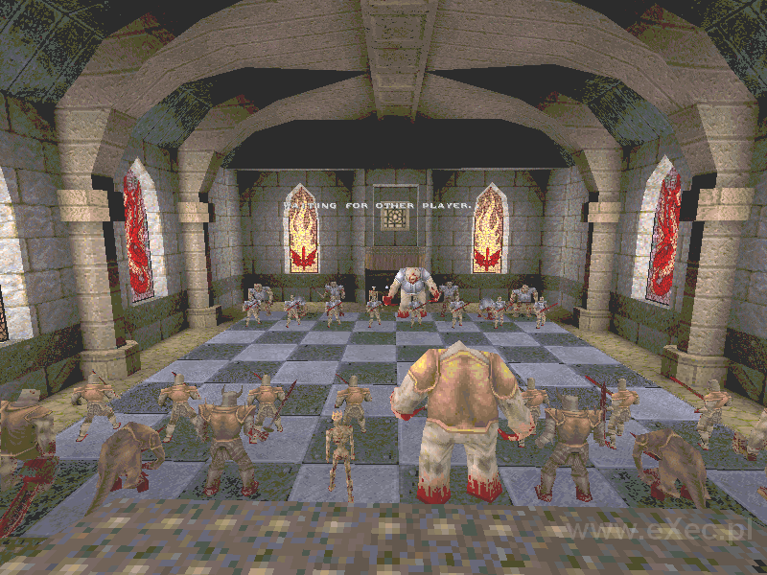
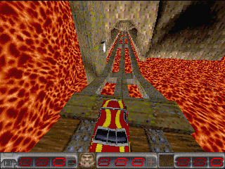

Slide 9
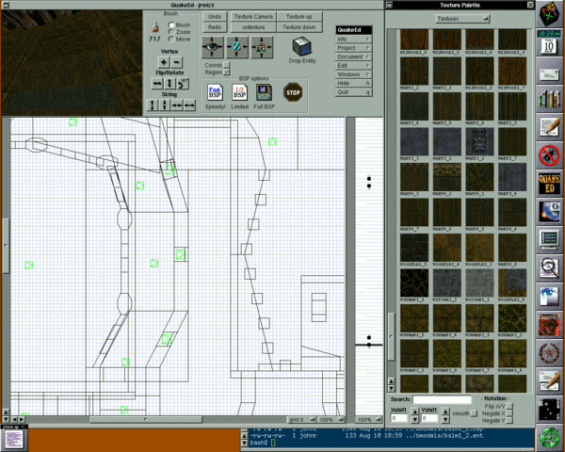

Slide 10
Game Engines ~2000
Quake II (idTech 2), Quake III (idTech 3)
Half-Life (goldsrc, Quake 1 based)
Ogre 3D (open-source)
Irrclich (open-source)
Unreal 1999
Unreal 2
  UnrealEd
  Good C++ API

Slide 11
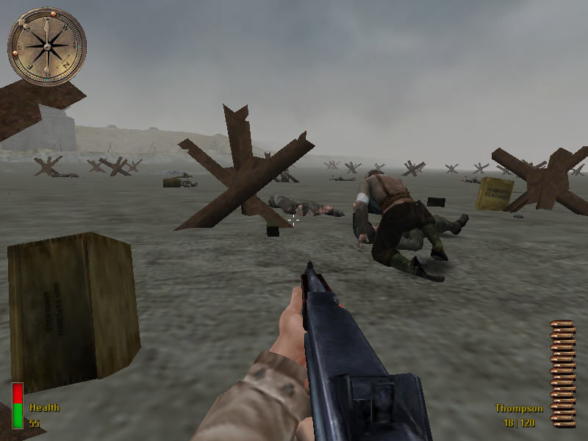
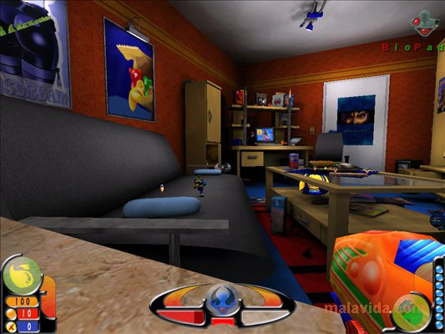
The Modding World
Quake III Arena (idTech3)
  Logic in separate VM to prevent crashes in mods
  Lcc (C compiler hacked to produce bytecode)
  Q3Radiant, QERadiant, GtkRadiant
  Written in C
  SDK

Slide 12
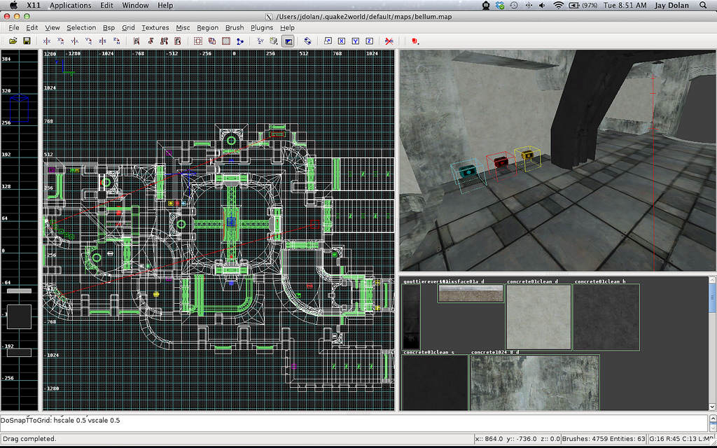

Slide 13


Slide 14
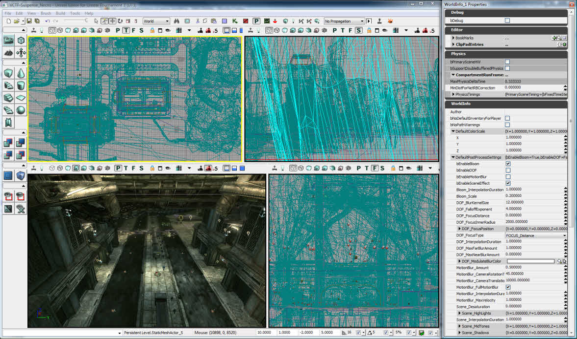

Slide 15
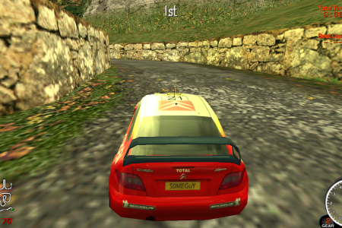
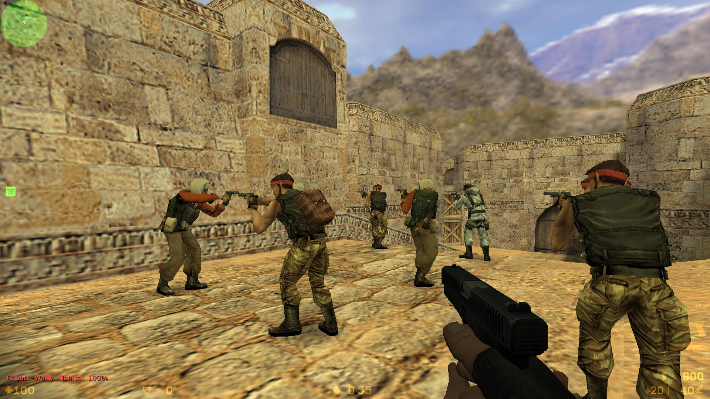
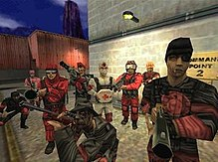
The Modding World
Half-Life
  C++
  Quake Based but heavily modified
  WorldCraft → Hammer
  SDK

Slide 16
The Age of the Prosumer
Making games was seen as fun
  DarkBasic, DarkGDK (Basic, .NET)
  Unreal UDK (Unreal Script, Kismet)
  Microsoft XNA (.NET)
  Unity (.NET)
  Unreal Engine 4 (Blueprint, Kismet 2)

Slide 17
The Death of Modding
With “fun” tools, everyone wants to go it alone
No “money” with mods
Death of a community
Unity / UE4 quite unfriendly to open-source
No longer “hard” to make a game
Making an engine is still very common for more technical developers
  Almost a requirement with OpenGL

Slide 18
Prosumer wars
Unity
Unreal Engine 4
UE4 a little less “nice” to use than Unity
  Unreal Engine built upon for internal AAA usage.
  A bit of a sprawling mess from UE2
  Thief 3, Splinter Cell, UT 2004, Unreal II, COD, Rainbow Six and many, many more
UE4 has C++
  Crucial for AAA middleware. Umbro does not have a nice C# binding
  Unity's C++ is horrid and not meant for direct use. Only binding with C#.

Slide 19
For your CV (as a developer)
An engine will look so much better than more Unity games (you already have some right?).
You want to show off your C++ skills
  This is the industry preferred language (since the late 80s and probably until the known universe implodes)
You want to show off a “bigger” project
Proper documentation and diagrams possible once you escape from “black box” tools

Slide 20
Lets begin!
Scope
Requirements
Dependencies
Design / Architecture
Implementation
  Testing
  Documentation
… game ;)

Slide 21
Scope
Don't make it too generic
  You will never get more generic than OpenGL
    Vulkan
Have a basic game idea in mind and aim for an engine that “could” power it
  Team Fortress Classic
    Could UE4/Unity power it?
Jan 17th doesn't leave us much time :(
  Assignment released November (25th)
Use for final year project?
Use for GACP? Ask Leigh!

Slide 22
Requirements
Really down to you
See assignment marking scheme ;)
3D
C, C++
Resource loading, Textures, Models, Sound
Collision
UI

Slide 23
More Interesting Requirements
Cross platform (Linux, Android, Web, Plan 9)
Networking
Deferred Rendering
Post Processing Pipeline
Animation system
Physics (custom or hook up with Bullet)
AI, bots, waypoints, A*
Scripting (Lua, Javascript (Duktape), etc)
Memory Safety. I.e UE4 has garbage collector with C++

Slide 24
Why C++?
Why not C#?
Why not Java?
Why is C or C++ pretty much the only choice for an engine when it comes to supporting all the different gaming platforms?

Slide 25
Quick Refresher on .NET
Java
Microsoft Sued over J++
Visual Basic 6 killed. Visual Basic .NET very different
C# is the premier .NET language.
It is not part of the C family. It is very restrictive (The C comes from its original codename Microsoft Cool)
Mono is an open-source implementation
VB6 lives on in Microsoft Office MACROs
Actually makes for an easy to use scripting language but you don’t make engines using it
The biggest issue is integration with AAA middleware. C/C++ or you have to make bindings which basically involves writing C/C++ anyway.
“I can just use a binding someone else has made”
  Kinda missing the point
  Future maintenance issues
  You could also just play a game someone else has made instead

Slide 26
Java
C-Sharp is Microsoft’s clone of Java so I would just end up duplicating the slide.

Slide 27
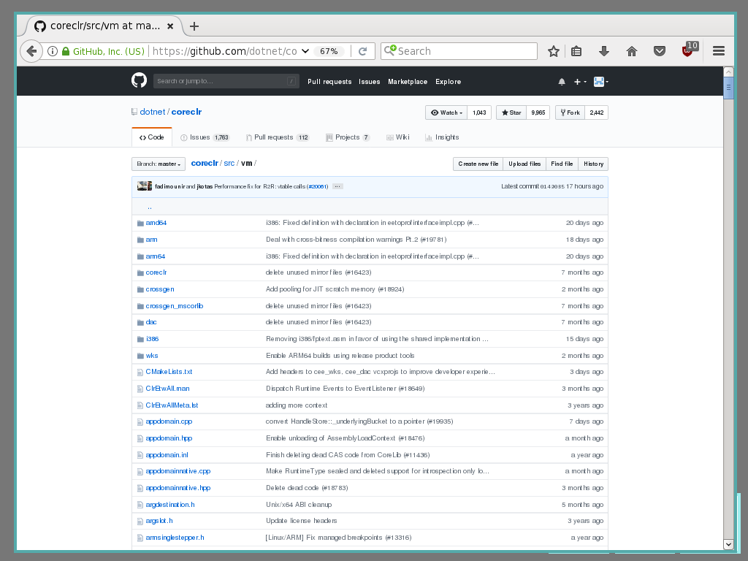

Slide 28
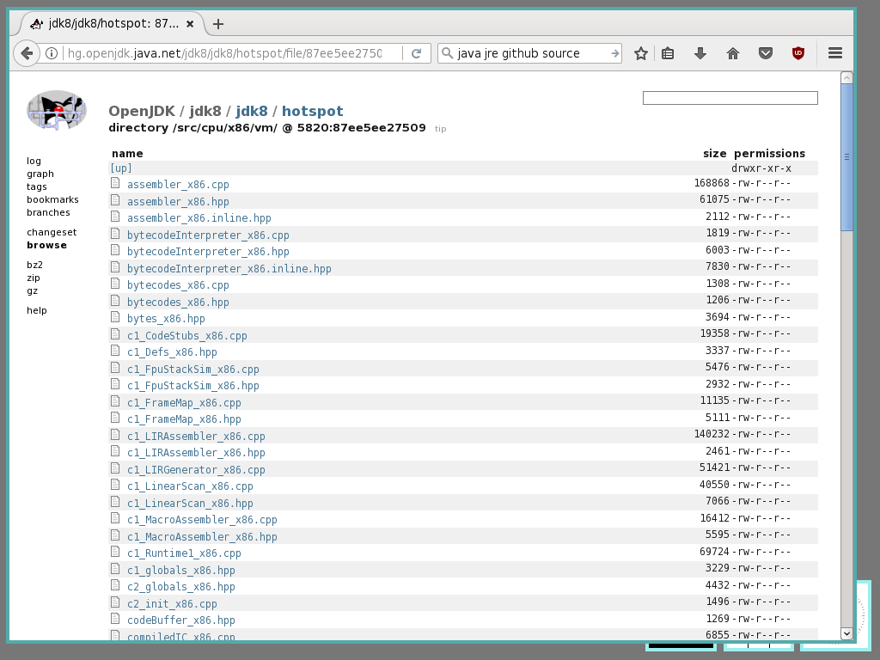

Slide 29
Its not about the language!
It is about the underlying technology
Computers read machine code
  1's, 0's
CSharp produces bytecode
Needs an interpreter (or VM)
C++ produces machine code
Interpreting is relatively expensive
Cut out the middle man
Homogeneous C++

Slide 30
The interpreter does JIT
For speed
But...
Notice anything even more depressing about Microsoft's coreclr?
This is the reason why Unity is relatively slow to embrace new platforms
  UE4 supported Web output via Emscripten over 1 year earlier than Unity.
Unity had to write a bytecode to C++ transpiler to get web support!

Slide 31

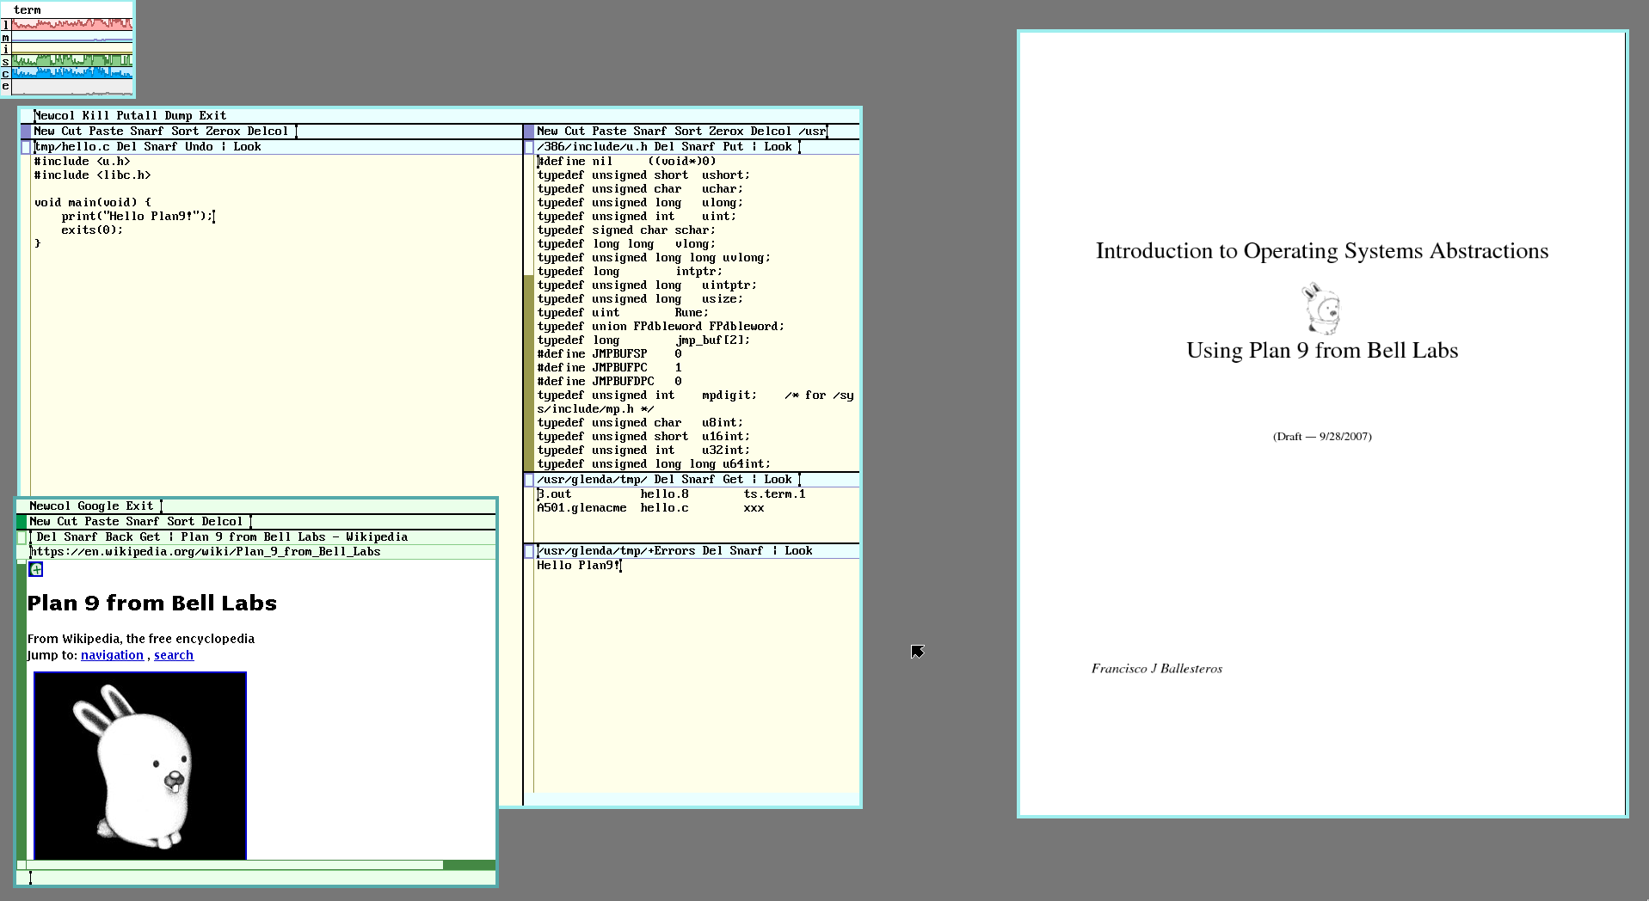
tl;dr;
C++ isn’t particularly nice
The alternatives are just woefully inadequate
The industry is still a little bit stuck with the backwards idea of a big VM to abstract all the “hard” things.
Stems from Alef, Limbo on Plan 9 (1992)

Slide 32
Alternatives
Mozilla Rust
  Native but also safe by default
  Single implementation
Google Go
  Native but also safe by default
  Less portable (garbage collector)
Objective-C
  Same issues as C/C++
  Same benefits as C/C++
  It will outlive Swift (you heard it here first!)

Slide 33

Dependencies
OpenGL, Vulkan, Direct X
  If Vulkan, have a word with me first
SDL, (free)Glut, SFML
OpenAL, SDL_mixer, FMOD
Winsock, BSD Sockets, SDL_net
Bullet, Physx
?
Each dependency you rely on often makes your project that little bit less cross platform / portable
A decent engine will often allow for interchangeable dependencies.

Slide 34
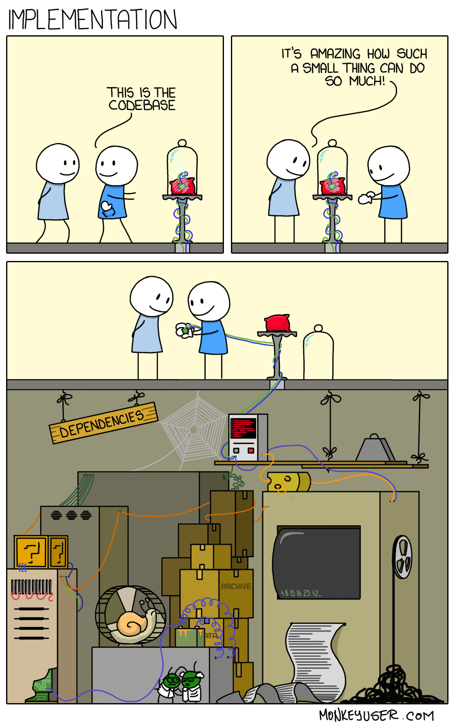

Slide 35
Mystery Dependency?
If it disappears, you will need to change quite a bit
It restricts your developer market to under 40% (TIOBE).
Restricts your project to just Windows
Disables the use of Valgrind and other professional testing tools

Slide 36
Microsoft Visual Studio
Or more specifically the build system
msbuild

Slide 37
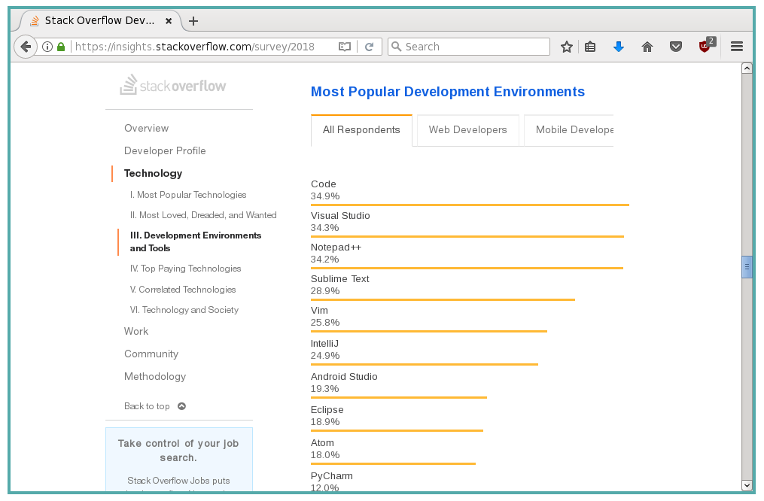

Slide 38
What is wrong with Visual Studio?
It isn't about what you like to use
It is about your client
It is about the users (developers) of your product (engine)
It is about reach (Just like games themselves)
  Will you support 2010, 2012, 2013, 2015, 2017, 2020 all at once? That will be hard work!
  IOS, Android, Linux, Web, PS4?

Slide 39

Enter CMake
Allows you to keep with Visual Studio
But allows you to not be “tied” to it
Ignore my rant
  Time is a little bit too tight to learn Vim

Slide 40
An example of what would be expected to use for AAA
Intel C++ (icc) compiler for Windows Desktop
Emscripten (em++) C++ compiler for Web
Clang++ (clang++) for Android
GCC (g++) for Linux
Clang (clang++) for FreeBSD / OpenBSD
Clang (clang++) for Mac OS X
Clang (clang++) for iOS
GCC (g++) for PS3 (CellOS)
Clang (clang++) for PS4 (OrbisOS)
(Emscripten is actually a modified Clang compiler)

Slide 41
Why CMake?
Don't need to trawl config files to see include paths, build settings, etc...
Deterministic. Visual Studio 2020 will not break your project
Can be tooled
  Works better with Git (more later)
  Works better with Build Servers
  Works better with Test Scripts
  Works better with installer builders

Slide 42
Hello World
cmake_minimum_required(VERSION 2.6) project(HELLO) add_executable(hello main.cpp )
VERSION 2.6 | Minimum version. 3.2 gives more features but will not work with older versions.
HELLO | The “Solution” name. The entire project name
hello | The executable name.

Slide 43
Flibble Engine
cmake_minimum_required(VERSION 2.6) project(FLIBBLE) add_library(flibble src/flibble/Entity.cpp Src/flibble/Component.cpp ) add_executable(game src/game/main.cpp )
VERSION 2.6 | Minimum version. 3.2 gives more features but will not work with older versions.
FLIBBLE | My engine name
flibble | The library name containing my engine (libflibble.so).
game | My example executable name (that uses the flibble engine)

Slide 44
To build it
mkdir build - Create temp dir
cd build - Go into temp dir
cmake .. - Generate project
cmake --build . - Build project in curr dir

Slide 45
To build it (awkwardly)
Make a new directory using the file explorer
Use the cmake GUI tool and tell it to use the correct directories
Open the generated Visual Studio project files
Select the startup project
Build it by clicking “play” button

Slide 46
To clean up
Just delete the “build” directory and you are back to a fresh project
You can now generate the build system again. Even for a different platform.

Slide 47

Git
Git with CMake is simple.
Don't commit “build” folder.
That is temporary
Don't even bother with a .gitignore with CMake projects
git add src

Slide 48
Benefits in Git
CMakeLists.txt is mergable
  Yes, developers can actually modify project settings at the same time!
Changes can be logged
  git diff

Slide 49
In the labs
Lets spend some time setting up the project filesystem
Lets set up a git repo
Collect dependencies you think you might want and add them to repo
Small framework CmakeLists.txt file

Slide 50
Important Dates
^{17th} January 2019 - Engine Assignment
^{20th} Januray 2019 – Exam

Slide 51
Next Steps
Design / Architecture
  Component Entity System

Slide 52
In the labs
Get you set up with an empty git repo
Get set up with SDK
Get set up with CMake
Basic scaffolding of project
Look at existing engine designs

Slide 53
Any Questions?

