Slide 1

Game Engine Programming
Parallel Processing

Slide 2
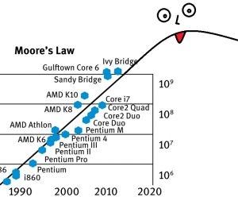
Moore’s Law

Slide 3
Aaand...
Devices are getting weaker than in the early 2000!
Phones
Raspberry Pi
Keep energy / temperature down
Keep users “dumb”
  Streaming / DRM
  Consumption devices

Slide 4
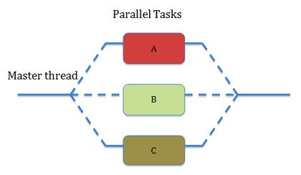
Tasks in parallel

Slide 5
POSIX Threads (pthreads)
pthread_t inc_x_thread; if(pthread_create(&inc_x_thread, NULL, inc_x, &x)) { throw std::exception(); } if(pthread_join(inc_x_thread, NULL)) { throw std::exception(); }
void *inc_x(void *x_void_ptr) { return NULL; }

Slide 6
OpenMP
#pragma omp parallel #pragma omp for for(int py = bboxmin.y; py < cp; ++py) { ... #pragma omp critical { // modify shared data } ... }
Remember to enable OpenMP flag in when invoking the compiler
/openmp on cl
-fopenmp on everything else (clang, gcc, icc, etc)

Slide 7
OpenCL
__kernel void hello(__global char* string) { string[0] = 'H'; string[1] = 'e'; string[2] = 'l'; string[3] = 'l'; string[4] = 'o'; string[5] = ','; string[6] = ' '; string[7] = 'W'; string[8] = 'o'; string[9] = 'r'; string[10] = 'l'; string[11] = 'd'; string[12] = '!'; string[13] = '\0'; }

Slide 8
NVIDIA CUDA
Basically the DirectX of the compute world
Proprietary and lifespan not guaranteed

Slide 9
Vulkan or OpenGL
Shaders
  GLSL
  SPIR-V
Happen in parallel
Can store outputs in texture

Slide 10
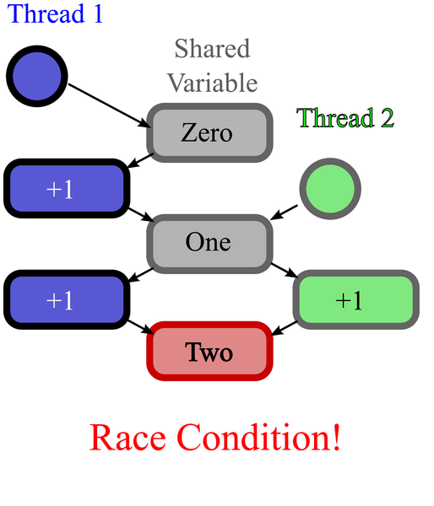
Complexity
Race conditions

Slide 11
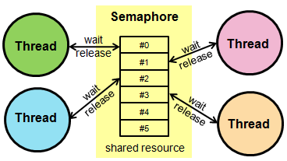
Solution
Mutex

Slide 12
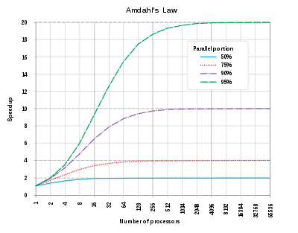
Why not millions of cores?
Amdahl’s Law

Slide 13
Next steps
Try to get some parallelization going for collision
Leighs assignment might benefit from this?
Great for assignments ;)

Slide 14
Any Questions?

