Slide 1

Game Engine Programming
Collision

Slide 2
Box Collision
Simple to implement
  Sphere collision is simplest
  Sphere collision response slightly easier
Axis Aligned
  Doesn’t support rotations
Very effective for pickups

Slide 3
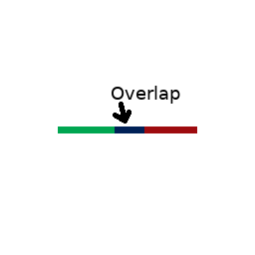
How it generally works
Check each axis individually
If one axis doesn’t overlap, early exit

Slide 4
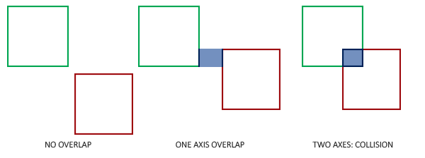
Adding a few more axis
Only if all axis overlap, do we have a collision

Slide 5
But thats only half the difficulty
We want to provide nice integration with the engine
The user can just “add” collision
We do not want the user to have to write code for the collision each frame

Slide 6
Enter the BoxCollider class
What kinds of things will it contain?
How to we define a box?
What kinds of things will it need to do?

Slide 7
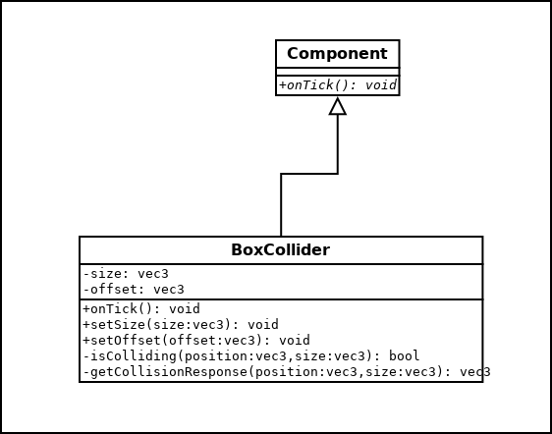
UML

Slide 8
We can detect a collision fairly easy
What should we do with this knowledge?
Perhaps notify the entities involved?
  void onCollision(Collision& c)
  Similar to our onTick().
Remember that c can provide whether:
  it has just started colliding
  is continually colliding
  has finished colliding

Slide 9
Collision event is useful but...
We want the user to avoid handling it themselves
We need to provide a response ourselves
  A response is pretty much what you covered in physics for games
  Can use a physics engine
  Or not
    Older games like Half-Life
    Modern games don’t use physics for everything

Slide 10
Lets simply...
Move the box away until it is no longer colliding
Easier said than done
  Which direction?
  Sphere collision is easier here
    normalize(a.center – b.center)

Slide 11
I call this...
The cludge!

Slide 12
vec3 BoxCollider::getCollisionResponse(vec3 position, vec3 size)
{
float amount = 0.1f;
float step = 0.1f;
while(true)
{
if(!isColliding(position, size)) break;
position.x += amount;
if(!isColliding(position, size)) break;
position.x -= amount;
position.x -= amount;
if(!isColliding(position, size)) break;
position.x += amount;
position.z += amount;
if(!isColliding(position, size)) break;
position.z -= amount;
position.z -= amount;
if(!isColliding(position, size)) break;
position.z += amount;
position.y += amount;
if(!isColliding(position, size)) break;
position.y -= amount;
position.y -= amount;
if(!isColliding(position, size)) break;
position.y += amount;
amount += step;
}
return position;
}

Slide 13
How it works
Do
Move in each direction individually
If still colliding
  Increase the amount you move each time
Loop

Slide 14
Some complexities #1
We need to be able to get entities based on their component
std::vector<std::sr1::shared_ptr<Entity> > smces;
getWorld()->getEntities<StaticModelCollider>(smces);

Slide 15
Complexity #2
We don’t want to collide against ourself
if(*it == getEntity())
{
continue;
}

Slide 16
Complexity #3
We have a thing called an offset
Remember you might not want the position of the collider directly in the center of an entity
  You might even have multiple colliders
qsoft::Vector3 np = getTransform()->getPosition() + offset;

Slide 17
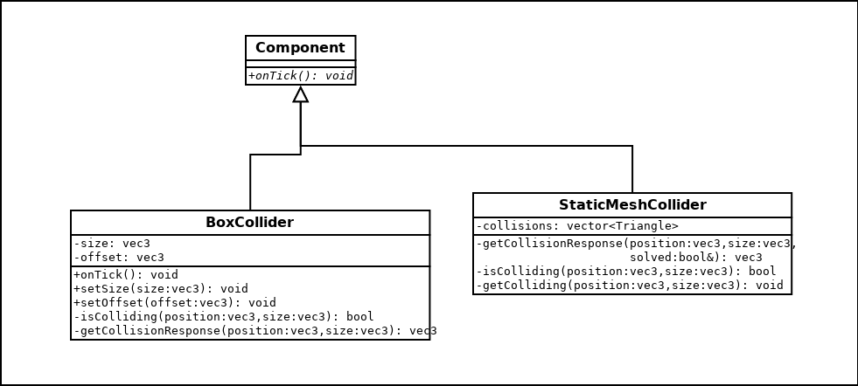
Mesh Collision
Effectively Tri-Box collision
Has some similar aspects to BoxCollider
  Actually BoxCollider does the work

Slide 18
isColliding
Loops through all faces
  Performs TriBox test

Slide 19
Collision Response
We basically apply the “kludge” method
  With some (more) hacks

Slide 20
The differences
Might not be solvable
We want a concept of a step height
We cannot move in just one axis individually

Slide 21
Is not solvable
Just revert back to previous position
Quite rare so “sticking” will not be noticeable
  Usually related to delta time jumping into the middle of a very tiny gap
Use a max solve distance
  To prevent shooting through walls or to the other side of the map in an attempt to “solve”
Don’t be afraid to revert to previous position here
  It might actually be the solution

Slide 22
The step
We basically first find all faces that are facing vaguely upwards
  This is where you define the slope amount
Apply the kludge on just these faces
Go to a max step height

Slide 23
Now for the rest of the faces
Just the “kludge” as usual
But store the normal for each face as you go through it
Now if still not solved; we try once more
  On the average of all the faces

Slide 24
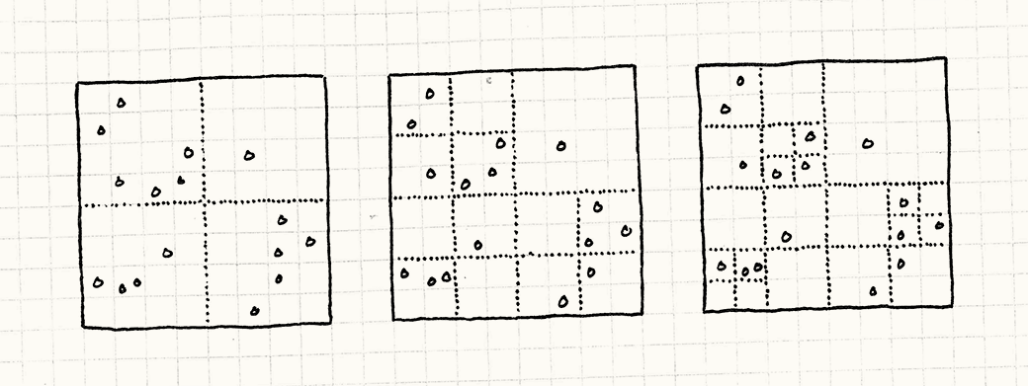
Spatial Partitioning
We don’t need to collide with every face
Only the faces within our grid cell

Slide 25
It really is 2D
Pretend you are using infinitely high columns
  Unless you are making a game set in a skyscraper perhaps

Slide 26
Prepare the columns
Columns are just big boxes
Go through all your triangles during initialization
If colliding with the column, store them in that partition

Slide 27
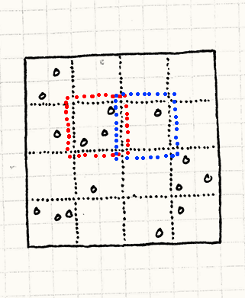
“overlap” the columns
Why do we do this?

Slide 28
A bit of a hack
Your player might be standing between two grids
Some triangles get duplicated but negligible performance impact

Slide 29
Any Questions?

