Slide 1

3D Graphics Programming
Revision

Slide 2
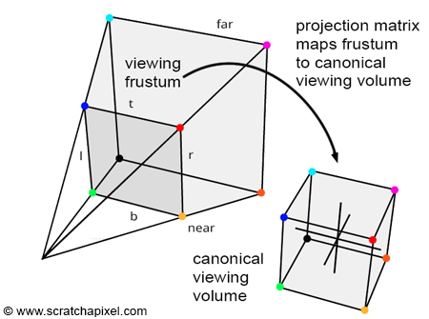
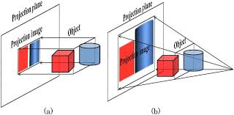
Projection Matrix
Perspective
  Simulate depth
Orthographic
  Great for GUIs

Slide 3
Textures
Stored on memory in the GPU
Data representing rgb[a] data
2D is most important for Games
  Wrapped around a 3D model

Slide 4
Retaining data on GPU
Do not need to keep sending it across from CPU to GPU each frame
Better performance
Not bottlenecked by the system bus
  Or a network
    OpenGL | Distributed

Slide 5
GUIs
GUI elements can be called widgets
Basically just shapes rendered using orthographic projection
Can be stored as a 1x1 “quad” (two triangles)
Scaled to whatever size you need

Slide 6
We are using modern OpenGL
glBegin, glEnd()
glPushMatrix, glPopMatrix
glVertexPointer / glTexCoordPointer
glEnableClientState(GL_VERTEX_POSITIONS)
glEnable
glVertexAttribPointer
glEnableVertexAttribArray

Slide 7
Modern OpenGL can only draw a small number of primitives
Points
Lines
Triangles
Not Quads! (two triangles)

Slide 8
VBOs / VAOs
Data stored in VBOs
Bound together by VAOs
Vertex Buffer Object
Vertex Array Object

Slide 9
We store data in a VBO
Avoid sending it each frame
More efficient

Slide 10
OpenGL workflow
Store model data on GPU
Set up pipeline (shaders)
Tell OpenGL to send model data through pipeline

Slide 11
OpenGL Shaders
Programmable
Part of the programmable graphics pipeline
Perform calculations in parallel
Written in GLSL
  OpenGL Shader Language
NVIDIA’s Deprecated Cg
  Actually transpiled to GLSL

Slide 12
What is the Vertex Shader for?
Perform viewing transformations
  Transform location of points as drawn

Slide 13
Coordinate Space
Where the origin is located
Where the coordinate axis point

Slide 14
What do viewing transformations do?
Convert Vertex positions from one space to another
Mesh data in object space
Model Matrix transforms to world space
View matrix transforms from World space to Eye Space
Projection matrix transforms from Eye Space to Clip Space

Slide 15
What is the Fragment Shader for?
Apply the final fragments color
gl_FragColor = vec4(1, 0, 0, 1);
gl_FragColor = texture2D(in_Texture, ex_TexCoord);
gl_FragColor = vec4(ex_TexCoord, 0, 1);

Slide 16
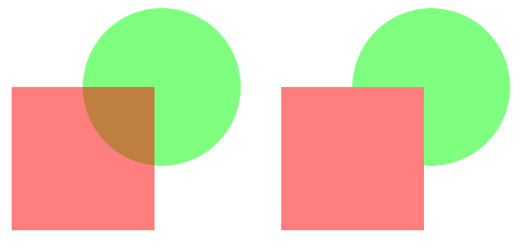
Depth Testing
Ensures objects further away from the camera appear behind other objects

Slide 17
Next Steps
Revision in your first lab (with me)
Test in your second lab (with Connor)
Win the test!
Dynamic Lighting

Slide 18
Any Questions?

