Slide 1

3D Game Programming
Ideas and Design

Slide 2
Planning
You have reading week
And ~4 weeks after that
Your main OpenGL stuff should be in place
The rest of the stuff we can integrate in as we cover it
Games Jam during reading week!

Slide 3
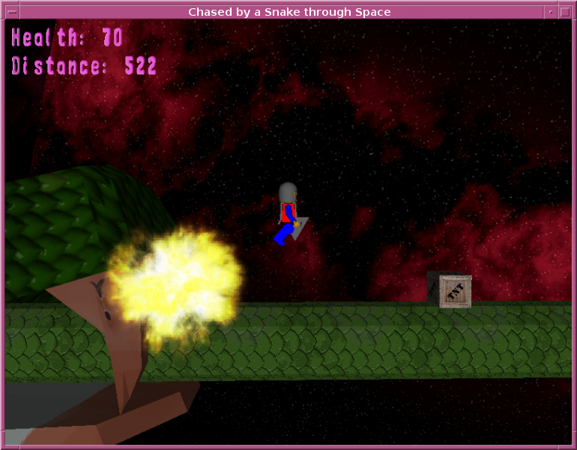
Game Ideas
Simple endless runner
AABB
Basic GUI
Models
Animation?

Slide 4
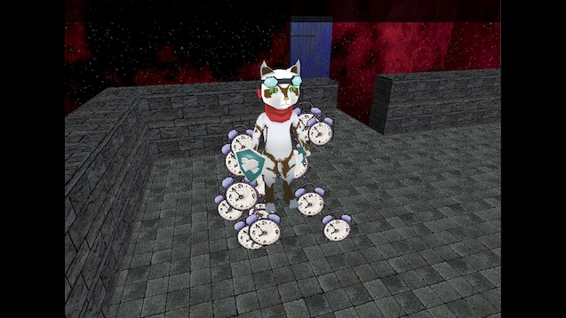
Simple Adventure Game
You can load models
Mouse driven camera
  Orbit
Tri-box Collision
Animation?

Slide 5
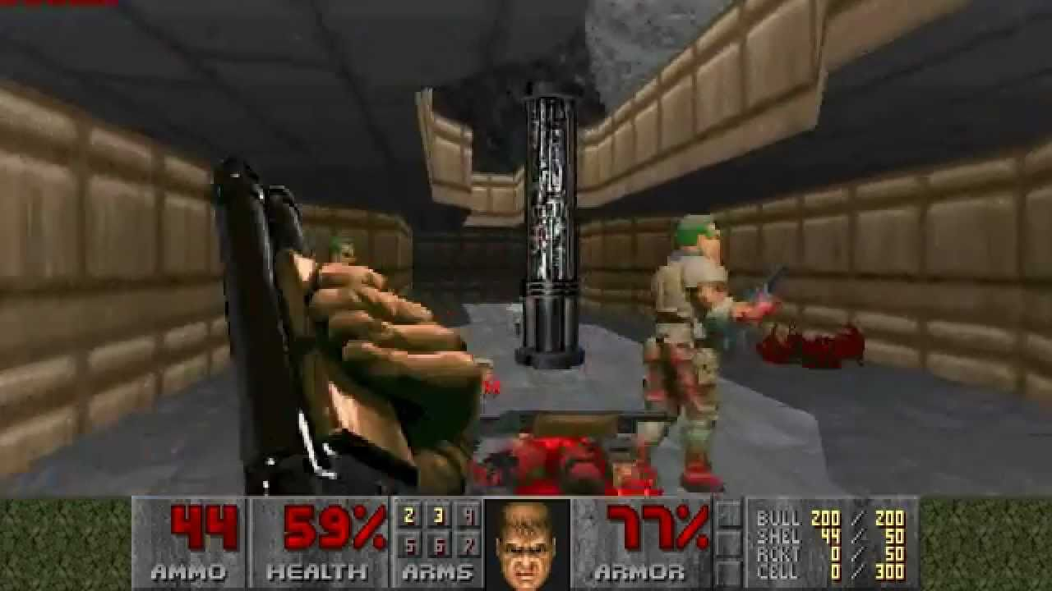
Simple FPS
FPS camera
No animation needed
  Sprite sheets
Tri box collisions - map
AABB – bullets, pickups
GUI Hud

Slide 6
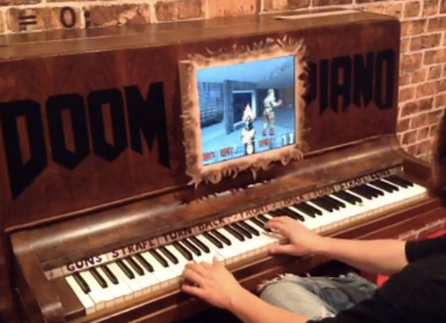
Doom Piano!
A Piano
Electronics for the key
pressure pads

Slide 7
How do we structure a game?
Many different ways
Some better than others
Aim for flexibility
The Component Entity System is a popular choice

Slide 8
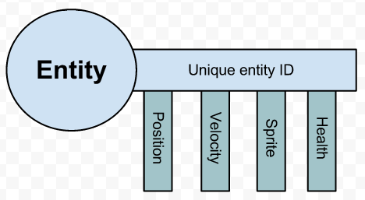
What is a CES?
Architecture / design
Favors composition to inheritance
Not large complex things. ~100 lines max for a basic one.

Slide 9
CES Summary
You have a number of Entities
You attach components to them
The components are what provides the behavior
I.e Player
  Transform
  MeshRenderer
  Collider

Slide 10
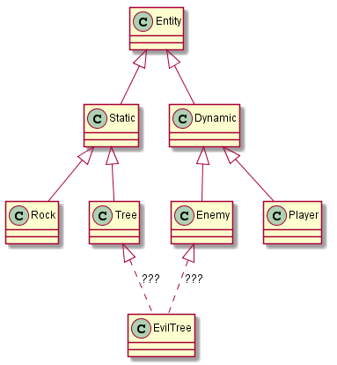
Avoids the “Evil Tree” situation

Slide 11
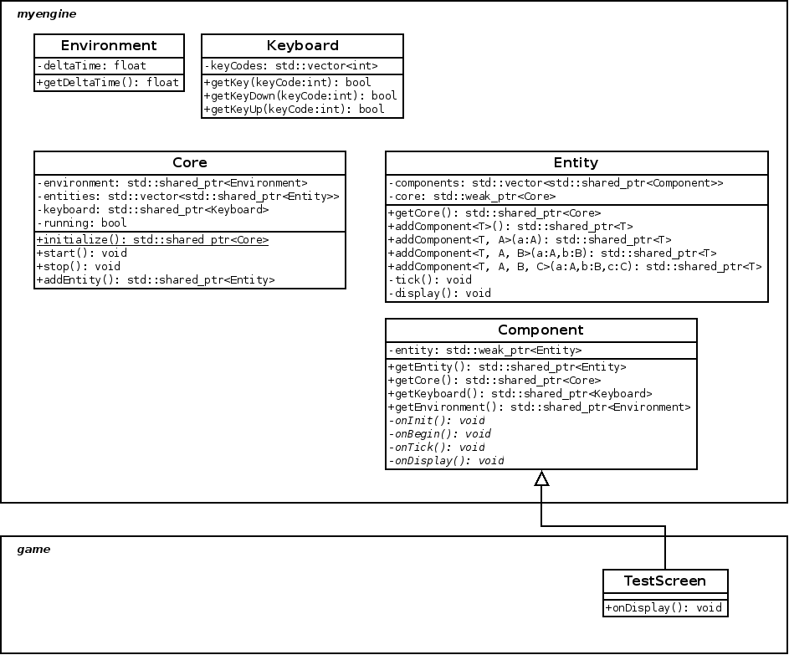
“My Engine” so far

Slide 12
Disadvantages to a CES
“Very object oriented”
Everything is an object
“Chasing pointers” to an object
Very little contiguous memory
Cache misses

Slide 13
“Extensions” to a CES
Hierarchical
Hold a reference to your parent
Easier memory handling with smart pointers
Can navigate the entire game state without hacks such as singletons.
getEntity()->getCore()->getEntityByName(“enemy”)-> getComponent<Enemy>()->applyDamage(4);

Slide 14
Next steps
Have a think on what you might want to make
Perhaps implement a basic CES framework
Games Jam

Slide 15
Any Questions?

