Slide 1

Game Engine Programming
Controls and More

Slide 2
Input
Keyboard
Mouse
Gamepad
Alternative

Slide 3
Keyboard (SDL 2)
while (SDL_PollEvent(&event)) { if(event.type == SDL_KEYDOWN) { if (event.keysym.sym == SDLK_a) { // A has been pressed } } }
Also look at SDL_GetKeyboardState()

Slide 4
Mouse (SDL 2)
if (event.type == SDL_MOUSEBUTTONDOWN) { if (event.button.button == SDL_BUTTON_LEFT) { // Do something . . . } }
if(event.type == SDL_MOUSEMOTION) { // use event.motion.x and event.motion.y; }
Also check out SDL_GetMouseState(...)

Slide 5
Gamepad (SDL)
if( e.type == SDL_JOYAXISMOTION ) { if( e.jaxis.which == 0 ) { if( e.jaxis.axis == 0 ) { } } }
GamePad API is the new way to go with SDL 2 https://davidgow.net/handmadepenguin/ch6.html

Slide 6
Other controllers
Generally libusb
RS-232
OpenCV (streaming visuals)
All C
Consumer APIs
Leap motion
Oculus Rift
Brain Sky

Slide 7
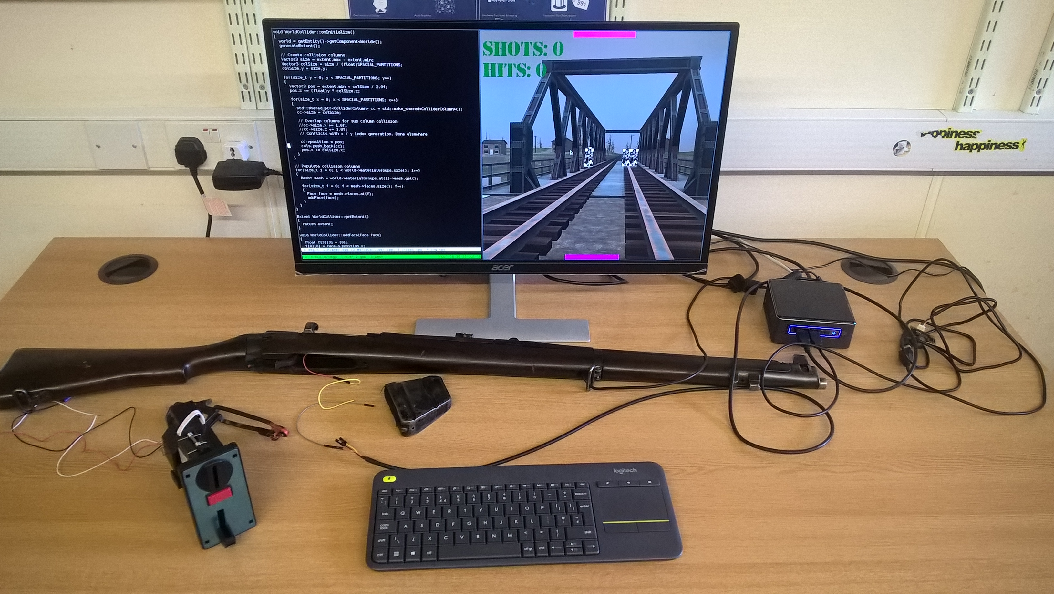
A recent one (RS-232)

Slide 8
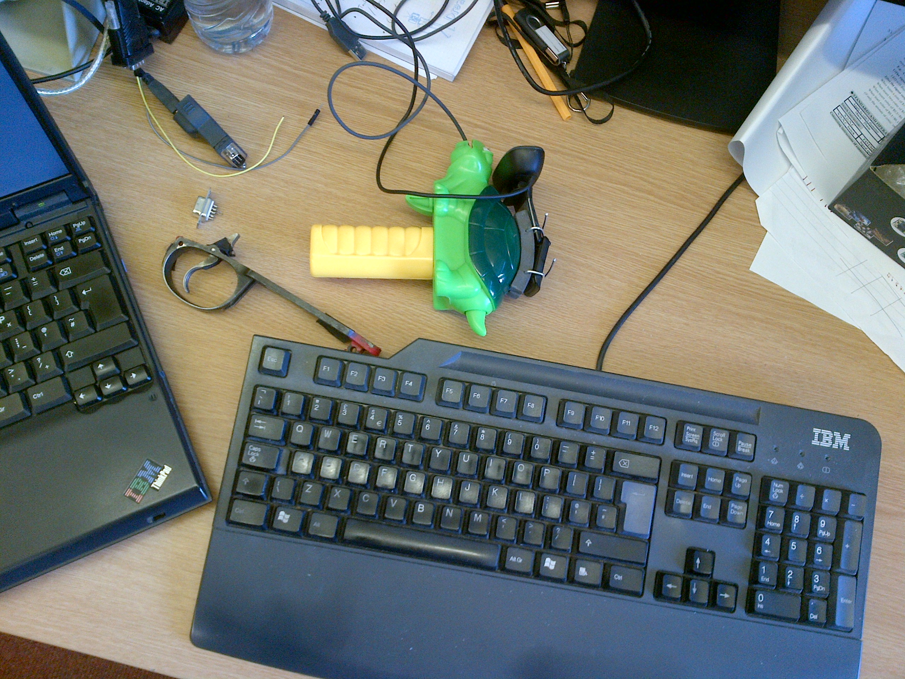
The prototype (Mouse)

Slide 9
RS-232 Protocol
Tx
Rx
Gnd (but who cares ;)
Basically read and write like a file
“Opening” the file is the only complex part

Slide 10
Planning
You have reading week
And not too long after that
Your main OpenGL stuff should be in place
The rest of the stuff we can integrate in as we cover it
  Controllers
  Animation
  Multiple cameras
  Post Processing
Games Jam during reading week!

Slide 11
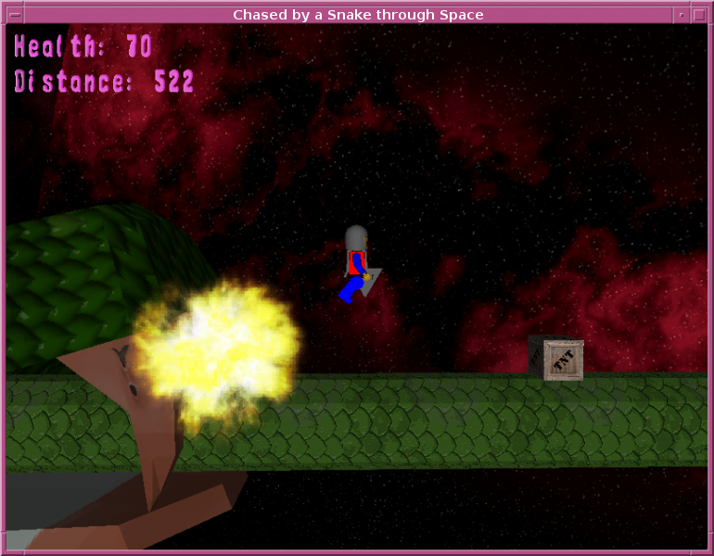
Game Ideas
Simple endless runner
AABB
Basic GUI
Models
Animation?

Slide 12
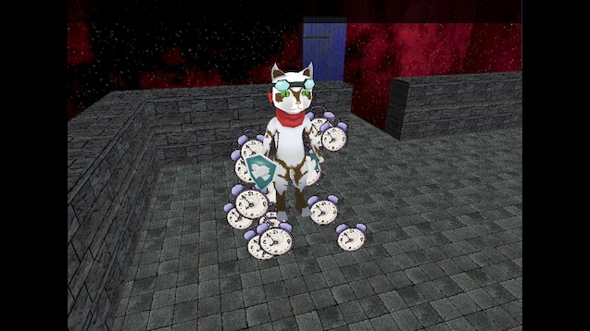
Simple Adventure Game
You can load models
Mouse driven camera
  Orbit
Tri-box Collision
Animation?

Slide 13
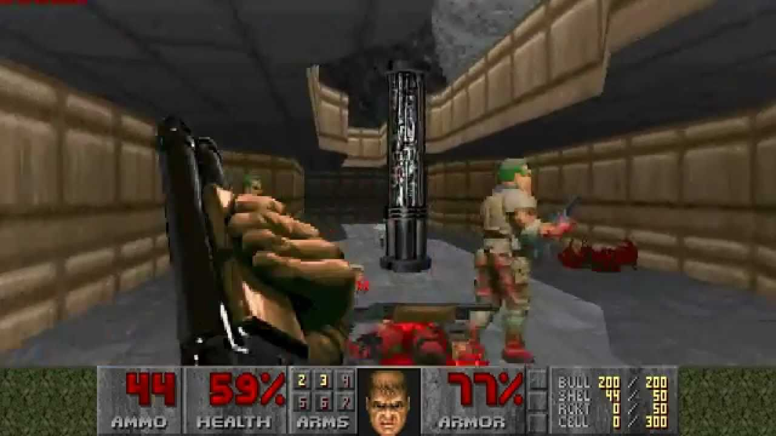
Simple FPS
FPS camera
No animation needed
  Sprite sheets
Tri box collisions - map
AABB – bullets, pickups
GUI Hud

Slide 14
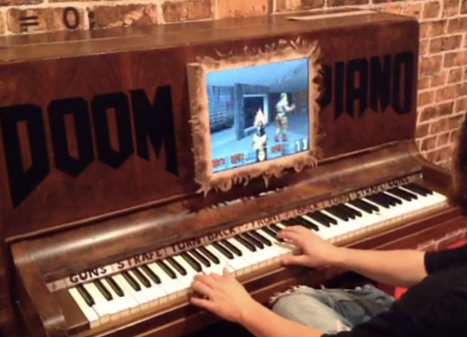
Doom Piano!
A Piano
Electronics for the key
pressure pads

Slide 15
Next steps
Have a think on what you might want to make
Make a start
Try to put the classes in place you may need
Games Jam

Slide 16
Any Questions?

