Slide 1

Game Engine Programming
Recap

Slide 2
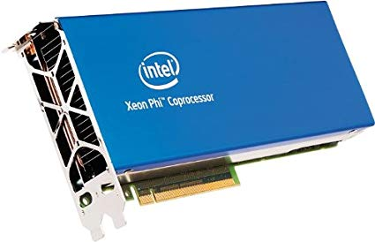
Why do we use a GPU?
Performance
GPUs are not “more powerful”
Parallelism
Micro threads
Certain tasks are faster if the work can be divided

Slide 3
How can work be divided?
Think of a ray tracer
Each ray handled by one GPU process
  Workload partitioning more common (over utilization)
Rasterisation, each triangle can be done in parallel

Slide 4
The rest is still just maths
Ray tracing
  Project out a ray from each pixel on screen
  See what it collides with
  Project out more rays from that point
  Most of you did this for your assignment
Rasterisation
  Projecting point from 3D space onto 2D screen
  Bresenham's line algorithm
  Interpolation of points
  Some of you did this for your assignment

Slide 5
GPUs currently favour rasterisation
Faster process (on current hardware)
Less accurate
A lot needs to be faked
NVIDIA RTX is first consumer hardware looking at ray tracing
I predict in 20 years, we will just use the CPU (they will have so many cores by that point)

Slide 6








Graphics API’s
3Dfx Glide
OpenGL
Direct X
AMD Mantle
Metal
Vulkan

Slide 7
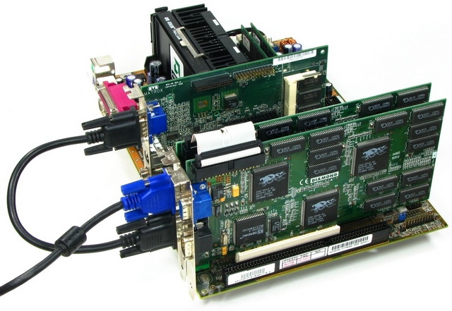
The Voodoo 2

Slide 8
OpenGL (and Vulkan) not libraries
They are specifications
Thus the “open” in the name
Implemented by your GPU manufacturer
Open closed source
Mesa (On Linux) is open-source
Because of this, can never really die

Slide 9

Vulkan will keep everything going
DXVK
Molten VK
GLO
GLide (kept glide alive. I.e Carmageddon 2)
ANGLE (OpenGL|ES → DirectX)
DirectX 10 maps to OpenGL 4.x

Slide 10

SDL 2
A small wrapper around
  Win32 API / X11 / Cocoa Window System
  OpenGL
  Direct X on Windows
  OpenGL / Metal on macOS
  GCM on PS4

Slide 11
OpenGL
Versions
  1.2 (oldschool)
  2.1 (most compatible for now)
  3.0 (disappointing because old crud remained)
  4.6 (the very latest that no-one can run ;)

Slide 12
How versions are handled on Windows
Windows provides version 1.2
We point the missing functionality towards the driver manufacturers implementation
Some manufacturers provide extensions that are not in the standard. Usually ending with EXT. They sometimes make it into the standard a few yars later.
  glGenBuffersEXT

Slide 13

Enter, glew
GL Extension Wrangler
We use this to manage the extensions manually.
Basically makes the Windows implementation of OpenGL look as modern as it can
#include <GL/glew.h> instead of <GL/gl.h> and call glewInit(). Done

Slide 14
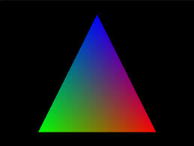
Drawing a triangle
Quite involved
Do it once and you can reuse code
We abstract the hard bits behind our game engine

Slide 15
The steps...
Upload positions of triangle to GPU (VBO)
Organise that data on the GPU (VAO)
Compile vertex shader
Compile fragment shader
Link vertex and fragment shader
Draw

Slide 16
Shaders
Vertex Shader
  Deals with the points (vertices) of the shape
  Position
  Colors
  Vertex lighting

Slide 17
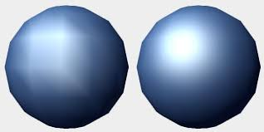
Shaders (contin)
Fragment Shader
  Deals with the fragments within a face
  The “pixels”
  Colors per-pixel
  Per-pixel lighting

Slide 18
GLSL
GL Shader Language
  NVIDIA Cg is deprecated but still a popular alternative (Unity uses it)
Very C-like with a few C++ elements.
Inbuilt mathematics features such as vec3, mat4, etc.
Some of it may look familiar because glm’s naming was based upon it.

Slide 19
In the labs
We will get you set up with OpenGL
We will draw a triangle

Slide 20
For your CV (as a developer)
OpenGL will look so much better than more Unity games (you already have some right?).
You want to show off your C++ skills
  This is the industry preferred language (since the late 80s and probably until the known universe implodes)
You want to show off a more technical project

Slide 21
Next Steps
Lets wrap OpenGL
  So we don’t need to use it directly
  We don’t need so much flexibility

Slide 22
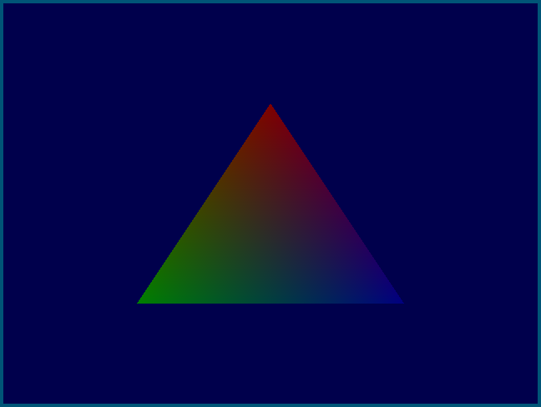
An example

Slide 23
An example (Usage)
VertexBuffer *positions = new VertexBuffer();
positions->add(glm::vec3(0.0f, 0.5f, 0.0f));
positions->add(glm::vec3(-0.5f, -0.5f, 0.0f));
positions->add(glm::vec3(0.5f, -0.5f, 0.0f));
VertexBuffer *colors = new VertexBuffer();
colors->add(glm::vec4(1.0f, 0.0f, 0.0f, 1.0f));
colors->add(glm::vec4(0.0f, 1.0f, 0.0f, 1.0f));
colors->add(glm::vec4(0.0f, 0.0f, 1.0f, 1.0f));
VertexArray *shape = new VertexArray();
shape->setBuffer("in_Position", positions);
shape->setBuffer("in_Color", colors);
ShaderProgram *shader = new ShaderProgram("simple.vert", "simple.frag");
// in the draw
shader->setUniform("in_Lightness", 0.5f);
shader->draw(shape);

Slide 24
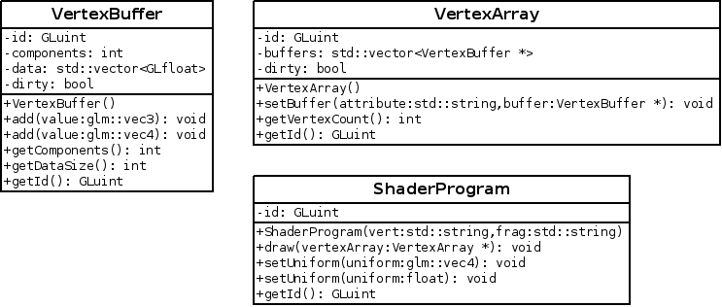
An example (UML)

Slide 25
Creating Objects
You already know this… but
Be careful of erroneous #includes
  Forward declare
Constructors cannot return error codes
  Exceptions
Avoid new and delete
  Smart pointers

Slide 26
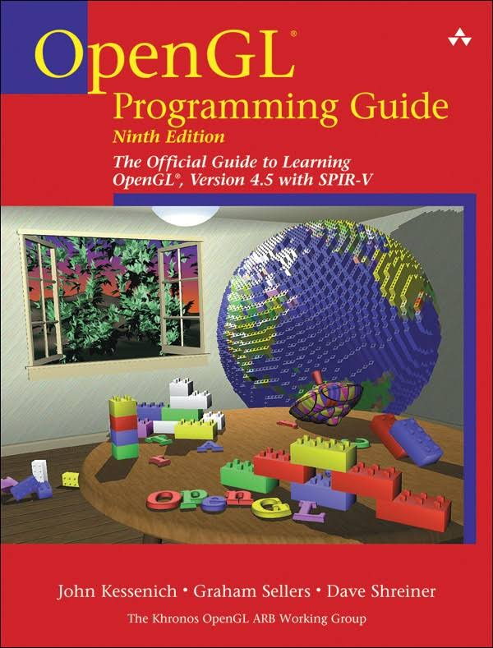
Reading Material
OpenGL Red Book
  Get the newest you can
  4.5 currently
https://learnopengl.com/
  Good content
  Following it will make it hard to make a game
  Use as reference only

Slide 27
Any Questions?

