Slide 1

Game Engine Programming
Audio

Slide 2
What is audio?
“A thing that all developers leave to the very last second”

Slide 3
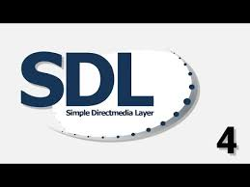


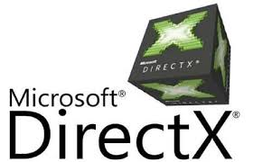
Audio APIs

Slide 4
We use OpenAL-soft
Driver awkward to install
Connects to specific audio cards
OpenAL-soft uses underlying platform library
  DirectAudio / SDL on Windows
  ALSA / Pulse on Linux
  OSS on BSD

Slide 5
Underlying API be very simple
cat /dev/urandom > /dev/dsp0

Slide 6
OpenAL is very portable
Like OpenGL, it mimics a specification
  Windows, Linux, BSD, macOS, Emscripten

Slide 7
How to initialise it
ALCdevice* device; ALCcontext* context; rtn->device = alcOpenDevice(NULL); if(!rtn->device) { throw std::exception(); } rtn->context = alcCreateContext(rtn->device, NULL); if(!rtn->context) { alcCloseDevice(rtn->device); throw std::exception(); } if(!alcMakeContextCurrent(rtn->context)) { alcDestroyContext(rtn->context); alcCloseDevice(rtn->device); throw std::exception(); }

Slide 8
Remember to clean up
alcMakeContextCurrent(NULL);
alcDestroyContext(context);
alcDestroyContext(context);

Slide 9
Loading a sound buffer
ALuint id = 0; ALenum format = 0; ALsizei freq = 0; std::vector<char> bufferData; alGenBuffers(1, &id); load_ogg(path, bufferData, format, freq); alBufferData(id, format, &bufferData[0], static_cast<ALsizei>(bufferData.size()), freq);

Slide 10
Creating a sound source
ALuint sid = 0; alGenSources(1, &sid); alListener3f(AL_POSITION, 0.0f, 0.0f, 0.0f); alSource3f(sid, AL_POSITION, 0.0f, 0.0f, 0.0f); alSourcei(sid, AL_BUFFER, impl->id); alSourcePlay(sid);

Slide 11
More complex
float variance = (std::rand() % ((int)varMin + 1 - (int)varMax) + (int)varMin)/1000.0f; ALuint sid = 0; alGenSources(1, &sid); alListener3f(AL_POSITION, 0.0f, 0.0f, 0.0f); alSource3f(sid, AL_POSITION, 0.0f, 0.0f, 0.0f); alSourcei(sid, AL_BUFFER, impl->id); alSourcef(sid, AL_PITCH, variance); alSourcef(sid, AL_GAIN, vol); alSourcePlay(sid);

Slide 12
Sources can leak
Should wait for them to finish and delete them
for(size_t asi = 0; asi < audioSources.size(); asi++) { ALuint& as = audioSources.at(asi); ALint state = 0; alGetSourcei(as, AL_SOURCE_STATE, &state); if(state == AL_STOPPED) { alDeleteSources(1, &as); audioSources.erase(audioSources.begin() + asi); asi--; } }

Slide 13
Ogg / Vorbis
Like OpenGL, we load I.e png to display
With OpenAL, we load I.e vorbis to play
Ogg is the container, vorbis is the codec
libogg
libvorbis
(I.e libpng)

Slide 14
Libogg / libvorbis a little fiddly
Just like using libpng ;)
bytes = ov_read(&oggFile, array, 2048, endian, 2, 1, &bitStream);

Slide 15
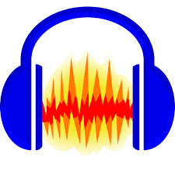
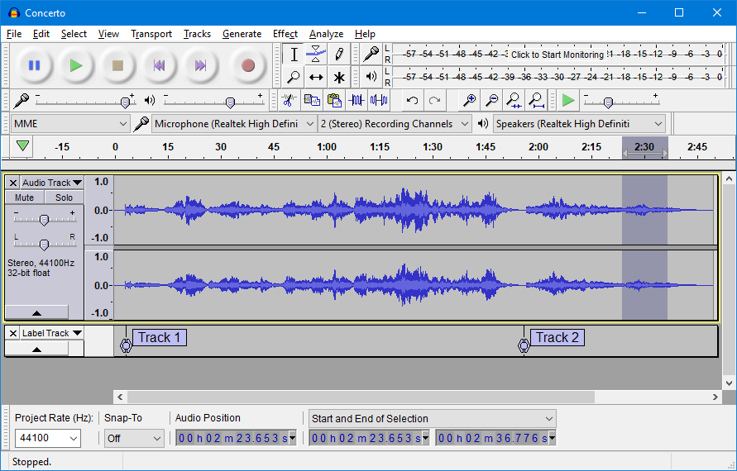
Tools
Audacity

Slide 16
Next Steps
Implement audio support in engine
(Don’t leave this to last moment)
This is an easy one, especially if you don’t really like graphics programming

Slide 17
Any Questions?

