Slide 1

Game Engine Programming
Navigating the hierarchy

Slide 2
The problem
We want to be able to access I.e keyboard from our component
Perhaps core to shut it down?
Core to add a component

Slide 3
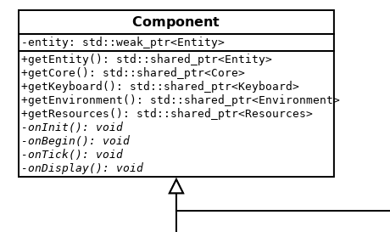
How do we access core?
getCore

Slide 4
But how is core obtained?
We only have a weak_ptr to entity

Slide 5
How is that weak_ptr set anyway?
std::shared_ptr<T> addComponent() { std::shared_ptr<T> rtn = std::make_shared<T>(); rtn->entity = ? components.push_back(rtn); return rtn; }
rtn->entity = this; Error: Invalid type (raw ptr is not a weak ptr)

Slide 6
“a” solution
std::enable_shared_from_this<T>
class Entity : public std::enable_shared_from_this<Entity> { ... }; … rtn->entity = shared_from_this();

Slide 7
We can do better
We don’t use a constructor
The rtn can be assigned to itself
class Core { ... std::weak_ptr<Core> self; ... };
std::shared_ptr<Core> Core::initialize() { std::shared_ptr<Core> rtn = std::make_shared<Core>(); rtn->self = rtn; return rtn; }

Slide 8
Be careful!
Must be a weak_ptr
Otherwise the shared_ptr will keep a reference count above 1 permanently

Slide 9
Any Questions?

