Slide 1

3D Graphics Programming
Dealing with 3D Objects

Slide 2
Quick Recap on Shaders
A lot of code!
Imagine this in each of your game objects
  Player
  Projectile
  Enemy
A lot of duplicated code

Slide 3
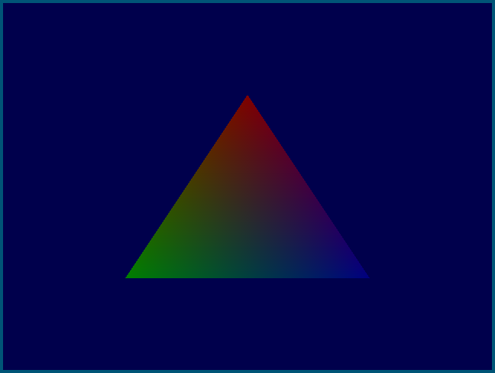
An example

Slide 4
An example (Usage)
VertexBuffer *positions = new VertexBuffer();
positions->add(glm::vec3(0.0f, 0.5f, 0.0f));
positions->add(glm::vec3(-0.5f, -0.5f, 0.0f));
positions->add(glm::vec3(0.5f, -0.5f, 0.0f));
VertexBuffer *colors = new VertexBuffer();
colors->add(glm::vec4(1.0f, 0.0f, 0.0f, 1.0f));
colors->add(glm::vec4(0.0f, 1.0f, 0.0f, 1.0f));
colors->add(glm::vec4(0.0f, 0.0f, 1.0f, 1.0f));
VertexArray *shape = new VertexArray();
shape->setBuffer("in_Position", positions);
shape->setBuffer("in_Color", colors);
ShaderProgram *shader = new ShaderProgram("simple.vert", "simple.frag");
// in the draw
shader->setUniform("in_Lightness", 0.5f);
shader->draw(shape);

Slide 5
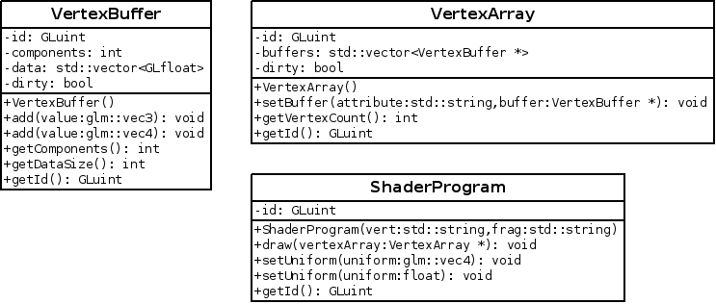
An example (UML)

Slide 6
The Process
This process is called “Wrapping”
Effectively creating a layer of abstraction
Can be done in almost all languages, even C
Works well in languages with OOP built in

Slide 7
Other benefits
Inside your wrapper you could support
  OpenGL
  Direct X
  Vulkan
Whoever uses your wrapper will not need to even know what the underlying wrapper is

Slide 8
Creating Objects
You already know this… but
Be careful of erroneous #includes
  Forward declare
Constructors cannot return error codes
  Exceptions
Avoid new and delete
  Smart pointers

Slide 9
In the labs
The shaders lab code
  Uniforms
  Attributes
Create a wrapper around OpenGL
  Make it easier to use to make a game

Slide 10
Any Questions?

