Slide 1

Game Engine Programming
Resources

Slide 2
What is a texture?
An image
  2D, 3D
On the GPU
2D – for games
3D – for research / medical science

Slide 3
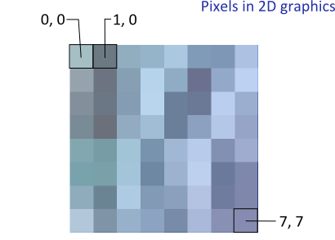
How we think of an image...

Slide 4

How an image is really stored

Slide 5
Loading an image
#include <stb_image/stb_image.h>
int w = 0;
int h = 0;
int channels = 0;
unsigned char *data = stbi_load(path.c_str(), &w, &h, &channels, 4);
if(!data)
{
throw std::exception();
}

Slide 6
Uploading data to GPU
Becomes a texture
glGenTextures(1, &id); if(!id) { throw std::exception(); } glBindTexture(GL_TEXTURE_2D, id); glTexImage2D(GL_TEXTURE_2D, 0, GL_RGBA, w, h, 0, GL_RGBA, GL_UNSIGNED_BYTE, data); free(data); glGenerateMipmap(GL_TEXTURE_2D); glBindTexture(GL_TEXTURE_2D, 0);

Slide 7
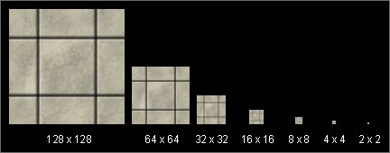
What is mipmapping?
Rather than mapping a large image to a small space per frame
Obtain the closest size and map that
Larger upfront cost
Improved runtime performance

Slide 8
glTexParameteri(GL_TEXTURE_2D, GL_TEXTURE_MIN_FILTER, GL_NEAREST); glTexParameteri(GL_TEXTURE_2D, GL_TEXTURE_MAG_FILTER, GL_LINEAR);
glTexParameteri(GL_TEXTURE_2D, GL_TEXTURE_MIN_FILTER, GL_LINEAR_MIPMAP_LINEAR); glTexParameteri(GL_TEXTURE_2D, GL_TEXTURE_MAG_FILTER, GL_LINEAR);

Slide 9
Fragment shader
What is ex_TexCoord?
uniform sampler2D in_Texture; varying vec2 ex_TexCoord; void main() { vec4 tex = texture2D(in_Texture, ex_TexCoord); gl_FragColor = tex; }

Slide 10
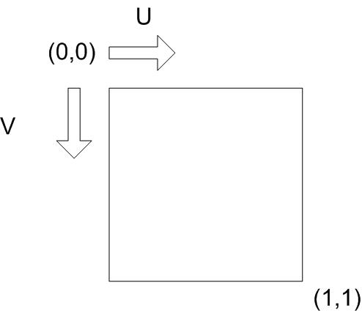
Texture coordinates
VertexBuffer *positions = new VertexBuffer(); positions->add(glm::vec3(0.0f, 0.5f, 0.0f)); positions->add(glm::vec3(-0.5f, -0.5f, 0.0f)); positions->add(glm::vec3(0.5f, -0.5f, 0.0f)); VertexBuffer *texCoords = new VertexBuffer(); texCoords->add(glm::vec2(0.5f, 0.0f)); texCoords->add(glm::vec2(0.0f, 1.0f)); texCoords->add(glm::vec2(1.0f, 1.0f)); VertexArray *shape = new VertexArray(); shape->setBuffer("in_Position", positions); shape->setBuffer("in_TexCoord", texCoords);

Slide 11
Vertex Shader
Again, just passing through the data
uniform mat4 in_Projection; uniform mat4 in_Model; attribute vec3 in_Position; attribute vec2 in_TexCoord; varying vec2 ex_TexCoord; void main() { gl_Position = in_Projection * in_Model * vec4(in_Position, 1.0); ex_TexCoord = in_TexCoord; }

Slide 12
Uploading data to GPU
Why set uniform value to 1?
GLint uniformId = glGetUniformLocation(id, “in_Texture”); if(uniformId == -1) { throw std::exception(); } glUseProgram(id); glUniform1i(uniformId, 1); glUseProgram(0);

Slide 13
An additional level of indirection
(It doesn’t work like how you think it should!)
glActiveTexture(GL_TEXTURE0 + 1);
Before
glBindTexture(GL_TEXTURE_2D, textureId);
glUnifom1i(uniformId, 1)
glUnifom1i(uniformId, textureId) IS WRONG!!

Slide 14
Next Steps
A resources system

Slide 15
Some things to consider
Portable functions?
  std::ifstream(...)
  fopen(…)

Slide 16
They are part of the standard
C++ Standard Library
C Standard Library
Guaranteed to be on 99.9% of available hardware, yesterday, today and tomorrow

Slide 17
The problem...
std::ifstream file(“images\\cat.png”);
Will this work on Linux?
Will this work on Android?
Will this work on iOS?
Will this work on Plan 9?

Slide 18
Paths are not always available
You may have seen / vs \
Android does not allow access to . or ..
iOS does not allow most things
Plan 9 splits filesystem into namespaces (potentially running on different CPU or Fossil servers)

Slide 19
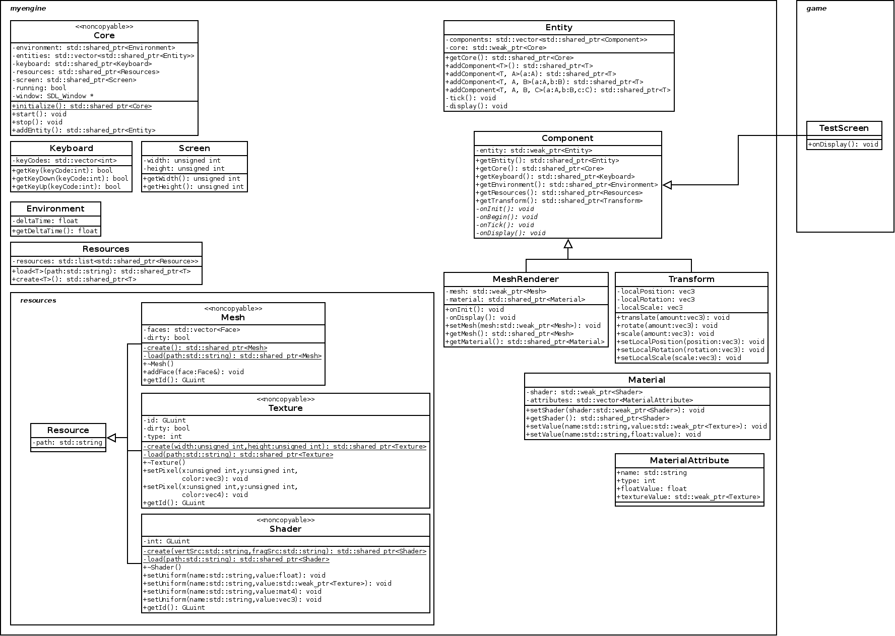

Slide 20
Architecture
Resource as a base class
Can have a list of all resources
std::shared_ptr is great here
  use_count() == 1 means no other references
  Remove the last owner from the list and it will be cleaned
  Scan this list once every ~minute :)

Slide 21
Any Questions?

