Slide 1

Game Engine Programming
Exceptions and Tear-down

Slide 2
Exceptions
We have looked at
  throwing
  catching
  std::exception

Slide 3
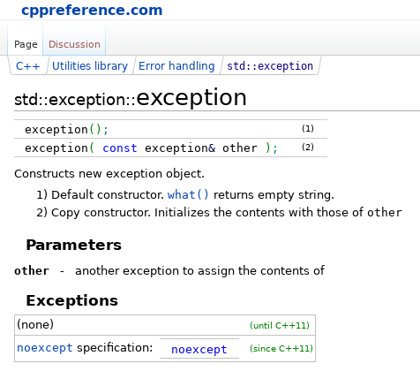
Exceptions should be extended
std::exception is actually the base class
MSVC allows passing a std::string into the constructor
  This is non-standard

Slide 4
Why do we extend them?
To include useful error messages
std::string into the constructor is common

Slide 5
How do we extend them?
#include <exception> #include <string> namespace myengine { class Exception : public std::exception { public: Exception(std::string message); ~Exception() throw(); const char *what(); private: std::string message; }; }

Slide 6
What else can we do with them?
try { c->start(); } catch(myengine::Exception& e) { std::cout << "MyEngine Exception: " << e.what() << std::endl; } catch(std::exception& e) { std::cout << "Exception: " << e.what() << std::endl; } catch(...) { std::cout << "An unknown object was thrown" << std::endl; }

Slide 7
Does Unity crash on an error
YES! XD
… but in theory it shouldn’t
The C# doesn’t at least
Neither should your engine

Slide 8
Avoiding crashes
void Entity::tick() { for(std::vector<std::shared_ptr<Component> >::iterator it = components.begin(); it != components.end(); it++) { if(!(*it)->began) { (*it)->onBegin(); (*it)->began = true; } try { (*it)->onTick(); } catch(…) { } } }

Slide 9
Slight complexity...
void Rocket::onTick() { if(timeout < 0) { // Throws exception (cannot find sound effect) createExplosion(); removeEntity(); } }
This will keep triggering / throwing every loop.
You might have seen this happen in Unity and UE4. The error log gets spammed with red text.

Slide 10
Solution
If an exception gets thrown by the entity in the onTick function…
Handle it by catching the exception
Remove the entity
Basically if a game object goes horrifically wrong, just “tuck it away” and hope the player didn’t see!!

Slide 11
The ultimate test #1!
If the user presses the ‘B’ key
Choose a random entity
Add a broken component that throws after a random amount of time
Can your engine survive this?
Make sure this “feature” is documented in the readme if you do add it!

Slide 12
Removing entities
void TestComponent::onTick() { delete getEntity(); }
What is wrong with this?

Slide 13
Removing entities (cont)
void TestComponent::onTick() { getCore()->eraseFromList(getEntity()); }
What is wrong with this?

Slide 14
Do not erase objects whilst “inside them”
Flag them for removal after completion of loop
getEntity()->kill(); void Entity::kill() { alive = false; }

Slide 15
The ultimate test #2!
Put your main() function in a loop (500 times)
Make it initialise and tear down the game each loop
Is the application successful?
Check the memory usage
Run this under Valgrind if you have access to a non-Windows machine.

Slide 16
A flaw in C++… YES!
C++ does not offer any way to protect you from clearing a vector<T> whilst you are inside one of the objects
Use after free
Painful to debug
Valgrind (on non-Windows)
Purify Plus (on Windows < Vista)
Replace std::vector with “debug” version that checks
  Shameless Plug: C++ SR1 Library

Slide 17
Check out my bomb example!
Stay safe out there!

Slide 18
Next Steps
Integrate Exceptions
Collisions

Slide 19
Any Questions?

