Slide 1

Game Engine Programming
Technical Documentation

Slide 2
Benefits
Explain your code to others
  And your future self
As part of the design process, helps spot design breakages
Helps you break problems into manageable tasks
Language agnostic

Slide 3
Benefits
This is still part of the portfolio piece
Allows less technical people to see how much work you have put in
People rather view diagrams than delve into random code

Slide 4
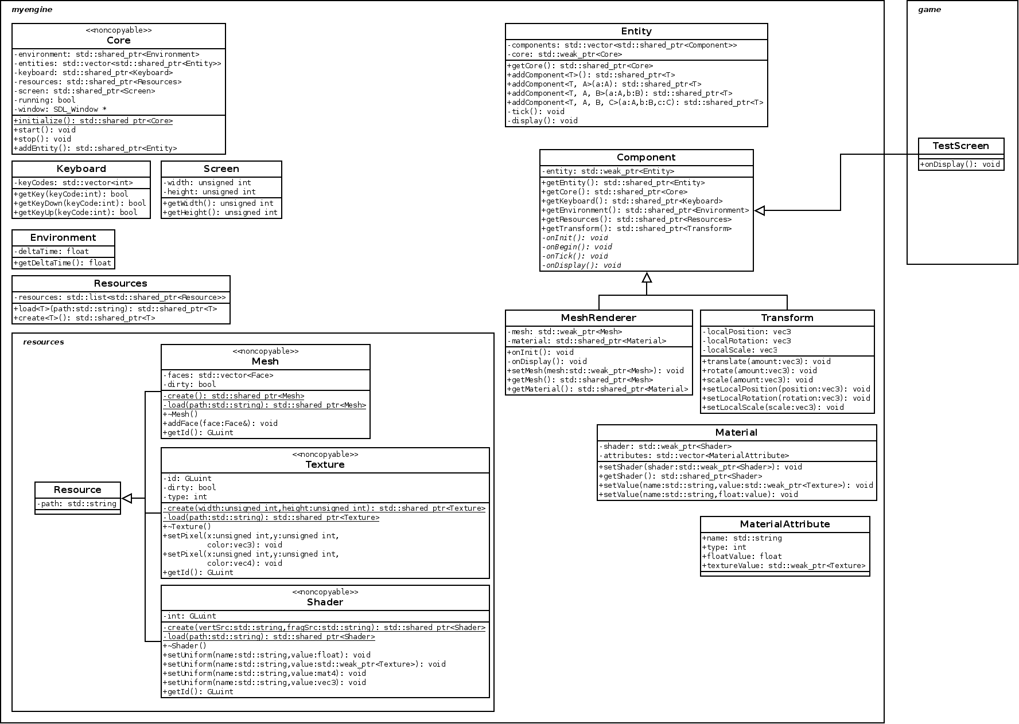
UML
Visio
Dia

Slide 5
Code Documentation
Much more detailed
With practice you know what kinds of things to write
Breaks up the code
Better than syntax highlighting

Slide 6
What if you have a private API?
Comment header files
Doxygen

Slide 7

Enter Doxygen
Similar to Java’s Javadoc
Generates
  HTML (for websites)
  LaTeX (for technical manuals)
  Some others...

Slide 8
Also...
One of the hardest things to do as a developer
  Familiarise yourself with an existing codebase
  What functions call what?
  How is this class used?
  What are the side effects of setting this bool?

Slide 9
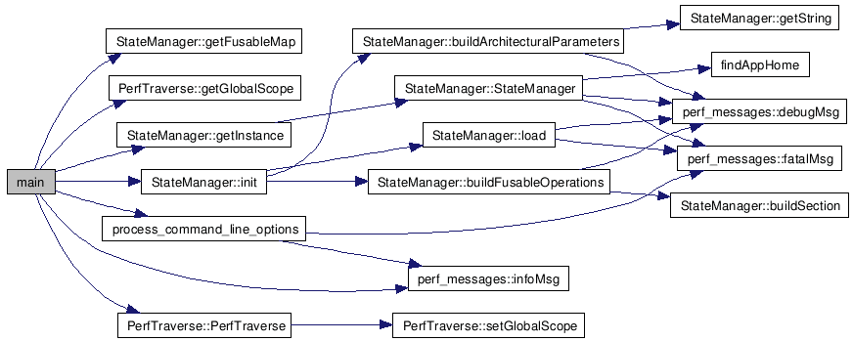
Use Doxygen
Generate Call graph
Reverse call graph

Slide 10
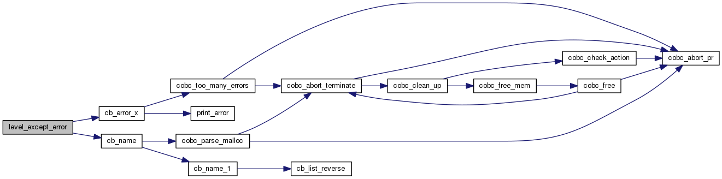
Reverse call graph

Slide 11
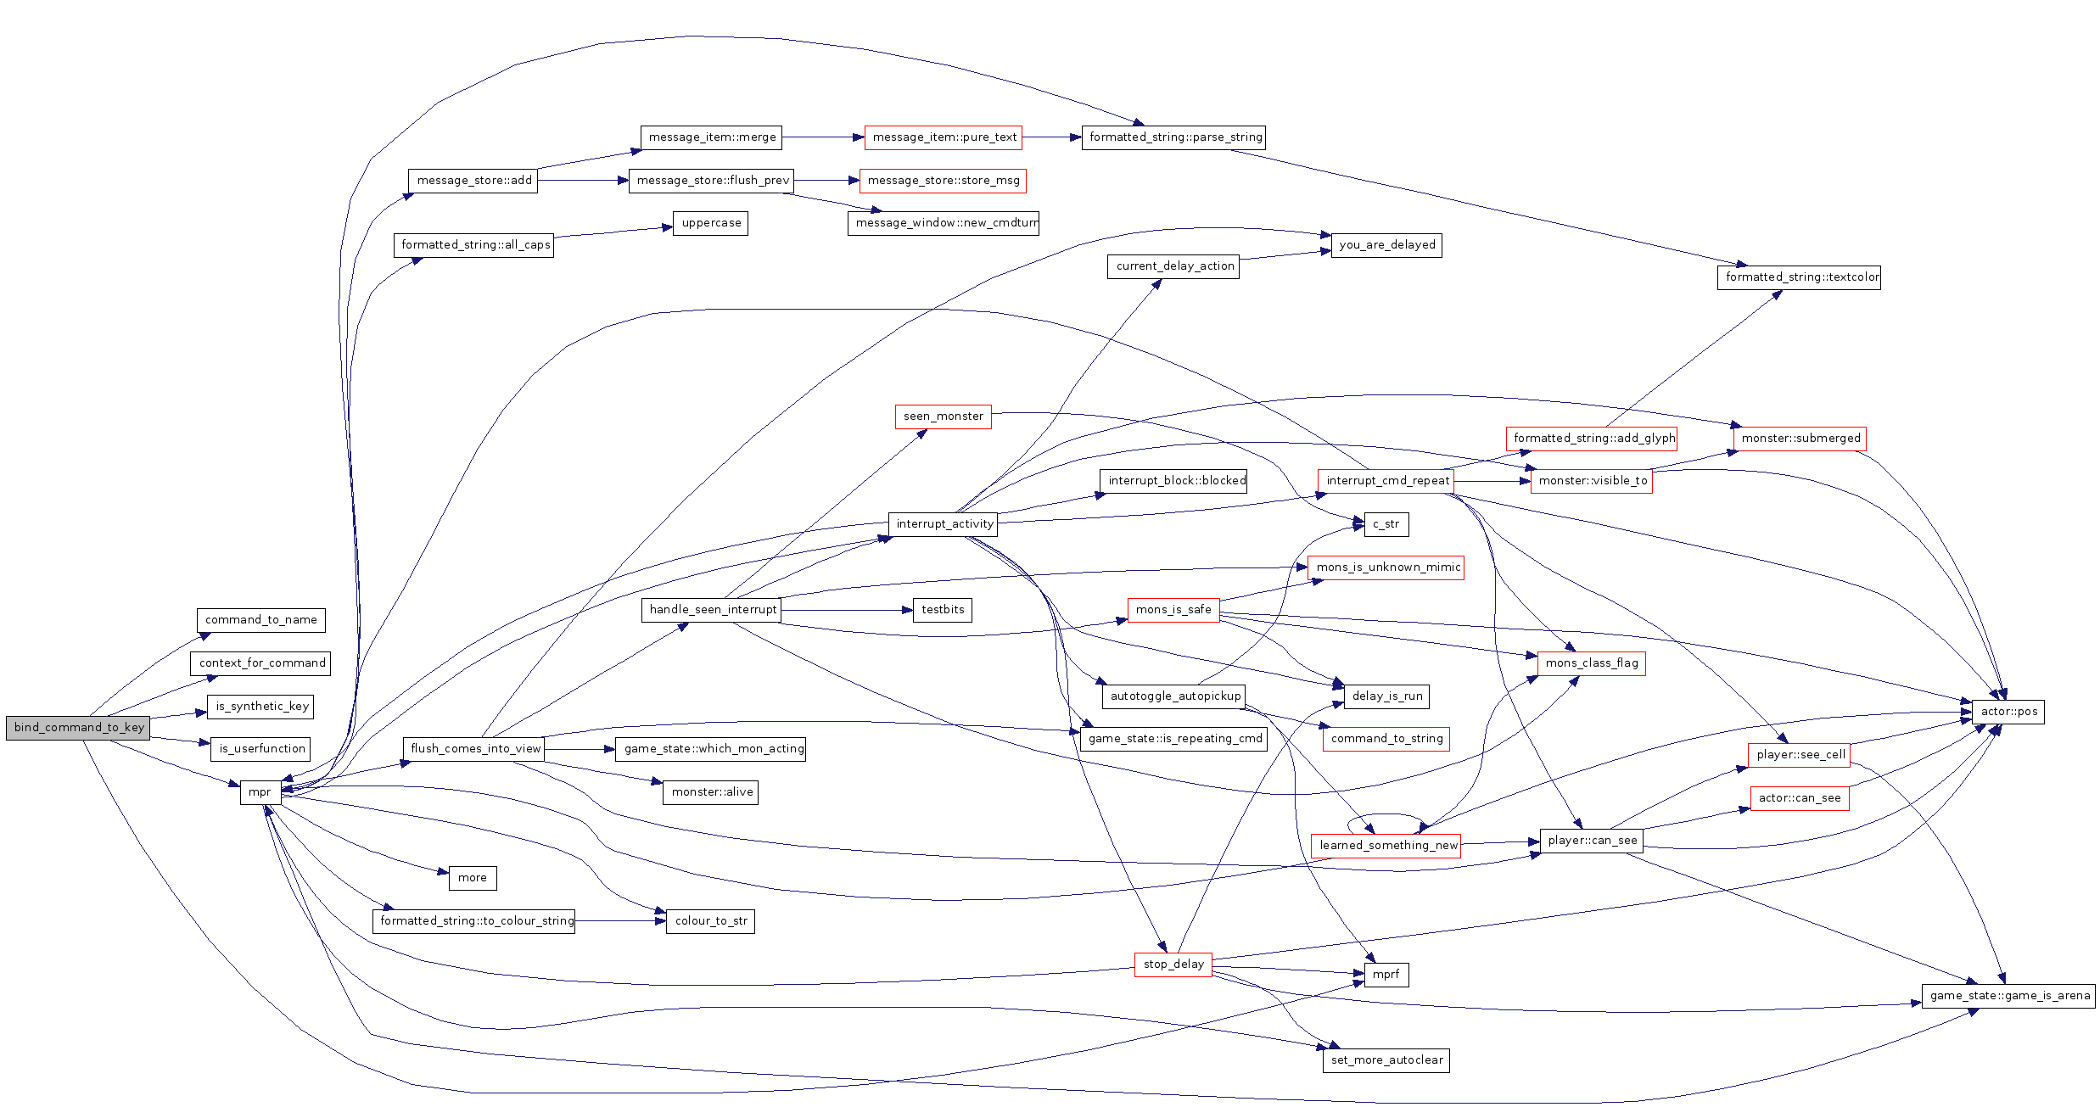
Or when to run!

Slide 12
So how to we use it?
Doxygen
  Command line tool
Comments in a certain format
Run with config file

Slide 13
Comments
/** * Represent a Player state */ class Player { Int health; ///< The amount of health remaining. };

Slide 14
The config file
PROJECT_NAME
EXTRACT_ALL
INPUT
RECURSIVE
HAVE_DOT
CALL_GRAPH

Slide 15
A note on Dot
Dot is a command-line diagram tool
Originally developed by AT&T Labs
Great for build servers
Doxygen uses it behind the scenes
We need to obtain it from the GraphViz package

Slide 16
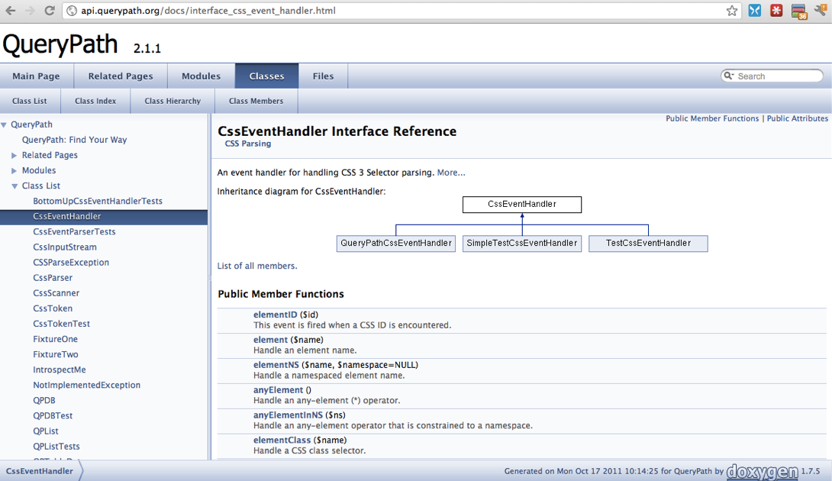
After compile

Slide 17
Recap
$ doxygen -g Doxyfile
$ doxygen

Slide 18
Next steps
Comment your project
Perhaps add some screenshots of the generated diagrams to GitHub

Slide 19
Any Questions?

