Slide 1

3D Graphics Programming
Pixel Effects

Slide 2
Depth Testing
GL_DEPTH_TEST
glClear
  GL_DEPTH_BUFFER_BIT

Slide 3
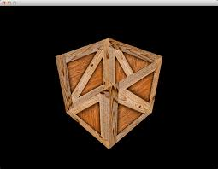
A symptom of leaving it disabled (in 3D)

Slide 4
GUI Drawing
Disable depth testing
Enable it after
We want the classic “z-order”
Last one to draw, draws on top
Like a stack

Slide 5
Discard
Does not draw fragment
Does not blend fragment
Cheap

Slide 6
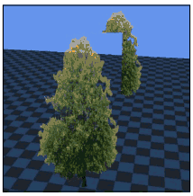
Can we not use blend?

Slide 7
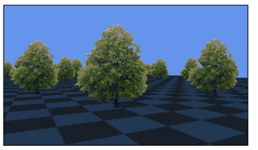
Blend will blend with what is already there
But depending on the order there may have been nothing to blend with until later
So use discard to simply not draw the fragment

Slide 8
Disadvantages of discard
Does not blend
Can be jagged

Slide 9
Backface Culling
glEnable
  GL_CULL_FACE

Slide 10
Why cull faces?
Performance
No point in rendering a face if we never see it!

Slide 11
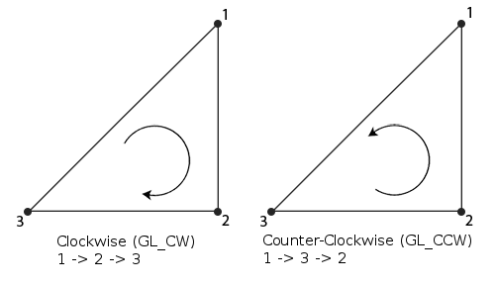
How does it know to cull a face
The “winding” of the triangle
a, b, c
c, b, a
The first one has a normal of 0, 0, 1
The other has a normal of 0, 0, -1
Default is CCW (counter clockwise)
  Clockwise faces are culled

Slide 12
What does this mean
If a model is broken
  Set glFrontFace(GL_CW)
If a model is really broken
  glDisable(GL_CULL_FACE)
You might be able to open it in I.e Blender and click “Flip Faces” but sometimes I notice it doesn’t quite work
  I.e mixed winding

Slide 13
The fragment shader can do more than we are using it for
Dynamic variables
Check pixel values
Discard

Slide 14
The classic glowy eyes
Lets try it!
  Uniform
  We can use sin()
  If texture has specific color
  Set to red * uniform

Slide 15
Next Steps
Next lecture is revision
  Turn up to this!
Next lab is revision lab
  Read through labs / slides and ask me questions

Slide 16
Any Questions?

