Slide 1
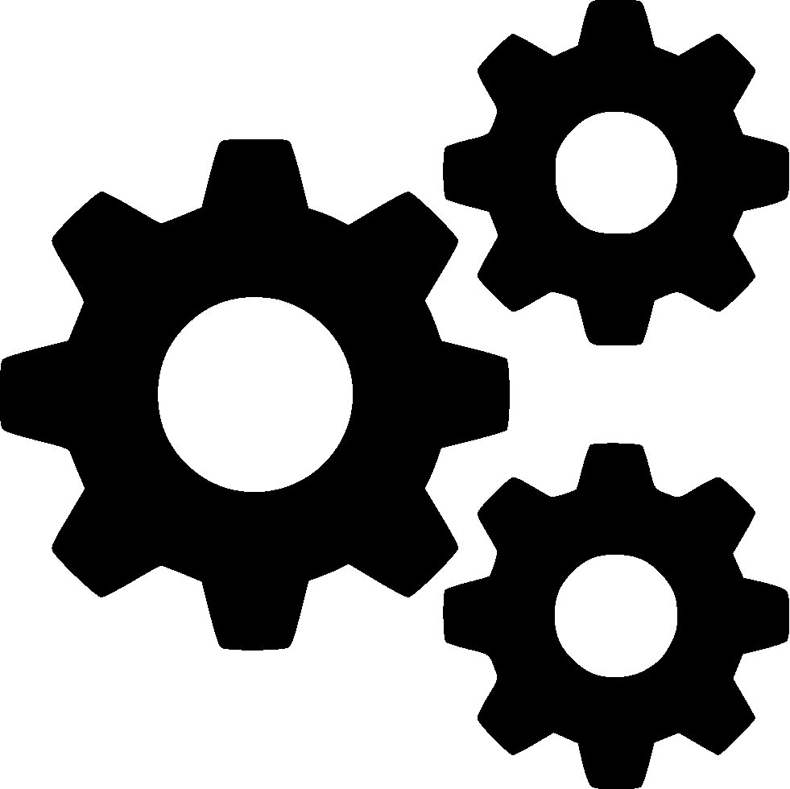
Game Engine Programming
Delegating Events

Slide 2
GameObjects don’t do much
They contain components
The engine (not a user) can call update, render, postrender on them
  What should they do?

Slide 3
Delegation of tasks
They simply forward the event to all their components
The components carry out the task

Slide 4
How does it do this?
Some very minor inheritance (C++)
  Virtual
Function callbacks (C)
Lambdas (Scripting languages)

Slide 5
How does this look?
struct Component { virtual void update() { } };
struct Player : public Component { virtual void update() { std::cout << “Updating” << std::endl; } };
std::shared_ptr<Component> c = std::make_shared<Player>(); c->update();
update() needs to be public?

Slide 6
How about?
struct Component { void update() { onUpdate(); } protected: virtual void onUpdate() { } };
struct Player : public Component { private: virtual void onUpdate() { std::cout << “Updating” << std::endl; } };
std::shared_ptr<Component> c = std::make_shared<Player>(); c->update();

Slide 7
Friend classes
OOP is great
  Until it kinda doesnt work
Getters and setters are awkward to maintain
  They go against the goal of encapsulation
  You don’t want people to be able to do too much with your class
Apart from you might want to give much more access to a “special” class

Slide 8
Example
class Foo { int a; };
struct Bob { void someFunc(Foo& foo) { foo.a = 9; } };
Error: ‘a’ is private in this context

Slide 9
Example
struct Bob; // Forward declare struct Foo { private: friend struct Bob; // Give bob all access int a; };
struct Bob { void someFunc(Foo& foo) { foo.a = 9; } };
foo.a is now 9

Slide 10
Keep note
Don’t over use
  I am guilty of this
  Never require your users to mark “friend” in their code to use your engine
  Don’t use for “convenience”

Slide 11
Keep note
Be aware of namespaces
  friend class myengine::Core;
  friend class Core;
  These are the same if Core had been forward declared.
  Otherwise Core will be forward declared but refers to ::Core (un-namespaced).
  Basically, fully qualify to be safe.
    friend class myengine::Core;
    friend class ::Core;

Slide 12
In the labs
Add entity
Add component
Main loop
  Goes through each entity and calls update
    Entity update goes through each component and calls update
Update your diagrams

Slide 13
Any Questions?

