Slide 1

3D Graphics Programming
3D Collision

Slide 2
Not all hardware was made equal
Slow hardware
Runs the loop slower
It tries!
It means that movement code, runs less
Equals less movement

Slide 3
Delta time
Translates to “per second”
playerPos += glm::vec3(0, 0, 1) * “per second”
On a fast machine this would be a small number
On a slow machine this would be a large number
  Bigger jumps

Slide 4
Calculating Delta time
// Store this variable and initialize float lastTime = SDL_GetTicks(); // In loop float time = SDL_GetTicks(); float diff = time - lastTime; evironment->deltaTime = diff / 1000.0f; lastTime = time;
We divide by 1000.0f for the “second” part in “per second”

Slide 5
Sleep off the remaining time
float idealTime = 1.0f / 60.0f; if(idealTime > Time::deltaTime) { // Sleep off remaining time SDL_Delay((idealTime - Time::deltaTime) * 1000.0f); }

Slide 6
Collisions
Remember this from your first year
AABB
if(a.x < b.x) { if(a.x + a.w < b.x) { break; } } else { if(b.x + b.w < a.x) { break; } } // Do the same for y

Slide 7
So the same for z too
We are dealing with the 3rd dimension

Slide 8
Triangle Box Intersect
Tomas Moller
  Tri-tri
  Tri-box
  Tay-tri
glm/gtx
  intersectLineSphere
  intersectLineTriangle
  intersectRaySphere
  intersectRayTriangle

Slide 9
The general idea
Your models are made up of loads of triangles
Store them in a list
Go through each one and check if it intersects against your box or triangle

Slide 10
Performance (Spatial Partitioning)
Add triangles to “partitions”
Only try collide with the triangles in the same partition as you

Slide 11
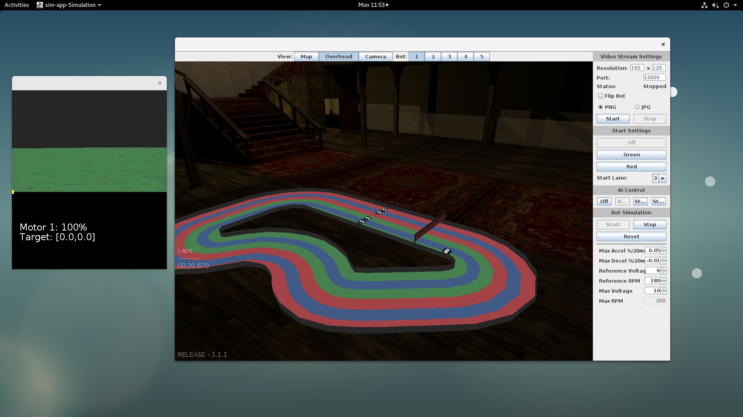
Recent contract job
(recognize the environment ;)
Does basically just this ;)

Slide 12
SpatialPartition class
CollisionResponse cr = sp.uncollide(bot.position.x, bot.position.y, 0); if(cr != null) { Vec3 s = cr.position; Vec3 op = new Vec3((float)bot.position.x, (float)bot.position.y, 0); bot.position.x = s.v[0]; bot.position.y = s.v[1]; bot.direction = (float)Math.toDegrees(Math.atan2(op.v[1] - s.v[1], op.v[0] - s.v[0])); bot.direction += 180; if(bot.direction < 0) { bot.direction += 360; } }

Slide 13
Next Steps
Structuring your game into classes
AABB jump collision
Triangle intersect
Revision
Test!

Slide 14
Any Questions?

