Slide 1

Game Engine Programming
Environment

Slide 2
Not all hardware was made equal
Slow hardware
Runs the loop slower
It tries!
It means that movement code, runs less
Equals less movement

Slide 3
Delta time
Translates to “per second”
playerPos += glm::vec3(0, 0, 1) * “per second”
On a fast machine this would be a small number
On a slow machine this would be a large number
  Bigger jumps

Slide 4
Calculating Delta time
// Store this variable and initialize float lastTime = SDL_GetTicks(); // In loop float time = SDL_GetTicks(); float diff = time - lastTime; evironment->deltaTime = diff / 1000.0f; lastTime = time;
We divide by 1000.0f for the “second” part in “per second”

Slide 5
Sleep off the remaining time
float idealTime = 1.0f / 60.0f; if(idealTime > Time::deltaTime) { // Sleep off remaining time SDL_Delay((idealTime - Time::deltaTime) * 1000.0f); }

Slide 6
Finding your location
Not many platforms store their executables inside their data
./build/Debug/game.exe
./build/game.exe
./game.exe

Slide 7
We need to find the location of our data
Use platform specific API
Windows – Winapi
Linux – popen / proc
Android – JNI
Emscripten… hardcode

Slide 8
An example for Windows
char strExePath [MAX_PATH]; GetModuleFileName(NULL, strExePath, MAX_PATH); fullPath = strExePath; basename = dirname.substr(fullPath.find_last_of("\\")); basename = basename.substr(0, basename.length() - 4); // You now know your name “game” // You now know the full path to your .exe // Recurse upwards in directories until I.e share/{basename} is found

Slide 9
An example for Linux
command = "cd `dirname \\`which " + std::string(argv[0]) + "\\``; cd ..; pwd | tr -d '\n'"; process = popen(command.c_str(), "r"); // read from process to get an absolute path to prefix

Slide 10
Collisions
Remember this from your first year
AABB
if(a.x < b.x) { if(a.x + a.w < b.x) { break; } } else { if(b.x + b.w < a.x) { break; } } // Do the same for y

Slide 11
Triangle Box Intersect
Tomas Moller
  Tri-tri
  Tri-box
  Tay-tri
glm/gtx
  intersectLineSphere
  intersectLineTriangle
  intersectRaySphere
  intersectRayTriangle

Slide 12
The general idea
Your models are made up of loads of triangles
Store them in a list
Go through each one and check if it intersects against your box or triangle

Slide 13
Performance (Spatial Partitioning)
Add triangles to “partitions”
Only try collide with the triangles in the same partition as you

Slide 14
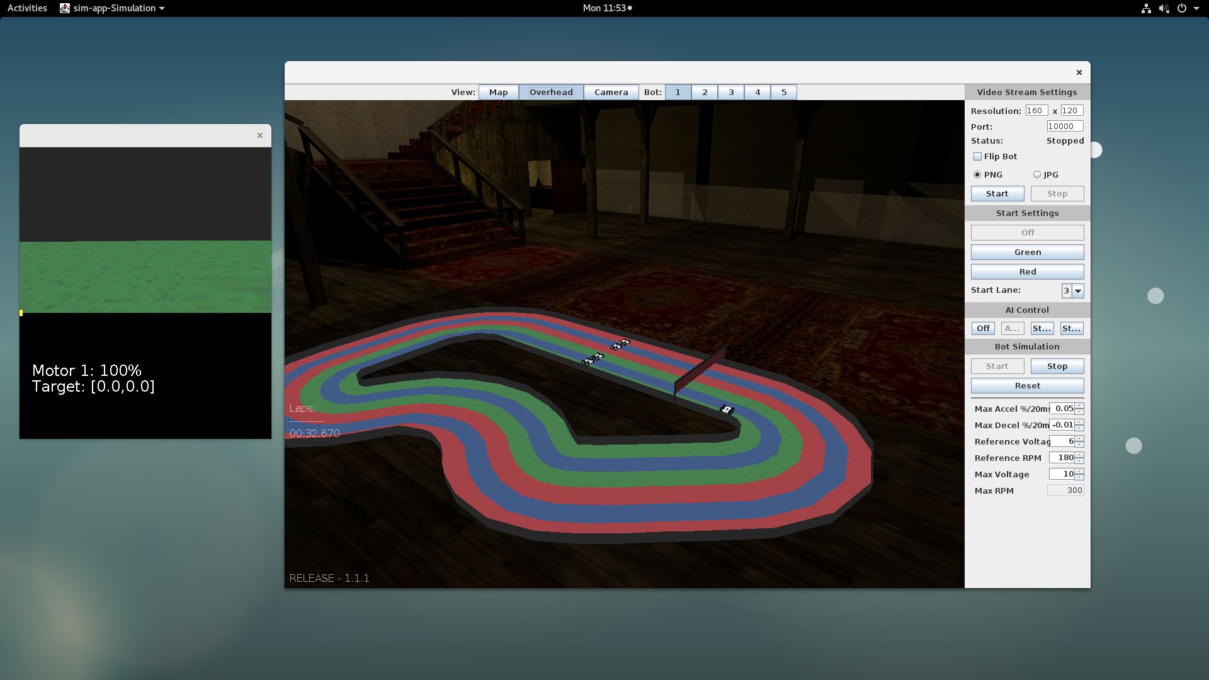
Recent contract job
(recognize the environment ;)
Does basically just this ;)

Slide 15
SpatialPartition class
CollisionResponse cr = sp.uncollide(bot.position.x, bot.position.y, 0); if(cr != null) { Vec3 s = cr.position; Vec3 op = new Vec3((float)bot.position.x, (float)bot.position.y, 0); bot.position.x = s.v[0]; bot.position.y = s.v[1]; bot.direction = (float)Math.toDegrees(Math.atan2(op.v[1] - s.v[1], op.v[0] - s.v[0])); bot.direction += 180; if(bot.direction < 0) { bot.direction += 360; } }

Slide 16
So how do we go about integrating this into our engine?
Collider
  BoxCollider
  MeshCollider
Mesh
  Stores triangles
RigidBody does the collision

Slide 17
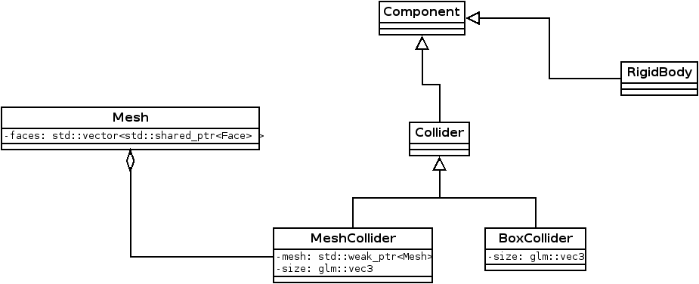
In UML

Slide 18
Concepts
Collider – Store data about shape
RigidBody – Do the processing
  core->findEntitiesByType<Collider>()
  collider->collide(Collider& c)

Slide 19
Next steps
Add colliders to your engine
Start with simple box collider
RigidBody perform processing

Slide 20
Any Questions?

