Slide 1

Game Engine Programming
Component Entity System

Slide 2
How do we structure a game engine?
Many different ways
Some better than others
Aim for flexibility
The Component Entity System is a popular choice

Slide 3
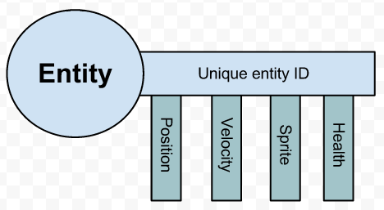
What is a CES?
Architecture / design
Favors composition to inheritance
Not large complex things. ~100 lines max for a basic one.

Slide 4
CES Summary
You have a number of Entities
You attach components to them
The components are what provides the behavior
I.e Player
  Transform
  MeshRenderer
  Collider

Slide 5
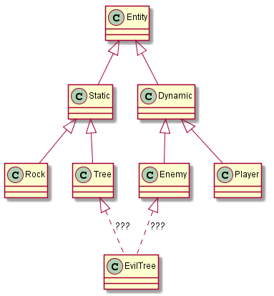
Avoids the “Evil Tree” situation

Slide 6
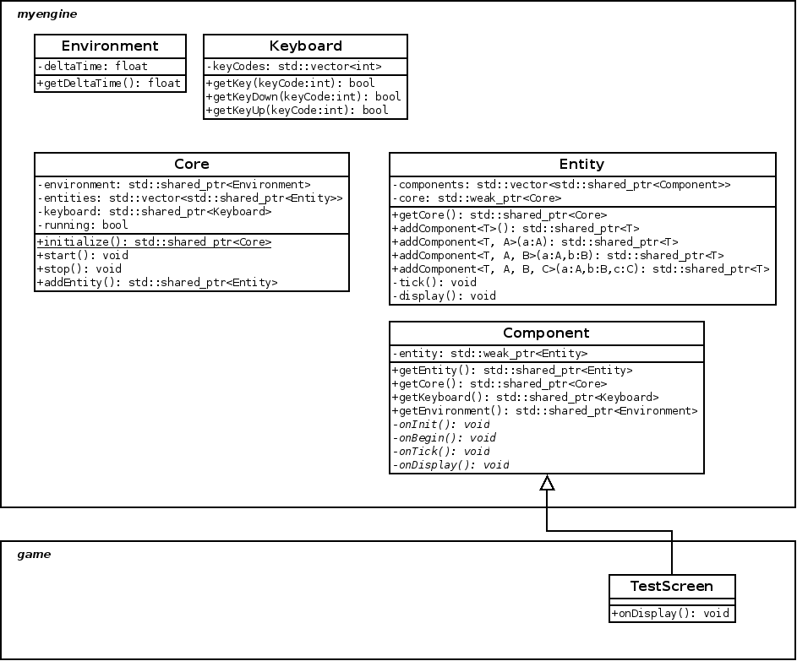
“My Engine” so far

Slide 7
Disadvantages to a CES
“Very object oriented”
Everything is an object
“Chasing pointers” to an object
Very little contiguous memory
Cache misses

Slide 8
“Extensions” to a CES
Hierarchical
Hold a reference to your parent
Easier memory handling with smart pointers
Can navigate the entire game state without hacks such as singletons.
getEntity()->getCore()-> getEntityByName(“enemy”)-> getComponent<Enemy>()-> applyDamage(4);

Slide 9
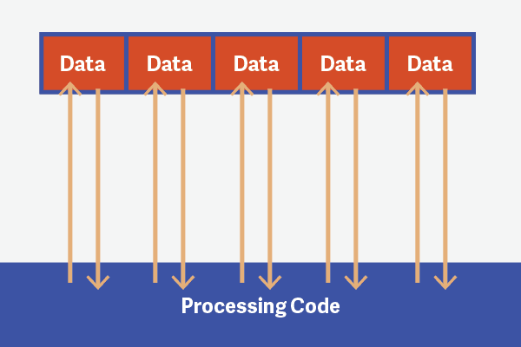
The choice is yours
Unless you know what you are doing stick with the CES design. We cover it in this unit
Inheritance Approach
  C++ supports multiple inheritance (Evil Tree possible)
Data oriented design

Slide 10
The next steps in your CMake adventure
We need to tell CMake to tell your compiler where header files are:
We didn’t write SDL2, glew or glm so these should go in the contrib folder
glm is platform agnostic so doesn’t need to go into a ‘msvc-windows-x86’ sub folder
include_directories( src contrib/msvc-windows-x86/SDL2/include contrib/msvc-windows-x86/glew/include )

Slide 11
Next steps
Implement a basic CES framework (~2 hours)
Refresher on OpenGL ;)
Write a TriangleRenderer Component

Slide 12
Any Questions?

