Slide 1

Game Engine Programming
Safety Tips &
Wrapping Render Textures

Slide 2
Safety
As nearing a deadline
Debugging safety issues time consuming
Hard to debug
  Inadequate tools
  C is portable assembly. Not designed to be safe
  Non deterministic

Slide 3
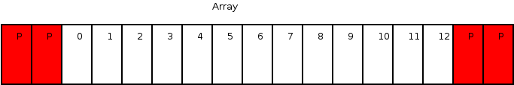
The best tool we have
Debug mode
  Slower
How it works
  VirtualProtect (Windows)
  mprotect (Everything else)

Slide 4
What is mprotect
A system call into the kernel
To lock a page of memory
Uses the MMU (Memory Management Unit)
  Since the 80386 (Yes, DOS had this feature)
Causes a page fault if later accessed
Can also be useful for security
  Making memory read only
  Making memory write only

Slide 5
Problems
We can jump past protected pages
Pages are later unlocked to be reused
  So we don’t run out of RAM
  After a while
  Non-deterministic
Some memory on the stack

Slide 6
Stack problem?
std::vector<Part>& Model::getParts() { std::vector<Part> parts; for(size_t i = 0; i < submeshes.size(); i++) { parts.push_back(submeshes.at(i)); } return parts; }

Slide 7
Stack solutions
Avoid returning references
Try to only use references as arguments
  void Model::getParts(std::vector<Part>& output);

Slide 8
Array issue
int ages[99]; populateAges(ages); int age = ages[99];

Slide 9
Use STL
Standard Template Library (Containers)
std::vector<T>
std::list<T>
std::array<T> (C++11)
And use .at(i) rather than [I]
  at(i) will return a reference so you can still modify the data in exactly the same way

Slide 10
Complex issues
World.cpp
void World::tick() { for(std::vector<std::shared_ptr<Entity> >::iterator it = entities.begin(); it != entities.end(); it++) { (*it)->tick(); } }
Gun.cpp
void Gun::onTick() { std::shared_ptr<Entity> bulletEntity = getWorld()->addEntity(); bulletEntity->addComponent<Bullet>(); }

Slide 11
Solving this is easy
Either use a standard for loop
Use a std::list<T>

Slide 12
Finding the issue is very hard
Run in debug
Valgrind (non-Windows, Slow)
Purify (Windows pre-XP)
Intel Analyser (Many false negatives, misses a lot)
Clang asan (Address Sanitizer)
  Looking to be the best
  Clang / LLVM specific
  Most compilers moving to this
  Provided in VS distribution
  UE4 uses it etc

Slide 13
Will a for each fix it?
World.cpp
void World::tick() { for each (std::vector<std::shared_ptr<Entity> > entity in entities) { entity->tick(); } }
Gun.cpp
void Gun::onTick() { std::shared_ptr<Entity> bulletEntity = getWorld()->addEntity(); bulletEntity->addComponent<Bullet>(); }

Slide 14
No
For each is syntax sugar for iterators
  Good because it is fast
  Bad because of this side effect
  Changing to a std::list would allow the for each to work fine though

Slide 15
Render Textures
Lets check out the wrapper
We wrap it because otherwise the code would get quite complex to follow

Slide 16
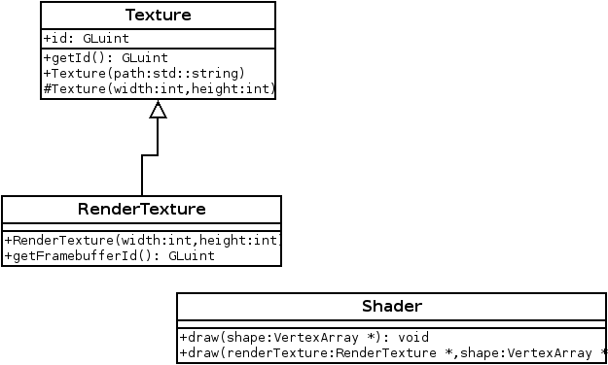
RenderTexture is a Texture

Slide 17
Next steps
Work on your engines and games
We will try to implement simple bloom

Slide 18
Any Questions?

