Slide 1

Game Engine Programming
Post Processing

Slide 2
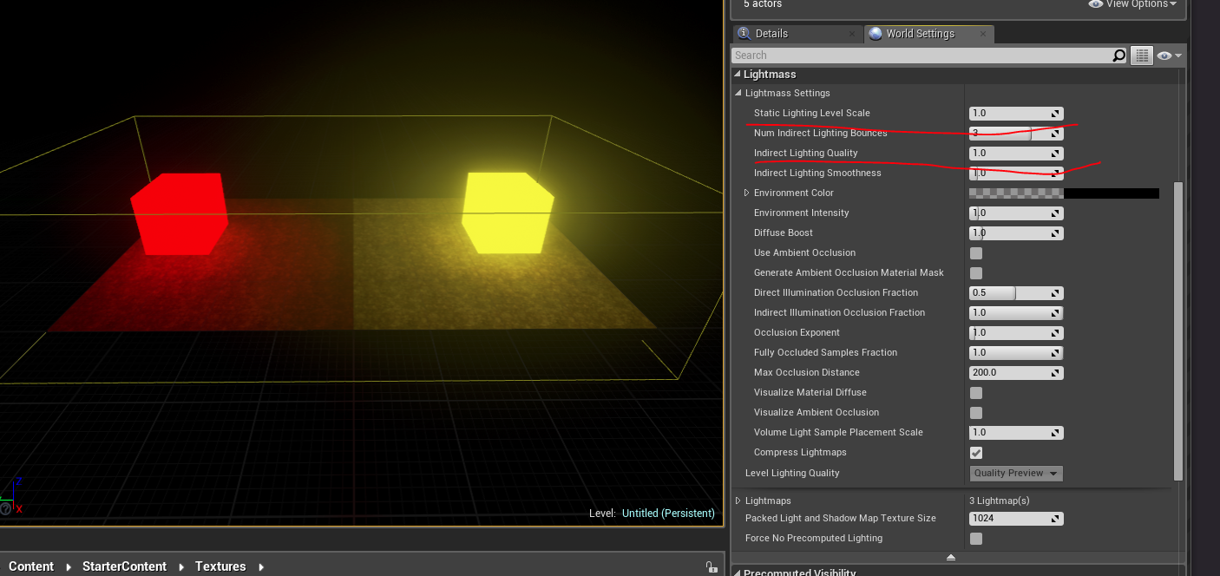
Why do we use post processing?
Emissive lighting

Slide 3

What emissive lighting is in OpenGL
Similar to ambient, it just states that the object is self lit
Unfortunately this is in isolation to other objects

Slide 4
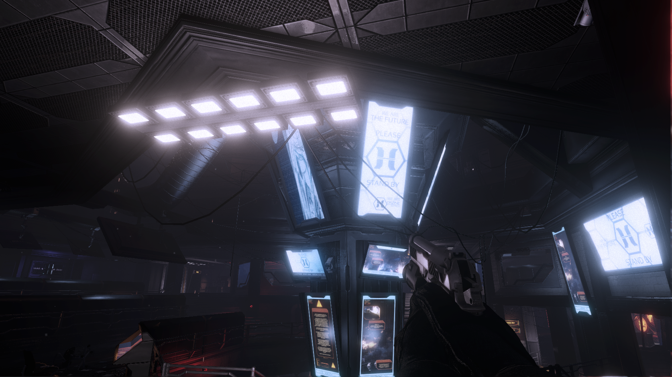
Bloom lighting
Non photorealistic rendering

Slide 5
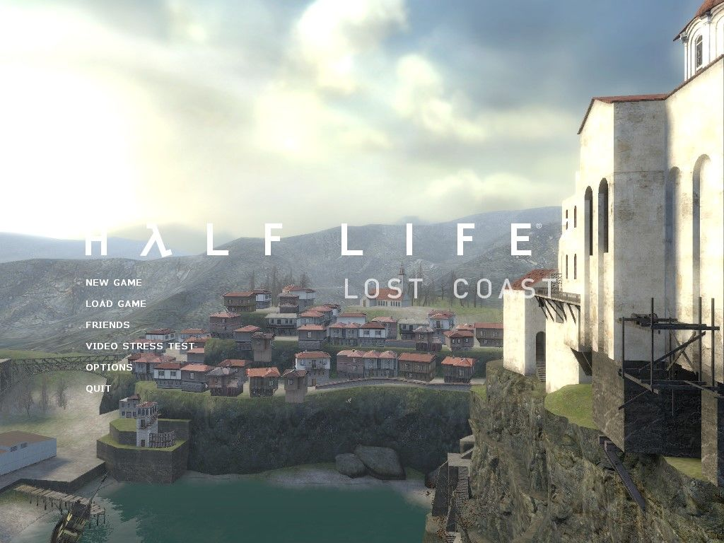
HDR

Slide 6
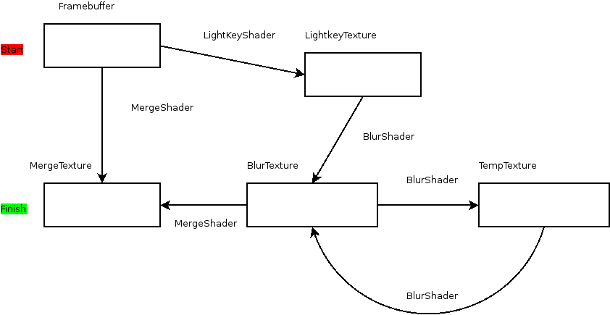
Lets try bloom

Slide 7
Render textures
Can be reused
Remember, cannot read from and write to same render texture at the same time
  Alternate between render textures

Slide 8
Texture coordinates
Can be used within the fragment shader
  map a texture
  know position within the image

Slide 9


Different kernels
Blur
Sharpen

Slide 10
Multiple passes
Sometimes the neighbor data isn’t yet available
Multiple passes
Blur → blur → blur = very blur

Slide 11
Expensive
Individual passes not particularly on modern hardware
A good blur will be over 8 passes.
  Starts to mount up

Slide 12
Memory handling
Dealing with a lot of render textures and shaders can be tricky
Smart pointers
Destructors
Disable copy

Slide 13
Next steps
Try to implement simple bloom
Great for assignments ;)

Slide 14
Any Questions?

