Slide 1

Eliminating Memory Errors in C
Karsten Pedersen
10/06/2020

Slide 2
Existing solutions
Valgrind
ElectricFence
Debug runtimes (I.e MSVC)
AddressSanitizer (Clang)
  Older Mudflap (GCC)

Slide 3
Introducing libstent
A "weak pointer" for C
  Only enabled at debug time
A "templated vector" for C
Header-only library
  C89+ compatible

Slide 4
Getting started (current)
#include <stdlib.h>
struct Employee
{
int id;
};
int main()
{
struct Employee *emp = calloc(1, sizeof(struct Employee));
free(emp);
return 0;
}

Slide 5
Getting started (libstent)
#define STENT_IMPLEMENTATION
#include <stent.h>
struct Employee
{
int id;
};
int main()
{
ref(Employee) emp = allocate(Employee);
release(emp);
return 0;
}

Slide 6
Accessing members
ref(Employee) emp = allocate(Employee);
_(emp).id = 2 * 2;
printf("ID: %i\n", _(emp).id);
Result:
ID: 4

Slide 7
Detecting leaks
int main()
{
ref(Employee) emp = allocate(Employee);
return 0;
}
Result:
Warning: Allocated memory [main.c:16] persisted after application exit [Employee]
Aborted

Slide 8
Use after free (simple)
int main()
{
ref(Employee) emp = allocate(Employee);
release(emp);
printf("ID: %i\n", _(emp).id);
return 0;
}
Result:
Error: Employee pointer no longer valid in main.c:17
Aborted

Slide 9
Use after free (continued)
ref(Employee) curr;
int main()
{
ref(Employee) emp = allocate(Employee);
curr = emp;
release(emp);
printf("ID: %i\n", _(curr).id);
return 0;
}
Result:
Error: Employee pointer no longer valid in main.c:19
Aborted

Slide 10
Use ref for members
struct Employee
{
int id;
ref(Department) dept;
ref(Employee) mgr;
};
ref(Employee) EmployeeCreate(ref(Department) dept, ref(Employee) mgr)
{
ref(Employee) rtn = allocate(Employee);
_(rtn).dept = dept;
_(rtn).mgr = mgr;
return rtn;
}

Slide 11
Assume raw to refer to stack
struct Employee
{
int id;
ref(Department) dept;
ref(Employee) mgr;
struct Work *work; /* Avoid raw pointers in structures */
};
void EmployeeWork(ref(Employee) ctx, struct Work *work)
{
/* work is stack memory so guaranteed be valid in this function */
if(work->type == WORK_JUMP) { ... }
}

Slide 12
Using vectors (simple)
int main()
{
vector(int) ids = vector_new(int);
vector_push(ids, 9);
vector_push(ids, 5);
vector_push(ids, 3);
printf("ID: %i\n", vector_at(ids, 1));
vector_delete(ids);
return 0;
}

Slide 13
Using vectors (continued)
int main()
{
vector(ref(Employee)) emps = vector_new(ref(Employee));
vector_push(emps, EmployeeCreate(NULL, NULL));
vector_push(emps, EmployeeCreate(NULL, NULL));
vector_push(emps, EmployeeCreate(NULL, NULL));
printf("ID: %i\n", EmployeeId(vector_at(emps, 1)));
vector_delete(emps);
return 0;
}

Slide 14
We just leaked memory!
Result:
Warning: Allocated memory persisted after application exit [Employee]
Warning: Allocated memory persisted after application exit [Employee]
Warning: Allocated memory persisted after application exit [Employee]
Aborted
Note: If you forget to call vector_delete, you would also see:
Warning: Allocated memory persisted after application exit [vector(ref(Employee))]

Slide 15
The quick fix (using foreach)
/*
* Free employees before deleting the vector
*/
foreach(ref(Employee) emp, emps,
release(emp);
)
vector_delete(emps);

Slide 16
Standard iteration through vectors
size_t i = 0;
/*
* Free employees before deleting the vector
*/
for(; i < vector_size(emps); ++i)
{
release(vector_at(emps, i));
}
vector_delete(emps);

Slide 17
Detecting vector out of bounds
vector(int) ids = vector_new(int);
vector_push(ids, 0);
vector_push(ids, 1);
vector_push(ids, 2);
printf("ID: %i\n", vector_at(ids, 3));
Result:
Error: Index [index=3] out of bounds [size=3]
Aborted

Slide 18
Additional vector functionality
vector_resize
vector_clear
vector_insert
vector_erase

Slide 19
Additional libstent features
Thread-safe
Some additional facilities
  sstream_new()
  ifstream_open(...)
  dir_open(...)

Slide 20
Overhead free release builds
Simply undefine STENT_ENABLE
Pointers aren’t checked
  ref(Employee) --> struct Employee *
Vector bounds aren’t checked

Slide 21


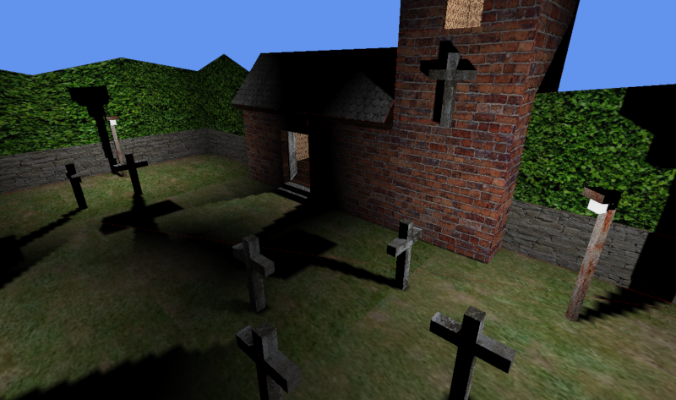
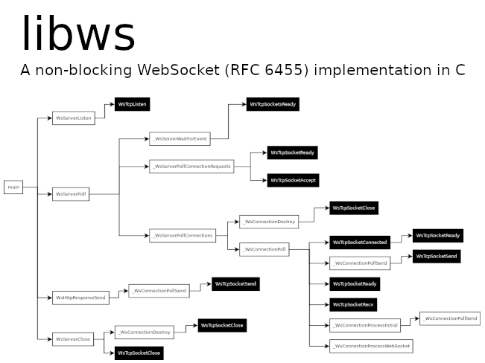
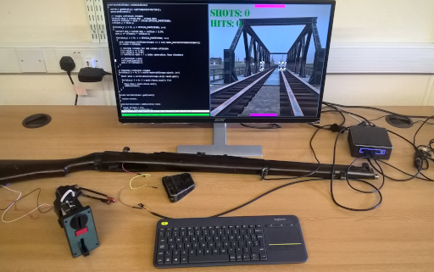
Some of our projects using libstent

Slide 22
Questions?
kpedersen@thamessoftware.co.uk
https://github.com/osen/stent

