Slide 1
Design and Implementation of a Web Based Programming Languages’ Tutoring Application
GROUP MEMBERS:
EWAOSE-JOSEPH OSENO O. 17/0516
UDEH ANTHONY 17/2262
Supervised by: Prof. Joshua J.V

Slide 2
TABLE OF CONTENT
Introduction
Problem Statement
Aim and Objectives
Scope and Significance
Literature Review
Methodologies
Results
Conclusion
References

Slide 3
INTRODUCTION
Learning is a core activity that must be mastered by students.
Research has shown that e- learning is considered more effective compared to other learning processes.
This is where our application comes in. It is to adapt to the use of each student so that they can learn at their own pace while proving to be extremely helpful to tutors as they can upload learning material.

Slide 4
INTRODUCTION: Background
Education can be obtained in many different ways; from the traditional system to the e-learning method to a hybrid of them both.
Many a times, the older learning processes follow a strict process that includes teaching in class and then giving assignments to work on afterwards regardless of the level of understanding of students. E-learning is considered more effective as it provides the same thing, however, with the option of learning at the pace of the student.
As students assimilate differently, e-learning provides a means to cater to their needs without leaving another student behind as opposed to the manual system.
Teachers are only human and can only try their best to cater to the needs of majority of the student body. However, this would mean that a minority is left behind.

Slide 5
PROBLEM STATEMENT
It is common knowledge that the sound knowledge of courses taken during the course of university is necessary before students are launched into the labour market.
However, to the disappointment of many, this is not the case.
The computer science labour market is incredibly competitive.
This is a recurring problem and although changes are made to the system, they have yet to prove effective.
This leads us to believe that the problem is the ineffectiveness of both the learning and teaching processes in place.
While thinking of the effective solution to this recurring problem, this project was borne.

Slide 6
AIM AND OBJECTIVES
The aim of the project is to make the use of sophisticated computer technologies to aid the studying of students in the university by the creation of a tutorial web application.
The general objectives of this study are to:
Conduct a review on existing e-learning platforms.
Develop an e-learning platform that will allow the upload of PowerPoint slides and PDF material.
Offer assistance to students in need of extra help outside of on-site classes via a meeting place on the application for both students and tutors.

Slide 7
SCOPE AND SIGNIFICANCE
SCOPE
This e-learning platform is aimed at students who struggle with grasping the concept of basic programming languages and have little to no knowledge of programming languages. It is not limited to just them however and students outside of the department with interest in learning are also given such opportunity.
SIGNIFICANCE
A cut down of cost of learning materials
A wider expanse of knowledge for students
Helping teachers do their work better
Others include gauging the type of information a student gets on a particular topic to avoid consumption of wrong information etc.

Slide 8
LITERATURE REVIEW
AUTHOR, YEAR | PROBLEM ADDRESSED | METHOD | RESULT OBTAINED | GAPS IDENTIFIED
Eze et al(2020) | Enabling learners to broaden their knowledge horizon using an e-learning platform | Existing e-learning applications were evaluated based on identified performance indicators (communicativeness of interface, security and system upgrade). | The result of the design was a prototype system that was developed which has a better communication interface, security and system upgrade capabilities with a firewall system integrated for security.
Mutiawani & Juwita (2014) | It addressed the problem that university students might have problems understanding the logic of basic programming | They made use of the waterfall software model and were able to achieve their goal by making use of HTML, CSS and JavaScript. | Course materials are divided into three categories, multimedia video, image and program code. | The gap in this article was that the method of programming is likely outdated as the programming world is ever evolving.

Slide 9
RESEARCH METHODOLOGY
A delineated version of the methodology based on the specific objectives include:
An analysis of existing systems so as to clearly outline what the system is to do and how to go about it.
Analysis of the database of the proposed model.
Design and implementation of a model for the proposed system.

Slide 10
Methodology: Analysis of existing systems
The existing systems to be reviewed include two applications created for varying Universities as well as w3 schools and Udemy.
The way by which existing systems will be reviewed is to be done by setting parameters which will be used to evaluate the Learning Management Systems.
The parameters include interface, database styling, compatibilities, student and tutor sides, efficiency, communication methods and feedback method.
After this analysis, it became easier to clearly state what we wanted my system to do and how we wanted to go about it.

Slide 11
Methodology: Analysis of the database of the proposed model
Database design is the organization of data according to a database model. Here, the data to be stored and the data elements interrelation is discussed.
The database to be constructed for such a system is heavily dependent on the actors and the actions they perform. This system contains two primary actors which are the student and tutor.
The database for the users, which include both students and tutors will be created using Structured Query Language (SQL).
This is an open-source relational database management system (RDBMS) which is reliable, easy to use, and quick for processing of data.

Slide 12
Methodology: Design and implementation of a model for the proposed system.
MODEL
The system makes use of the iterative waterfall model. This is preferred because iterative waterfall model is an advanced version of the waterfall model which includes feedback paths from every phase*
DESIGN TOOLS
HTML
CSS
Javascript
MYSQL
PHP
The activities are explained in the use case diagram.

Slide 13
USECASE
Signup
Sign In
Pick Course(s)
tutor
Upload material
Signup
Sign In
student
View Course(s)
Pick tutor
View material

Slide 14
RESULTS
Homepage
Student page
Tutor Page
Automated Tutor Page
Others including Contact Us, About Us, Register, Login and the functioning database that stores the information of users.

Slide 15
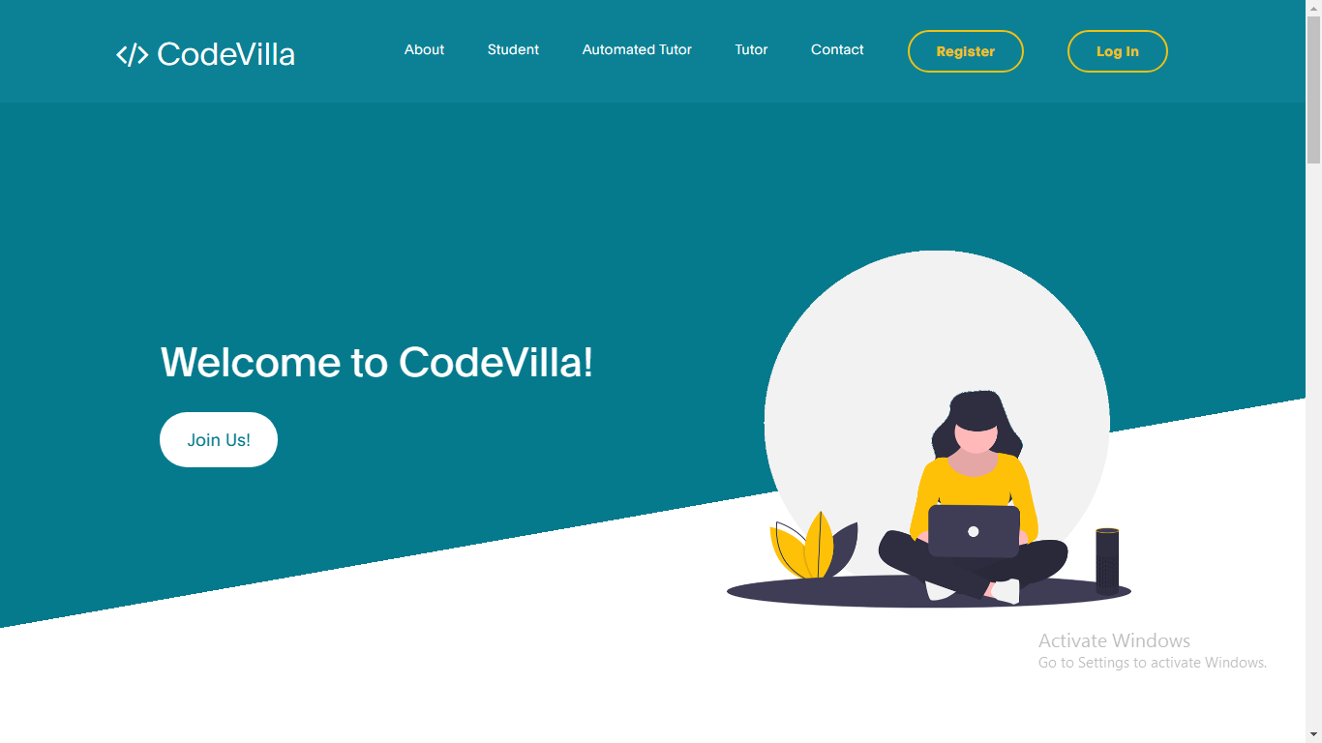
HOMEPAGE

Slide 16
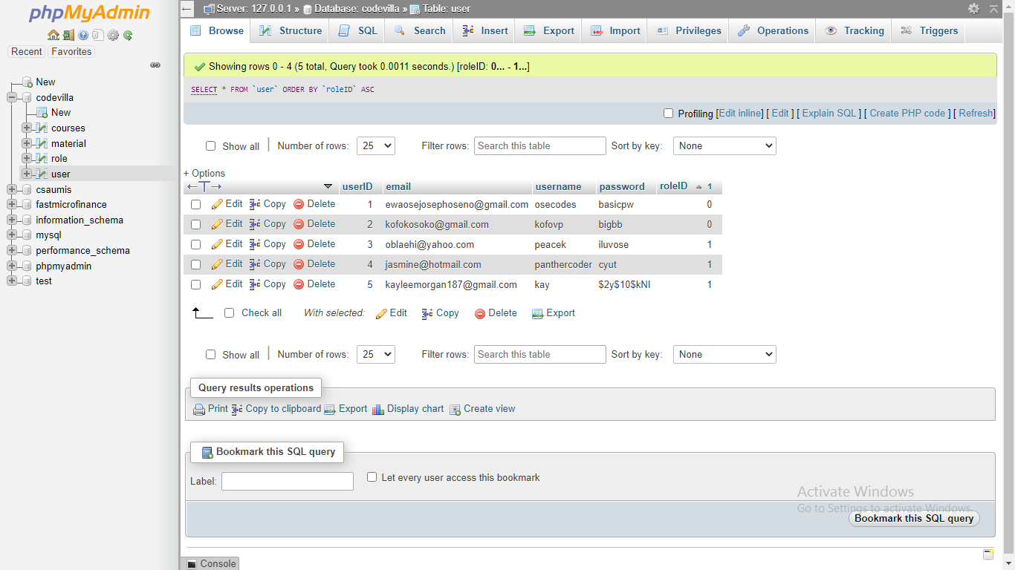
DATABASE

Slide 17
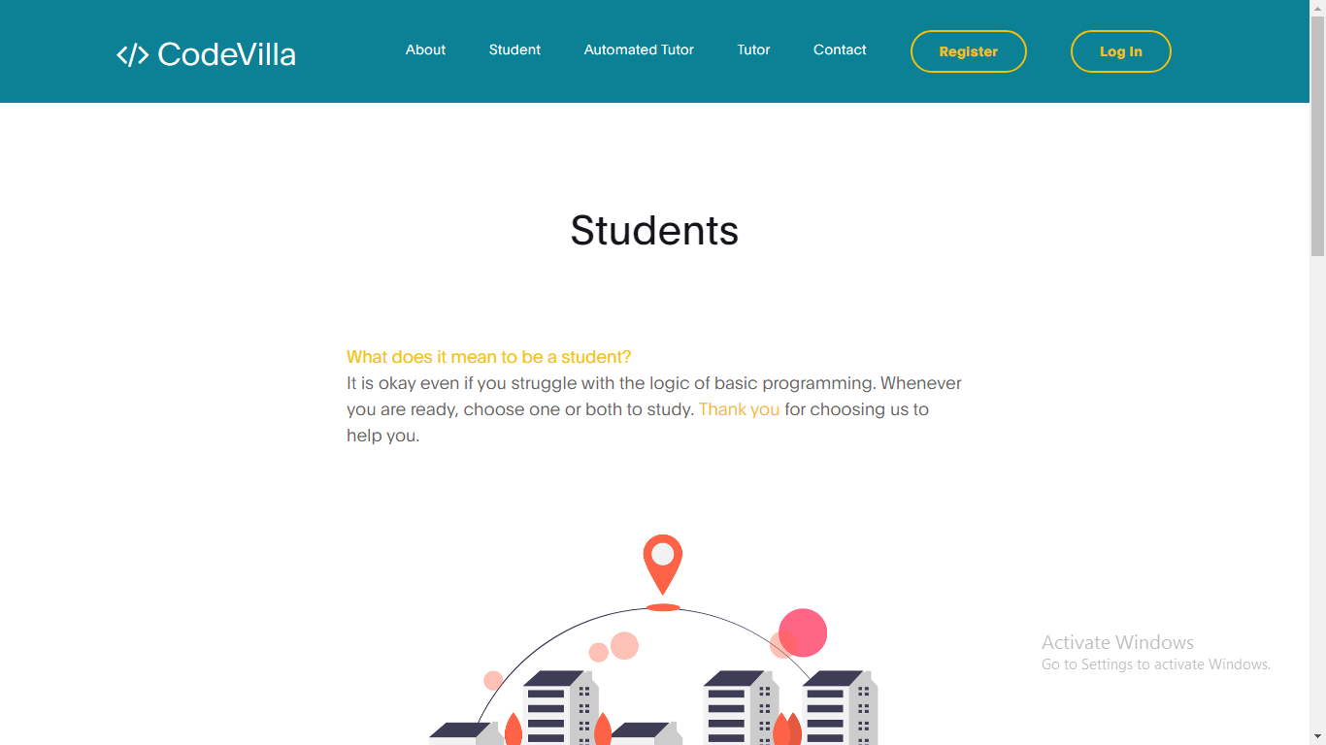
STUDENT PAGE

Slide 18
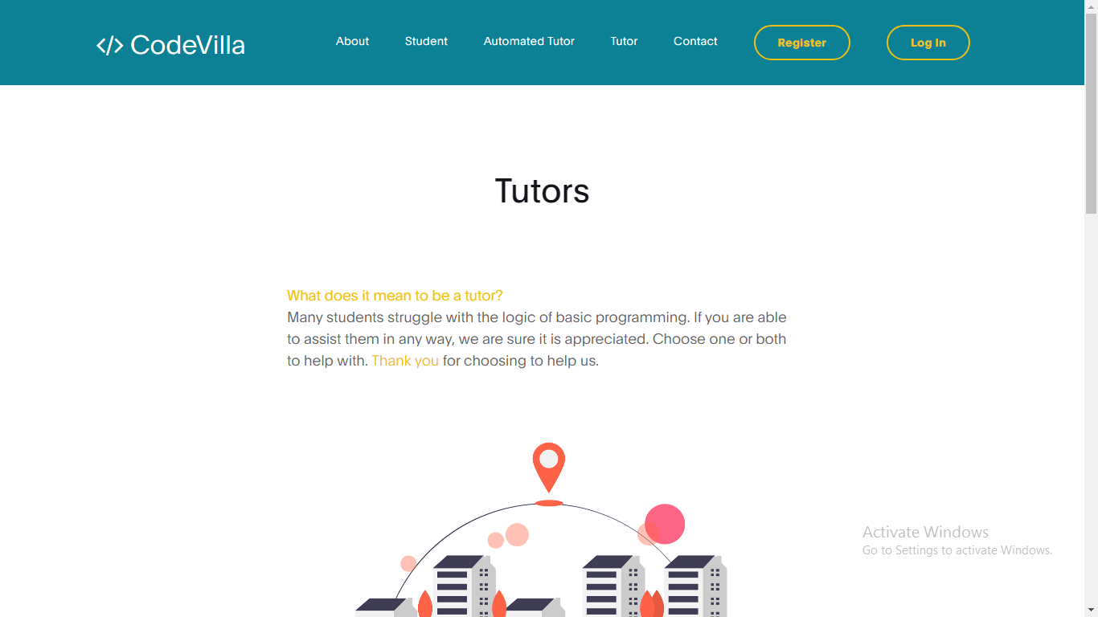
TUTOR PAGE

Slide 19
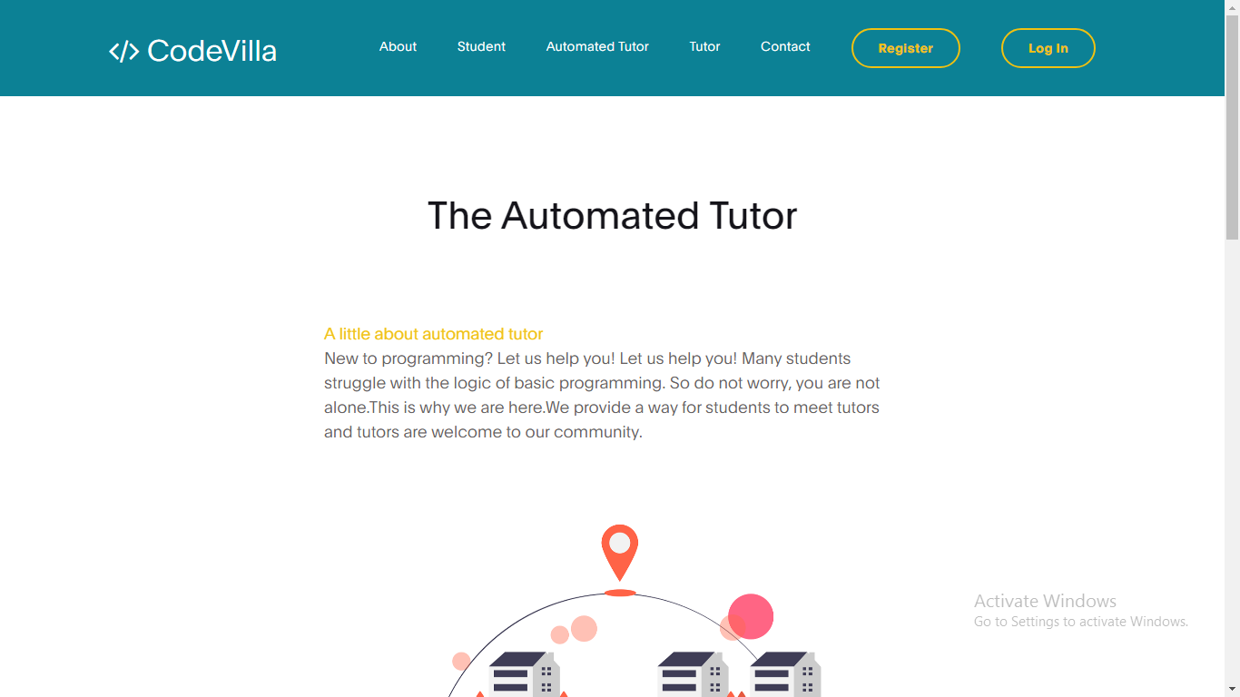
AUTOMATED TUTOR

Slide 20
CONCLUSION
This study covers an essential aspect in the development of an e-learning web application which aids both students and tutors alike in sharing or viewing content that benefits their programming skills.

Slide 21
RECOMMENDATION
The design and implementation of a tutoring web application for programming languages as a topic will suggest the existence of coursework for the ever growing number of applications that are in use in the software industry. This provides a cause for further studies on how to integrate even more languages that would not only aid the students in their comprehension of the technology but put them on the technological map of the world with its up to date knowledge that can be relied on.

Slide 22
REFERENCES
Eze, Udoka & Ihuoma, M & Chima Ajanwachuku, Nwagu. (2020). An Enhanced E-Learning Application for Tertiary Institutions. International Journal of Computer Applications. 176. 35-56.https://www.researchgate.net/publication/341453457_An_Enhanced_E-Learning_Application_for_Tertiary_Institutions
Soegoto, E. S., & Ardian, F. (2018). Designing E-Learning Application. IOP Conference Series: Materials Science and Engineering, 407, 012002. https://doi.org/10.1088/1757-899x/407/1/012002
Adnan, Enas & Elameer, Amer & Hamed, Ashwaq. (2018). Design and Development DataBase System of ELearning Platform for Iraqi Higher Education. 7. 1140-1142. 10.21275/ART20181138 https://www.researchgate.net/publication/330037265_Design_and_Development_DataBase_System_of_ELearning_Platform_for_Iraqi_Higher_Education
Tello, Jesús & Pérez de la Cámara, Santiago & Peña, Juan. (2011). A COMPARATIVE STUDY BETWEEN FREE E-LEARNING PLATFORMS https://www.researchgate.net/publication/236656139_A_COMPARATIVE_STUDY_BETWEEN_FREE_E-LEARNING_PLATFORMS
Jacyntho, Mark Douglas & Schwabe, Daniel & Rossi, Gustavo. (2002). A Software Architecture for Structuring Complex Web Applications.. J. Web Eng.. 1. 37-60 https://www.researchgate.net/publication/220538185_A_Software_Architecture_for_Structuring_Complex_Web_Applications
Mutiawani, Viska & Juwita, Juwita. (2015). Developing e-learning application specifically designed for learning introductory programming. 2014 International Conference on Information Technology Systems and Innovation, ICITSI 2014 - Proceedings. 126-129. 10.1109/ICITSI.2014.7048250 https://www.researchgate.net/publication/283098279_Developing_e-learning_application_specifically_designed_for_learning_introductory_programming

Slide 23

Thanks!

