Slide 1
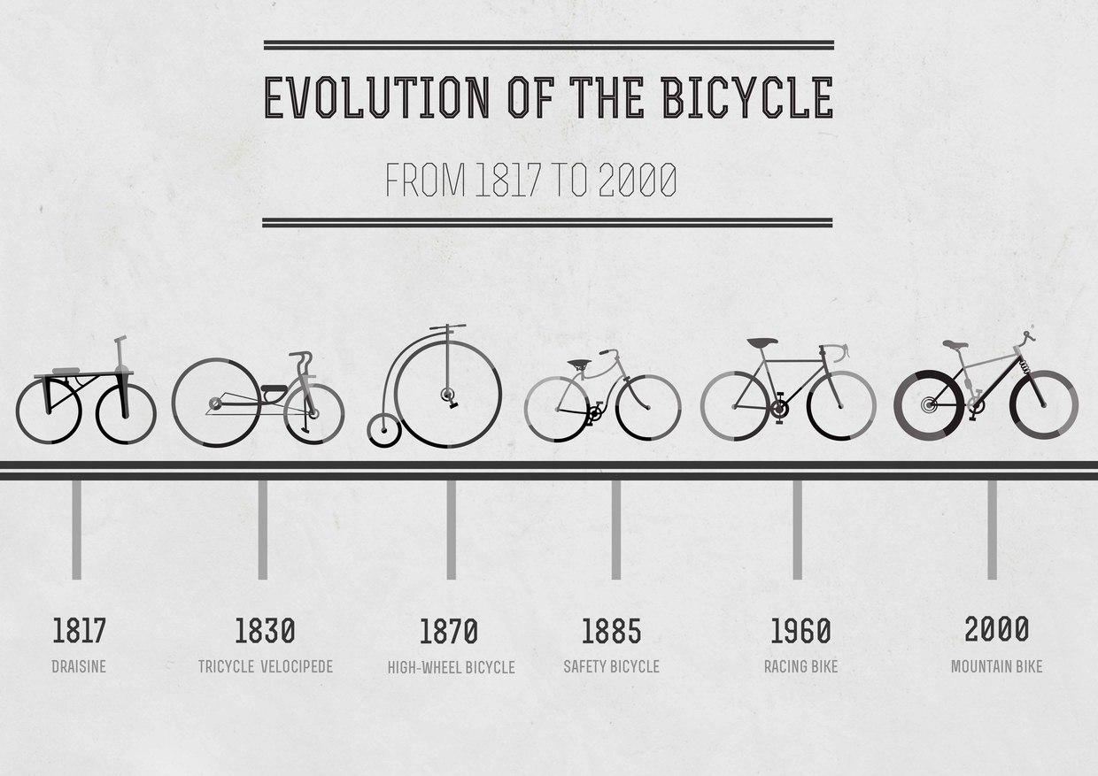
The Genetic Bike!
Group 4B.
Oleg Sergeev (Russia)
Martin Lavecchia (Argentina)
Shanawer Niaz (Pakistan)
Srivastav Ranganathan (India)

Slide 2
Overall Objective
Generate an 'optimal' bike design using the genetic algorithm

Slide 3
Sub-tasks
Model 'realistic' bike physics
Generate random inital bike populations
Implementation of the genetic algorithm
Visualization of the simulation
Managing the development tasks (the collaborative experience)

Slide 4
Source Code Management
Surface
Bike
Physics
Simulation Engine
Genetic
Algorithm
Visualization
Bike
Generator

Slide 5



Source Code Management
Github
Trello for keeping track of subtasks
Regular team meetings to revisit targets and introspect the progress

Slide 6
What Worked
Effective communication and task assignment during meetings
Modular approach allowed testing of modules independantly
Use of github

Slide 7
Problems faced
Deciding upon the bicycle physics computationally simple yet realistic enough to assist the evolution of an optimal bike
Understanding the functionality of each others' modules
Managing to thread the individual modules together

Slide 8
Lessons learnt
Managing a team project without source code management software is not feasible!
Developing a software as a part of a team is a skill and harder work than it is credited for!
Splitting a task into various modules and testing them independantly can assist debugging

Slide 9

Thank You!

