Slide 1
Drawing squiggly lines with Functional Python - Hakim Cassimally
└──────┬─────┘ ┗━━━━━━━┳━━━━━━━┛ └───────┬──────┘
┌──────────────┘ ┃ │
│┏━━━━━━━━━━━━━━━━━━━━━━━━━━━━━━━━━━┛ │
│┃┌─────────────────────────────────────────────────────┘
└╂┼─╴ with unicode box characters
┃│
┗┿━╸ some interesting FP features
│
└─╴ My talk for PythonNW, Thu 19th Sep 2019
@TechySquirrel
Technology Training Squirrel, BBC

Slide 2
1. Background

Slide 3
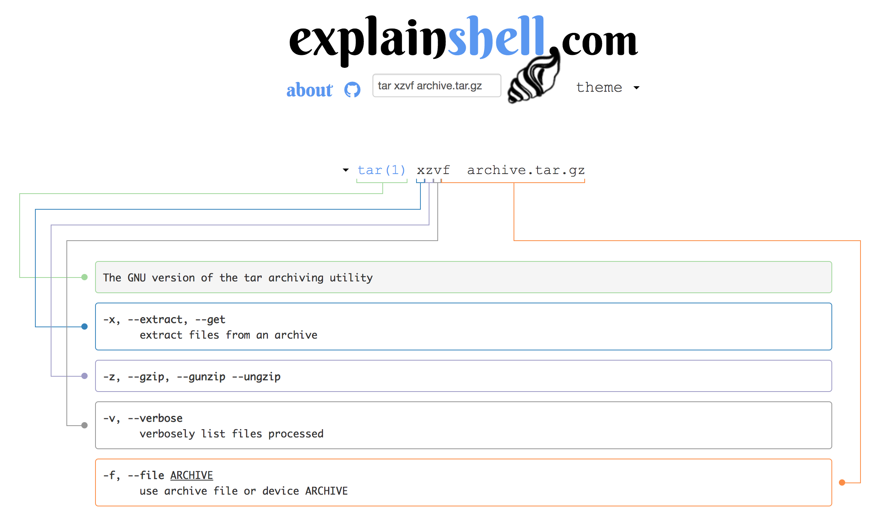

Slide 4
git diff-tree -M -r --name-status <commit>
└───┬───┘ ┗┫ └┤ ┗━━━━━┳━━━━━┛ └───┬──┘
┌───────┘ ┃ │ ┃ │
│┏━━━━━━━━━━━━━┛ │ ┃ │
│┃┌───────────────┘ ┃ │
│┃│┏━━━━━━━━━━━━━━━━━━━━━━┛ │
│┃│┃┌─────────────────────────────────┘
└╂┼╂┼─╴ Compares the content and mode of blobs found via two tree
┃│┃│ objects
┗┿╋┿━╸ Detect renames
└╂┼─╴ recurse into subtrees
┗┿━╸ Show only names and status of changed files
│ for example:
│ M foo.py
└─╴ show differences between this commit and preceding one

Slide 5
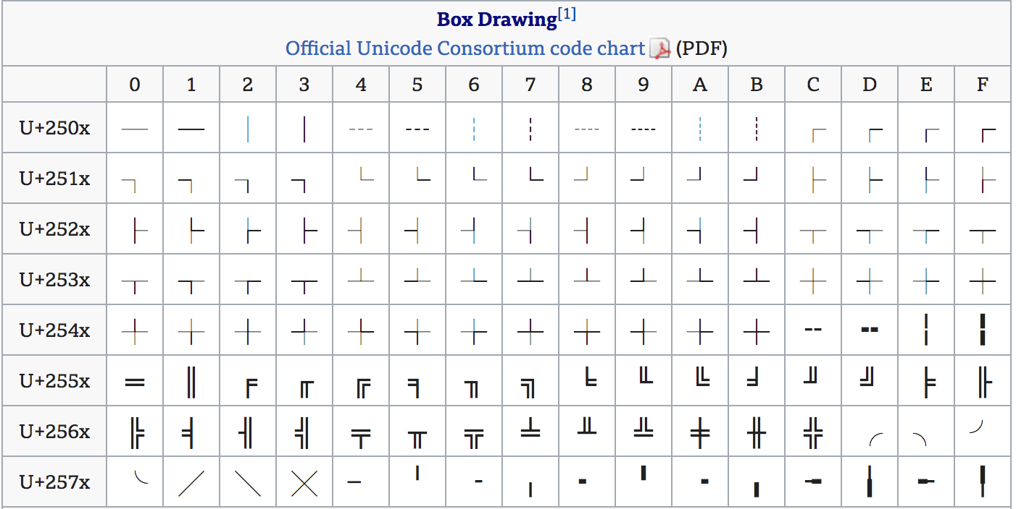

Slide 6


Slide 7
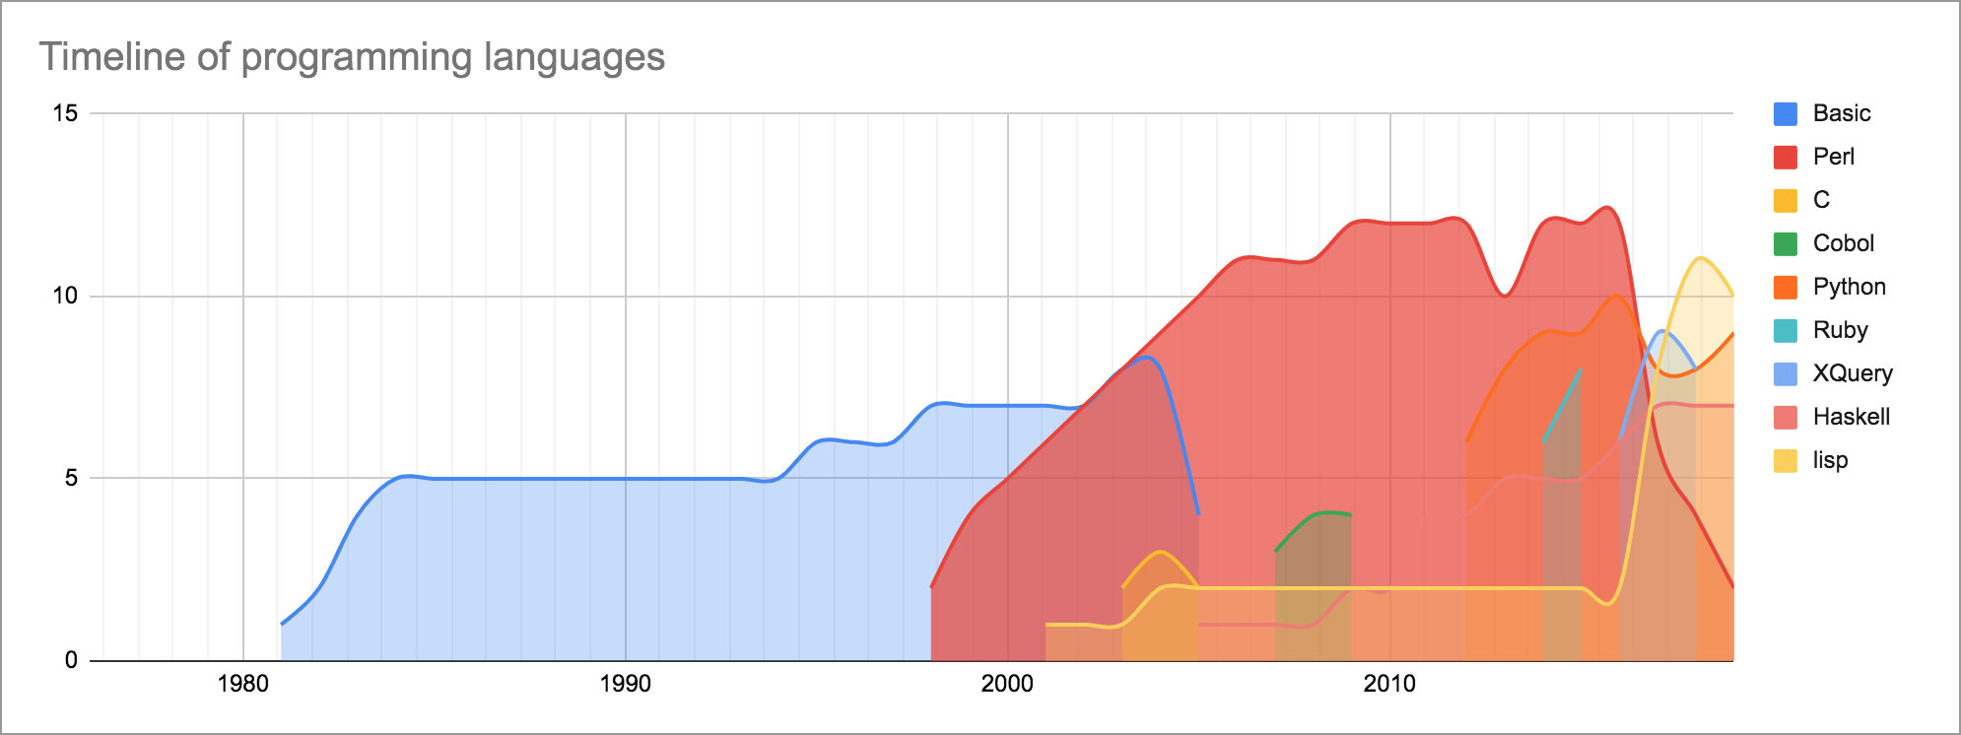
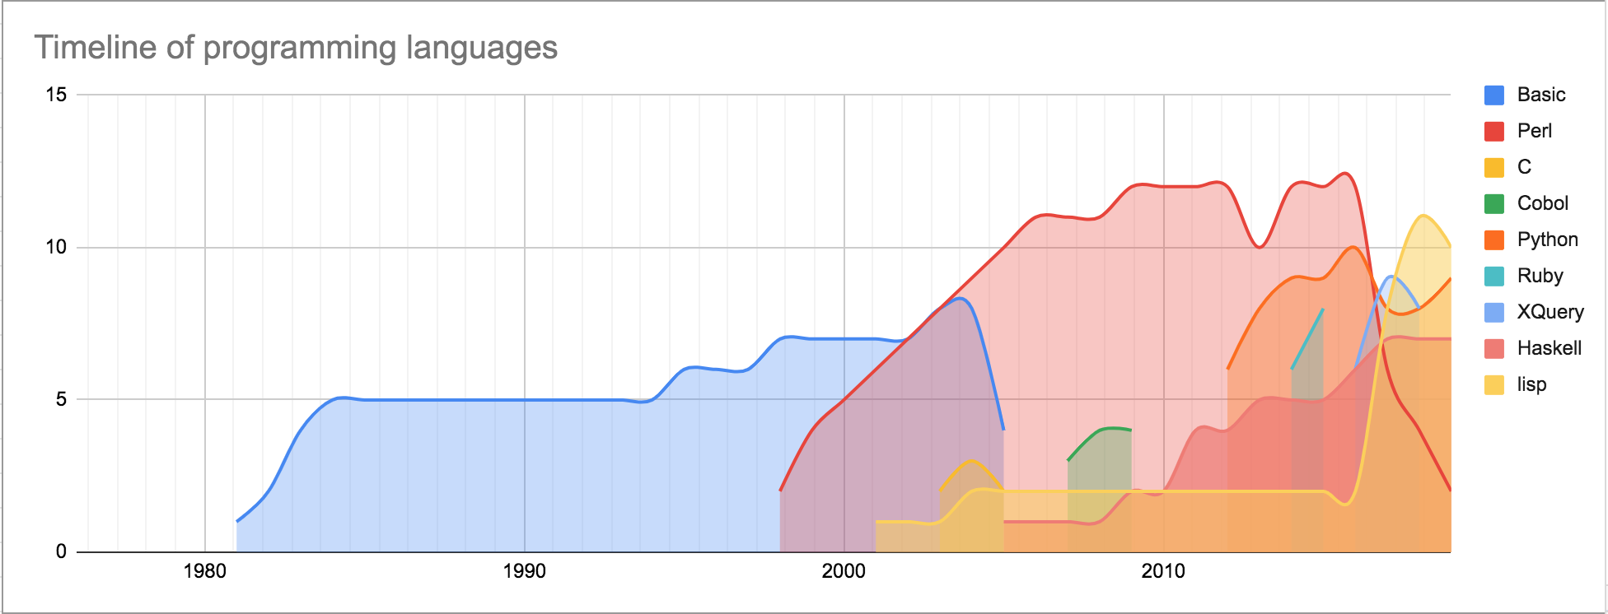


Slide 8


Slide 10
Functions
Double
1
2

Slide 11
?
formatDate
“Thursday 19th September”

Slide 12
<DATE>
formatDate
“Thursday 19th September”

Slide 13
<DATE>
formatDate
shell
date
“Thursday 19th September”

Slide 14
<RANDOM>
generate Insult
shell
rand
“a flying flamingo”

Slide 15
UPPER=true
format String
shell
upper
“A FLYING FLAMINGO”
“a flying flamingo”

Slide 16
UPPER=true
format String
shell
upper
“A FLYING FLAMINGO”
“a flying flamingo”
print(insult)

Slide 17
format Number
shell
1
“ONE!”
counter++

Slide 18
format Number
shell
2
“TWO!”
counter++

Slide 19
Concepts
Referential Transparency
Immutability
Functional Core, Imperative Shell

Slide 20
2. The Problem

Slide 21
git diff-tree -M -r --name-status <commit>
└───┬───┘ ┗┫ └┤ ┗━━━━━┳━━━━━┛ └───┬──┘
┌───────┘ ┃ │ ┃ │
│┏━━━━━━━━━━━━━┛ │ ┃ │
│┃┌───────────────┘ ┃ │
│┃│┏━━━━━━━━━━━━━━━━━━━━━━┛ │
│┃│┃┌─────────────────────────────────┘
└╂┼╂┼─╴ Compares the content and mode of blobs found via two tree
┃│┃│ objects
┗┿╋┿━╸ Detect renames
└╂┼─╴ recurse into subtrees
┗┿━╸ Show only names and status of changed files
│ for example:
│ M foo.py
└─╴ show differences between this commit and preceding one

Slide 22
git diff-tree -M -r --name-status <commit>
└───┬───┘ ┗┫ └┤ ┗━━━━━┳━━━━━┛ └───┬──┘
┌───────┘ ┃ │ ┃ │
│┏━━━━━━━━━━━━━┛ │ ┃ │
│┃┌───────────────┘ ┃ │
│┃│┏━━━━━━━━━━━━━━━━━━━━━━┛ │
│┃│┃┌─────────────────────────────────┘
└╂┼╂┼─╴ Compares the content and mode of blobs found via two tree
┃│┃│ objects
┗┿╋┿━╸ Detect renames
└╂┼─╴ recurse into subtrees
┗┿━╸ Show only names and status of changed files
│ for example:
│ M foo.py
└─╴ show differences between this commit and preceding one

Slide 23
git diff-tree -M -r --name-status <commit>
└───┬───┘ ┗┫ └┤ ┗━━━━━┳━━━━━┛ └───┬──┘
┌───────┘ ┃ │ ┃ │
│┏━━━━━━━━━━━━━┛ │ ┃ │
│┃┌───────────────┘ ┃ │
│┃│┏━━━━━━━━━━━━━━━━━━━━━━┛ │
│┃│┃┌─────────────────────────────────┘
└╂┼╂┼─╴ Compares the content and mode of blobs found via two tree
┃│┃│ objects
┗┿╋┿━╸ Detect renames
└╂┼─╴ recurse into subtrees
┗┿━╸ Show only names and status of changed files
│ for example:
│ M foo.py
└─╴ show differences between this commit and preceding one

Slide 24
git diff-tree -M -r --name-status <commit>
└───┬───┘ ┗┫ └┤ ┗━━━━━┳━━━━━┛ └───┬──┘
┌───────┘ ┃ │ ┃ │
│┏━━━━━━━━━━━━━┛ │ ┃ │
│┃┌───────────────┘ ┃ │
│┃│┏━━━━━━━━━━━━━━━━━━━━━━┛ │
│┃│┃┌─────────────────────────────────┘
└╂┼╂┼─╴ Compares the content and mode of blobs found via two tree
┃│┃│ objects
┗┿╋┿━╸ Detect renames
└╂┼─╴ recurse into subtrees
┗┿━╸ Show only names and status of changed files
│ for example:
│ M foo.py
└─╴ show differences between this commit and preceding one

Slide 25
git diff-tree -M -r --name-status <commit>
└───┬───┘ ┗┫ └┤ ┗━━━━━┳━━━━━┛ └───┬──┘
┌───────┘ ┃ │ ┃ │
│┏━━━━━━━━━━━━━┛ │ ┃ │
│┃┌───────────────┘ ┃ │
│┃│┏━━━━━━━━━━━━━━━━━━━━━━┛ │
│┃│┃┌─────────────────────────────────┘
└╂┼╂┼─╴ Compares the content and mode of blobs found via two tree
┃│┃│ objects
┗┿╋┿━╸ Detect renames
└╂┼─╴ recurse into subtrees
┗┿━╸ Show only names and status of changed files
│ for example:
│ M foo.py
└─╴ show differences between this commit and preceding one

Slide 26
2. Input data structure

Slide 27
git diff-tree -M -r --name-status <commit>
descs = ['git',
' ',
('diff-tree', 'Compares the content and mode of blobs found via two tree objects'),
' ',
('M', 'Detect renames'),
' ',
('-r', 'recurse into subtrees'),
' ',
('--name-status',
"""Show only names and status of changed files
for example:
M foo.py"""),
' ',
('<commit>', 'show differences between this commit and preceding one')]

Slide 28
git diff-tree -M -r --name-status <commit>
descs = ['git',
' ',
('diff-tree', 'Compares the content and mode of blobs found via two tree objects'),
' ',
('M', 'Detect renames'),
' ',
('-r', 'recurse into subtrees'),
' ',
('--name-status',
"""Show only names and status of changed files
for example:
M foo.py"""),
' ',
('<commit>', 'show differences between this commit and preceding one')]

Slide 29
git diff-tree -M -r --name-status <commit>
def norm(desc):
(t,c) = desc if type(desc) is tuple else (desc, None)
return (t, c, len(t))
raw = [norm(desc) for desc in descs]
header = ''.join([item[0] for item in raw])

Slide 30
git diff-tree -M -r --name-status <commit>
def norm(desc):
(t,c) = desc if type(desc) is tuple else (desc, None)
return (t, c, len(t))
raw = [norm(desc) for desc in descs]
header = ''.join([item[0] for item in raw])
(“git ”, None, 4)

Slide 31
git diff-tree -M -r --name-status <commit>
def norm(desc):
(t,c) = desc if type(desc) is tuple else (desc, None)
return (t, c, len(t))
raw = [norm(desc) for desc in descs]
header = ''.join([item[0] for item in raw])
[(“git ”, None, 4),
(“diff-tree”, 'Compares the content and mode of blobs found via two tree objects’, 9),
… ]

Slide 32
git diff-tree -M -r --name-status <commit>
def norm(desc):
(t,c) = desc if type(desc) is tuple else (desc, None)
return (t, c, len(t))
raw = [norm(desc) for desc in descs]
[x * 2 for x in [1,2,3]] => [2,4,6]
header = ''.join([item[0] for item in raw])

Slide 33
git diff-tree -M -r --name-status <commit>
def norm(desc):
(t,c) = desc if type(desc) is tuple else (desc, None)
return (t, c, len(t))
raw = [norm(desc) for desc in descs]
[x * 2 for x in [1,2,3]] => [2,4,6]
header = ''.join([item[0] for item in raw])

Slide 34
git diff-tree -M -r --name-status <commit>
def norm(desc):
(t,c) = desc if type(desc) is tuple else (desc, None)
return (t, c, len(t))
raw = [norm(desc) for desc in descs]
header = ''.join([item[0] for item in raw])
[“git ”,
“diff-tree”,
… ]

Slide 35
git diff-tree -M -r --name-status <commit>
def norm(desc):
(t,c) = desc if type(desc) is tuple else (desc, None)
return (t, c, len(t))
raw = [norm(desc) for desc in descs]
header = ''.join([item[0] for item in raw])

Slide 36
Concepts
Map (list comprehension)
Join

Slide 37
git diff-tree -M -r --name-status <commit>
└───┬───┘ ┗┫ └┤ ┗━━━━━┳━━━━━┛ └───┬──┘

Slide 38
git diff-tree -M -r --name-status <commit>
└───┬───┘ ┗┫ └┤ ┗━━━━━┳━━━━━┛ └───┬──┘

Slide 39
git diff-tree -M -r --name-status <commit>
└───┬───┘ ┗┫ └┤ ┗━━━━━┳━━━━━┛ └───┬──┘

Slide 40
git diff-tree -M -r --name-status <commit>
└───┬───┘ ┗┫ └┤ ┗━━━━━┳━━━━━┛ └───┬──┘

Slide 41
git diff-tree -M -r --name-status <commit>
└───┬───┘ ┗┫ └┤ ┗━━━━━┳━━━━━┛ └───┬──┘

Slide 42
git diff-tree M -r --name-status <commit>
└───┬───┘ ┃ └┤ ┗━━━━━┳━━━━━┛ └───┬──┘

Slide 43
git diff-tree M -r --name-status <commit>
└───┬───┘ ┃ └┤ ┗━━━━━┳━━━━━┛ └───┬──┘
def markers(ts):
def draw(t):
(text, comment, length) = t
if comment:
if l == 1:
return '│’
elif l == 2:
return '├┘’
else:
left = math.floor((l-3) / 2)
right = math.ceil((l-3) / 2)
return ''.join(['└',
left * '─',
'┬',
right * '─',
'┘'])
else:
return ' ' * length
return ''.join([draw(t) for t in ts])

Slide 44
git diff-tree M -r --name-status <commit>
└───┬───┘ ┃ └┤ ┗━━━━━┳━━━━━┛ └───┬──┘
def markers(ts):
def draw(t):
(text, comment, length) = t
if comment:
if l == 1:
return '│’
elif l == 2:
return '├┘’
else:
left = math.floor((l-3) / 2)
right = math.ceil((l-3) / 2)
return ''.join(['└',
left * '─',
'┬',
right * '─',
'┘'])
else:
return ' ' * length
return ''.join([draw(t) for t in ts])

Slide 45
git diff-tree M -r --name-status <commit>
└───┬───┘ ┃ └┤ ┗━━━━━┳━━━━━┛ └───┬──┘
def markers(ts):
def draw(t):
(text, comment, length) = t
if comment:
if l == 1:
return '│’
elif l == 2:
return '├┘’
else:
left = math.floor((l-3) / 2)
right = math.ceil((l-3) / 2)
return ''.join(['└',
left * '─',
'┬',
right * '─',
'┘'])
else:
return ' ' * length
return ''.join([draw(t) for t in ts])

Slide 46
git diff-tree M -r --name-status <commit>
└───┬───┘ ┃ └┤ ┗━━━━━┳━━━━━┛ └───┬──┘
def markers(ts):
def draw(t):
(text, comment, length) = t
if comment:
if l == 1:
return '│’
elif l == 2:
return '├┘’
else:
left = math.floor((l-3) / 2)
right = math.ceil((l-3) / 2)
return ''.join(['└',
left * '─',
'┬',
right * '─',
'┘'])
else:
return ' ' * length
return ''.join([draw(t) for t in ts])

Slide 47
git diff-tree M -r --name-status <commit>
└───┬───┘ ┃ └┤ ┗━━━━━┳━━━━━┛ └───┬──┘
def markers(ts):
def draw(t):
(text, comment, length) = t
if comment:
if l == 1:
return '│’
elif l == 2:
return '├┘’
else:
left = math.floor((l-3) / 2)
right = math.ceil((l-3) / 2)
return ''.join(['└',
left * '─',
'┬',
right * '─',
'┘'])
else:
return ' ' * length
return ''.join([draw(t) for t in ts])

Slide 48
git diff-tree M -r --name-status <commit>
└───┬───┘ ┃ └┤ ┗━━━━━┳━━━━━┛ └───┬──┘
def markers(ts):
def draw(t):
(text, comment, length) = t
if comment:
if l == 1:
return '│’
elif l == 2:
return '├┘’
else:
left = math.floor((l-3) / 2)
right = math.ceil((l-3) / 2)
return ''.join(['└',
left * '─',
'┬',
right * '─',
'┘'])
else:
return ' ' * length
return ''.join([draw(t) for t in ts])

Slide 49
Concepts
Cases

Slide 50
git diff-tree -M -r --name-status <commit>
└───┬───┘ ┗┫ └┤ ┗━━━━━┳━━━━━┛ └───┬──┘
┌───────┘ ┃ │ ┃ │
│┏━━━━━━━━━━━━━┛ │ ┃ │
│┃┌───────────────┘ ┃ │
│┃│┏━━━━━━━━━━━━━━━━━━━━━━┛ │
│┃│┃┌─────────────────────────────────┘
└╂┼╂┼─╴ Compares the content and mode of blobs found via two tree
┃│┃│ objects
┗┿╋┿━╸ Detect renames
└╂┼─╴ recurse into subtrees
┗┿━╸ Show only names and status of changed files
│ for example:
│ M foo.py
└─╴ show differences between this commit and preceding one

Slide 51
git diff-tree -M -r --name-status <commit>
└───┬───┘ ┗┫ └┤ ┗━━━━━┳━━━━━┛ └───┬──┘
┌───────┘ ┃ │ ┃ │
│┏━━━━━━━━━━━━━┛ │ ┃ │
│┃┌───────────────┘ ┃ │
│┃│┏━━━━━━━━━━━━━━━━━━━━━━┛ │
│┃│┃┌─────────────────────────────────┘
└╂┼╂┼─╴ Compares the content and mode of blobs found via two tree
┃│┃│ objects
┗┿╋┿━╸ Detect renames
└╂┼─╴ recurse into subtrees
┗┿━╸ Show only names and status of changed files
│ for example:
│ M foo.py
└─╴ show differences between this commit and preceding one

Slide 52
git diff-tree -M -r --name-status <commit>
└───┬───┘ ┗┫ └┤ ┗━━━━━┳━━━━━┛ └───┬──┘
┌───────┘ ┃ │ ┃ │
│┏━━━━━━━━━━━━━┛ │ ┃ │
│┃┌───────────────┘ ┃ │
│┃│┏━━━━━━━━━━━━━━━━━━━━━━┛ │
│┃│┃┌─────────────────────────────────┘
└╂┼╂┼─╴ Compares the content and mode of blobs found via two tree
┃│┃│ objects
┗┿╋┿━╸ Detect renames
└╂┼─╴ recurse into subtrees
┗┿━╸ Show only names and status of changed files
│ for example:
│ M foo.py
└─╴ show differences between this commit and preceding one

Slide 53
git diff-tree -M -r --name-status <commit>
└───┬───┘ ┗┫ └┤ ┗━━━━━┳━━━━━┛ └───┬──┘
┌───────┘ ┃ │ ┃ │
│┏━━━━━━━━━━━━━┛ │ ┃ │
│┃┌───────────────┘ ┃ │
│┃│┏━━━━━━━━━━━━━━━━━━━━━━┛ │
│┃│┃┌─────────────────────────────────┘
└╂┼╂┼─╴ Compares the content and mode of blobs found via two tree
┃│┃│ objects
┗┿╋┿━╸ Detect renames
└╂┼─╴ recurse into subtrees
┗┿━╸ Show only names and status of changed files
│ for example:
│ M foo.py
└─╴ show differences between this commit and preceding one

Slide 54
git diff-tree -M -r --name-status <commit>
└───┬───┘ ┗┫ └┤ ┗━━━━━┳━━━━━┛ └───┬──┘
┌───────┘ ┃ │ ┃ │
│┏━━━━━━━━━━━━━┛ │ ┃ │
│┃┌───────────────┘ ┃ │
│┃│┏━━━━━━━━━━━━━━━━━━━━━━┛ │
│┃│┃┌─────────────────────────────────┘
└╂┼╂┼─╴ Compares the content and mode of blobs found via two tree
┃│┃│ objects
┗┿╋┿━╸ Detect renames
└╂┼─╴ recurse into subtrees
┗┿━╸ Show only names and status of changed files
│ for example:
│ M foo.py
└─╴ show differences between this commit and preceding one

Slide 55
git diff-tree -M -r --name-status <commit>
└───┬───┘ ┗┫ └┤ ┗━━━━━┳━━━━━┛ └───┬──┘
┌───────┘ ┃ │ ┃ │
│┏━━━━━━━━━━━━━┛ │ ┃ │
│┃┌───────────────┘ ┃ │
│┃│┏━━━━━━━━━━━━━━━━━━━━━━┛ │
│┃│┃┌─────────────────────────────────┘
└╂┼╂┼─╴ Compares the content and mode of blobs found via two tree
┃│┃│ objects
┗┿╋┿━╸ Detect renames
└╂┼─╴ recurse into subtrees
┗┿━╸ Show only names and status of changed files
│ for example:
│ M foo.py
└─╴ show differences between this commit and preceding one

Slide 56
git diff-tree -M -r --name-status <commit>
└───┬───┘ ┗┫ └┤ ┗━━━━━┳━━━━━┛ └───┬──┘
┌───────┘ ┃ │ ┃ │
│┏━━━━━━━━━━━━━┛ │ ┃ │
│┃┌───────────────┘ ┃ │
│┃│┏━━━━━━━━━━━━━━━━━━━━━━┛ │
│┃│┃┌─────────────────────────────────┘
└╂┼╂┼─╴ Compares the content and mode of blobs found via two tree
┃│┃│ objects
┗┿╋┿━╸ Detect renames
└╂┼─╴ recurse into subtrees
┗┿━╸ Show only names and status of changed files
│ for example:
│ M foo.py
└─╴ show differences between this commit and preceding one

Slide 57
git diff-tree -M -r --name-status <commit>
└───┬───┘ ┗┫ └┤ ┗━━━━━┳━━━━━┛ └───┬──┘
┌───────┘ ┃ │ ┃ │
│┏━━━━━━━━━━━━━┛ │ ┃ │
│┃┌───────────────┘ ┃ │
│┃│┏━━━━━━━━━━━━━━━━━━━━━━┛ │
│┃│┃┌─────────────────────────────────┘
└╂┼╂┼─╴ Compares the content and mode of blobs found via two tree
┃│┃│ objects
┗┿╋┿━╸ Detect renames
└╂┼─╴ recurse into subtrees
┗┿━╸ Show only names and status of changed files
│ for example:
│ M foo.py
└─╴ show differences between this commit and preceding one

Slide 58
git diff-tree -M -r --name-status <commit>
└───┬───┘ ┗┫ └┤ ┗━━━━━┳━━━━━┛ └───┬──┘
4, 9, 1,2,1,2,1, 13, 1, 8

Slide 59
git diff-tree -M -r --name-status <commit>
└───┬───┘ ┗┫ └┤ ┗━━━━━┳━━━━━┛ └───┬──┘
4, 9, 1,2,1,2,1, 13, 1, 8
from operator import itemgetter
hasComment = itemgetter(1) # None vs “Compares the content...”
ts = filter(hasComment, ts)

Slide 60
git diff-tree -M -r --name-status <commit>
└───┬───┘ ┗┫ └┤ ┗━━━━━┳━━━━━┛ └───┬──┘
4, 9, 1,2,1,2,1, 13, 1, 8
from operator import itemgetter
hasComment = itemgetter(1) # None vs “Compares the content...”
ts = filter(hasComment, ts)

Slide 61
git diff-tree -M -r --name-status <commit>
└───┬───┘ ┗┫ └┤ ┗━━━━━┳━━━━━┛ └───┬──┘
9, 2, 2, 13, 8
from operator import itemgetter
hasComment = itemgetter(1) # None vs “Compares the content...”
ts = filter(hasComment, ts)

Slide 62
git diff-tree -M -r --name-status <commit>
└───┬───┘ ┗┫ └┤ ┗━━━━━┳━━━━━┛ └───┬──┘
9, 2, 2, 13, 8
from operator import itemgetter
hasComment = itemgetter(1) # None vs “Compares the content...”
ts = filter(hasComment, ts)
[t for t in ts if hasComment(t)]

Slide 63
git diff-tree -M -r --name-status <commit>
└───┬───┘ ┗┫ └┤ ┗━━━━━┳━━━━━┛ └───┬──┘
4, 9, 1,2,1,2,1, 13, 1, 8
=4+(9/2)

Slide 64
git diff-tree -M -r --name-status <commit>
└───┬───┘ ┗┫ └┤ ┗━━━━━┳━━━━━┛ └───┬──┘
4 + 9 +1+2+1+2+1 + 13 + 1 + 8 = 42

Slide 65
git diff-tree -M -r --name-status <commit>
└───┬───┘ ┗┫ └┤ ┗━━━━━┳━━━━━┛ └───┬──┘
4 + 9 +1+2+1+2+1 + 13 + 1 + 8 = 42
lengths = [l[2] for l in raw]
sum(lengths) # 42

Slide 66
git diff-tree -M -r --name-status <commit>
└───┬───┘ ┗┫ └┤ ┗━━━━━┳━━━━━┛ └───┬──┘
4 + 9 +1+2+1+2+1 + 13 + 1 + 8 = 42
lengths = [l[2] for l in raw]
sum(lengths) # 42
from functools import reduce
from operator import add
reduce(add, lengths) # 42

Slide 67
git diff-tree -M -r --name-status <commit>
└───┬───┘ ┗┫ └┤ ┗━━━━━┳━━━━━┛ └───┬──┘
4 + 9 +1+2+1+2+1 + 13 + 1 + 8 = 42
lengths = [l[2] for l in raw]
sum(lengths) # 42
from functools import reduce
from operator import add
reduce(add, lengths, 0) # 42

Slide 68
git diff-tree -M -r --name-status <commit>
└───┬───┘ ┗┫ └┤ ┗━━━━━┳━━━━━┛ └───┬──┘
4 + 9 = 13

Slide 69
git diff-tree -M -r --name-status <commit>
└───┬───┘ ┗┫ └┤ ┗━━━━━┳━━━━━┛ └───┬──┘
13 + 1 =
14

Slide 70
git diff-tree -M -r --name-status <commit>
└───┬───┘ ┗┫ └┤ ┗━━━━━┳━━━━━┛ └───┬──┘
14 + 2 =
16

Slide 71
git diff-tree -M -r --name-status <commit>
└───┬───┘ ┗┫ └┤ ┗━━━━━┳━━━━━┛ └───┬──┘
4, 9, 1,2,1,2,1,13, 1,8
from itertools import accumulate

Slide 72
git diff-tree -M -r --name-status <commit>
└───┬───┘ ┗┫ └┤ ┗━━━━━┳━━━━━┛ └───┬──┘
4, 9, 1,2,1,2,1,13, 1,8
from itertools import accumulate
accumulate(lengths)
[ 4, 13,14,16,17,19,20, 33,34, 42]

Slide 73
git diff-tree -M -r --name-status <commit>
└───┬───┘ ┗┫ └┤ ┗━━━━━┳━━━━━┛ └───┬──┘
4, 9, 1,2,1,2,1,13, 1,8
from itertools import accumulate
accumulate(lengths, add)
[ 4, 13,14,16,17,19,20, 33,34, 42]

Slide 74
git diff-tree -M -r --name-status <commit>
└───┬───┘ ┗┫ └┤ ┗━━━━━┳━━━━━┛ └───┬──┘
4, 9, 1,2,1,2,1,13, 1,8
from itertools import accumulate
accumulate(lengths, add)
<itertools.accumulate object at 0x10d313bc8>

Slide 75
git diff-tree -M -r --name-status <commit>
└───┬───┘ ┗┫ └┤ ┗━━━━━┳━━━━━┛ └───┬──┘
4, 9, 1,2,1,2,1,13, 1,8
from itertools import accumulate
list(accumulate(lengths, add))
[ 4, 13,14,16,17,19,20, 33,34, 42]

Slide 76
git diff-tree -M -r --name-status <commit>
└───┬───┘ ┗┫ └┤ ┗━━━━━┳━━━━━┛ └───┬──┘
4, 9, 1,2,1,2,1,13, 1,8
from itertools import accumulate
offsets = accumulate(lengths, add)
list(offsets)
[ 4, 13,14,16,17,19,20, 33,34, 42]

Slide 77
git diff-tree -M -r --name-status <commit>
└───┬───┘ ┗┫ └┤ ┗━━━━━┳━━━━━┛ └───┬──┘
4, 9, 1,2,1,2,1,13, 1,8
from itertools import accumulate
offsets = accumulate(lengths, add)
list(offsets)
[ 4, 13,14,16,17,19,20, 33,34, 42]
list(offsets)
[]
#WAT

Slide 78
git diff-tree -M -r --name-status <commit>
└───┬───┘ ┗┫ └┤ ┗━━━━━┳━━━━━┛ └───┬──┘
[4, 9, 1,2,1,2,1,13, 1,8 ]
[ 4, 13,14,16,17,19,20, 33,34, 42]

Slide 79
git diff-tree -M -r --name-status <commit>
└───┬───┘ ┗┫ └┤ ┗━━━━━┳━━━━━┛ └───┬──┘
[4, 9, 1,2,1,2,1,13, 1,8 ]
[0, 4, 13,14,16,17,19,20, 33,34, 42]

Slide 80
Concepts
Filter (filter, list comprehension)
Fold (sum, reduce)
Scan (accumulate)
Iterators

Slide 81
git diff-tree -M -r --name-status <commit>
└───┬───┘ ┗┫ └┤ ┗━━━━━┳━━━━━┛ └───┬──┘
[4, 9, 1,2,1,2,1,13, 1, 8]
[0, 4, 13,14,16,17,19,20, 33,34]
zip(lengths, offsets)

Slide 82
git diff-tree -M -r --name-status <commit>
└───┬───┘ ┗┫ └┤ ┗━━━━━┳━━━━━┛ └───┬──┘
[4, 9, 1,2,1,2,1,13, 1, 8]
[0, 4, 13,14,16,17,19,20, 33,34]
zip(lengths, offsets)

Slide 83
git diff-tree -M -r --name-status <commit>
└───┬───┘ ┗┫ └┤ ┗━━━━━┳━━━━━┛ └───┬──┘
[(4,0)] [9, 1,2,1,2,1,13, 1, 8]
[4, 13,14,16,17,19,20, 33,34]
zip(lengths, offsets)

Slide 84
git diff-tree -M -r --name-status <commit>
└───┬───┘ ┗┫ └┤ ┗━━━━━┳━━━━━┛ └───┬──┘
[(4,0),(9,4)] [ 1,2,1,2,1,13, 1, 8]
[13,14,16,17,19,20, 33,34]
zip(lengths, offsets)

Slide 85
git diff-tree -M -r --name-status <commit>
└───┬───┘ ┗┫ └┤ ┗━━━━━┳━━━━━┛ └───┬──┘
[(4,0),(9,4),(1,13)] [2,1,2,1,13, 1, 8]
[14,16,17,19,20, 33,34]
zip(lengths, offsets)

Slide 86
git diff-tree -M -r --name-status <commit>
└───┬───┘ ┗┫ └┤ ┗━━━━━┳━━━━━┛ └───┬──┘
[(4,0),(9,4),(1,13),(2,14), ...]
zip(lengths, offsets)

Slide 87
git diff-tree -M -r --name-status <commit>
└───┬───┘ ┗┫ └┤ ┗━━━━━┳━━━━━┛ └───┬──┘
┌───────┘ ┃ │ ┃ │
│┏━━━━━━━━━━━━━┛ │ ┃ │
│┃┌───────────────┘ ┃ │
│┃│┏━━━━━━━━━━━━━━━━━━━━━━┛ │
│┃│┃┌─────────────────────────────────┘
└╂┼╂┼─╴ Compares the content and mode of blobs found via two tree
┃│┃│ objects
┗┿╋┿━╸ Detect renames
└╂┼─╴ recurse into subtrees
┗┿━╸ Show only names and status of changed files
│ for example:
│ M foo.py
└─╴ show differences between this commit and preceding one

Slide 88
git diff-tree -M -r --name-status <commit>
└───┬───┘ ┗┫ └┤ ┗━━━━━┳━━━━━┛ └───┬──┘
┌───────┘ ┃ │ ┃ │
│┏━━━━━━━━━━━━━┛ │ ┃ │
│┃┌───────────────┘ ┃ │
│┃│┏━━━━━━━━━━━━━━━━━━━━━━┛ │
│┃│┃┌─────────────────────────────────┘
└╂┼╂┼─╴ Compares the content and mode of blobs found via two tree
┃│┃│ objects
┗┿╋┿━╸ Detect renames
└╂┼─╴ recurse into subtrees
┗┿━╸ Show only names and status of changed files
│ for example:
│ M foo.py
└─╴ show differences between this commit and preceding one

Slide 89
git diff-tree -M -r --name-status <commit>
└───┬───┘ ┗┫ └┤ ┗━━━━━┳━━━━━┛ └───┬──┘
┌───────┘ ┃ │ ┃ │
│┏━━━━━━━━━━━━━┛ │ ┃ │
│┃┌───────────────┘ ┃ │
│┃│┏━━━━━━━━━━━━━━━━━━━━━━┛ │
│┃│┃┌─────────────────────────────────┘
└╂┼╂┼─╴ Compares the content and mode of blobs found via two tree
┃│┃│ objects
┗┿╋┿━╸ Detect renames
└╂┼─╴ recurse into subtrees
┗┿━╸ Show only names and status of changed files
│ for example:
│ M foo.py
└─╴ show differences between this commit and preceding one

Slide 90
git diff-tree -M -r --name-status <commit>
└───┬───┘ ┗┫ └┤ ┗━━━━━┳━━━━━┛ └───┬──┘
┌───────┘ ┃ │ ┃ │
│┏━━━━━━━━━━━━━┛ │ ┃ │
│┃┌───────────────┘ ┃ │
│┃│┏━━━━━━━━━━━━━━━━━━━━━━┛ │
│┃│┃┌─────────────────────────────────┘
└╂┼╂┼─╴ Compares the content and mode of blobs found via two tree
┃│┃│ objects
┗┿╋┿━╸ Detect renames
└╂┼─╴ recurse into subtrees
┗┿━╸ Show only names and status of changed files
│ for example:
│ M foo.py
└─╴ show differences between this commit and preceding one

Slide 91
└╂┼╂┼─╴ Compares the content and mode of blobs found via two tree
┃│┃│ objects
┗┿╋┿━╸ Detect renames
└╂┼─╴ recurse into subtrees
┗┿━╸ Show only names and status of changed files
│ for example:
│ M foo.py
from textwrap import wrap
def reflow(text, width):
return sum([wrap(para, width)
for para in text.split("\n")],
[])

Slide 92
└╂┼╂┼─╴ Compares the content and mode of blobs found via two tree
┃│┃│ objects
┗┿╋┿━╸ Detect renames
└╂┼─╴ recurse into subtrees
┗┿━╸ Show only names and status of changed files
│ for example:
│ M foo.py
from textwrap import wrap
def reflow(text, width):
return sum([wrap(para, width)
for para in text.split("\n")],
[])

Slide 93
└╂┼╂┼─╴ Compares the content and mode of blobs found via two tree
┃│┃│ objects
┗┿╋┿━╸ Detect renames
└╂┼─╴ recurse into subtrees
┗┿━╸ Show only names and status of changed files
│ for example:
│ M foo.py
from textwrap import wrap
def reflow(text, width):
return sum([wrap(para, width)
for para in text.split("\n")],
[])
?

Slide 94
└╂┼╂┼─╴ Compares the content and mode of blobs found via two tree
┃│┃│ objects
┗┿╋┿━╸ Detect renames
└╂┼─╴ recurse into subtrees
┗┿[[“Show only names and status of changed files”,
│ “for example:”],
│ [“M foo.py”]]
from textwrap import wrap
def reflow(text, width):
return sum([wrap(para, width)
for para in text.split("\n")],
[])

Slide 95
└╂┼╂┼─╴ Compares the content and mode of blobs found via two tree
┃│┃│ objects
┗┿╋┿━╸ Detect renames
└╂┼─╴ recurse into subtrees
┗┿ [“Show only names and status of changed files”,
│ “for example:”,
│ “M foo.py”]
from textwrap import wrap
def reflow(text, width):
return sum([wrap(para, width)
for para in text.split("\n")],
[])

Slide 96
nested = [[1,2], [3,4], [5,6]]
flattened = [1,2, 3,4, 5,6]

Slide 97
nested = [[1,2], [3,4], [5,6]]
flattened = [1,2] + [3,4] + [5,6]

Slide 98
nested = [[1,2], [3,4], [5,6]]
flattened = sum(nested, [])
#YAY!

Slide 99
nested = [[1,2], [3,4], [5,6]]
flattened = sum(nested, [])
flattened = [item for sublist in nested
for item in sublist]

Slide 100
nested = [[1,2], [3,4], [5,6]]
flattened = sum(nested, [])
flattened = [item for sublist in nested
for item in sublist]
flattened = itertools.chain(*nested)
...

Slide 101
nested = [[1,2], [3,4], [5,6]]
flattened = sum(nested, [])
flattened = [item for sublist in nested
for item in sublist]
flattened = itertools.chain(*nested)
=> <itertools.chain object at 0x10b011668>

Slide 102
nested = [[1,2], [3,4], [5,6]]
flattened = sum(nested, [])
flattened = [item for sublist in nested
for item in sublist]
flattened = list(itertools.chain(*nested))

Slide 103
nested = [[1,2], [3,4], [5,6]]
flattened = sum(nested, [])
flattened = [item for sublist in nested
for item in sublist]
flattened = list(itertools.chain(*nested))
flattened = list(itertools.chain.from_iterable(nested))

Slide 104
nested = [[1,2], [3,4], [5,6]]
flattened = sum(nested, [])
flattened = [item for sublist in nested
for item in sublist]
flattened = list(itertools.chain(*nested))
flattened = list(itertools.chain.from_iterable(nested))
flattened = reduce(operator.iconcat, nested, [])

Slide 105
nested = [[1,2], [3,4], [5,6]]
flattened = sum(nested, [])
flattened = [item for sublist in nested
for item in sublist]
flattened = list(itertools.chain(*nested))
flattened = list(itertools.chain.from_iterable(nested))
flattened = reduce(operator.iconcat, nested, [])
sum([1,2,3], 0) => reduce(operator.add, [1,2,3], 0)

Slide 106
nested = [[1,2], [3,4], [5,6]]
flattened = sum(nested, [])
flattened = [item for sublist in nested
for item in sublist]
flattened = list(itertools.chain(*nested))
flattened = list(itertools.chain.from_iterable(nested))
flattened = reduce(operator.iconcat, nested, [])
There should be one – and preferably only one – obvious way to do it.

Slide 107
nested = [[1,2], [3,4], [5,6]]
flattened = sum(nested, [])
flattened = [item for sublist in nested
for item in sublist]
flattened = list(itertools.chain(*nested))
flattened = list(itertools.chain.from_iterable(nested))
flattened = reduce(operator.iconcat, nested, [])
def flatten(LoL):
...
flattened = flatten(nested)
There should be one – and preferably only one – obvious way to do it.

Slide 108
└╂┼╂┼─╴ Compares the content and mode of blobs found via two tree
┃│┃│ objects
┗┿╋┿━╸ Detect renames
def definitions(ts):
l = len(ts)
for x in range(0,l):
first = ''.join([' ' * x,
'└',
'┼' * (l-x-1),
'─ '])
then = ''.join([' ' * (x+1),
'│' * (l-x-1),
' '])
width = 80 - (l + 2)
text = reflow(ts[x][1], width)
...

Slide 109
└╂┼╂┼─╴ Compares the content and mode of blobs found via two tree
┃│┃│ objects
┗┿╋┿━╸ Detect renames
def definitions(ts):
l = len(ts)
for x in range(0,l):
first = '└╂┼╂┼─'
then = ' ┃│┃│ '
width = 80 - (l + 2)
text = reflow(ts[x][1], width)
print("\n".join(
[h+t for (h,t)
in zip(chain([first],
repeat(then)),
text)]))

Slide 110
└╂┼╂┼─╴ Compares the content and mode of blobs found via two tree
┃│┃│ objects
┗┿╋┿━╸ Detect renames
zip(chain(['└╂┼╂┼─’], repeat(' ┃│┃│ ’)),
[“Compares the content and mode of blobs found via two tree”,
“objects”)]))

Slide 111
└╂┼╂┼─╴ Compares the content and mode of blobs found via two tree
┃│┃│ objects
┗┿╋┿━╸ Detect renames
zip(chain(['└╂┼╂┼─’], repeat(' ┃│┃│ ’)),
[“Compares the content and mode of blobs found via two tree”,
“objects”)]))
1 2
'└╂┼╂┼─’ “Compares the content and mode of blobs found via two tree”
' ┃│┃│ ’ “objects”
' ┃│┃│ ’
' ┃│┃│ ’
.....

Slide 112
└╂┼╂┼─╴ Compares the content and mode of blobs found via two tree
┃│┃│ objects
┗┿╋┿━╸ Detect renames
zip(chain(['└╂┼╂┼─’], repeat(' ┃│┃│ ’)),
[“Compares the content and mode of blobs found via two tree”,
“objects”)]))
1 2
('└╂┼╂┼─’, “Compares the content and mode of blobs found via two tree”)
' ┃│┃│ ’ “objects”
' ┃│┃│ ’
' ┃│┃│ ’
.....

Slide 113
└╂┼╂┼─╴ Compares the content and mode of blobs found via two tree
┃│┃│ objects
┗┿╋┿━╸ Detect renames
zip(chain(['└╂┼╂┼─’], repeat(' ┃│┃│ ’)),
[“Compares the content and mode of blobs found via two tree”,
“objects”)]))
1 2
('└╂┼╂┼─’, “Compares the content and mode of blobs found via two tree”)
(' ┃│┃│ ’, “objects”)
' ┃│┃│ ’
' ┃│┃│ ’
.....

Slide 114
└╂┼╂┼─╴ Compares the content and mode of blobs found via two tree
┃│┃│ objects
┗┿╋┿━╸ Detect renames
zip(chain(['└╂┼╂┼─’], repeat(' ┃│┃│ ’)),
[“Compares the content and mode of blobs found via two tree”,
“objects”)]))
1 2
('└╂┼╂┼─’, “Compares the content and mode of blobs found via two tree”)
(' ┃│┃│ ’, “objects”)

Slide 115
└╂┼╂┼─╴ Compares the content and mode of blobs found via two tree
┃│┃│ objects
┗┿╋┿━╸ Detect renames
print("\n".join(
[h+t for (h,t)
in zip(chain([first],
repeat(then)),
text)]))
[“└╂┼╂┼─ Compares the content and mode of blobs found via two tree”,
“ ┃│┃│ objects”]

Slide 116
└╂┼╂┼─╴ Compares the content and mode of blobs found via two tree
┃│┃│ objects
┗┿╋┿━╸ Detect renames
print("\n".join(
[h+t for (h,t)
in zip(chain([first],
repeat(then)),
text)]))
“└╂┼╂┼─ Compares the content and mode of blobs found via two tree
┃│┃│ Detect renames”

Slide 117
Concepts
zip
zip over infinite lists
zipWith (list comprehension over zip)

Slide 118
git diff-tree -M -r --name-status <commit>
└───┬───┘ └┤ └┤ └─────┬─────┘ └───┬──┘
┌───────┘ │ │ │ │
│┌─────────────┘ │ │ │
││┌───────────────┘ │ │
│││┌──────────────────────┘ │
││││┌─────────────────────────────────┘
└┼┼┼┼─╴ Compares the content and mode of blobs found via two tree
││││ objects
└┼┼┼─╴ Detect renames
└┼┼─╴ recurse into subtrees
└┼─╴ Show only names and status of changed files
│ for example:
│ M foo.py
└─╴ show differences between this commit and preceding one

Slide 119
Thank You!
So much more:
bold lines!
remodelling
accidentally inventing Monads
@TechySquirrel
https://github.com/osfameron/explane/
WIP

Slide 120
Bonus Slides
More on unicode boxes!

Slide 122
git diff-tree -M -r --name-status <commit>
└───┬───┘ └┤ └┤ ┗━━━━━┳━━━━━┛ └───┬──┘
┌───────┘ │ │ ┃ │
│┌─────────────┘ │ ┃ │
││┌───────────────┘ ┃ │
│││┏━━━━━━━━━━━━━━━━━━━━━━┛ │
│││┃┌─────────────────────────────────┘
└┼┼╂┼─╴ Compares the content and mode of blobs found via two tree
││┃│ objects
└┼╂┼─╴ Detect renames
└╂┼─╴ recurse into subtrees
┗┿━╸ Show only names and status of changed files
│ for example:
│ M foo.py
└─╴ show differences between this commit and preceding one

Slide 123
git diff-tree -M -r --name-status <commit>
└───┬───┘ └┤ └┤ ┗━━━━━┳━━━━━┛ └───┬──┘
┌───────┘ │ │ ┃ │
│┌─────────────┘ │ ┃ │
││┌───────────────┘ ┃ │
│││┏━━━━━━━━━━━━━━━━━━━━━━┛ │
│││┃┌─────────────────────────────────┘
└┼┼╂┼─╴ Compares the content and mode of blobs found via two tree
││┃│ objects
└┼╂┼─╴ Detect renames
└╂┼─╴ recurse into subtrees
┗┿━╸ Show only names and status of changed files
│ for example:
│ M foo.py
└─╴ show differences between this commit and preceding one
an... object?

Slide 124
git diff-tree -M -r --name-status <commit>
└───┬───┘ └┤ └┤ ┗━━━━━┭─────┘ └───┬──┘
┌───────┘ │ │ │ │
│┌─────────────┘ │ │ │
││┌───────────────┘ │ │
│││┌──────────────────────┘ │
││││┌─────────────────────────────────┘
└┼┼┼┼─╴ Compares the content and mode of blobs found via two tree
││││ objects
└┼┼┼─╴ Detect renames
└┼┼─╴ recurse into subtrees
└┼─╴ Show only names and status of changed files
│ for example:
│ M foo.py
└─╴ show differences between this commit and preceding one
20->26

Slide 125
git diff-tree -M -r --name-status <commit>
└───┬───┘ └┤ └┤ └─────┮━━━━━┛ └───┬──┘
┌───────┘ │ │ │ │
│┌─────────────┘ │ │ │
││┌───────────────┘ │ │
│││┌──────────────────────┘ │
││││┌─────────────────────────────────┘
└┼┼┼┼─╴ Compares the content and mode of blobs found via two tree
││││ objects
└┼┼┼─╴ Detect renames
└┼┼─╴ recurse into subtrees
└┼─╴ Show only names and status of changed files
│ for example:
│ M foo.py
└─╴ show differences between this commit and preceding one
32->26

Slide 126
git diff-tree -M -r --name-status <commit>
└───┬───┘ └┤ └┤ └─────┰─────┘ └───┬──┘
┌───────┘ │ │ ┃ │
│┌─────────────┘ │ ┃ │
││┌───────────────┘ ┃ │
│││┏━━━━━━━━━━━━━━━━━━━━━━┛ │
│││┃┌─────────────────────────────────┘
└┼┼╂┼─╴ Compares the content and mode of blobs found via two tree
││┃│ objects
└┼╂┼─╴ Detect renames
└╂┼─╴ recurse into subtrees
┗┿━╸ Show only names and status of changed files
│ for example:
│ M foo.py
└─╴ show differences between this commit and preceding one
26->3
3->6!

Slide 127
resolve
[ (26, True, ‘blah blah’),
.... ],
[move(26, 3)]]

Slide 128
resolve
[ (26, True, ‘blah blah’),
.... ],
[ (3, True, ‘blah blah’),
.... ],
[move(26, 3)]]
“│││┏━━━━━━━━━━━━━━━━━━━━━━┛ │”

Slide 129
box(‘n’) '╵'

Slide 130
box(‘n’) '╵'
box(‘ew’) '─'

Slide 131
box(‘n’) '╵'
box(‘ew’) '─'
box(‘ew’,True) '━’

Slide 132
box(‘n’) '╵'
box(‘ew’) '─'
box(‘ew’,True) '━’
overlayc('╵', '━’) '┷’

Slide 133
box(‘n’) '╵'
box(‘ew’) '─'
box(‘ew’,True) '━’
overlayc('╵', '━’) '┷’
overlay(“ ╵ ╵ ╵╵ ╵╵ ╵ ╵ ╵ ╵”,
“ ╶───╴”,
“ ╶───╴”,
“ ╶╴”,
“ ╶╴”,
“ ╶─────╴”,
“ ╶─────╴”,
“ ╶──╴”,
“ ╶───╴”,
“ ╷ ╷ ╷ ╷ ╷”)

Slide 134
box(‘n’) '╵'
box(‘ew’) '─'
box(‘ew’,True) '━’
overlayc('╵', '━’) '┷’
overlay(“ ╵ ╵ ╵╵ ╵╵ ╵ ╵ ╵ ╵”,
“ ╶───╴”,
“ ╶───╴”,
“ ╶╴”,
“ ╶╴”,
“ ╶─────╴”,
“ ╶─────╴”,
“ ╶──╴”,
“ ╶───╴”,
“ ╷ ╷ ╷ ╷ ╷”)
reduce

Slide 135
box(‘n’) '╵'
box(‘ew’) '─'
box(‘ew’,True) '━’
overlayc('╵', '━’) '┷’
overlay(“ ╵ ╵ ╵╵ ╵╵ ╵ ╵ ╵ ╵”,
“ ╶───╴”,
“ ╶───╴”,
“ ╶╴”,
“ ╶╴”,
“ ╶─────╴”,
“ ╶─────╴”,
“ ╶──╴”,
“ ╶───╴”,
“ ╷ ╷ ╷ ╷ ╷”)
reduce
zip_longest

Slide 136
box(‘n’) '╵'
box(‘ew’) '─'
box(‘ew’,True) '━’
overlayc('╵', '━’) '┷’
overlay(“ ╵ ╵ ╵╵ ╵╵ ╵ ╵ ╵ ╵”,
“ ╶───────╴ ╶╴ ╶╴ ╶───────────╴ ╶──────╴”,
“ ╷ ╷ ╷ ╷ ╷”)
“ └───┬───┘ ├┘ ├┘ └─────┬─────┘ └──┬───┘”

Slide 137
Thank You!
Questions?
@TechySquirrel
https://github.com/osfameron/explane/
WIP

Slide 138
Bonus Slides
More on unicode boxes!

Slide 141
boxes = {
'ew': '─', 'EW': '━', 'ns': '│', 'NS': '┃', 'se': '┌',
'sE': '┍', 'Se': '┎', 'SE': '┏', 'sw': '┐', 'sW': '┑',
'Sw': '┒', 'SW': '┓', 'ne': '└', 'nE': '┕', 'Ne': '┖',
'NE': '┗', 'nw': '┘', 'nW': '┙', 'Nw': '┚', 'NW': '┛',
'nse': '├', 'nsE': '┝', 'Nse': '┞', 'nSe': '┟', 'NSe': '┠',
'NsE': '┡', 'nSE': '┢', 'NSE': '┣', 'nsw': '┤', 'nsW': '┥',
'Nsw': '┦', 'nSw': '┧', 'NSw': '┨', 'NsW': '┩', 'nSW': '┪',
'NSW': '┫', 'sew': '┬', 'seW': '┭', 'sEw': '┮', 'sEW': '┯',
'Sew': '┰', 'SeW': '┱', 'SEw': '┲', 'SEW': '┳', 'new': '┴',
'neW': '┵', 'nEw': '┶', 'nEW': '┷', 'New': '┸', 'NeW': '┹',
'NEw': '┺', 'NEW': '┻', 'nsew': '┼', 'nseW': '┽', 'nsEw': '┾',
'nsEW': '┿', 'Nsew': '╀', 'nSew': '╁', 'NSew': '╂', 'NseW': '╃',
'NsEw': '╄', 'nSeW': '╅', 'nSEw': '╆', 'NsEW': '╇', 'nSEW': '╈',
'NSeW': '╉', 'NSEw': '╊', 'NSEW': '╋', 'w': '╴', 'n': '╵',
'e': '╶', 's': '╷', 'W': '╸', 'N': '╹', 'E': '╺',
'S': '╻', 'Ew': '╼', 'nS': '╽', 'eW': '╾', 'Ns': '╿'}

