Slide 1
Moving Data on the OSPool
Wednesday, August 7
Andrew Owen
Slides adapted from Mats Rynge
This work was supported by NSF grants MPS-1148698, OAC-1836650, and OAC-2030508

Slide 2
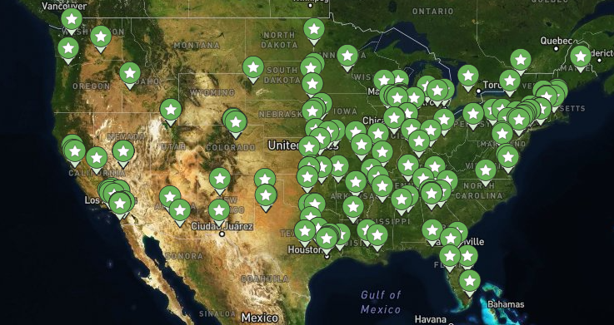
You are here
Your job is here

Slide 3
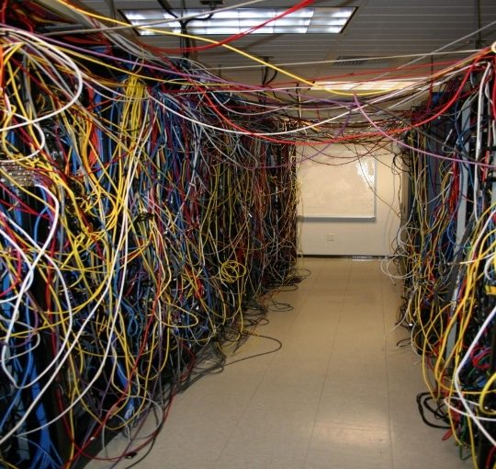
You are here
Your job is here

Slide 4
From yesterday…
container_image = py-cowsay.sif

Slide 5
From yesterday…
container_image = py-cowsay.sif
queue 10000

Slide 6

Like all things
We like to think of HTC/OSPool usage as a spectrum:
More Resources, More Planning
Laptop
Cluster
OSPool

Slide 7
Moving Data on the OSPool
Overview / Things to Consider
HTCondor File Transfer
OSDF
Other Considerations

Slide 8
What is big large data?
In reality, “big data” is relative
What is ‘big’ for you? Why?

Slide 9
What is big large data?
In reality, “big data” is relative
What is ‘big’ for you? Why?
Volume, velocity, variety!
think: a million 1-KB files, versus one 1-TB file

Slide 10
Determining In-Job Needs
“Input” includes any files needed for the job to run
executable
transfer_input_files
data and software
“Output” includes any files produced for the job that need to come back
output, error

Slide 11
Data Management Tips
Determine your per-job needs
minimize per-job data needs
Determine your batch needs
Leverage HTCondor and OSPool data handling features!

Slide 12
First! Try to minimize your data
split large input for better throughput
eliminate unnecessary data
file compression and consolidation
job input: prior to job submission
job output: prior to end of job
moving data between your laptop and the submit server

Slide 13
‘Large’ data: The collaborator analogy
What method would you use to send data to a collaborator?
amount | method of delivery
words | email body
tiny – 100MB | email attachment (managed transfer)
100MB – GBs | download from Google Drive, Drop/Box, other web-accessible repository
TBs | ship an external drive (local copy needed)
Never underestimate the bandwidth of a station wagon
full of tapes hurtling down the highway.
Andrew S. Tanenbaum (1981) – Professor Emeritus, Vrije Universiteit Amsterdam

Slide 14
Large input in HTC and OSPool
exec server
file size | method of delivery
words | within executable or arguments?
tiny – 1GB per file | HTCondor file transfer (up to 1GB total per job)
1GB – 20GB | OSDF (regional replication)
20 GB – TBs | shared file system (local copy, local execute servers)

Slide 15
Transfers
More Data
HTCondor
File Transfer
OSDF
Local
Storage

Slide 16
Rule of thumb - many dimensions
Number
of jobs
Input Size

Slide 17
Rule of thumb - many dimensions
Should this be HTCondor file transfer, OSDF, or shared filesystem?
Number
of jobs
Input Size

Slide 18
Rule of thumb - many dimensions
Should this be HTCondor file transfer, OSDF, or shared filesystem?
Number
of jobs
Job length
Input Size

Slide 19
Moving Data on the OSPool
Overview / Things to Consider
HTCondor File Transfer
OSDF
Other Considerations

Slide 20
Review: HTCondor Data Handling
submit server
HTCondor
exec server
submit file
executable
dir/ input
output
(exec dir)/
executable
input
output

Slide 21
Network bottleneck: the submit server
exec server
exec server
exec server
submit server
HTCondor
exec server
submit file
executable
dir/ input
output
(exec dir)/
executable
input
output

Slide 22
Network bottleneck: the submit server
Input transfers for many jobs will coincide
exec server
exec server
exec server
submit server
HTCondor
exec server
submit file
executable
dir/ input
output
(exec dir)/
executable
input
output

Slide 23
Network bottleneck: the submit server
Input transfers for many jobs will coincide
exec server
exec server
exec server
submit server
HTCondor
exec server
submit file
executable
dir/ input
output
(exec dir)/
executable
input
output
Output transfers are staggered

Slide 24
Hardware transfer limits
1GB total
exec server
exec server
exec server
submit server
HTCondor
exec server
1GB total
submit file
executable
dir/ input
output
(exec dir)/
executable
input
output

Slide 25
Moving Data on the OSPool
Overview / Things to Consider
HTCondor File Transfer
OSDF
Other Considerations

Slide 26
Large input in HTC and OSPool
exec server
file size | method of delivery
words | within executable or arguments?
tiny – 100MB per file | HTCondor file transfer (up to 1GB total per-job)
100MB – 1GB, shared | download from web server (local caching)
1GB – 20GB, unique or shared | OSDF (regional replication)
10 GB - TBs | shared file system (local copy, local execute servers)

Slide 27
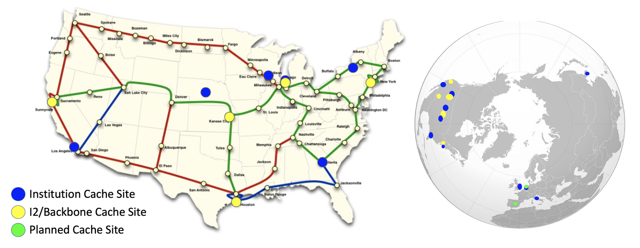
Open Science Data Federation (OSDF)

Slide 28
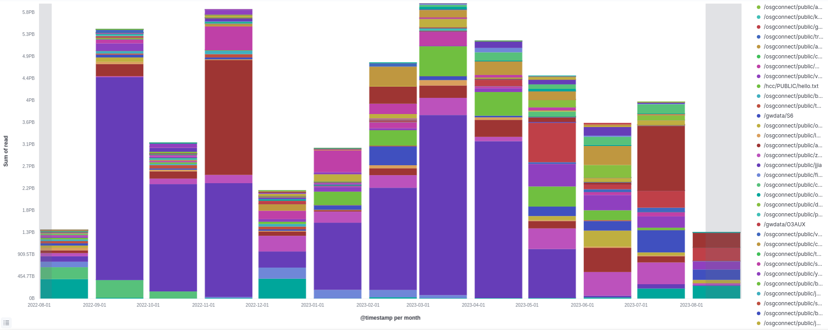
OSDF Usage on OSG

Slide 29
OSDF Considerations
Available at ~95% of OSG sites
Regional caches on very fast networks
Recommended max file size: 20 GB
Can copy multiple files totaling >10GB
Change name when update files

Slide 30
Placing Files in OSDF
Place files in /ospool/apXX/data/username/
/ospool/apXX/data/username/
“OSDF” origin
"OSDF" cache
local server
file
Access Point
exec server
exec server
Execute Point

Slide 31
Obtaining Files in OSDF
Use HTCondor transfer for other files
/ospool/apXX/data/username/
“OSDF” origin
"OSDF" cache
local server
file
HTCondor
Access Point
exec server
exec server
Execute Point

Slide 32
Obtaining Files in OSDF
Execute point downloads the large file through the cache
/ospool/apXX/data/username/
“OSDF” origin
"OSDF" cache
local server
file
file
HTCondor
Access Point
exec server
exec server
Execute Point

Slide 33
Open Science Data Federation (OSDF)
You are here
Your job is here

Slide 34
Open Science Data Federation (OSDF)
You are here
Data
Data
Your job is here
Data

Slide 35
Open Science Data Federation (OSDF)
You are here
Data

Slide 36
Open Science Data Federation (OSDF)
You are here
Data
Job 2
Data

Slide 37
Open Science Data Federation (OSDF)
You are here
Data
Job 2
Job 2
Data
Job 2
Data
Job 2
Data
Job 2
Data
Job 2
Data
Job 2
Data
Job N
Data
Data

Slide 38
In the Submit File
transfer_input_files = osdf:///ospool/apXX/data/username/…
3 slashes, not 2!

Slide 39
How about output?

Slide 40
Output for HTC and OSPool
exec server
amount | method of delivery
words | within executable or arguments?
tiny – 1GB, total | HTCondor file transfer
1GB - 20GB, unique or shared | OSDF
20GB+, total | shared file system (local copy, local execute servers)

Slide 41
Output for HTC and OSPool
exec server
amount | method of delivery
words | within executable or arguments?
tiny – 1GB, total | HTCondor file transfer
1GB – 20GB, unique or shared | OSDF
20GB+, total | shared file system (local copy, local execute servers)

Slide 42
Writing to OSDF
transfer_output_remaps = "Output.txt = osdf:///ospool/apXX/data/username/Output.txt"
*Use semicolons (;) to separate multiple entries

Slide 43
Moving Data on the OSPool
Overview / Things to Consider
HTCondor File Transfer
OSDF
Other Considerations

Slide 44
Working with Even Larger Data
Only use these options if you MUST!!
Comes with limitations on site accessibility and/or job performance, and extra data management concerns
file size | method of delivery
words | within executable or arguments?
tiny – 10MB per file | HTCondor file transfer (up to 1GB total per-job)
10MB – 1GB, shared | download from web server (local caching)
1GB - 10GB, unique or shared | OSDF (regional replication)
10 GB - TBs | shared file system (local copy, local execute servers)

Slide 45
Cleaning Up Old Data
Make sure to delete data when you no longer need it in the origin!!!
Servers do NOT have unlimited space!
Some may regularly clean old data for you. Check with local support.

Slide 46
Quick Reference
Option | Input or Output? | File size limits | Placing files | In-job file movement | Accessibility?
HTCondor file transfer | Both | 100 MB/file (in), 1 GB/file (out); 1 GB/tot (either) | via HTCondor access point | via HTCondor submit file | anywhere HTCondor jobs can run
OSDF | Both | 20 GB/file | via HTCondor access point or Pelican origin | transfer_*_file | OSG-wide (most sites), by anyone
Shared filesystem | Input, likely output | TBs (may vary) | via mount location (may vary) | use directly, or copy into/out of execute dir | local cluster, only by YOU (usually)

Slide 47

What Powers the OSDF?
Pelican Platform
www.pelicanplatform.org
Just like how OSG uses
HTCondor as the software that runs the OSPool,
OSG is transitioning to use
Pelican as the software that runs the OSDF.

Slide 48
What is Pelican?
Like HTCSS, the Pelican Platform is an open-source software being developed at CHTC (Center for High Throughput Computing) at University of Wisconsin – Madison
Overall goal for Pelican includes:
Make it easy to deploy and manage systems like the OSDF
Provide a single protocol for users to access data (regardless of storage location)
Make it easy for data owners to share their data
Want to learn more? Please talk to Andrew for more info

Slide 49
Questions?

Slide 50
More info about Pelican: HTC24 talks
"Deployment Scale and Use of OSDF" session: https://agenda.hep.wisc.edu/event/2175/contributions/30968/
"Introducing Pelican: Powering the OSDF" https://agenda.hep.wisc.edu/event/2175/contributions/30967/
"Pelican under the hood: how the data federation works" https://agenda.hep.wisc.edu/event/2175/contributions/31334/
"Connecting Pelican to your data" https://agenda.hep.wisc.edu/event/2175/contributions/31335/
"Data in Flight: Delivering Data with Pelican – Tutorial" https://agenda.hep.wisc.edu/event/2175/contributions/31337/

Slide 51
Additional Slides
Shared Filesystem Details

Slide 52
(Local) Shared Filesystems
data stored on file servers, but network-mounted to local submit and execute servers
use local user accounts for file permissions
Jobs run as YOU!
readable (input) and writable (output, most of the time)
MOST perform better with fewer large files (versus many small files of typical HTC)

Slide 53
Shared FS Technologies
via network mount
NFS
AFS
Lustre
Isilon (may use NSF mount)
distributed file systems (data on many exec servers)
HDFS (Hadoop)
CEPH

Slide 54
Shared FS Configurations
Submit directories WITHIN the shared filesystem
most campus clusters
limits HTC capabilities!!
Shared filesystem separate from local submission directories
supplement local HTC systems
treated more as a repository for VERY large data (>GBs)
Read-only (input-only) shared filesystem
Treated as a repository for VERY large input, only

Slide 55
Submit dir within shared FS
exec server
exec server
exec server
submit server
exec server
HTCondor
Shared FS
(submit dir)/
file.sub
input, software
log, error, output
Notes:
Don’t use HTCondor. Use the shared filesystem

Slide 56
Submit dir within shared FS
exec server
exec server
exec server
submit server
exec server
HTCondor
# file.sub:
should_transfer_files = NO
transfer_input_files =
Shared FS
(submit dir)/
file.sub
input, software
log, error, output

Slide 57
Separate shared FS
exec server
exec server
exec server
submit server
exec server
HTCondor
submit file
executable
dir/ input
output
(exec dir)/
executable
input
output
Separate FS

Slide 58
Separate shared FS - Input
exec server
exec server
exec server
submit server
exec server
HTCondor
(exec dir)/
1.Place compressed input into FS
Separate FS
/path/to/lgfile
lgfile

Slide 59
Separate shared FS - Input
exec server
exec server
exec server
submit server
exec server
HTCondor
(exec dir)/
lgfile
2. Executable copies and decompressesthe file
Separate FS
/path/to/lgfile
lgfile

Slide 60
Separate shared FS - Input
exec server
exec server
exec server
submit server
exec server
HTCondor
(exec dir)/
3. Executable must remove the file in the exec dir after use
Separate FS
/path/to/lgfile
lgfile

Slide 61
Separate shared FS - Output
exec server
exec server
exec server
submit server
exec server
HTCondor
(exec dir)/
lgfile
1.Executable creates and compresses the output file
Separate FS

Slide 62
Separate shared FS - Output
exec server
exec server
exec server
submit server
exec server
HTCondor
(exec dir)/
lgfile
2. Executable copies the file
Separate FS
/path/to/lgfile
lgfile

Slide 63
Separate shared FS - Output
exec server
exec server
exec server
submit server
exec server
HTCondor
(exec dir)/
3. Executable removes the file in the exec dir
Separate FS
/path/to/lgfile
lgfile

