Slide 1
Introduction to High Throughput Computing
Christina Koch
OSG School 2024
August 5, 2024

Slide 2
Researcher Problems

Slide 3
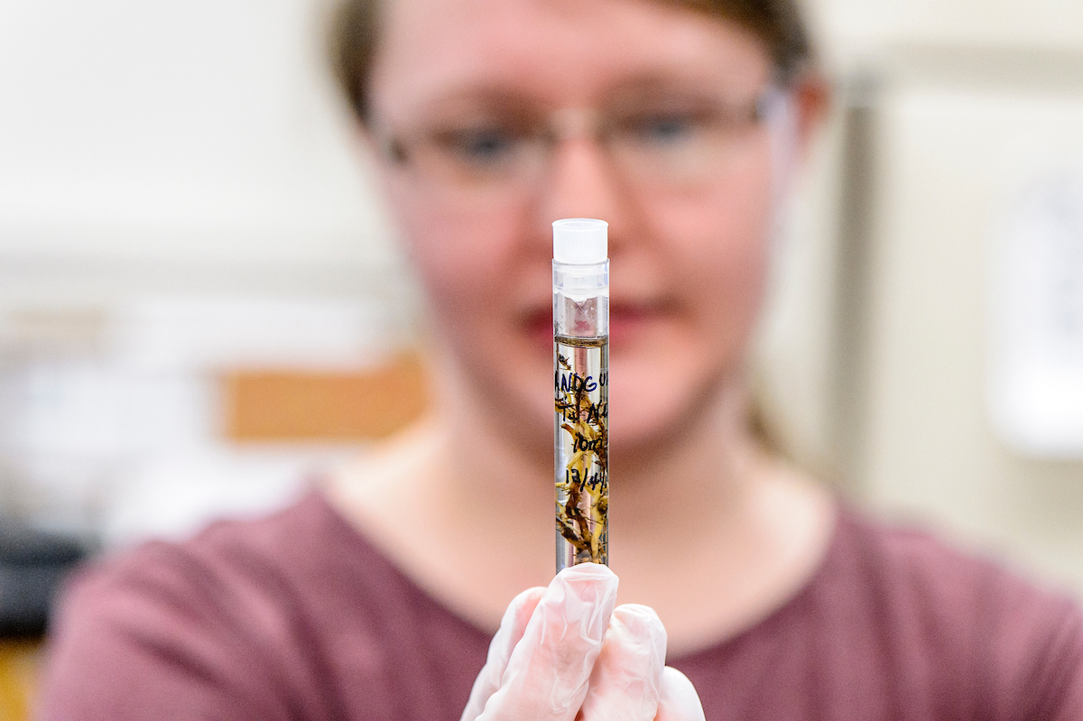
Researcher #1
New research student
Working in plant pathology lab, studying plant genomes
Can run first step of pipeline on one sample
Now has 50 samples to run

Slide 4
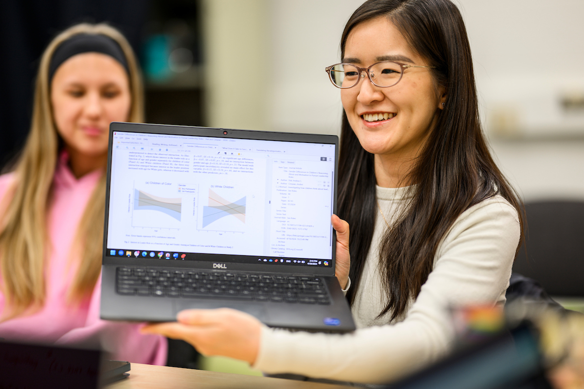
Researcher #2
Starting master’s project
Using self-written model which predicts accuracy of a medical trial design
Model takes 3-4 hours to run
Want to test many designs (each design is expressed as a combination of parameters)

Slide 5
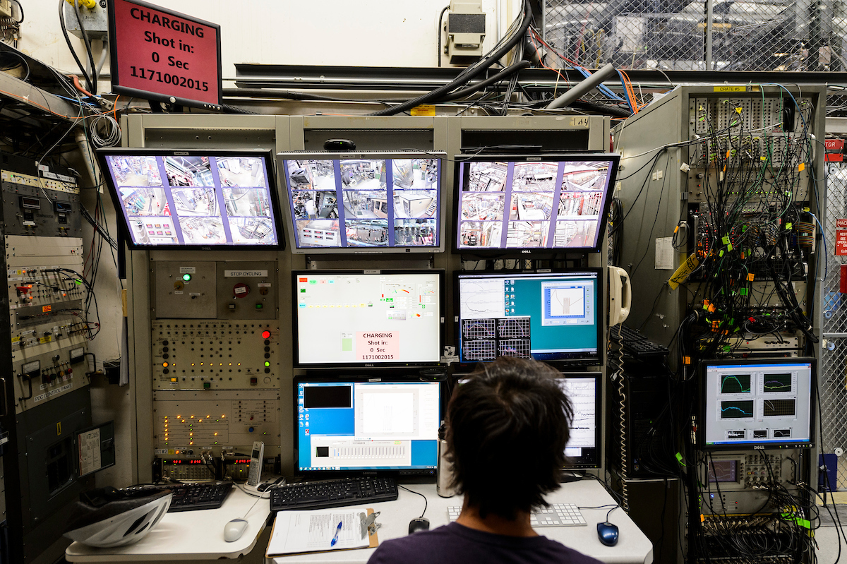
Researcher #3
Member of a large physics collaboration
Want to predict (with probability) behavior of particle in detector
Collaboration has particle simulation code already
Probability estimate comes from running millions of particle simulations

Slide 6
What do they have in common?
Each researcher has a (non-ordered) list of tasks that would take too long to run sequentially on their local computer.
Running analysis pipeline for each sample.
Running a simulation for each parameter combination
Running millions of simulations.

Slide 7
Your Turn
In the worksheet, write down the following
A one-sentence summary of your research
A typical computational task
This should be the smallest *self-contained* piece of your workflow
What is your list of tasks?
“I need to run <computational task> for each <list of inputs>”
Estimate how computationally intense *one* task is
How many tasks do you have?

Slide 8
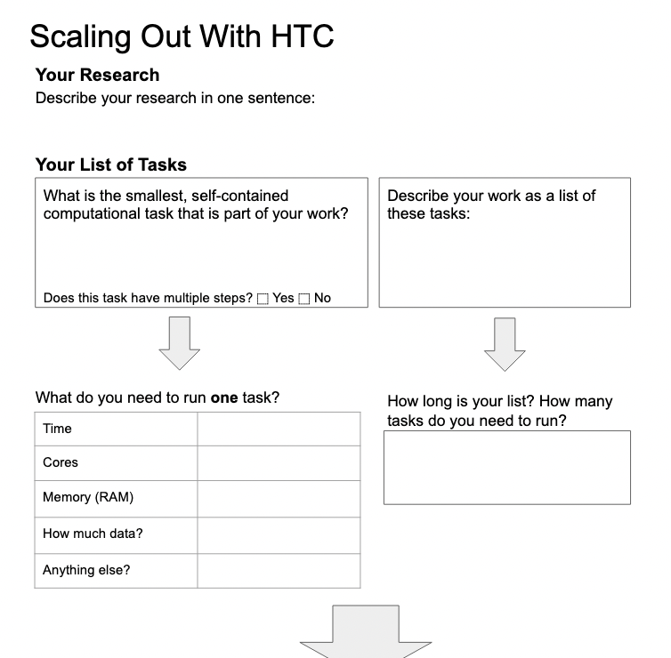
Example
develop a model that can predict the best trial design
one run of my model
model runs for each input parameter from a list
X
4 hours
?? it runs
on my laptop
very small
code is in R
3 x 8 x 4 x 2 parameter combos

Slide 9
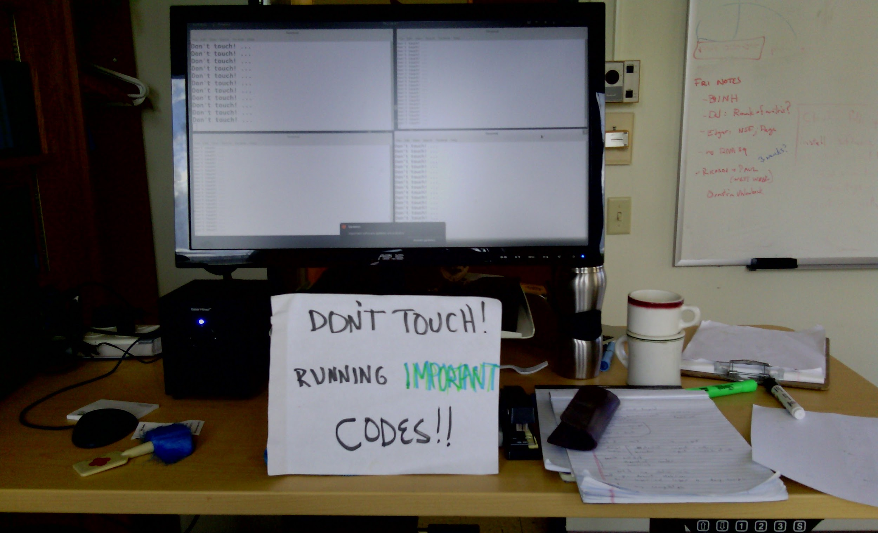
Why do we care?
Each researcher has a (non-ordered) list of tasks that would take too long to run sequentially on their local computer.

Slide 10
Scaling Up
Each researcher has a (non-ordered) list of tasks that would take too long to run sequentially on their local computer.
Don’t let computing be a barrier to your research!! We want to be able to tackle big problems.
The strategy to speed things up with computers is ALWAYS to run in parallel.
Then you can go from using a small number of resources (one computer) to a LOT of resources (for example, many computers).

Slide 11

Running in Parallel
There are different ways to parallelize in computing:
List of tasks
Parallelize on multiple (more) computers.
Parallelize on computer components (CPU/GPU)
This is what we’ll be focusing on; no need to re-write code
Requires special programming; good for dependent or correlated sub-tasks

Slide 12
High Throughput Computing (HTC)
List of tasks
Parallelize on multiple (more) computers.

Slide 13
Some Terms
Execution Point
Computer available to run jobs
List of tasks
Resources in an EP
cores/CPUs: processing unit of computer
memory/RAM: space to temporarily store information (working memory)
disk: space for persistent files
GPUs: specialized processing units
Scheduler
A program that can assign Jobs to Execution Points
Job
Formal description of the task you want to run (usually input, executable, output)

Slide 14
High Throughput Computing (HTC)
List of tasks

Slide 15
What you need to do HTC
A “home” to organize and start the computation
Tools to manage and run our list of tasks (the scheduler)
Access to more computing capacity (an HTC system)
Components needed to run our tasks: software, scripts, data
This is exactly what we’re going to cover this week.

Slide 16
A “Home” for HTC Workflows
Access Point accounts
ap1.facility.path-cc.io
ap40.uw.osg-htc.org
OSG Online Guides
Main Page > Get Started on the OSPool > Account Setup
Account and guide portal: https://portal.osg-htc.org/

Slide 17
Managing and Running Jobs
HTCondor (for most cases) and DAGMan (for workflows)
OSG School materials
HTCondor Introduction (Mon)
Troubleshooting (Tues)
Workflows with DAGMan (Thurs)
OSG Online Guides
Main Page > Submit HTC Workloads > HTC Workload Planning, Testing and Scaling Up
Main Page > Submit HTC Workloads > Monitor, Review and Troubleshoot Jobs

Slide 18
Access to HTC Systems
PATh Facility (used Monday), Open Science Pool (used Tues – Fri)
OSG School materials
OSPool Introduction (Tuesday)
OSG Online Guides
Main Page > Get Started on the OSPool > Welcome
Account and guide portal: https://portal.osg-htc.org/

Slide 19
Job Components: Software, Data, Scripts
OSG School materials:
Software (Tuesday)
Data (Wednesday)
OSG Online Guides
Main Page > Submit HTC Workloads > Managing Data for Jobs
Main Page > Submit HTC Workloads > Using Software

Slide 20
Getting Started
We’re here to help you do the following:
Think about your work as a list of jobs
Get it running on the OSPool
Lots of resources available:
OSG School materials: slides, exercises
OSG guides and training materials
Other technical lessons (unix, git, naming things, docker…let’s crowd-source other materials as needed)
Staff are also a resource! Talk to us and sign up for consultations.

Slide 21
Acknowledgements
This work was supported by the National Science Foundation under Cooperative Agreement OAC-2030508 – Partnership to Advance Throughput Computing (PATh)

