Slide 1
Workflows with HTCondor’s DAGMan
OSG School 2025
Andrew Owen

Slide 2
Scenario
You have two jobs to run: job A and job B.
You have two corresponding template submit files: A.sub and B.sub
You want job B to run only after job A has completed successfully
continue only if successful
A (A.sub)
B (B.sub)
A is the parent
B is the child

Slide 3
How?
HTCondor offers you the services of the
Directed Acyclic Graph Manager → DAGMan
to automate the submission of jobs (with dependencies)

Slide 4
How?
The Directed Acyclic Graph Manager (DAGMan) manages the placement of lists of jobs represented by "nodes" that are connected by "edges"
continue only if successful
node
node
A (A.sub)
B (B.sub)
edge
A is the parent
B is the child

Slide 5
Create the DAG input file
In a file, you need to
(1) declare the job submissions and (2) declare the dependencies.
my-first.dag

Slide 6
Create the DAG input file
In a file, you need to
(1) declare the job submissions and (2) declare the dependencies.
JOB A A.sub
JOB B B.sub
Syntax
JOB <node_name> <submit_file_name>
my-first.dag

Slide 7
Create the DAG input file
In a file, you need to
(1) declare the job submissions and (2) declare the dependencies.
JOB A A.sub
JOB B B.sub
Syntax
JOB <node_name> <submit_file_name>
If any job fails in this submit file, the whole job (node) fails!
my-first.dag
Notes:
If 1 in 100 jobs goes on hold, the remaining 99 are immediately removed and the whole node is marked as a failure. It’s a fast fail. Moving towards having a system where the remaining 99 will keep running before the dagman exits

Slide 8
Create the DAG input file
In a file, you need to
(1) declare the job submissions and (2) declare the dependencies.
A is the parent
B is the child
JOB A A.sub
JOB B B.sub
PARENT A CHILD B
Syntax
PARENT <node_name> CHILD <node_name>
depends on
my-first.dag

Slide 9
Create the DAG input file
In a file, you need to
(1) declare the job submissions and (2) declare the dependencies.
JOB A A.sub
JOB B B.sub
PARENT A CHILD B
my-first.dag

Slide 10
Create the DAG input file
How can we tell if job A completed successfully?
Default behavior: if the job exits with code 0 → successful
JOB A A.sub
JOB B B.sub
PARENT A CHILD B
my-first.dag

Slide 11
Create the DAG input file
How can we tell if job A completed successfully?
For more complex checks, you can use a script
JOB A A.sub
JOB B B.sub
PARENT A CHILD B
my-first.dag

Slide 12
Create the DAG input file
How can we tell if job A completed successfully?
For more complex checks, you can use a script
JOB A A.sub
SCRIPT POST A A-check.sh
JOB B B.sub
PARENT A CHILD B
Syntax
SCRIPT POST <node_name> <script_name>
*order of lines does not actually matter
my-first.dag

Slide 13
Submitting and Monitoring the DAG

Slide 14
Submit the DAG
By default, DAGMan expects the submit files A.sub and B.sub are in the same directory as my-first.dag, along with A-check.sh, on an HTCondor Access Point
Basic Working Directory
DAG_simple/
|-- my-first.dag
|-- A.sub
|-- A-check.sh
|-- B.sub
Notes:
[Working directory]

Slide 15
Submit the DAG
By default, DAGMan expects the submit files A.sub and B.sub are in the same directory as my-first.dag, along with A-check.sh, on an HTCondor Access Point
Basic Working Directory
DAG_simple/
|-- my-first.dag
|-- A.sub
|-- A-check.sh
|-- B.sub
It is possible to create other directory structures, but for now we will use this simple, flat organization.
Notes:
[Working directory]

Slide 16
Submit the DAG
Command to submit, or place, the DAGMan job:
condor_submit_dag <dag_description_file>
condor_submit_dag my-first.dag
This then starts the DAG node scheduler job, which we can see in the queue:
[user@ap40 DAG_simple]$ condor_q
-- Schedd: ap40.uw.osg-htc.org : <128.105.68.92:9618?... @ 09/01/24 11:26:51
OWNER BATCH_NAME SUBMITTED DONE RUN IDLE TOTAL JOB_IDS
user my-first.dag+562265 09/01 11:26 _ _ 1 2 562279.0
Notes:
, creates an instance of DAGMan in the AP]

Slide 17
Monitor the DAG
This then starts the DAG node scheduler job, which we can see in the queue:
[user@ap40 DAG_simple]$ condor_q
-- Schedd: ap40.uw.osg-htc.org : <128.105.68.92:9618?... @ 09/01/24 11:26:51
OWNER BATCH_NAME SUBMITTED DONE RUN IDLE TOTAL JOB_IDS
user my-first.dag+562265 09/01 11:26 _ _ 1 2 562279.0
BATCH_NAME for the DAGMan job is the name of the input description file, my-first.dag, plus the Job ID of the scheduler job (562265)
Notes:
, creates an instance of DAGMan in the AP]

Slide 18
Monitor the DAG
This then starts the DAG node scheduler job, which we can see in the queue:
[user@ap40 DAG_simple]$ condor_q
-- Schedd: ap40.uw.osg-htc.org : <128.105.68.92:9618?... @ 09/01/24 11:26:51
OWNER BATCH_NAME SUBMITTED DONE RUN IDLE TOTAL JOB_IDS
user my-first.dag+562265 09/01 11:26 _ _ 1 2 562279.0
The total number of jobs for my-first.dag+562265 corresponds to the total number of nodes in the DAG (2)
Notes:
, creates an instance of DAGMan in the AP]

Slide 19
Monitor the DAG
This then starts the DAG node scheduler job, which we can see in the queue:
[user@ap40 DAG_simple]$ condor_q
-- Schedd: ap40.uw.osg-htc.org : <128.105.68.92:9618?... @ 09/01/24 11:26:51
OWNER BATCH_NAME SUBMITTED DONE RUN IDLE TOTAL JOB_IDS
user my-first.dag+562265 09/01 11:26 _ _ 1 2 562279.0
Only 1 node is listed as "Idle", so DAGMan has only submitted 1 job so far. This is consistent with the fact that node A has to complete before DAGMan can submit the job for node B.
Notes:
, creates an instance of DAGMan in the AP]
Note that if you are very quick to run your condor_q command after running your condor_submit_dag command, then you may see only the DAGMan scheduler job. It may take a few seconds for DAGMan to start up and submit the HTCondor job associated with the first node.

Slide 20
Monitor the DAG
For more detailed monitoring:
[user@ap40 DAG_simple]$ condor_q -dag -nob
-- Schedd: ap40.uw.osg-htc.org : <128.105.68.92:9618?... @ 12/14/23 11:27:03
ID OWNER/NODENAME SUBMITTED RUN_TIME ST PRI SIZE CMD
562265.0 user 09/01 11:26 0+00:00:37 R 0 0.5 condor_dagman
562279.0 |-A 09/01 11:26 0+00:00:00 I 0 0.0 A.sh
First entry: dag node scheduler job created upon submission
Notes:
Note that if you are very quick to run your condor_q command after running your condor_submit_dag command, then you may see only the DAGMan scheduler job. It may take a few seconds for DAGMan to start up and submit the HTCondor job associated with the first node.

Slide 21
Monitor the DAG
For more detailed monitoring:
[user@ap40 DAG_simple]$ condor_q -dag -nob
-- Schedd: ap40.uw.osg-htc.org : <128.105.68.92:9618?... @ 12/14/23 11:27:03
ID OWNER/NODENAME SUBMITTED RUN_TIME ST PRI SIZE CMD
562265.0 user 09/01 11:26 0+00:00:37 R 0 0.5 condor_dagman
562279.0 |-A 09/01 11:26 0+00:00:00 I 0 0.0 A.sh
Additional entries: correspond to nodes whose jobs are currently in the queue.
Reminder: Nodes that have not yet been submitted by DAGMan or that have completed and thus left the queue will not show up in condor_q output.
Notes:
, creates an instance of DAGMan in the AP]
Note that if you are very quick to run your condor_q command after running your condor_submit_dag command, then you may see only the DAGMan scheduler job. It may take a few seconds for DAGMan to start up and submit the HTCondor job associated with the first node.

Slide 22
Additional Tools to Monitor your Workflow
DAGMan will produce helpful files to learn about and troubleshoot your workflow.
[user@ap40 DAG_simple]$ condor_submit_dag my-first.dag
-----------------------------------------------------------------------
File for submitting this DAG to HTCondor : my-first.dag.condor.sub
Log of DAGMan debugging messages : my-first.dag.dagman.out
Log of HTCondor library output : my-first.dag.lib.out
Log of HTCondor library error messages : my-first.dag.lib.err
Log of the life of condor_dagman itself : my-first.dag.dagman.log
Submitting job(s).
1 job(s) submitted to cluster 562265.
-----------------------------------------------------------------------
Notes:
*.dagman.out → contains timestamped log information of the execution and status of nodes in the DAG, along with statistics.

Slide 23
Overview of process
condor_submit_dag
DAG node scheduler job starts
A.sub executes → completes
A returned exit code 0 → continue
B.sub executes → completes
DAG node scheduler job completes
JOB A A.sub
JOB B B.sub
PARENT A CHILD B
my-first.dag
Notes:
The success of a node is based upon the success of the associated job(s), PRE script, and POST script. Where an exit value not equal to 0 is considered failed. The exit value of whatever component of the node was run last determines the success or failure of the node.

Slide 24
Overview of process
condor_submit_dag
DAG node scheduler job starts
A.sub executes → completes
A-check.sh succeeds → continue
B.sub executes → completes
DAG node scheduler job completes
JOB A A.sub
SCRIPT POST A A-check.sh
JOB B B.sub
PARENT A CHILD B
my-first.dag
Notes:
The success of a node is based upon the success of the associated job(s), PRE script, and POST script. Where an exit value not equal to 0 is considered failed. The exit value of whatever component of the node was run last determines the success or failure of the node.

Slide 25
PRE/POST scripts
All DAGMan PRE/POST scripts run on the Access Point and not on an Execution Point Slot.
Scripts provide a way to perform tasks at key points in a node’s lifetime.
E.g., checking if files exist, creating directories, consolidating files
Should be lightweight (low computational) programs/tasks
Node
PRE Script
JOB
POST Script
DAGMan Node Scripts Documentation

Slide 26
What is Considered a Failure
A non-zero exit code in the PRE script, JOB, or POST script is considered a failure
DAGMan will continue running work until can no longer progress
Node
PRE Script
JOB
POST Script

Slide 27
Overall
DAGMan will do as much work as it can until completion ("success") or failure

Slide 28
A Failed DAG
Once a node has failed and no more progress in the DAG can be made, DAGMan will produce a rescue file and exit.
Rescue file is named <dag_description_file>.rescue001
"001" increments for each new rescue file
Records which NODEs have completed successfully
does not contain the actual DAG structure
DAG_simple/
A.sub B.sub check-A.sh
my-first.dag my.-first.dag.condor.sub my.dag.dagman.log
my-first.dag.dagman.out my-first.dag.lib.err my-first.dag.lib.out
my-first.dag.metrics my-first.dag.nodes.log my-first.dag.rescue001
(other job files)
Rescue DAGs Documentation

Slide 29
Dealing with a Failed DAG
Search for issue in <dag filename>.dagman.out and job standard error/output files
Once issue is fixed, resubmit with condor_submit_dag
Rescue file will be automatically detected and progress will resume from the point it left off

Slide 30
Many DAGs

Slide 31
Many DAGs
Scenario: Now you have to run the A→B workflow many times in parallel
How to accomplish?
A₁
B₁
A₂
B₂
⋮
A_{N}
B_{N}

Slide 32
Many DAGs … or One Big DAG
Write a script that generates your DAG description file* for you (and the needed files)
JOB A A.sub
JOB B B.sub
PARENT A CHILD B
my-first.dag
*for now. We are working to develop better of ways of handling this scenario.

Slide 33
Many DAGs … or One Big DAG
Write a script that generates your DAG description file* for you (and the needed files)
JOB A1 A1.sub
JOB B1 B1.sub
PARENT A1 CHILD B1
JOB A2 A2.sub
JOB B2 B2.sub
PARENT A2 CHILD B2
⋮
JOB A A.sub
JOB B B.sub
PARENT A CHILD B
python
bash
…
my-first.dag
my-big.dag
*for now. We are working to develop better of ways of handling this scenario.

Slide 34
One Big DAG
Once ready, do a single condor_submit_dag command
The DAG node scheduler job will manage all of the submissions while keeping track of the dependencies
JOB A1 A1.sub
JOB B1 B1.sub
PARENT A1 CHILD B1
JOB A2 A2.sub
JOB B2 B2.sub
PARENT A2 CHILD B2
⋮
my-big.dag

Slide 35
One Big DAG – Reuse Files
In the big DAG, there were a lot of similar files: A{x}.sub, B{x}.sub
Instead of A1.sub, A2.sub, … AN.sub, can use A.sub
JOB A1 A.sub
JOB B1 B1.sub
PARENT A1 CHILD B1
JOB A2 A.sub
JOB B2 B2.sub
PARENT A2 CHILD B2
⋮
my-big.dag

Slide 36
One Big DAG – Reuse Files
In the big DAG, there were a lot of similar files: A{x}.sub, B{x}.sub
Instead of A1.sub, A2.sub, … AN.sub, can use A.sub
Then pass the number to the submit file with the VARS command
JOB A1 A.sub
VARS A1 number=1
JOB B1 B1.sub
PARENT A1 CHILD B1
JOB A2 A.sub
VARS A2 number=2
JOB B2 B2.sub
PARENT A2 CHILD B2
⋮
DAG Description File Syntax
VARS <node_name> <variable>=<value>
Submit File Syntax
arguments = $(<variable>)
my-big.dag
Notes:
arguments=$(number) would be the correct syntax for this example

Slide 37
One Big DAG – Reuse Files
In the big DAG, there were a lot of similar files: A{x}.sub, B{x}.sub
Instead of A1.sub, A2.sub, … AN.sub, can use A.sub
Then pass the number to the submit file with the VARS command
Can repeat for B.sub
JOB A1 A.sub
VARS A1 number=1
JOB B1 B.sub
VARS B1 number=1
PARENT A1 CHILD B1
JOB A2 A.sub
VARS A2 number=2
JOB B2 B.sub
VARS B1 number=2
PARENT A2 CHILD B2
⋮
my-big.dag

Slide 38
One Big DAG - What If It Fails?
Let's say that A₁ job finishes and A-check.sh finds that the output of A₁ is incorrect, and that A₁ has failed. What happens?
?
A₁
X
B₁
?
?
A₂
B₂
⋮
?
?
A_{N}
B_{N}
X = Failed
? = Not known yet
Notes:
Let’s say A-check.sh fails (i.e., non zero exit code). Checks the output in step A is "good". If it fails, the node is marked as a failure.

Slide 39
One Big DAG - What If It Fails?
Let's say that A₁ job finishes and A-check.sh finds that the output of A₁ is incorrect, and that A₁ has failed. What happens?
DAGMan does as much work as it can, then creates a Rescue DAG.
While B₁ won't be started, the DAG node scheduler will keep submitting and managing the other A_{N} & B_{N} jobs until there is no more work.
Ø
A₁
X
B₁
S
?
A₂
B₂
⋮
S
?
A_{N}
B_{N}
S = Submitted
X = Failed
Ø = Will not be submitted
? = Not known yet

Slide 40
One Big DAG - What If It Fails
Let's say that A₁ job finishes and A-check.sh finds that the output of A₁ is incorrect, and that A₁ has failed. What happens?
The Rescue DAG is used automatically the next time you run condor_submit_dag, and the DAG node scheduler job will only submit the unsuccessful nodes.
If all but A₁→B₁ completed successfully, then when the Rescue DAG is submitted, only the A₁→B₁ will be attempted.
S
?
A₁
B₁
A₂
✔
✔
B₂
⋮
A_{N}
✔
✔
B_{N}
S = Submitted
? = Not known yet
✔= Successful completion

Slide 41
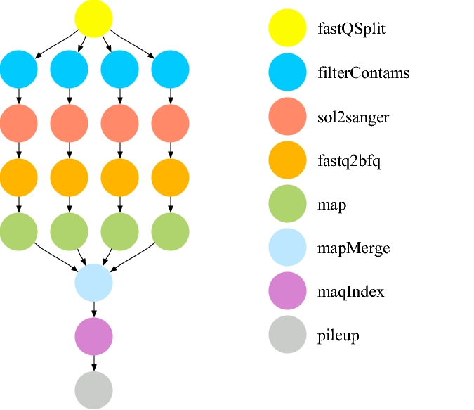
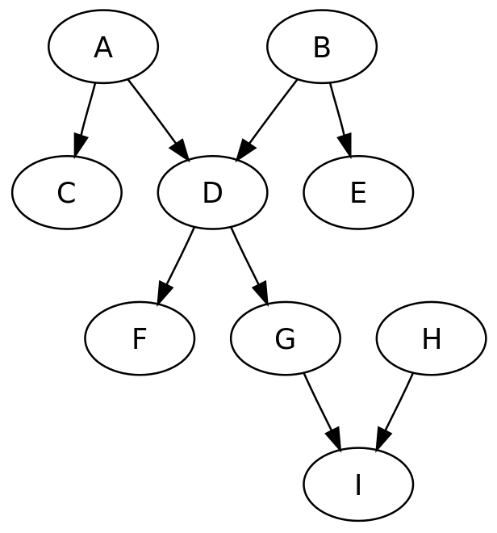
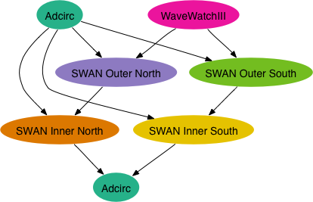
Endless Workflow Possibilities
Shared ancestor workflows
Wikimedia Commons
https://confluence.pegasus.isi.edu/display/pegasus/WorkflowGenerator

Slide 42
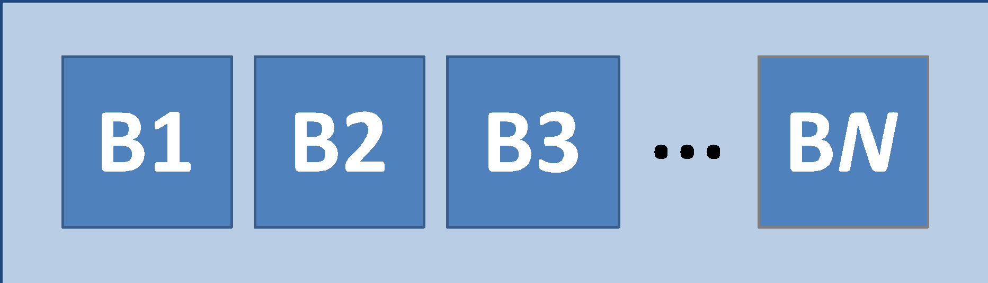
Endless Workflow Possibilities
Different ancestor workflows
A "Bag" of Jobs
Disjoined Workflows

Slide 43
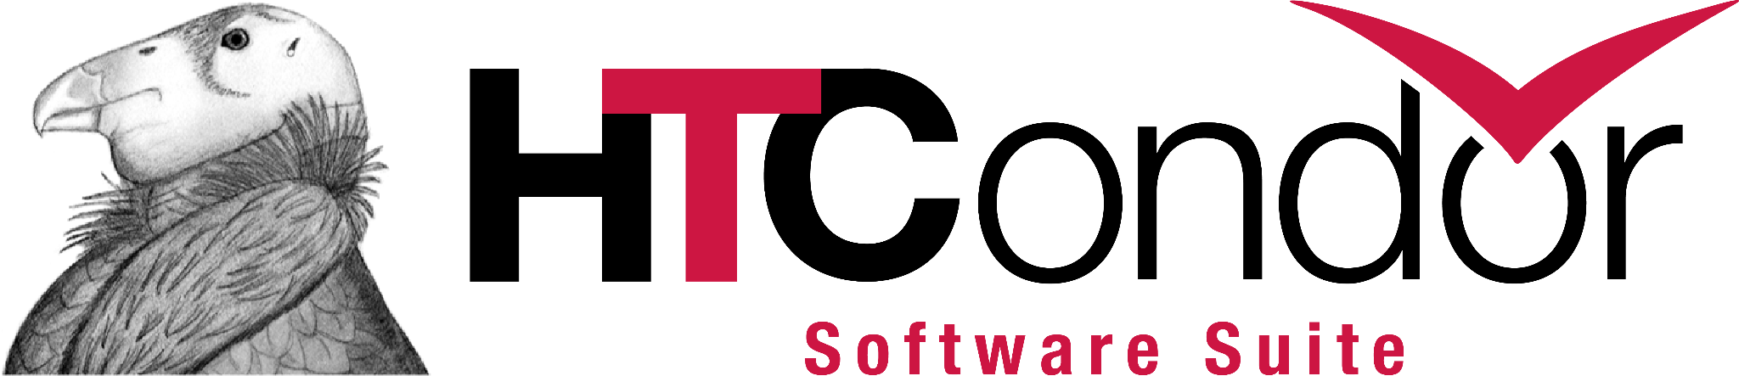
Learn More
Beginner DAGMan Resources:
https://www.youtube.com/watch?v=OuIBf6x24r0&pp=ygUGZGFnbWFu
https://portal.osg-htc.org/documentation/htc_workloads/automated_workflows/dagman-workflows/
https://portal.osg-htc.org/documentation/htc_workloads/automated_workflows/dagman-simple-example/
Intermediate DAGMan Resources:
https://portal.osg-htc.org/documentation/support_and_training/training/osgusertraining/
https://github.com/OSGConnect/tutorial-dagman-intermediate
DAGMan Core Documentation
https://htcondor.readthedocs.io/en/latest/automated-workflows/index.html

Slide 44
Questions?

Slide 45
Submit File Templates via VARS
VARS line defines node-specific values that are passed into submit file variables
VARS node_name var1="value" [var2="value"]
Allows a single submit file shared by all B jobs, rather than one submit file for each JOB.
my.dag
B.sub
JOB B1 B.sub
VARS B1 data="B1" opt="10"
JOB B2 B.sub
VARS B2 data="B2" opt="12"
JOB B3 B.sub
VARS B3 data="B3" opt="14"
…
InitialDir = $(data)
arguments = $(data).csv $(opt)
…
queue

Slide 46
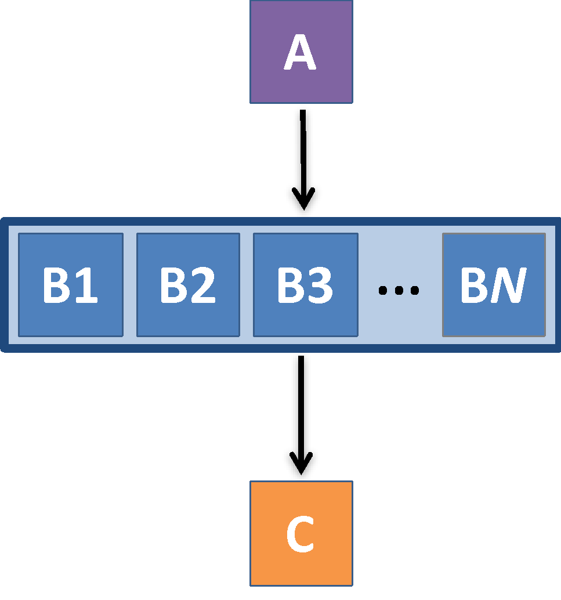
A DAG within a DAG = "SUBDAG"
my.dag
JOB A A.sub
SCRIPT POST A generate_B.sh
SUBDAG EXTERNAL B B.dag
JOB C C.sub
PARENT A CHILD B
PARENT B CHILD C
B

Slide 47
A DAG within a DAG = "SUBDAG"
my.dag
JOB A A.sub
SCRIPT POST A generate_B.sh
SUBDAG EXTERNAL B B.dag
JOB C C.sub
PARENT A CHILD B
PARENT B CHILD C
B.dag
JOB B1 B1.sub
JOB B2 B2.sub
…
JOB BN BN.sub

Slide 48
A DAG within a DAG = "SUBDAG"
my.dag
JOB A A.sub
SCRIPT POST A generate_B.sh
SUBDAG EXTERNAL B B.dag
JOB C C.sub
PARENT A CHILD B
PARENT B CHILD C
JOB → condor_submit
SUBDAG EXTERNAL → condor_submit_dag

Slide 49
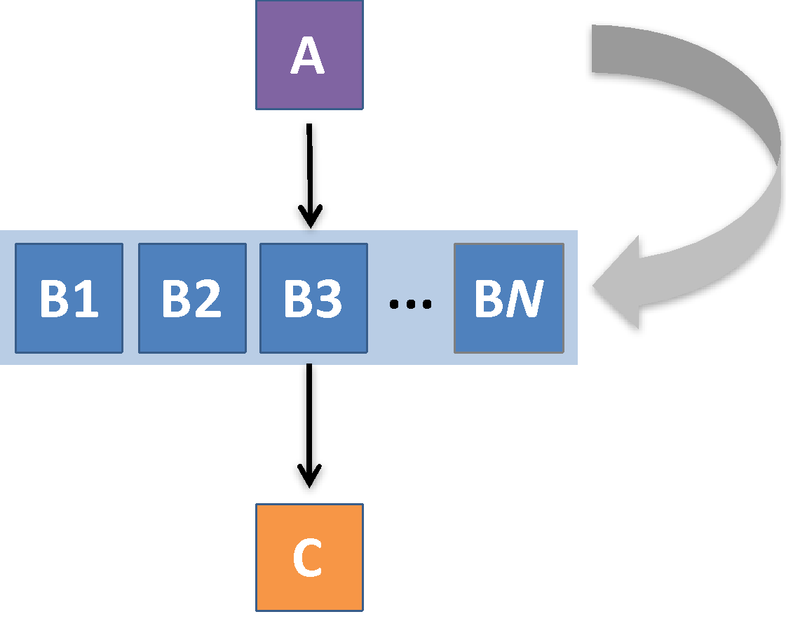
A DAG within a DAG = "SUBDAG"
A can write the input files for subdag B!

