Slide 1
Troubleshooting Jobs on OSPool
Showmic Islam
Research Computing Facilitator@ OSG
HPC Applications Specialist
Holland Computing Center
University of Nebraska-Lincoln

Slide 2



Outline
Job Failures
Why a job may fail?
What can go wrong?
Reviewing failed jobs
Job holds
Diagnosis
Tips for troubleshooting
Diagnosing Holds
Common Issues
Examples of typos
Badput
Broken computer by akash k from NounProject.com
Stethoscope by wyasa design from NounProject.com
Issues by sugiyarto from NounProject.com

Slide 3




HTCondor Workflow
Job specifications
OSPool Execute Point
1. Log in to an OSG Access Point*
and upload data/software
/condor/scratch
Software
Scripts
Input Data
OSPool Access Point
HTCondor
Output Data
Log/Error/Out
SSH
/home/user
Job Components
Software
Scripts
Input Data
HTCondor Submit File
Output transferred
back
Executable
Input Files
Job Resources
Error/Log Files
Number of Jobs
$ condor_submit SubmitFile.submit

Slide 4
Job Failures

Slide 5
What can go wrong?
Let’s start with the issues that we are all familiar with
The code tries to run and fails
Script has typos (e.g. : misspelled input arguments)
Path names to a file or data are misspelled/wrong
Software does not have the required libraries (e.g. : mismatch between libraries in Window/linux)

Slide 6
What can go wrong?
OSPool is heterogeneous
Different varieties of Unix Operating Systems
Never assume any required library packages to be present at the execute point
Sample Software Error Messages
/srv//cp: /lib64/libc.so.6: version `GLIBC_2.33' not found (required by /srv//cp) /srv//cp: /lib64/libc.so.6: version `GLIBC_2.34' not found (required by /srv//cp) /srv//cp: /lib64/libselinux.so.1: no version information available (required by /srv//cp)
Traceback (most recent call last): File "/srv//mcpi.py", line 6, in <module> def mcpi(iterations: int) -> tuple[float, int]: TypeError: 'type' object is not subscriptable

Slide 7





What else can go wrong?
Submit File
OSPool Execute Point
Needs more
resources
Executable
Input Files
Job Resources
Error/Log Files
Number of Jobs
Computer by miracle from NounProject.com
CPU by Prithvi from NounProject.com
RAM by George Ianta from NounProject.com
Code by Lagot Design from NounProject.com
Hard drive by Perilisima Shoeder from NounProject.com
Fail by Bluetip Design from NounProject.com

Slide 8
What other things can go wrong?
Jobs can go wrong in the HTCondor workflow.
A job can’t be matched(no machine in the pool to accommodate user’s request)
Files not found for transfer
Job used too much memory
Job used too much disk space
Badly-formatted executable
And many more
Error in transferring input files
Error in transferring output files

Slide 9

Job Holds
HTCondor will hold your job if there’s a logistical issue that YOU (or maybe an admin) need to fix.
files not found for transfer, over memory, etc.
A job that goes on hold is interrupted (all progress is lost) but remains in the queue in the “H” state until removed, or (fixed and) released.
$ condor_q
OWNER BATCH_NAME SUBMITTED DONE RUN IDLE HOLD TOTAL JOB_IDS
cat ID: 123456 7/11 11:23 _ _ _ 1 1 123456.0

Slide 10
Diagnosis

Slide 11

General Troubleshooting Tips
Comparing expectations vs. what happened: Either might be wrong!
Read messages carefully — even if some parts make no sense, what hints can you get?
Search online … but evaluate what you find
Collect links and other resources that help
Ask for help! And provide key details: versions, commands, files, messages, logs, etc.
Always keep the log, error and condor output file

Slide 12
Reviewing Failed Jobs
Job log, output and error files can provide valuable troubleshooting details:
Log | Output | Error
when jobs were submitted, started, held, or stopped where job ran resources used interruption reasons exit status | stdout (or other output files) may contain errors from the executable | stderr captures errors from the operating system, or reported by the executable, itself.
12

Slide 13
Diagnosing Holds: Hold Reasons
If HTCondor puts a job on hold, it provides a hold reason, which can be viewed in the log file, with
condor_q –hold <Job.ID>, or with <username>:
Failed to initialize user log to /path
Could not create log file, check /path carefully
Error from …: memory usage exceeded request_memory
Job in status 2 put on hold by SYSTEM_PERIODIC_HOLD due to memory usage BBB.
Job used too much memory
Request more memory than BBB megabytes
Transfer input files failure at access point ap40 while sending files to the execution point. Details: reading from file /path: (errno 2) No such file or directory
Job can not find the files in /path to transfer to execute point
13
Notes:
Talk about when hold happens. You can see when you type condor_q –hold

Slide 14
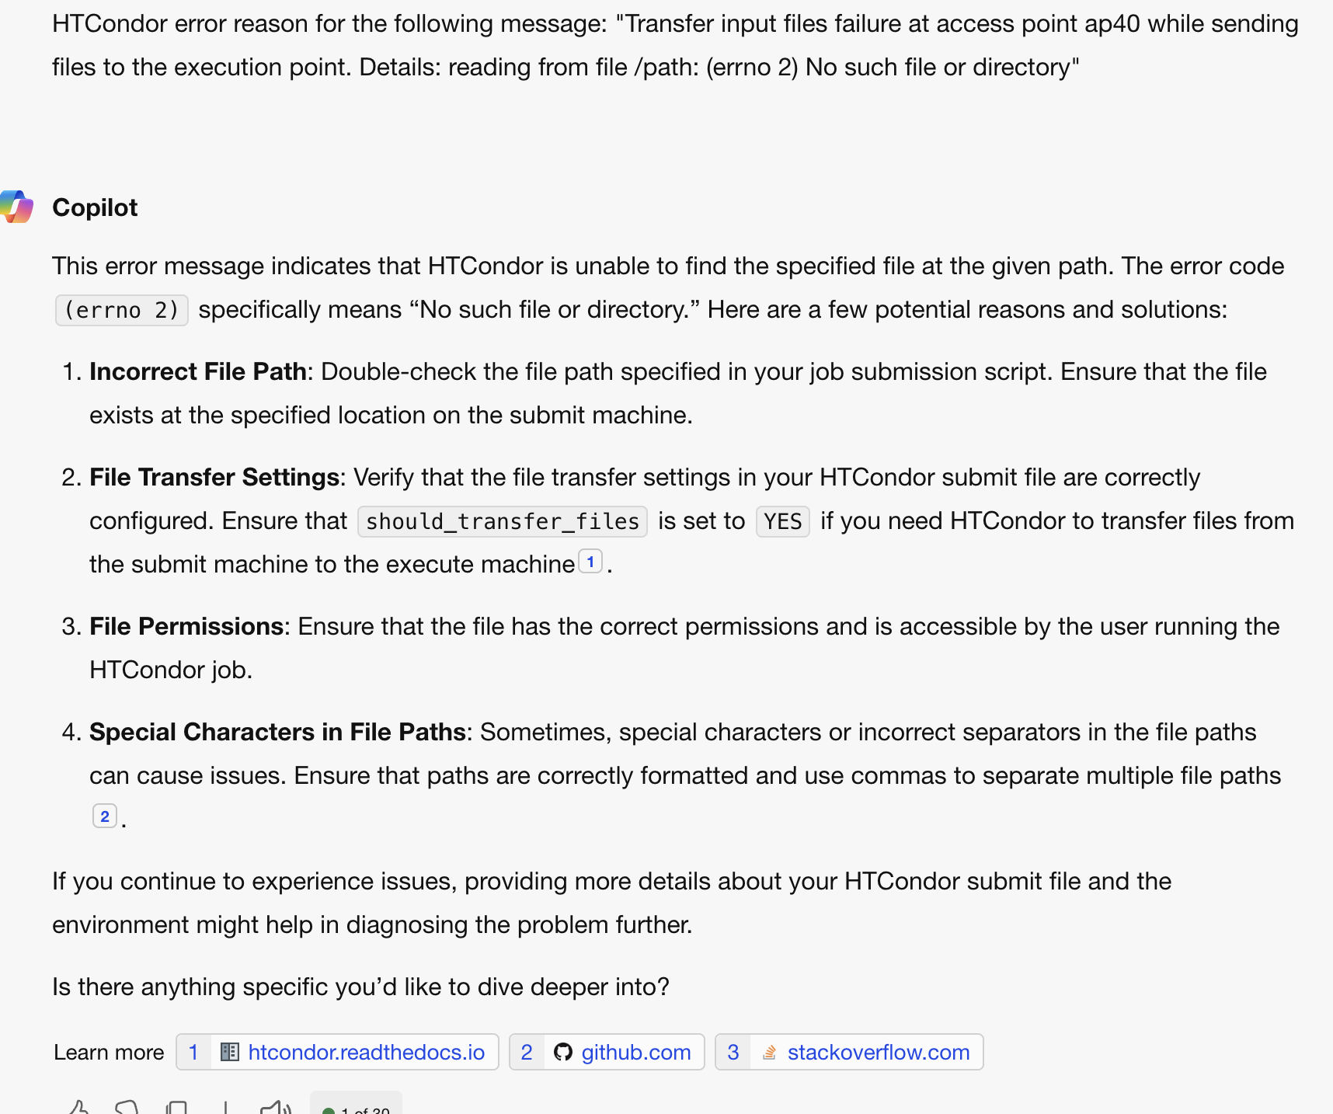
Diagnosing Holds: Hold Reasons
False ChatGPT

Slide 15
Example of common hold reasons
Job specified transfer_output_files but /path on execute point was not found
The job exceeded allowed execute duration of 20:00:00
Job ran for too long
Error from ….: execute point failed to upload checkpoint
Job failed to checkpoint (more on Friday)
Transfer output files failure at access point… while receiving files from the execution point. Details: Error from ….execute point … failed to send file(s) at apxx; failed to create directory /path Disk quota exceeded
File transfer error due to exceeding disk space
Notes:
Have stash transfer too slow; job has run too long;

Slide 16
What To Do About Held Jobs
If the situation can be fixed while job is held (e.g., you forgot to create directory for output):
Fix the situation: condor_qedit
Release the job(s): condor_release JOB_IDs
condor_release <username>
Otherwise (and this is common):
Remove the held jobs: condor_rm JOB_IDs
Fix the problems
Re-submit
Notes:
Slide 7 & 15 are similar

Slide 17
DEMO

Slide 18
Common Issues

Slide 19
Issue: Failed to Parse
$ condor_submit job.sh
Submitting job(s)
ERROR: on Line 6 of submit file:
ERROR: Failed to parse command file (line 6).
Completely failed to submit!
Notice: Failed to parse
Why: You tried to submit your executable (or other file), not an HTCondor submit file
Fix: Submit an HTCondor submit file (e.g., .sub)

Slide 20
Issue: Typos in Submit File
$ condor_submit sleep.sub
Submitting job(s)
• ERROR: No 'executable' parameter was provided
• ERROR: Parse error in expression:
RequestMemory = 1BG
• ERROR: Executable file /bin/slep does not exist
Also failed to submit (missing job(s) submitted)
Why: Typos in your submit file (e.g., BG for GB)
Fix: Correct typos!

Slide 21
Issue: Jobs Idle for a Long Time
$ condor_q
OWNER BATCH_NAME SUBMITTED DONE RUN IDLE TOTAL JOB_IDS
cat ID: 123456 6/30 12:34 _ _ 1 1 123456.0
Jobs are idle for a long time – can be hard to judge!
condor_q -analyze <JobId>
condor_q –better-analyze <JobId>
$ condor_q -better-analyze 123456.0
...
Slots
Step Matched Condition
----- -------- ---------
[0] 13033 TARGET.PoolName == "OSPool"
[9] 13656 TARGET.Disk >= RequestDisk
[11] 0 TARGET.Memory >= RequestMemory

Slide 22
Issue: Missing or Unexpected Results
Job runs … but something does not seem right
Short or zero-length output file(s)
Very short runtime (almost instant)
May be problems with app, inputs, arguments, …
Check log files for unexpected exit codes, etc.
Check output and error files for messages from app
Can’t find anything? Add more debugging output
Notes:
Move to the diagnosis- can be in here either

Slide 23
Issue: Badput
What is badput?
Basically, wasted computing
Job runs for 97 minutes, gets kicked off, starts over on another server
Job runs for 97 minutes, is removed
Not jobs that must be re-run due to code changes! (that’s just part of science, right?)
Badput uses resources that others could have used
If contacted, help us help you and others!

Slide 24
Tips for Avoiding Badput
Always test with a small set of jobs before scaling up. (This practice applies to any modifications made to a tried and tested code as well )
Monitor your jobs memory and disk usage
condor_q <jobid> -af RequestMemory MemoryUsage |sort |uniq –c
condor_q <jobid> -af RequestDisk DiskUsage |sort |uniq –c
Have an idea/expectation about the software/code’s limit- e.g. Segfault.
Have a general idea about the inner workings of the software and libraries.

Slide 25
DEMO 2

Slide 26
More Troubleshooting Resources
Tim Cartwright’s OSG User School 2021 talk
OSPool Documentation-https://portal.osg-htc.org/documentation/
Can’t solve issues-email us: support@osg-htc.org

Slide 27
Acknowledgements
Christina Koch; Tim Cartwright
This work was supported by NSF grants MPS-1148698, OAC-1836650, and OAC-2030508

