Slide 1
Moving Data on the OSPool
Wednesday, June 25
Showmic Islam
Slides adapted from Mats Rynge, Andrew Owen
This work was supported by NSF grants MPS-1148698, OAC-1836650, and OAC-2030508

Slide 2
Outline
What is big large data?
Data Management Tips
Characteristics of OSPool
Solutions to moving data
HTCondor File Transfer
OSDF/Pelican

Slide 3
What is big large data?
In reality, “big data” is relative
What is ‘big’ for you? Why?

Slide 4
What is big large data?
In reality, “big data” is relative
What is ‘big’ for you? Why?
Volume, velocity, variety!
think: a million 1-KB files, versus one 1-TB file

Slide 5
Determining In-Job Needs
“Input” includes any files needed for the job to run
executable
transfer_input_files
data and software
“Output” includes any files produced for the job that need to come back
output, error

Slide 6
Data Management Tips
Determine your per-job needs
minimize per-job data needs
Determine your batch needs
Leverage HTCondor and OSPool data handling features!

Slide 7
First! Try to minimize your data
split large input for better throughput
eliminate unnecessary data
file compression and consolidation
job input: prior to job submission
job output: prior to end of job
moving data between your laptop and the submit server

Slide 8
‘Large’ data: The collaborator analogy
What method would you use to send data to a collaborator?
amount | method of delivery
words | email body
tiny – 100MB | email attachment (managed transfer)
100MB – GBs | download from Google Drive, Drop/Box, other web-accessible repository
TBs | ship an external drive (local copy needed)
Never underestimate the bandwidth of a station wagon
full of tapes hurtling down the highway.
Andrew S. Tanenbaum (1981) – Professor Emeritus, Vrije Universiteit Amsterdam

Slide 9
Large input in HTC and OSPool
exec server
file size | method of delivery
words | within executable or arguments?
tiny – 1GB per file | HTCondor file transfer (up to 1GB total per job)
1GB – 20GB | OSDF (regional replication)
20 GB – TBs | shared file system (local copy, local execute servers)

Slide 10
OSPool Characteristics
No Shared FS (File System)
Execute Point does not have access to data on the Access Point

Slide 11
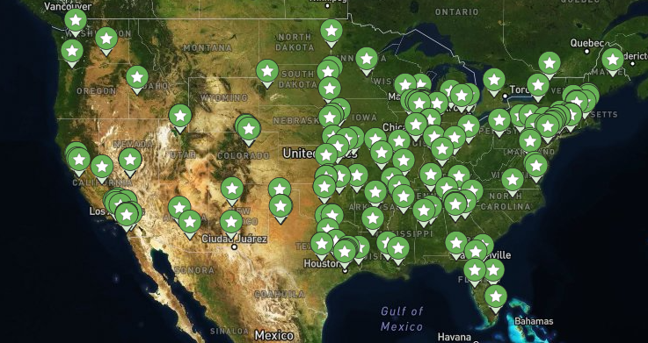
You are here
Your job is here

Slide 12
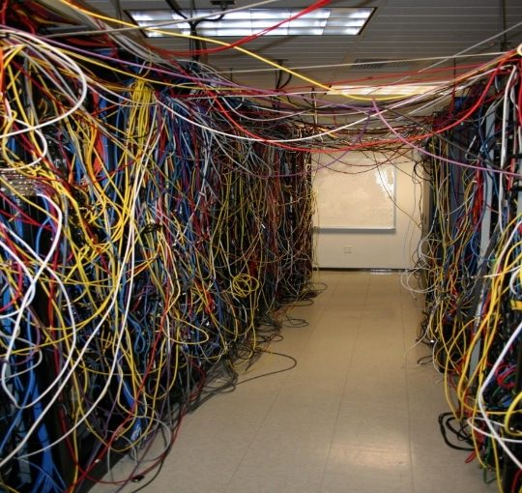
You are here
Your job is here
Notes:
One way to approach- Have the HTCondor file transfer slides afterwards. and describe the bottleneck and move forward to OSDF/Pelican

Slide 13
Review: HTCondor Data Handling
submit server
HTCondor
exec server
submit file
executable
dir/ input
output
(exec dir)/
executable
input
output

Slide 14
Network bottleneck: the submit server
exec server
exec server
exec server
submit server
HTCondor
exec server
submit file
executable
dir/ input
output
(exec dir)/
executable
input
output

Slide 15
Network bottleneck: the submit server
Input transfers for many jobs will coincide
exec server
exec server
exec server
submit server
HTCondor
exec server
submit file
executable
dir/ input
output
(exec dir)/
executable
input
output

Slide 16
Network bottleneck: the submit server
Input transfers for many jobs will coincide
exec server
exec server
exec server
submit server
HTCondor
exec server
submit file
executable
dir/ input
output
(exec dir)/
executable
input
output
Output transfers are staggered

Slide 17
Hardware transfer limits
1GB total
exec server
exec server
exec server
submit server
HTCondor
exec server
1GB total
submit file
executable
dir/ input
output
(exec dir)/
executable
input
output

Slide 18

Like all things
We like to think of HTC/OSPool usage as a spectrum:
More Resources, More Planning
Laptop
Cluster
OSPool

Slide 19
Outline
What is big large data?
Data Management Tips
Characteristics of OSPool
Solutions to moving data
HTCondor File Transfer
OSDF/Pelican

Slide 20
Transfers
More Data
HTCondor
File Transfer
OSDF
Local
Storage
osdf:///
transfer_input_files
transfer_output_files

Slide 21
Rule of thumb - many dimensions
Number
of jobs
Input Size

Slide 22
Rule of thumb - many dimensions
Should this be HTCondor file transfer, OSDF, or shared filesystem?
Number
of jobs
Input Size

Slide 23
Rule of thumb - many dimensions
Should this be HTCondor file transfer, OSDF, or shared filesystem?
Number
of jobs
Job length
Input Size

Slide 24
Summary so far…
For small file transfer use HTCondor file transfer
For larger files -> OSDF

Slide 25
Outline
What is big large data?
Data Management Tips
Characteristics of OSPool
Solutions to moving data
HTCondor File Transfer
OSDF/Pelican

Slide 26
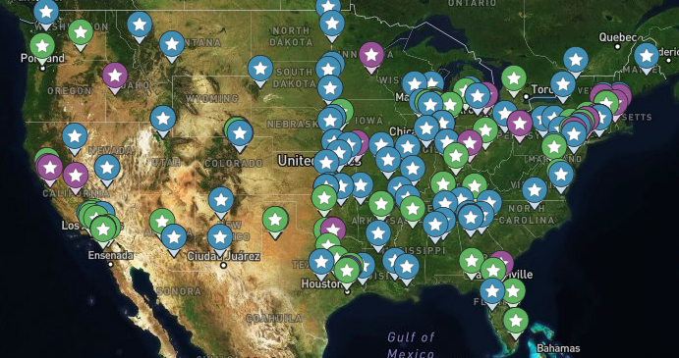
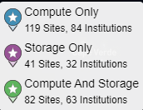
OSPool and the Open Science Data Federation (OSDF)
The OSPool is a High Throughput Computing system distributed across most of the United States, that runs 500,000 - 1,000,000+ jobs per day

Slide 27
OSPool and the Open Science Data Federation (OSDF)
With distributed computing comes the need for data distribution that works at large scale and large volume
Submitting Jobs Here*
Could run anywhere!

Slide 28
OSPool and the Open Science Data Federation (OSDF)
Submitting many jobs that use the same large file can quickly flood the network
10,000 jobs
x
10 GB input file
x
1 transfer / job
=
100,000 GB network transfer

Slide 29
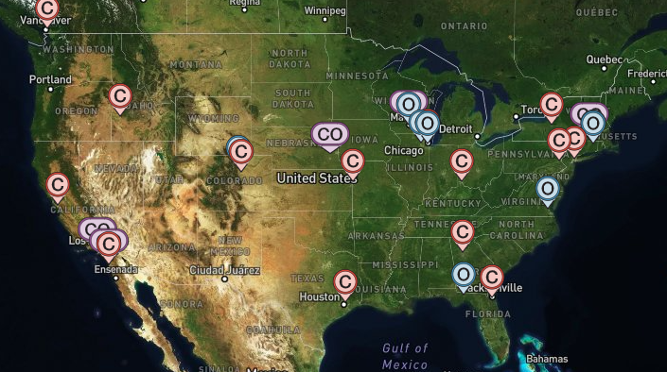
OSPool and the Open Science Data Federation (OSDF)
Enter the OSDF - a system of data caches that can stage large, repeatedly used files closer to the actual compute resources
10,000 jobs
x
10 GB input file
x
1 transfer total
=
10 GB network transfer

Slide 30
Use OSDF to Transfer Large Input Files
OSPool users can use the OSDF to transfer large data for their HTCondor jobs
Place large file(s) in /ospool/ap40/data/[Username]/large_file
Use OSDF plugin in submit file: transfer_input_files = osdf:///ospool/ap40/data/[Username]/large_file
HTCondor & OSDF automatically handle transfer of data when the job starts
https://portal.osg-htc.org/documentation/htc_workloads/managing_data/osdf/
By default, only the OSPool user who placed the data can use that data
3 slashes, not 2!

Slide 31
Use OSDF to Transfer Large Output Files
OSPool users can use the OSDF to transfer large data for their HTCondor jobs
In your submit file, specify the output file(s) you want transferred with transfer_output_files = large_file
Also in your submit file, remap the output location using OSDF plugin: transfer_output_remaps = "large_file = osdf:///ospool/ap40/data/[Username]/large_file”
HTCondor & OSDF automatically handle transfer of data when the job finishes
https://portal.osg-htc.org/documentation/htc_workloads/managing_data/osdf/
*Use semicolons (;) to separate multiple entries

Slide 32
Good Practices for OSDF
If you modify a file in OSDF please give the file a unique name, otherwise:
OSDF won’t know whether it’s a new/older file
Some jobs may run new version of the file, some will run with the old one
Make sure to delete data when you no longer need it in the origin!!!

Slide 33
When to use HTCondor file transfer vs OSDF
HTCondor File transfer:
Data Location: /home/<user.name>
Perfect for:
Smaller files (<5GB)
Repeated changed/updated files
Submit Files
Executables
Temporary intermediate files
OSDF File transfer:
Data Location: /ospool/<ap##>/data/<user.name>
Perfect for:
Larger files (>5GB)
Repeated used files
Containers
Notes:
After this slide: Pull data from different sources. Ap40 specific diagram for Harsha/Brian B.’s talk from HTC 25.

Slide 34
Pelican and the OSDF
Just like how OSG uses
HTCondor as the software that runs the OSPool,
OSG is transitioning to use
Pelican as the software that runs the OSDF.
The benefits for the OSDF (as the flagship instance of Pelican):
More reliable, robust software stack
Lots more room for new features, improvements
More extensible to other contributors and data stores

Slide 35
What is Pelican?
Like HTCSS, the Pelican Platform is an open-source software being developed at CHTC (Center for High Throughput Computing) at University of Wisconsin - Madison
pelicanplatform.org
Overall goals for Pelican development include
empowering infrastructure for target domains, such as climate data
supporting a wide range of storage backends to support user needs
making the setup and use of Pelican services convenient and easy

Slide 36
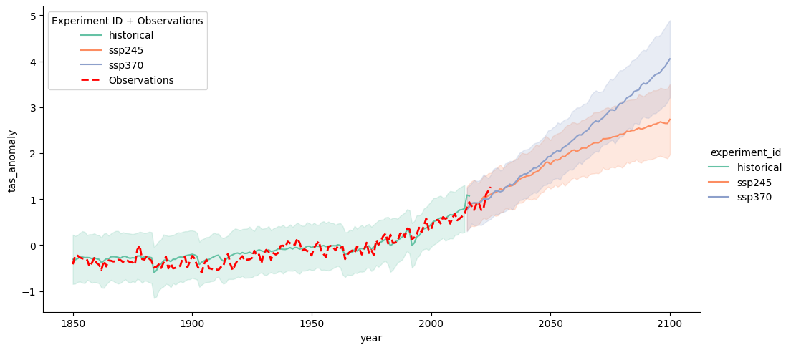
Researcher uses a Jupyter Notebook to create a visualization that requires two objects:
NCAR
AWS
Open Data
OSDF Origin
(AWS-Opendata/US-west-2)
OSDF Origin
(NCAR)
Ap40/Jupyter Notebook
[1] Pelican Get (OSDF, NCAR/…
Pelican Client
[2] Pelican Get (OSDF, AWS-…
[3] Visualize (…
NCAR/ rda/harshah/osdf_data/HadCRUT.5.0.2.0.analysis.summary_series.global.monthly.zarr
rda/harshah/osdf_data/HadCRUT.5.0.2.0.analysis.summary_series.global.monthly.zarr @ NCAR Object Store
- cmip6-pds/CMIP6/CFMIP/NCAR/CESM2/aqua-4xCO2/r1i1p1f1/Amon/co2mass/gn/v20190816 @ AWS Open Data Object Store
AWS-OpenData/US-West-2/cmip6-pds/CMIP6/CFMIP/NCAR/CESM2/aqua-4xCO2/r1i1p1f1/Amon/co2mass/gn/v20190816
Notes:
OSDF director and Cache piece.. Make it a separate 2 slides. 1 for general audience, 2nd for the Campus Champion people

Slide 37
Researcher uses a Jupyter Notebook to create a visualization that requires two objects:
NCAR
OSDF Director
(Namespace)
AWS
Open Data
NCAR
AWS-Open
Data
OSDF Origin
(AWS-Opendata/US-west-2)
OSDF Origin
(NCAR)
US-West-2
OSDF Cache
Ap40/Jupyter Notebook
[1] Pelican Get (OSDF, NCAR/…
Pelican Client
[2] Pelican Get (OSDF, AWS-…
[3] Visualize (…
NCAR/ rda/harshah/osdf_data/HadCRUT.5.0.2.0.analysis.summary_series.global.monthly.zarr
rda/harshah/osdf_data/HadCRUT.5.0.2.0.analysis.summary_series.global.monthly.zarr @ NCAR Object Store
- cmip6-pds/CMIP6/CFMIP/NCAR/CESM2/aqua-4xCO2/r1i1p1f1/Amon/co2mass/gn/v20190816 @ AWS Open Data Object Store
AWS-OpenData/US-West-2/cmip6-pds/CMIP6/CFMIP/NCAR/CESM2/aqua-4xCO2/r1i1p1f1/Amon/co2mass/gn/v20190816
Notes:
OSDF director and Cache piece.. Make it a separate 2 slides. 1 for general audience, 2nd for the Campus Champion people

Slide 38
Questions?

Slide 39
Placing Files in OSDF
Place files in /ospool/apXX/data/username/
/ospool/apXX/data/username/
“OSDF” origin
"OSDF" cache
local server
file
Access Point
exec server
exec server
Execute Point

Slide 40
Obtaining Files in OSDF
Use HTCondor transfer for other files
/ospool/apXX/data/username/
“OSDF” origin
"OSDF" cache
local server
file
HTCondor
Access Point
exec server
exec server
Execute Point

Slide 41
Obtaining Files in OSDF
Execute point downloads the large file through the cache
/ospool/apXX/data/username/
“OSDF” origin
"OSDF" cache
local server
file
file
HTCondor
Access Point
exec server
exec server
Execute Point

Slide 42
In the Submit File
transfer_input_files = osdf:///ospool/apXX/data/username/…
3 slashes, not 2!

Slide 43
How about output?

Slide 44
Output for HTC and OSPool
exec server
amount | method of delivery
words | within executable or arguments?
tiny – 1GB, total | HTCondor file transfer
1GB - 20GB, unique or shared | OSDF
20GB+, total | shared file system (local copy, local execute servers)

Slide 45
Output for HTC and OSPool
exec server
amount | method of delivery
words | within executable or arguments?
tiny – 1GB, total | HTCondor file transfer
1GB – 20GB, unique or shared | OSDF
20GB+, total | shared file system (local copy, local execute servers)

Slide 46
Writing to OSDF
transfer_output_remaps = "Output.txt = osdf:///ospool/apXX/data/username/Output.txt"
*Use semicolons (;) to separate multiple entries

Slide 47
More info about Pelican: HTC24 talks
"Deployment Scale and Use of OSDF" session: https://agenda.hep.wisc.edu/event/2175/contributions/30968/
"Introducing Pelican: Powering the OSDF" https://agenda.hep.wisc.edu/event/2175/contributions/30967/
"Pelican under the hood: how the data federation works" https://agenda.hep.wisc.edu/event/2175/contributions/31334/
"Connecting Pelican to your data" https://agenda.hep.wisc.edu/event/2175/contributions/31335/
"Data in Flight: Delivering Data with Pelican – Tutorial" https://agenda.hep.wisc.edu/event/2175/contributions/31337/
Notes:
Update the links where applicable

Slide 48
Cleaning Up Old Data
Make sure to delete data when you no longer need it in the origin!!!
Servers do NOT have unlimited space!
Some may regularly clean old data for you. Check with local support.

Slide 49
Quick Reference
Option | Input or Output? | File size limits | Placing files | In-job file movement | Accessibility?
HTCondor file transfer | Both | 100 MB/file (in), 1 GB/file (out); 1 GB/tot (either) | via HTCondor access point | via HTCondor submit file | anywhere HTCondor jobs can run
OSDF | Both | 20 GB/file | via HTCondor access point or Pelican origin | transfer_*_file | OSG-wide (most sites), by anyone
Shared filesystem | Input, likely output | TBs (may vary) | via mount location (may vary) | use directly, or copy into/out of execute dir | local cluster, only by YOU (usually)

Slide 50
Additional Slides
Shared Filesystem Details

Slide 51
(Local) Shared Filesystems
data stored on file servers, but network-mounted to local submit and execute servers
use local user accounts for file permissions
Jobs run as YOU!
readable (input) and writable (output, most of the time)
MOST perform better with fewer large files (versus many small files of typical HTC)

Slide 52
Shared FS Technologies
via network mount
NFS
AFS
Lustre
Isilon (may use NSF mount)
distributed file systems (data on many exec servers)
HDFS (Hadoop)
CEPH

Slide 53
Shared FS Configurations
Submit directories WITHIN the shared filesystem
most campus clusters
limits HTC capabilities!!
Shared filesystem separate from local submission directories
supplement local HTC systems
treated more as a repository for VERY large data (>GBs)
Read-only (input-only) shared filesystem
Treated as a repository for VERY large input, only

Slide 54
Submit dir within shared FS
exec server
exec server
exec server
submit server
exec server
HTCondor
Shared FS
(submit dir)/
file.sub
input, software
log, error, output
Notes:
Don’t use HTCondor. Use the shared filesystem

Slide 55
Submit dir within shared FS
exec server
exec server
exec server
submit server
exec server
HTCondor
# file.sub:
should_transfer_files = NO
transfer_input_files =
Shared FS
(submit dir)/
file.sub
input, software
log, error, output

Slide 56
Separate shared FS
exec server
exec server
exec server
submit server
exec server
HTCondor
submit file
executable
dir/ input
output
(exec dir)/
executable
input
output
Separate FS

Slide 57
Separate shared FS - Input
exec server
exec server
exec server
submit server
exec server
HTCondor
(exec dir)/
1.Place compressed input into FS
Separate FS
/path/to/lgfile
lgfile

Slide 58
Separate shared FS - Input
exec server
exec server
exec server
submit server
exec server
HTCondor
(exec dir)/
lgfile
2. Executable copies and decompressesthe file
Separate FS
/path/to/lgfile
lgfile

Slide 59
Separate shared FS - Input
exec server
exec server
exec server
submit server
exec server
HTCondor
(exec dir)/
3. Executable must remove the file in the exec dir after use
Separate FS
/path/to/lgfile
lgfile

Slide 60
Separate shared FS - Output
exec server
exec server
exec server
submit server
exec server
HTCondor
(exec dir)/
lgfile
1.Executable creates and compresses the output file
Separate FS

Slide 61
Separate shared FS - Output
exec server
exec server
exec server
submit server
exec server
HTCondor
(exec dir)/
lgfile
2. Executable copies the file
Separate FS
/path/to/lgfile
lgfile

Slide 62
Separate shared FS - Output
exec server
exec server
exec server
submit server
exec server
HTCondor
(exec dir)/
3. Executable removes the file in the exec dir
Separate FS
/path/to/lgfile
lgfile

